Slide 2
OPEN CLOUD SERVER- PROJECT OLYMPUS- JBOD
Bruce Hoch/Senior Mechanical Engineer/Microsoft
Sage Shih/Hardware Engineer/Quanta Computer
March 09, 2017

Slide 3
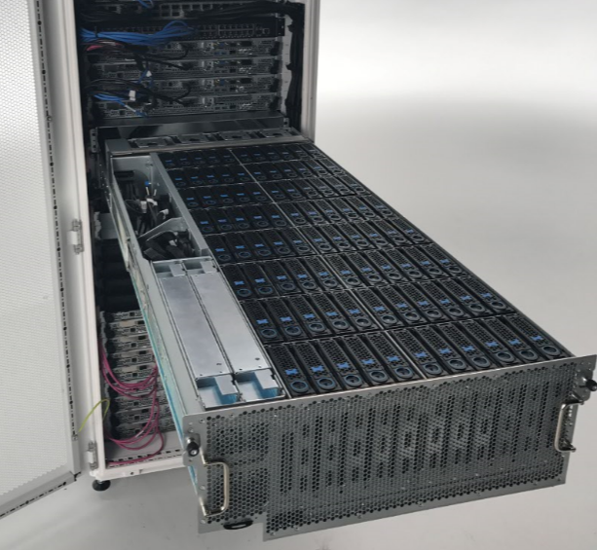
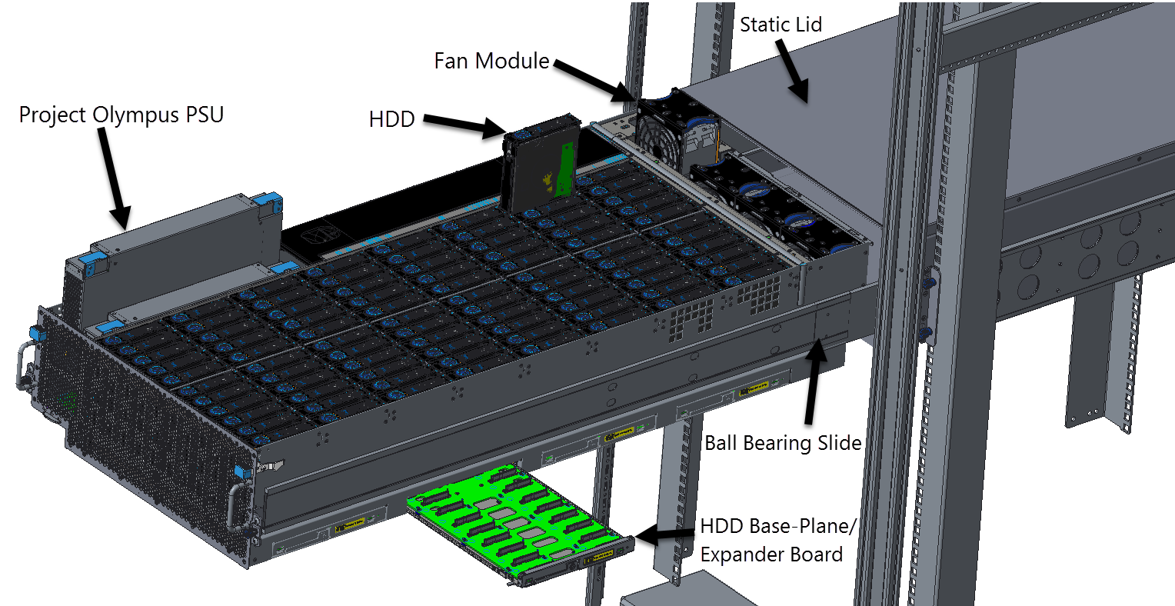
OVERVIEW
4U JBOD
88 Hot-plug HDDs
N+1 Dual Rotor Fans
N+N Redundant, 1650W 3-Phase, Hot-Swap PSUs
Drawer design – slide out for service
Robust Feature Set
Integrates into Project Olympus Infrastructure through Universal PDU
Runs on OpenBMC
Gathers HDD temps and component status info
Individual HDD on/off to minimize NTF

Slide 4
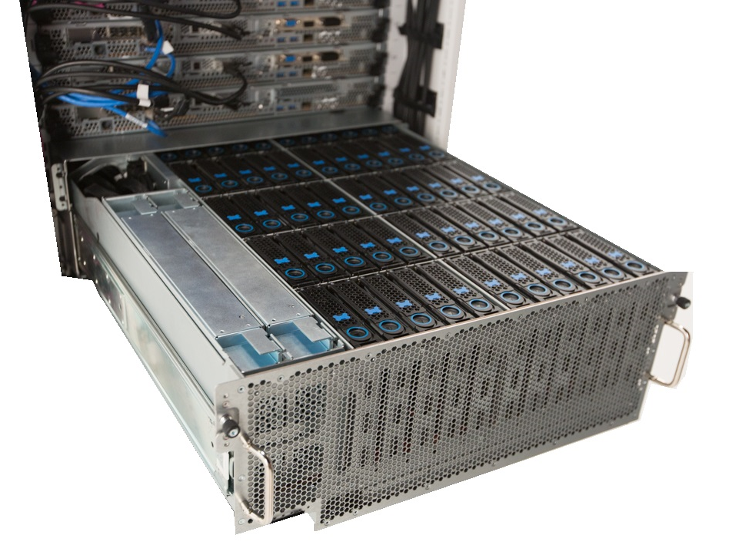
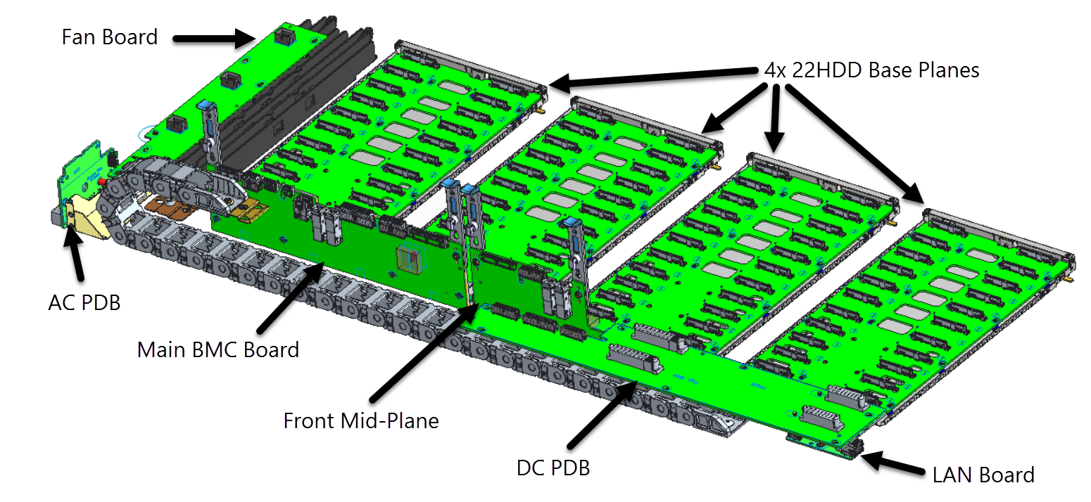
OVERVIEW
Controlled by Project Olympus Server
Configurable with 1, 2 or 4 head nodes
HDD Bay segregated into 4x 22HDD Zones
Supports SMR, HAMR, & 12Gb/s single port SAS near-line HDDs
1.2PB/Chassis (14TB/HDD)
9.6PB/Rack in Cold Storage Configuration (8x JBOD/Rack)
Designed to optimize performance and reliability
Minimized Rotational Vibration and Acoustic Noise
<5% HDD Performance Degradation
Maximum HDD Case Temperature ≤ 51°C

Slide 5
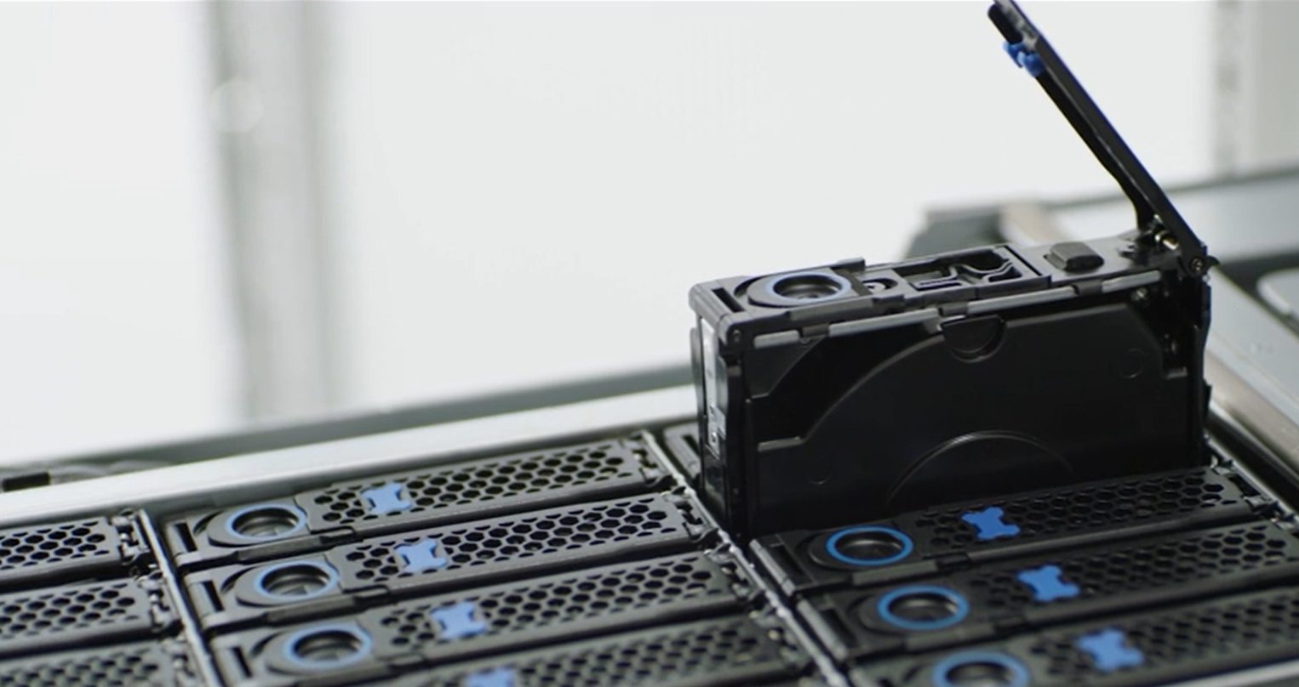
SERVICEABILITY
Tool-less Accessible, Hot-swappable Components
Cam Action Tool-Less Installed HDD Carrier
Top Loaded Cam Action PSUs
Pinch and Pull Tool-Less Fan Module
LEDs for quick failed component identification
Cold-Aisle, In-Rack Active PCA Serviceability
All active boards are accessible for service with unit in rack
Serviceable BMC
4x Independently serviceable expanders

Slide 6
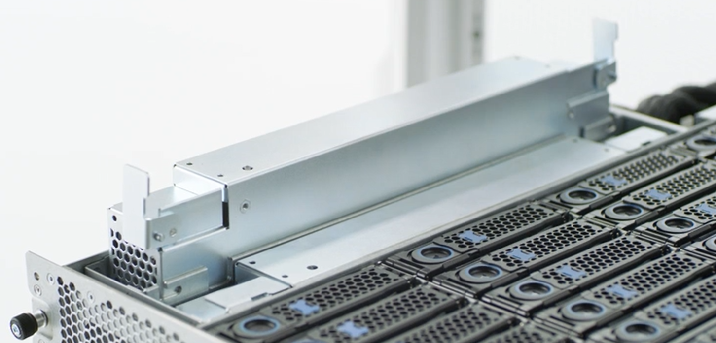
SERVICEABILITY
Tool-less Accessible, Hot-swappable Components
Cam Action Tool-Less Installed HDD Carrier
Top Loaded Cam Action PSUs
Pinch and Pull Tool-Less Fan Module
LEDs for quick failed component identification
Cold-Aisle, In-Rack Active PCA Serviceability
All active boards are accessible for service with unit in rack
Serviceable BMC
4x Independently serviceable expanders

Slide 7
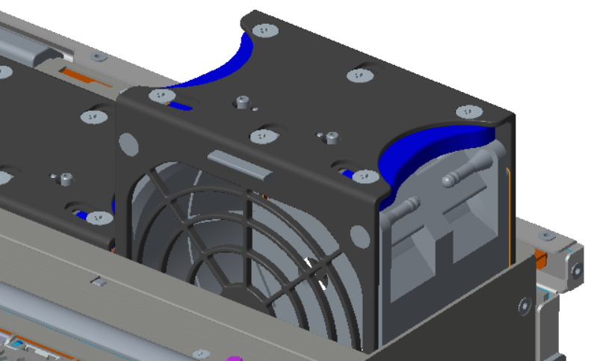
SERVICEABILITY
Tool-less Accessible, Hot-swappable Components
Cam Action Tool-Less Installed HDD Carrier
Top Loaded Cam Action PSUs
Pinch and Pull Tool-Less Fan Module
LEDs for quick failed component identification
Cold-Aisle, In-Rack Active PCA Serviceability
All active boards are accessible for service with unit in rack
Serviceable BMC
4x Independently serviceable expanders

Slide 8
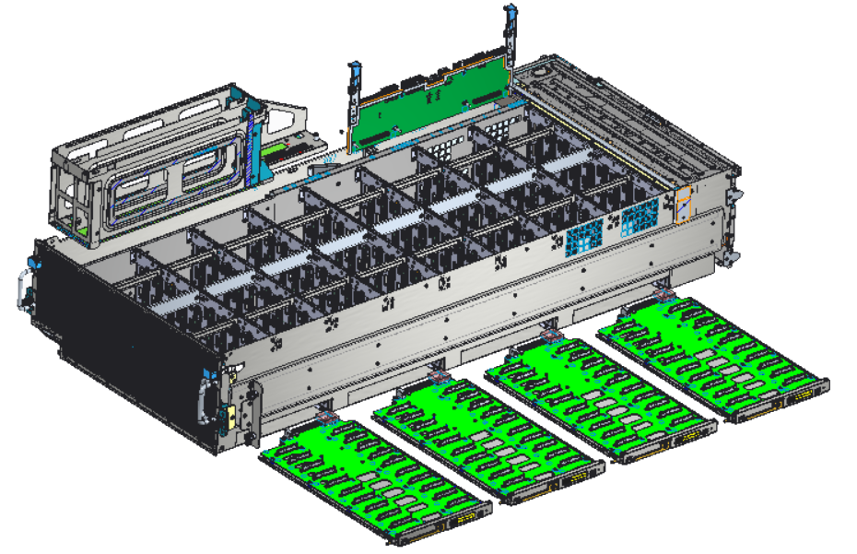
SERVICEABILITY
Tool-less Accessible, Hot-swappable Components
Cam Action Tool-Less Installed HDD Carrier
Top Loaded Cam Action PSUs
Pinch and Pull Tool-Less Fan Module
LEDs for quick failed component identification
Cold-Aisle, In-Rack Active PCA Serviceability
All active boards are accessible for service with unit in rack
Serviceable BMC
4x Independently serviceable expanders

Slide 9
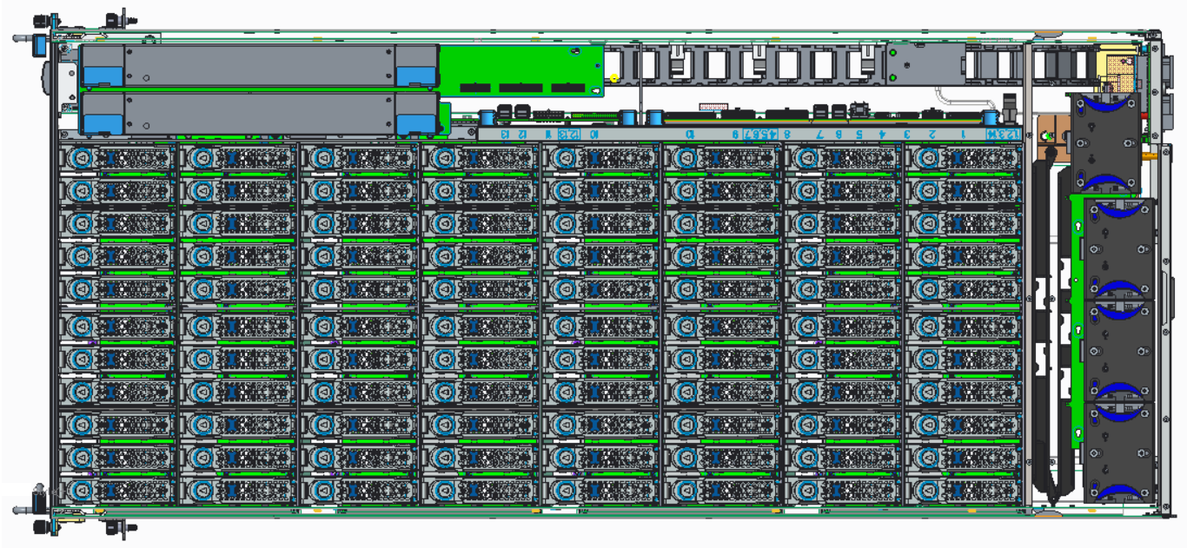
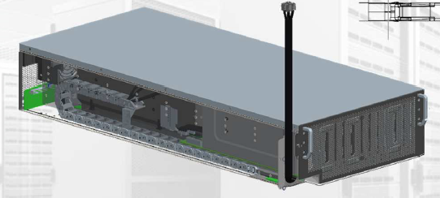
HARDWARE ARCHITECTURE
External mini-SAS HD cables route directly into enclosure
Reduces number of interconnects, improving SI
Eliminates need for repeater and ultra low-loss PCB materials
Static lid and outer chassis shell
Reduces services steps and cost
Facilitates blind-mate rack integration
Side Loaded independent HDD/Expander boards
Expander integrated onto HDD board
Improves cooling efficiency
Reduces number of interconnects for improved SI
SAS Cable Chain
A/C Power Cable Chain

Slide 10
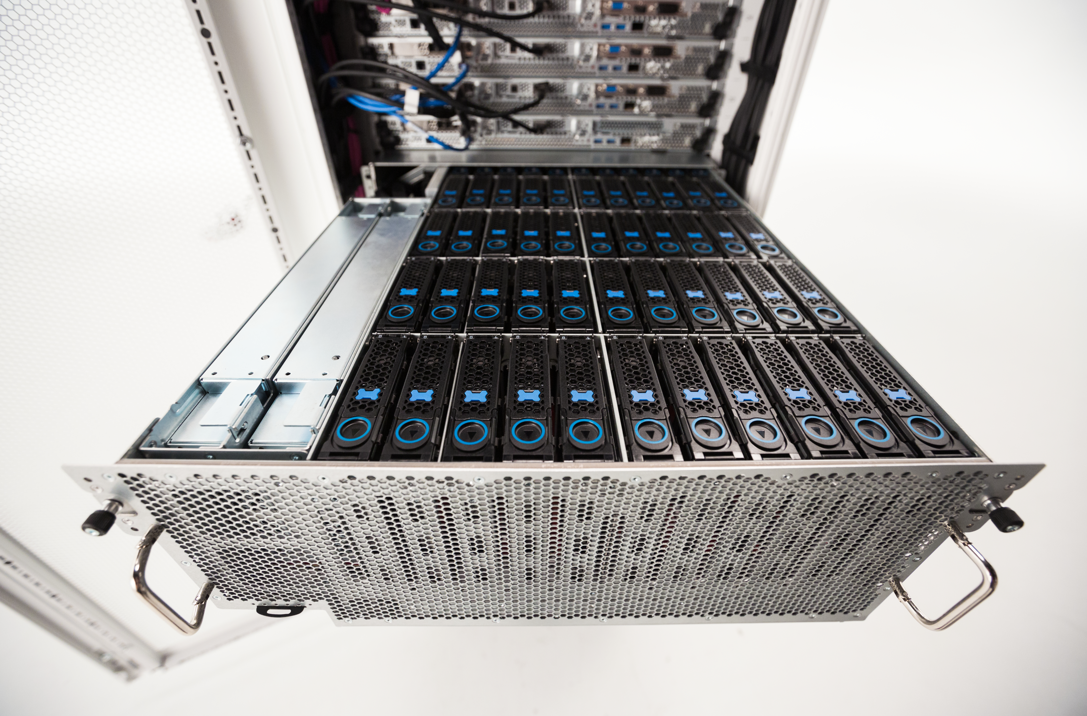
HARDWARE ARCHITECTURE
External mini-SAS HD cables route directly into enclosure
Reduces number of interconnects, improving SI
Eliminates need for repeater and ultra low-loss PCB materials
Static lid and outer chassis shell
Reduces services steps and cost
Facilitates blind-mate rack integration
Side Loaded independent HDD/Expander boards
Expander integrated onto HDD board
Improves cooling efficiency
Reduces number of interconnects for improved SI

Slide 11
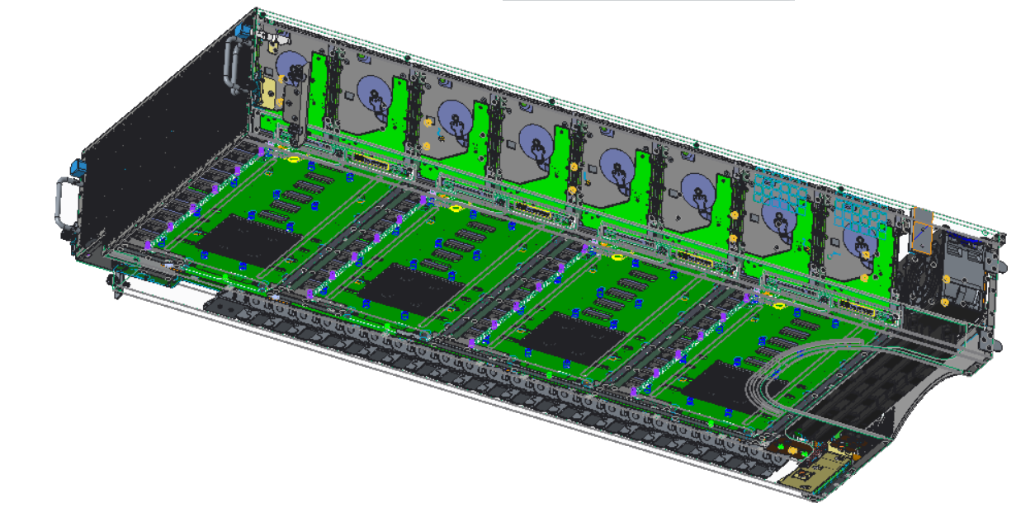
HARDWARE ARCHITECTURE
External mini-SAS HD cables route directly into enclosure
Reduces number of interconnects, improving SI
Eliminates need for repeater and ultra low-loss PCB materials
Static lid and outer chassis shell
Reduces services steps and cost
Facilitates blind-mate rack integration
Side Loaded independent HDD/Expander boards
Expander integrated onto HDD board
Improves cooling efficiency
Reduces number of interconnects for improved SI
Expanders

Slide 12
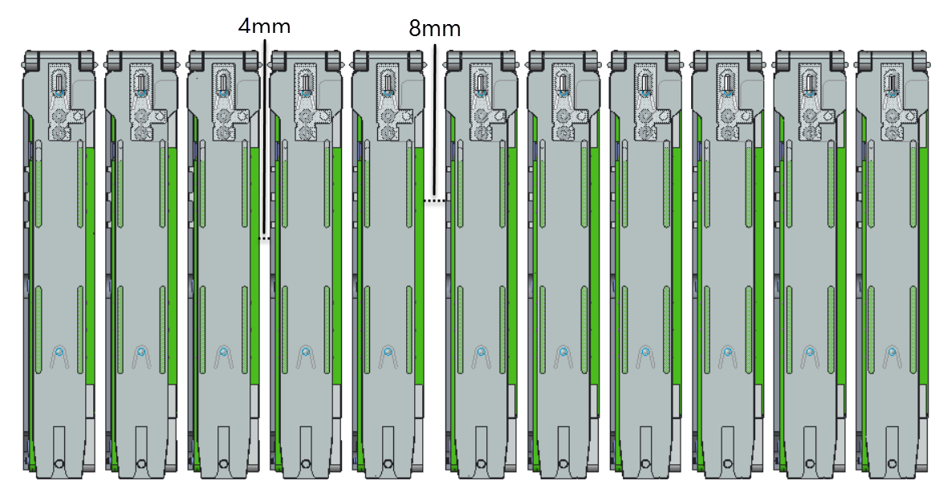
HARDWARE ARCHITECTURE
External mini-SAS HD cables route directly into enclosure
Reduces number of interconnects, improving SI
Eliminates need for repeater and ultra low-loss PCB materials
Static lid and outer chassis shell
Reduces services steps and cost
Facilitates blind-mate rack integration
Side Loaded independent HDD/Expander boards
Expander integrated onto HDD board
Improves cooling efficiency
Reduces number of interconnects for improved SI
HDD Row Spacing Front View

Slide 13
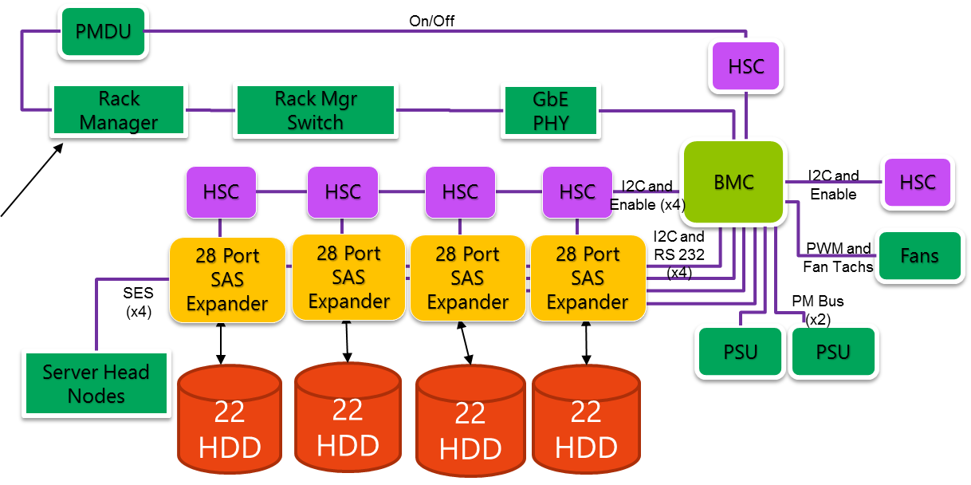
FIRMWARE ARCHITECTURE
Block Diagram
Runs on OpenBMC
DCM

Slide 14
THERMAL ARCHITECTURE
Supports 88x 14W HDDs & 4x 16W Expanders
Air-flow management reduces temperatures
Multiple by-pass air channels to feed rear rows cold air
HDD temperature ≤51C with failed rotor and 35C inlet
Minimizes required total chassis airflow
4x N+1 dual rotor fan modules
Performance targets supported in failed rotor case
Supports up to 5-minute hot service
Isolated PSU cooling – No HDD to PSU pre-heat

Slide 15
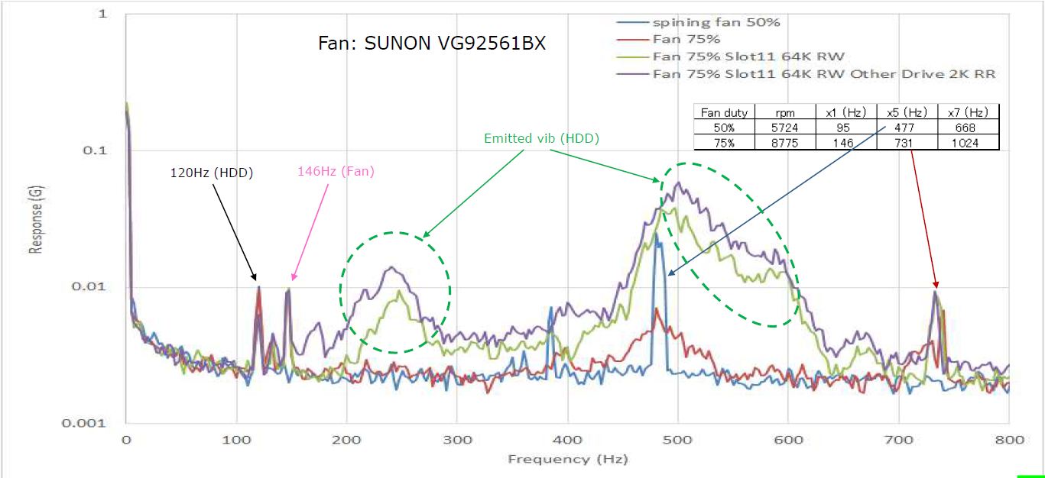
HDD PERFORMANCE
Maintains ≤5% throughput degradation due to self-excitation and external vibration
External Vibration Isolation
Chassis architecture reduces mechanical and acoustic transmitted vibrations
Configurable option to add acoustic damping material to limit transmission of high frequency broadband noise to rear row of HDDs from fans
Thermal algorithm will minimize fan rpm with consideration to HDD performance

Slide 16
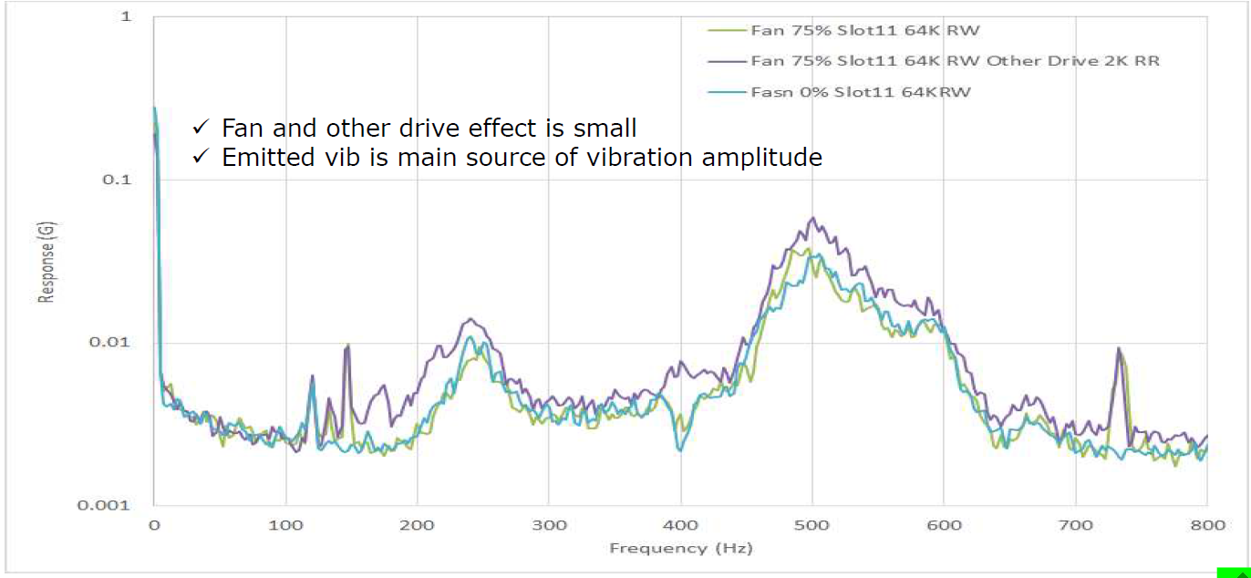
HDD PERFORMANCE
Maintains ≤5% throughput degradation due to self-excitation and external vibration
External Vibration Isolation
Chassis architecture reduces mechanical and acoustic transmitted vibrations
Configurable option to add acoustic damping material to limit transmission of high frequency broadband noise to rear row of HDDs from fans
Thermal algorithm will minimize fan rpm with consideration to HDD performance

Slide 17
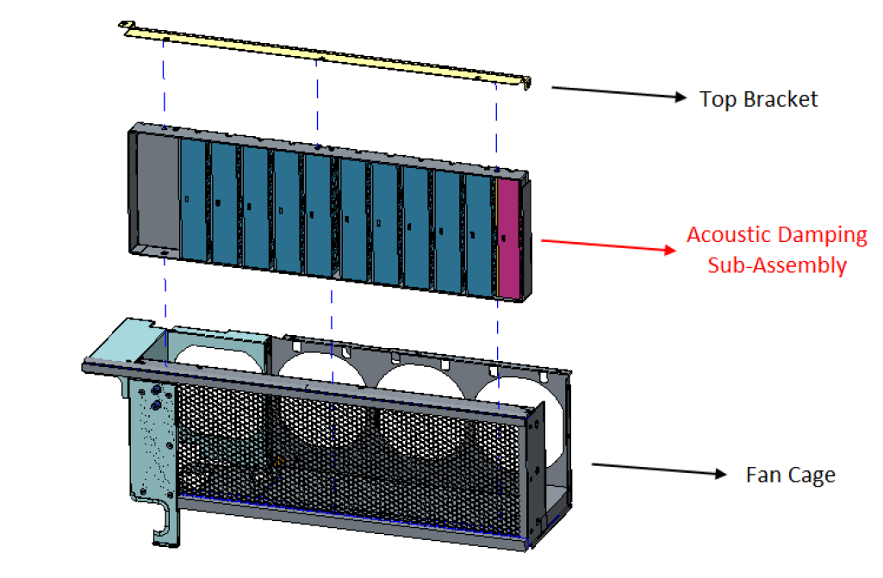
HDD PERFORMANCE
Maintains ≤5% throughput degradation due to self-excitation and external vibration
External Vibration Isolation
Chassis architecture reduces mechanical and acoustic transmitted vibrations
Configurable option to add acoustic damping material to limit transmission of high frequency broadband noise to rear row of HDDs from fans
Thermal algorithm will minimize fan rpm with consideration to HDD performance

Slide 18
ACHEIVEMENTS
Maintaining low HDD case temperatures
Developing architecture that allows for in-field servicing
Providing <5% HDD performance degradation in all operating conditions
Achieving 12G/s SAS signal speeds without using a repeater

