Slide 2
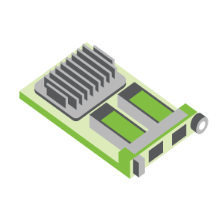
SERVER
OCP NIC Community Update November 2021 Sub-group Project wiki: https://www.opencompute.org/wiki/Server/Mezz
Mailing List: https://ocp-all.groups.io/g/OCP-NIC
NIC3.0

Slide 3
Agenda
PCIe Gen5 SI test fixture update
OCP Global Summit
Cable up solutions

Slide 4
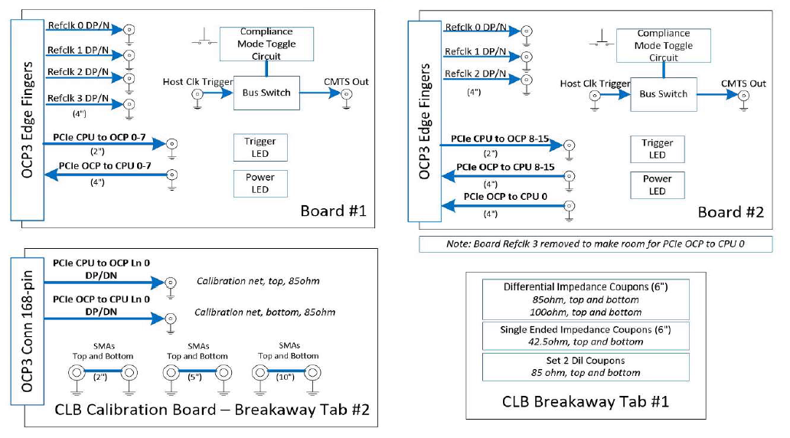
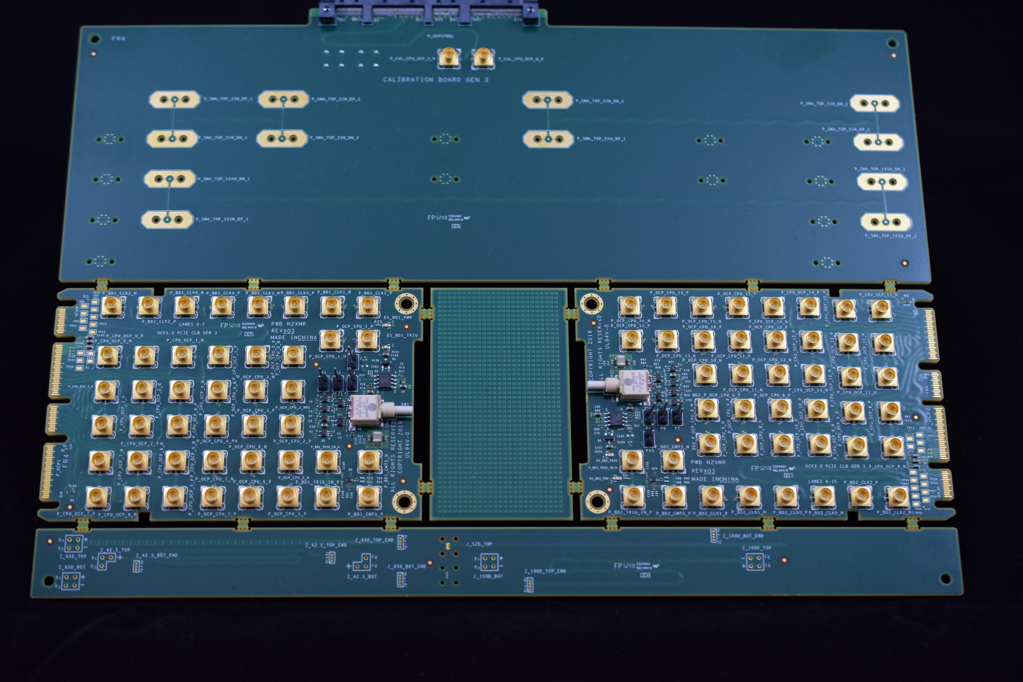
SI PCIe Gen5 test fixture update
Netlist block diagram
OCP3 SFF CLBs include:
Two compliance test boards (lanes 0-7, 8-15)
Calibration board
Impedance coupon
Currently CLB PCI Gen4 is available
https://www.iol.unh.edu/solutions/test-tools/ocp-pcie
Continued ..
OCP3 SFF CLB Gen4 Example
Calibration
CLB board 1
CLB board 2
Impedance Coupon

Slide 5
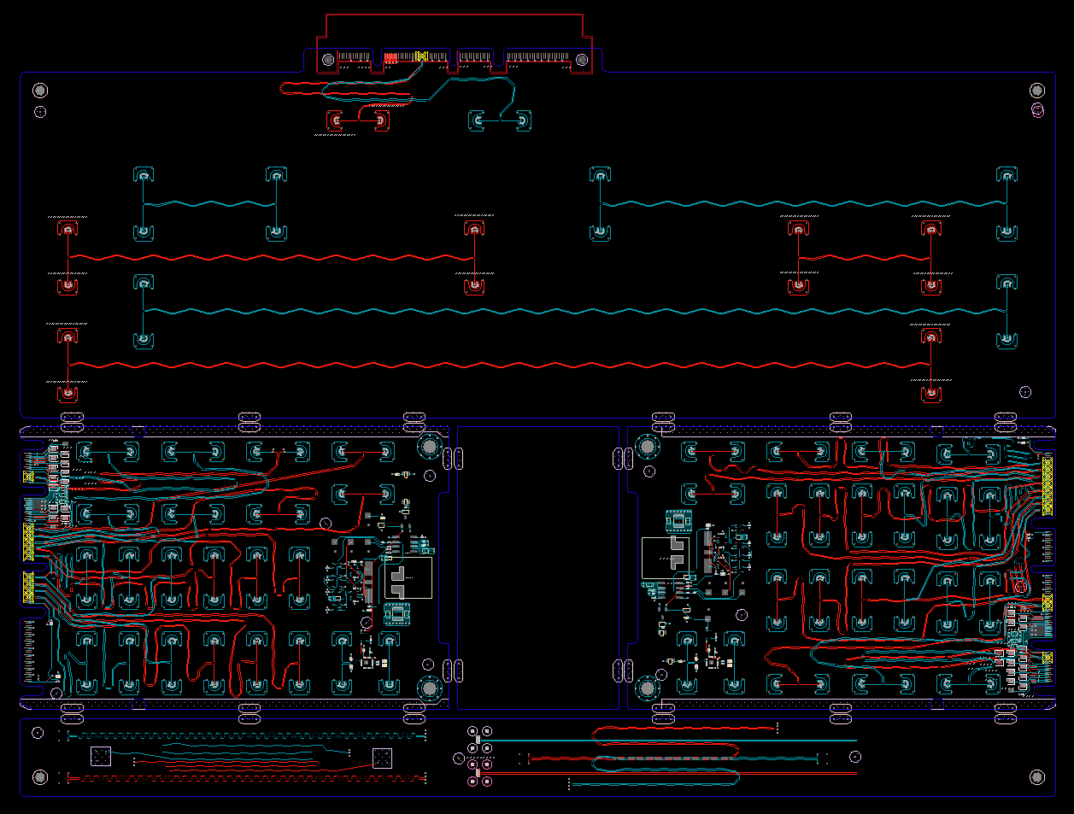
SI PCIe Gen5 test fixture update
Current CLB Gen5 status:
Schematic netlist done
ECAD cleanup
Thanks to the reviewers
Gerber: 8 Nov 2021 (est)
In lab by EOY (pending supply)
CBB Gen 5 Status:
Updating to support SRIS
Estimated Review after Thanksgiving
Netlist block diagram
OCP3 SFF CLB Gen5 ECAD
Calibration
CLB board 1
CLB board 2
Impedance Coupon

Slide 6
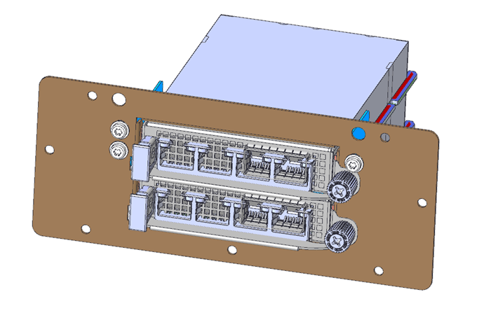
TSFF TTF Status
Mechanical files completed (submitted for posting)
Uses existing TTF with 3 different components to convert to TSFF.
Prototypes ordered to retrofit existing fixtures. ETA: 2 wks

Slide 7
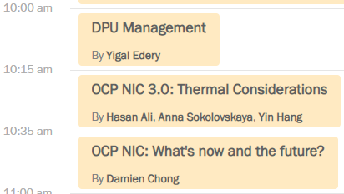
OCP Global Summit: Workshop presentations

Slide 9
OCP Global Summit: Lightning Talk

Slide 10
Cable-up OCP NIC solutions
Any interest to study and propose an elegant solutions?

Slide 11
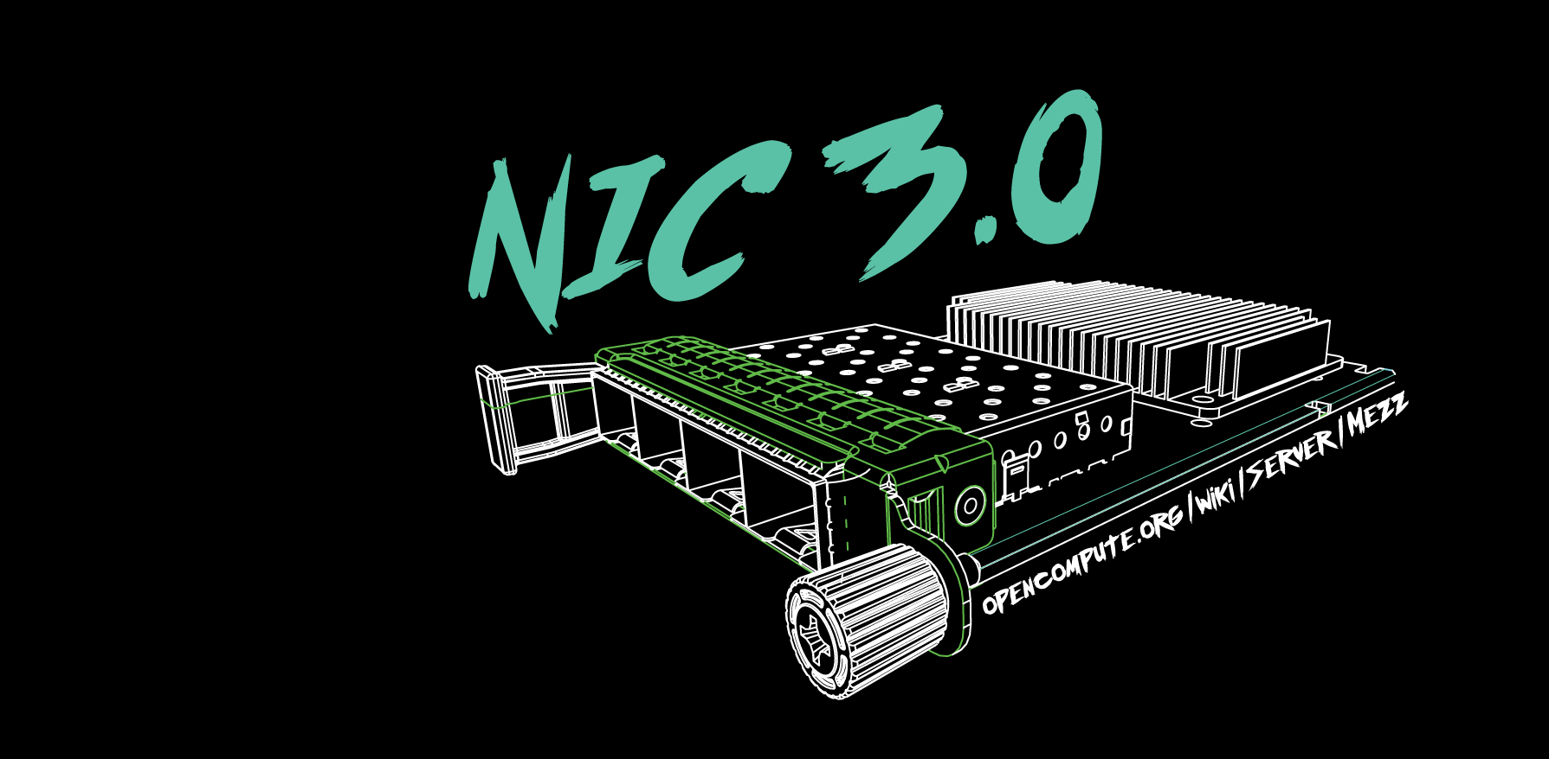

Slide 12
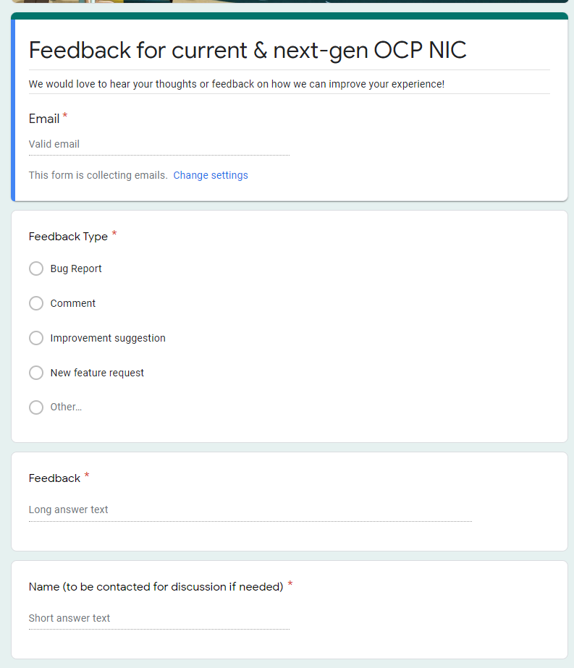
Gather feedback throughout the year
Provide your feedback at: https://tinyurl.com/feedback2ocpnic

Slide 13
Thermal Test: TSFF TTF Status
Mechanical files received. Pending mechanical engineer peer review
Uses existing TTF with 3 different components to convert to TSFF.

Slide 14
NIC self-shutdown discussion
Get DMTF & HW management feedback
Discussion 1: NIC self shutdown as optional feature?
Discussion 2: NIC self shutdown as threshold?
Discussion 3: If NIC self shutdown implemented, it shall provide mechanism to enable/disable the feature?

Slide 15
NIC self-shutdown discussion
Discussion 1:
NIC self shutdown as optional feature
Keep as optional

Slide 16
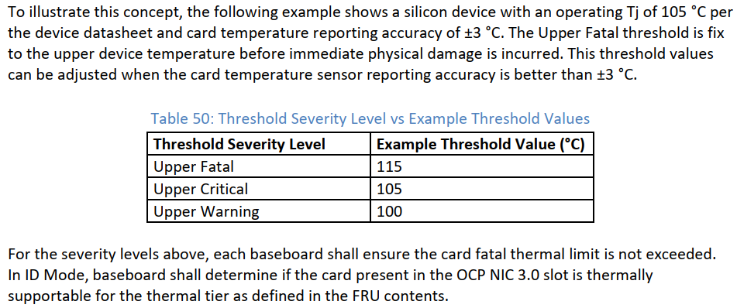
NIC self-shutdown discussion
Discussion 2:
NIC self shutdown as threshold
Change between to “at least”
Or remove this recommendation
Current recommendation

Slide 17
NIC self-shutdown discussion
Discussion 3:
If NIC self shutdown implemented, it shall provide mechanism to enable/disable the feature

