Slide 2
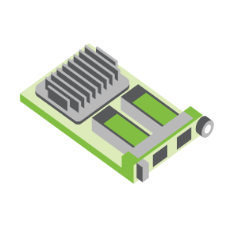
SERVER
OCP NIC Community Update May 2022
For Server Workgroup Sub-group Project wiki: https://www.opencompute.org/wiki/Server/Mezz
Mailing List: https://ocp-all.groups.io/g/OCP-NIC
NIC3.0

Slide 3
Agenda
OCP Tech Week 2022
SI Test Fixture Update
Thermal Test Fixture Update
PCIe Gen6 channel analysis
NCSI OOB discussion

Slide 4
OCP Tech Week 2022
NIC sub-group presented OCP NIC group activities, SI & Thermal test fixtures and our next-gen plans
We presented from 6:30 to 28:00 of the recorded session below
https://www.youtube.com/watch?v=jopZUWgy48U
Question from AMD/Ravi: Whether we have plans to update/enhance hot swap design?

Slide 5
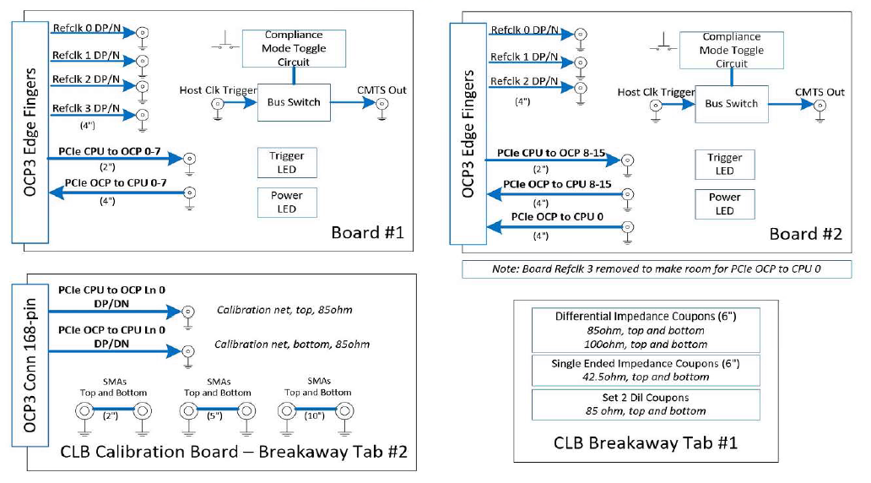
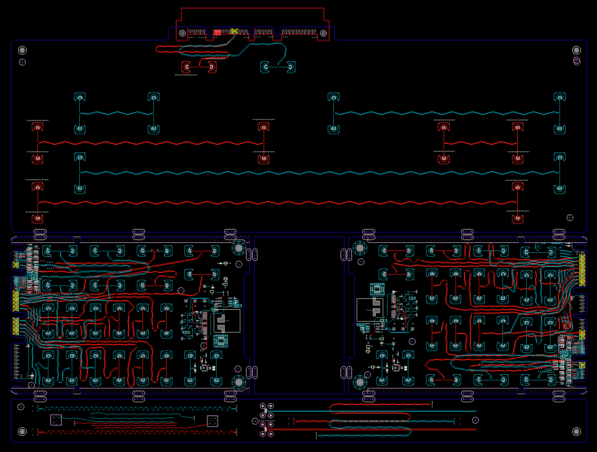
SI PCIe Gen5 test fixture update
Presenter: Jason Rock (Dell)
Netlist block diagram
CLB Gen5 status:
Gerbered in January
PCB arrived at assembler mid-March
Assembled units arrived end-of-March
Preliminary results ~ mid-April
CBB Gen 5 Status:
Based on Gen4 design
Updates to align with PCI CEM
To be staffed within Dell
OCP3 SFF CLB Gen5 ECAD
Calibration
CLB board 1
CLB board 2
Impedance Coupon

Slide 6
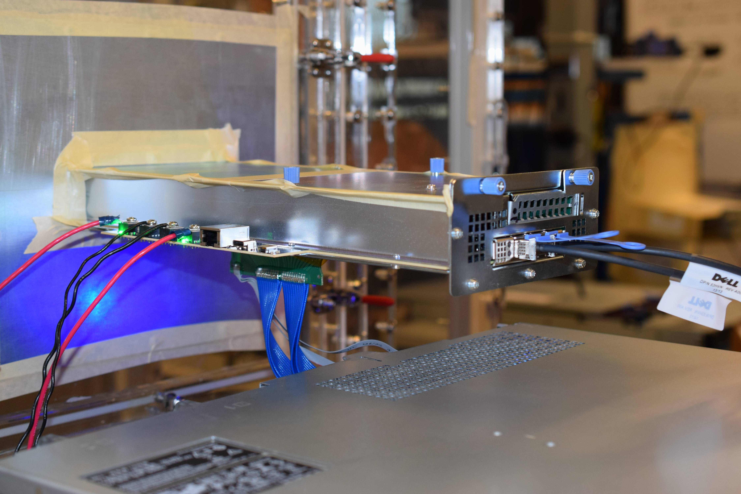
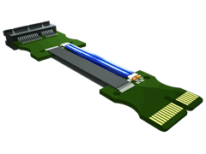
PCIe Gen5 thermal test fixture update
Presenter: Jason Rock (Dell)
OCP NIC 3.0 TTF in use
Much of the existing TTF can be re-used based on simulation *
Mechanicals not impacted
PCB designed to support PCIe Gen5
* PCIE-C (cable assembly) must be rated and sourced for PCIe Gen5 lane speed
Lab experimentation required to confirm simulation
Example cable assembly from Samtec
* Image sourced from Samtec

Slide 7
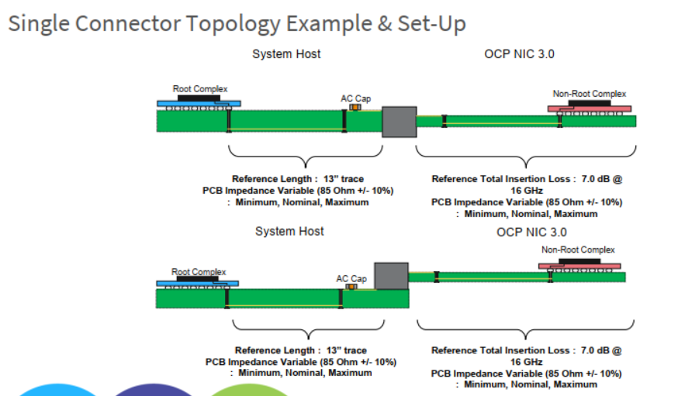
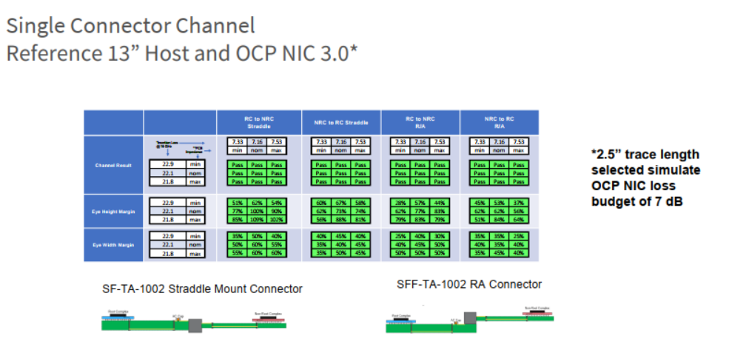
PCIe Gen6 channel analysis by TE
Note: Assumptions on different host and channel varies. Individual companies are recommended to perform own analysis and conclusion

Slide 8
NCSI sideband
SFF 2 reserved pins (B68, B69)
Guidance is no-connect in rev1.2 spec
Need to prevent NIC & System damage if plugged into wrong System/NIC pair
Using generic USB3 interface as expansion is one of the option being considered
 | OCP NIC 3.0 rev1.2 RMII based Transport | SGMII | USB3
OCP_A4 | RBT_ARB_IN | SGMII_TX_CLK_P?
OCP_A5 | RBT_ARB_OUT | SGMII_TX_CLK_N?
OCP_A7 | RBT_TX_EN | N/A?
OCP_A8 | RBT_TX_1 | SGMII_RX_P
OCP_A9 | RBT_TX_0 | SGMII_RX_N
OCP_B8 | RBT_RX_1 | SGMII_TX_P
OCP_B9 | RBT_RX_0 | SGMII_TX_N
B68 | RFU_1 | MODE_RBT_SGMII#
B69 | RFU_2 | RFU_2

Slide 9
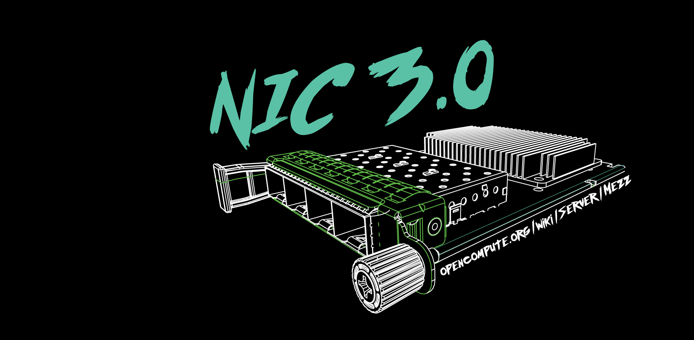

Slide 10
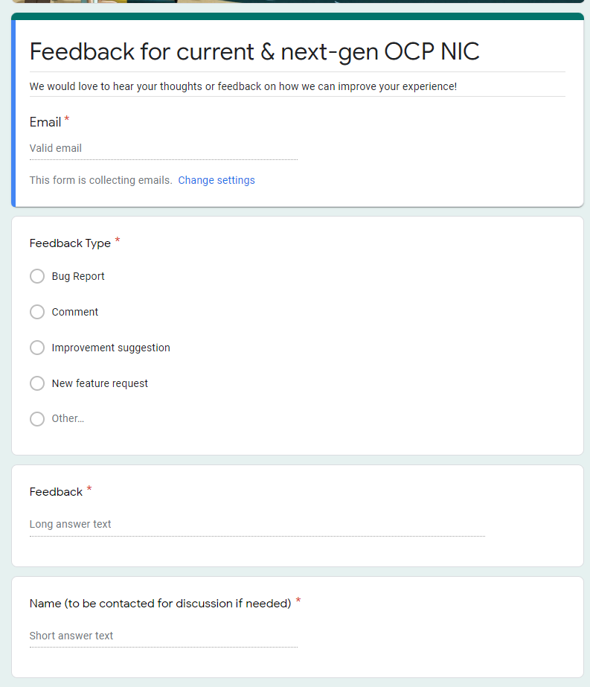
Gather feedback throughout the year
Provide your feedback at: https://tinyurl.com/feedback2ocpnic

Slide 11
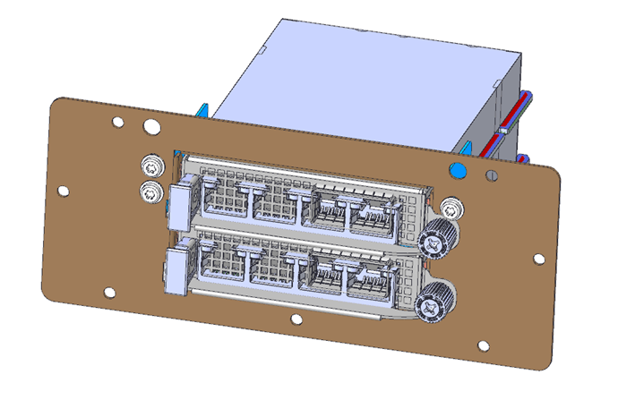
Thermal Test: TSFF TTF Status
Mechanical files received. Pending mechanical engineer peer review
Uses existing TTF with 3 different components to convert to TSFF.

Slide 12
NIC self-shutdown discussion
Get DMTF & HW management feedback
Discussion 1: NIC self shutdown as optional feature?
Discussion 2: NIC self shutdown as threshold?
Discussion 3: If NIC self shutdown implemented, it shall provide mechanism to enable/disable the feature?

Slide 13
NIC self-shutdown discussion
Discussion 1:
NIC self shutdown as optional feature
Keep as optional

Slide 14
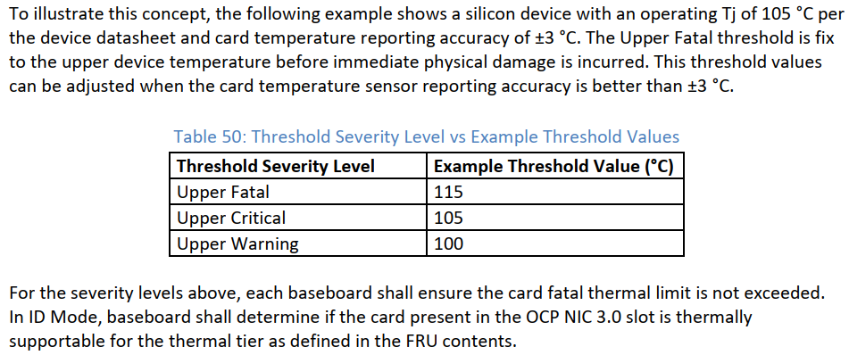
NIC self-shutdown discussion
Discussion 2:
NIC self shutdown as threshold
Change between to “at least”
Or remove this recommendation
Current recommendation

Slide 15
NIC self-shutdown discussion
Discussion 3:
If NIC self shutdown implemented, it shall provide mechanism to enable/disable the feature

Slide 16
Presenter: Zhineng Fan (Amphenol)
SERVER
SNIA SFF TA-1002 Connector SI Requirements For OCP NIC 3.0 PCIe6 Speed
NIC3.0
Amphenol

Slide 17
Background
Presenter: Zhineng Fan (Amphenol)
OCP NIC start looking at PCIe6 64G PAM4 speed
NIC interface connector follows SNIA SFF TA-1002 spec
SNIA SFF TA-1002 did not specify 64G PAM4 connector SI requirements
SNIA SFF TA-1002 specified 56G PAM4, 32G NRZ, 56G NRZ and 112G PAM4

Slide 18
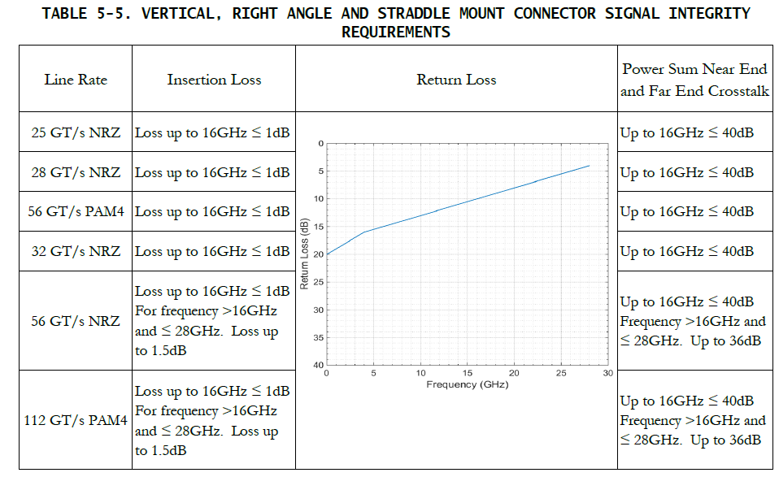
SNIA SFF TA-1002 Connector SI Requirements
Presenter: Zhineng Fan (Amphenol)
Return loss is the same for all speed

Slide 19
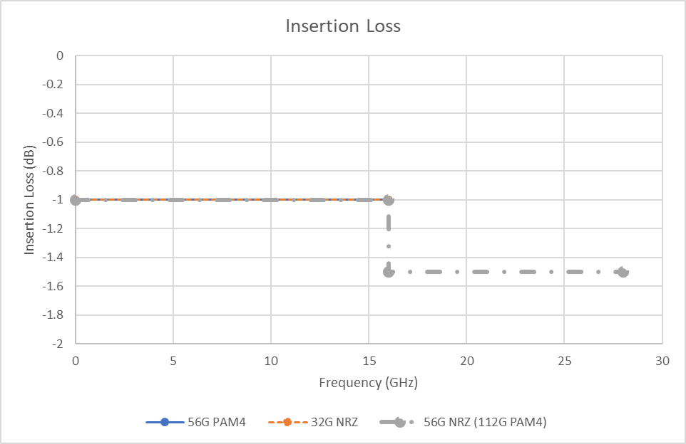
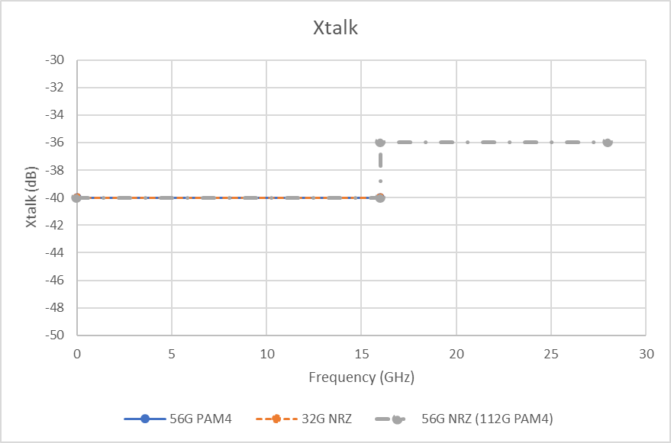
Insertion Loss and Xtalk
Presenter: Zhineng Fan (Amphenol)
56G PAM4 and 32G NRZ share the same limit line
56G NRZ and 112G PAM4 share the same limit line

Slide 20
NCSI sideband landscape
RMII
7 parallel pins
Not backward compatible
RGMII
12 parallel pins
Not backward compatible with RMII
SFF
2 spare RFU pins available
NIC ASIC
Is NIC ASICs capable of RGMII?

