Slide 2
SERVER
OCP NIC Community Update
For Server Workgroup June 2021
Sub-group Project wiki: https://www.opencompute.org/wiki/Server/Mezz
Mailing List: https://ocp-all.groups.io/g/OCP-NIC
NIC3.0

Slide 3
Agenda
New NIC3.0 contributor
OCP Global Summit
NIC3.0 spec update (draft)

Slide 4
New NIC3.0 contributor

Slide 5
2021 OCP Global Summit - Demo
-2020-
OCP NIC Experience Lab demo coordination
2019: Facebook
2020: Intel & Nvidia
2021: Broadcom

Slide 6
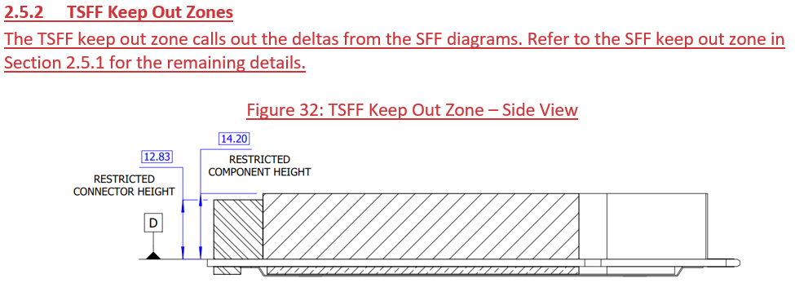
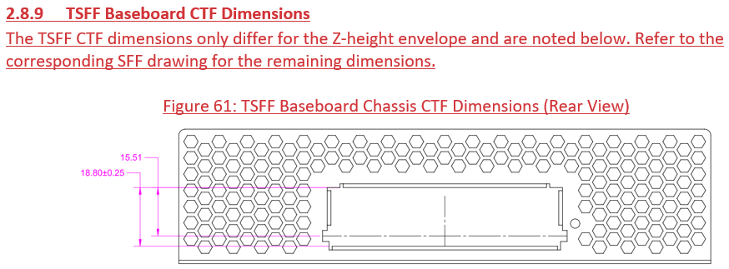
NIC3.0 spec update (draft)

