Slide 1
Wiwynn OCP Design Contribution Guideline
Jan. 11, 2018

Slide 2
Agenda
2 Designs and 5 Product Contributions
Datasheets
System Block Diagrams
Guide for Design Files
(Bryce Canyon as the example)

Slide 3
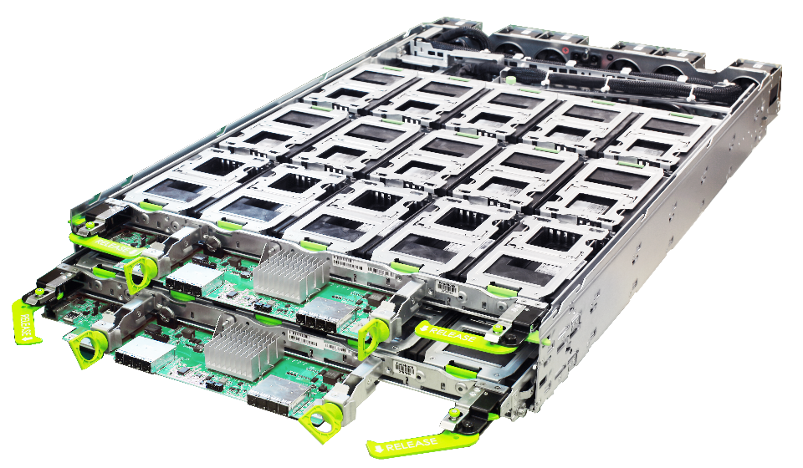
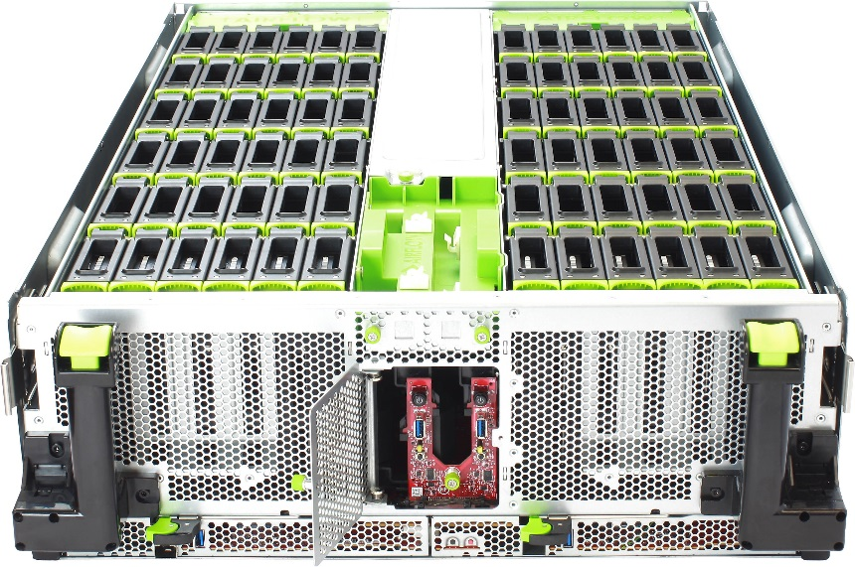
2 Design and 5 Product Contribution List
ST7200-30P
ST7200-60M
1
Lightning
A
B
30 U.2 Bays
60 M.2 Bays
2
SV7000G2
SV7000G2-L
ST7000G2
Bryce Canyon
A
B
C
MonoLake
MonoLake
MonoLake
IOM
IOM
IOM

Slide 4
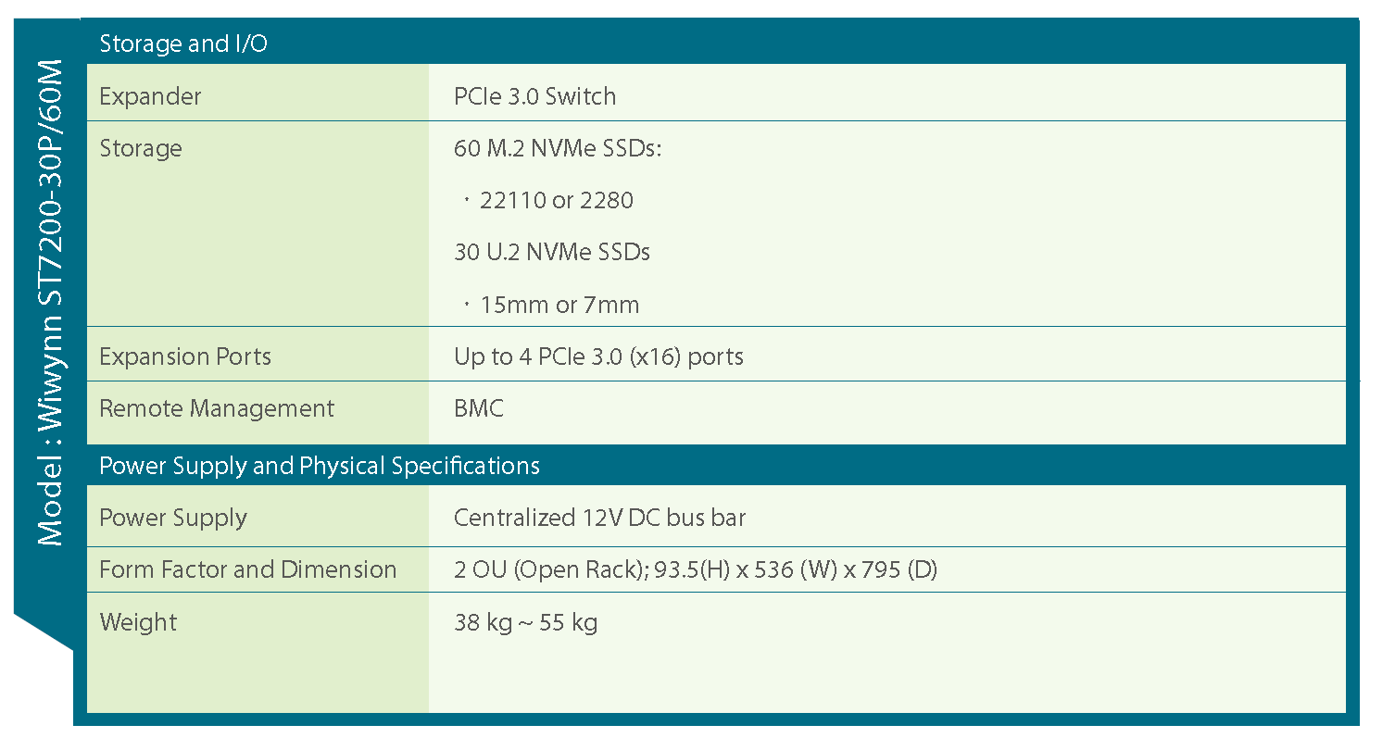
SV7200-30P/60M (Lightning Series) Datasheet

Slide 5
ST7000G2/SV7000G2 (Bryce Canyon) Datasheet

Slide 6
Bryce Canyon Contribution

Slide 7
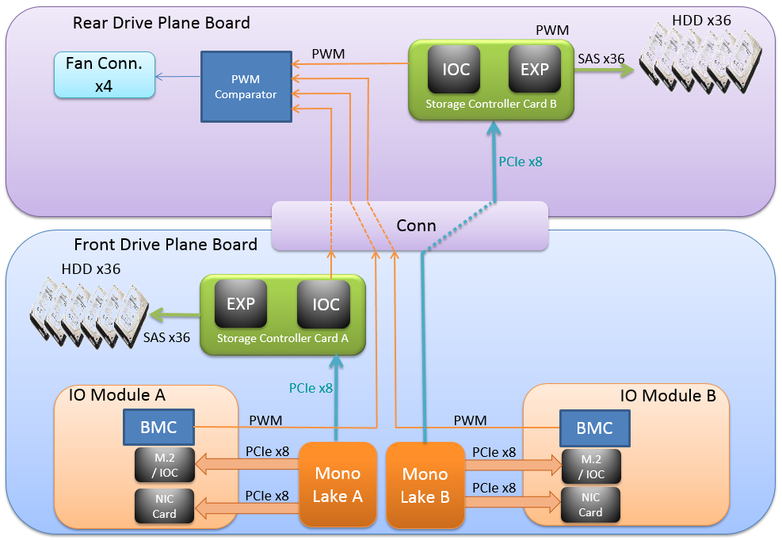
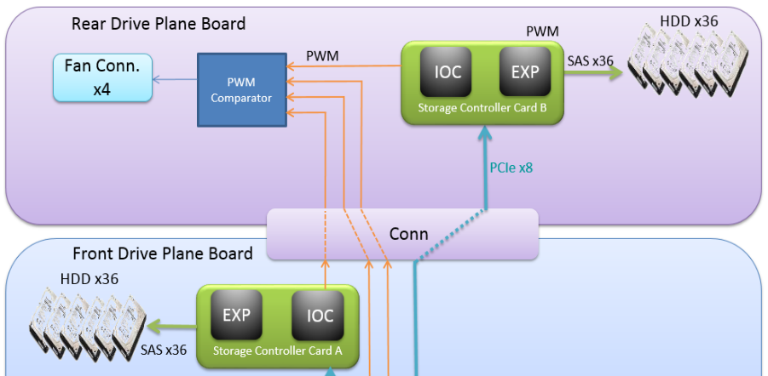
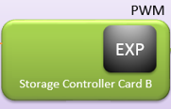
System Topology
M.2*2
M.2*2
IOC
M.2*2
SV7000G2
SV7000G2-L
ST7000G2

Slide 8
Design Files
The following folders are included in the zip file
Schematic:
Contain designed DSN files (Cadence OrCAD) and .pdf files
Layout and Stackup:
Contain designed BRD files (Allegro) and Excel files show detail stack up information
BOMs (Bill of material):
An excel file shows full component information. (Including EE & ME)
Manufacture files:
Gerber files for PCB manufacture.
Contain PCBAs DXF, PDF and EMN.
MB Placement
ME CAD(3D & 2D):
Contain all system Solidworks files and neutral file. (STEP)
Contain all chassis assemblies, metals, plastics, accessories, cables 2D files.
oBMC:
https://github.com/facebook/openbmc

Slide 9
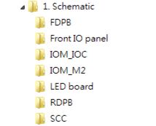
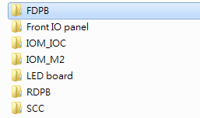
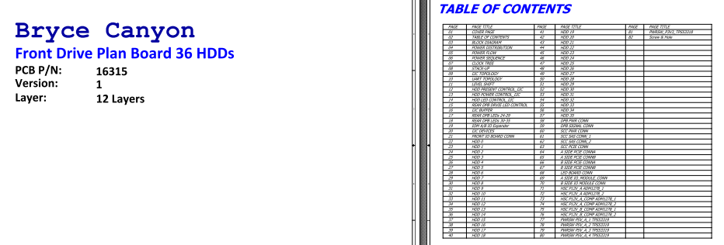
Schematic

Slide 10
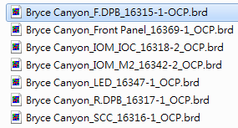
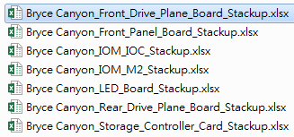
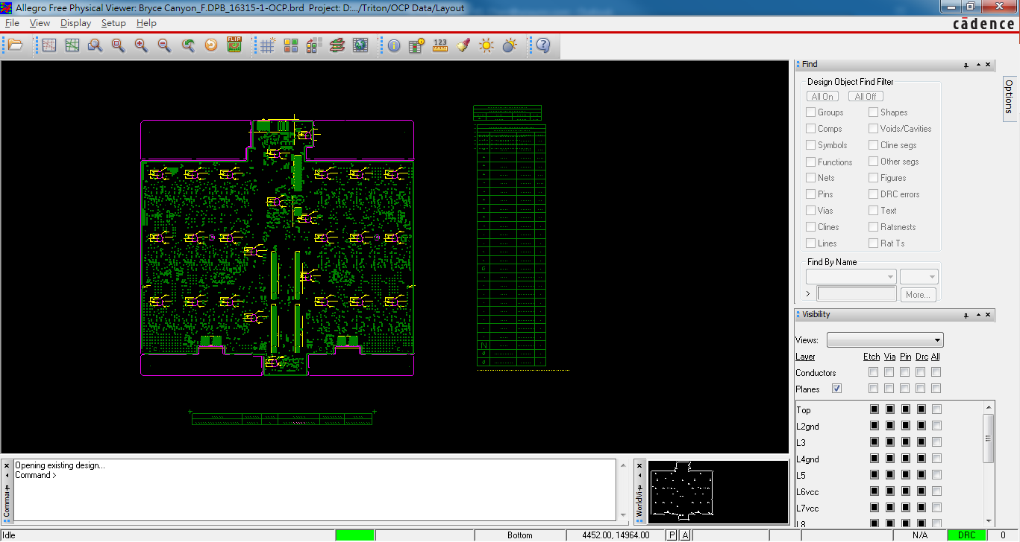
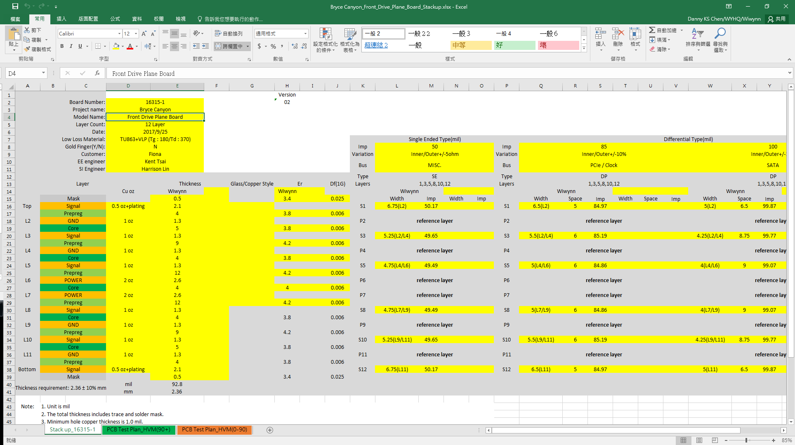
Layout and Stackup

Slide 11
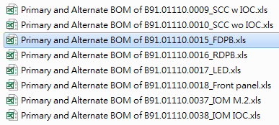
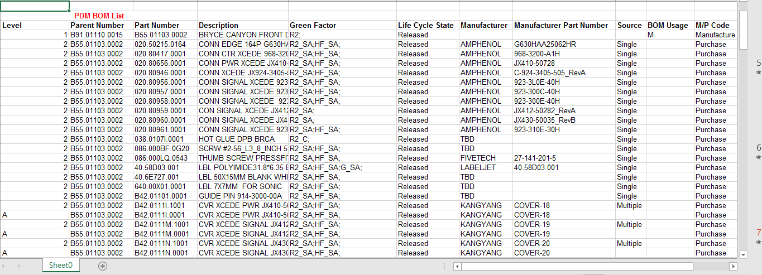
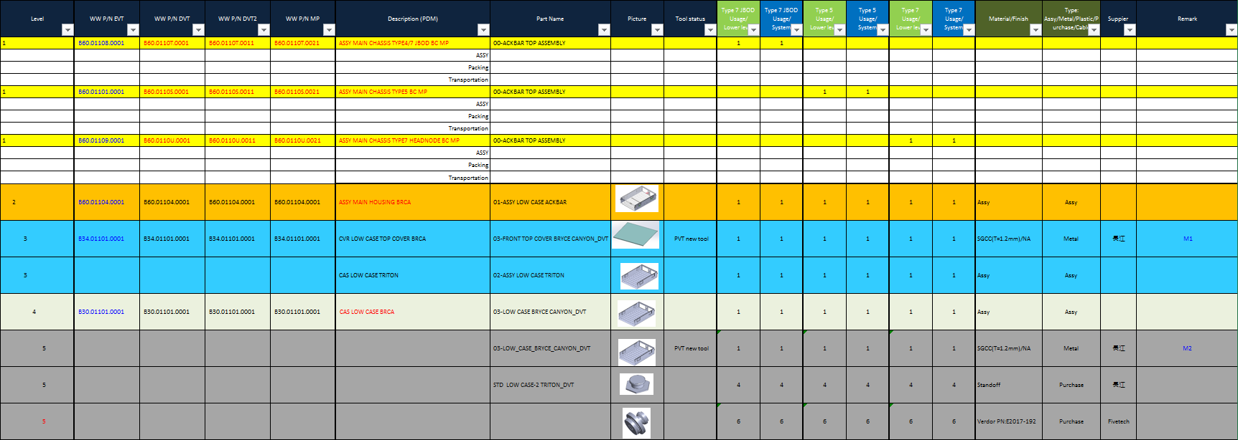
BOMs (EE & ME)

Slide 12
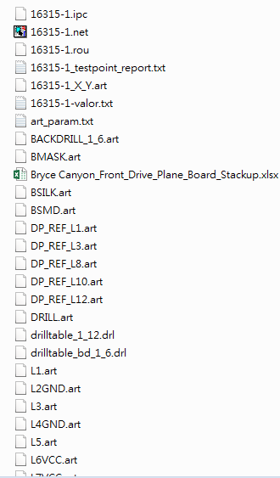
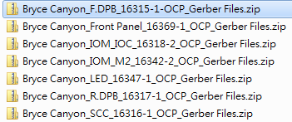
Manufacture Files _ Gerber

Slide 13
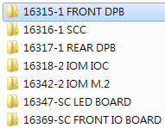
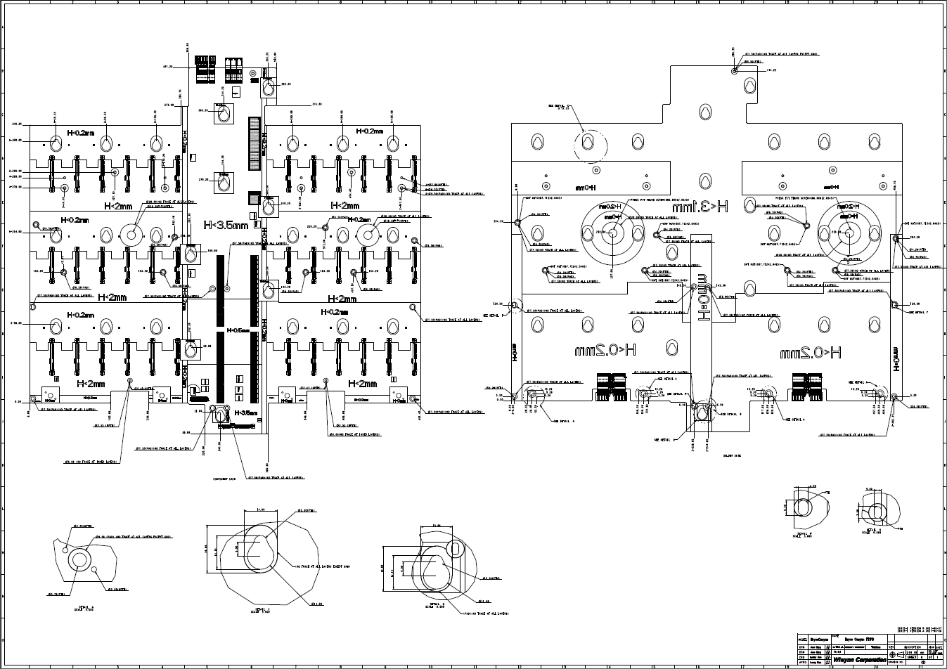
Manufacture Files _ PCBA

Slide 14
MB Placement

Slide 15
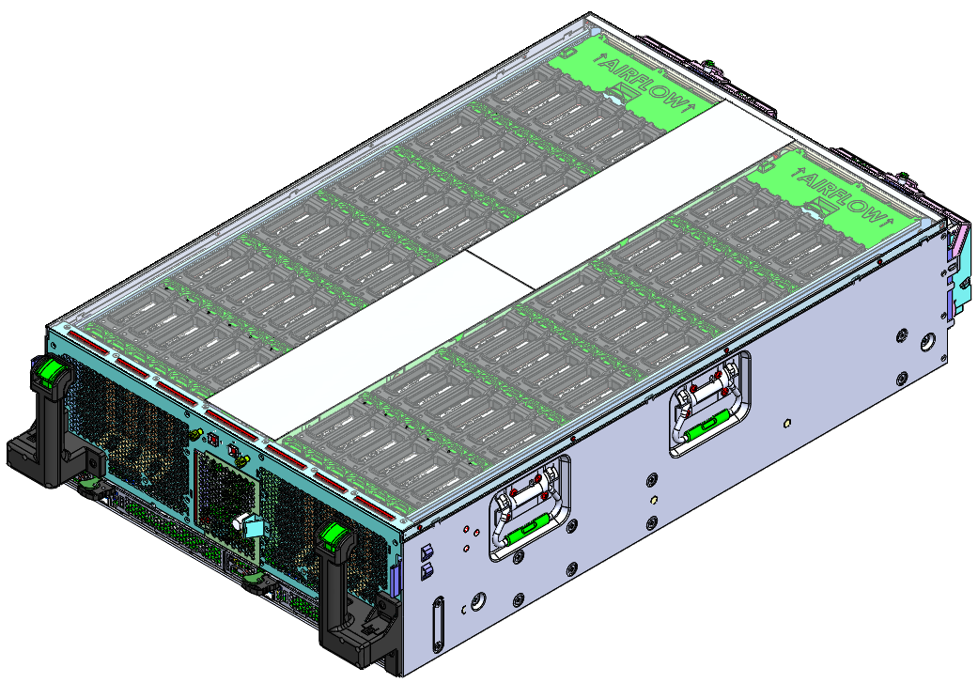
ME CAD(3D)
Neutral file. (STEP)
Solidworks file.

Slide 16
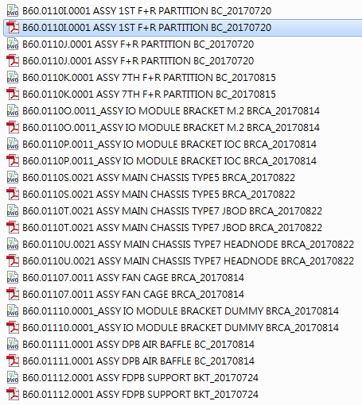
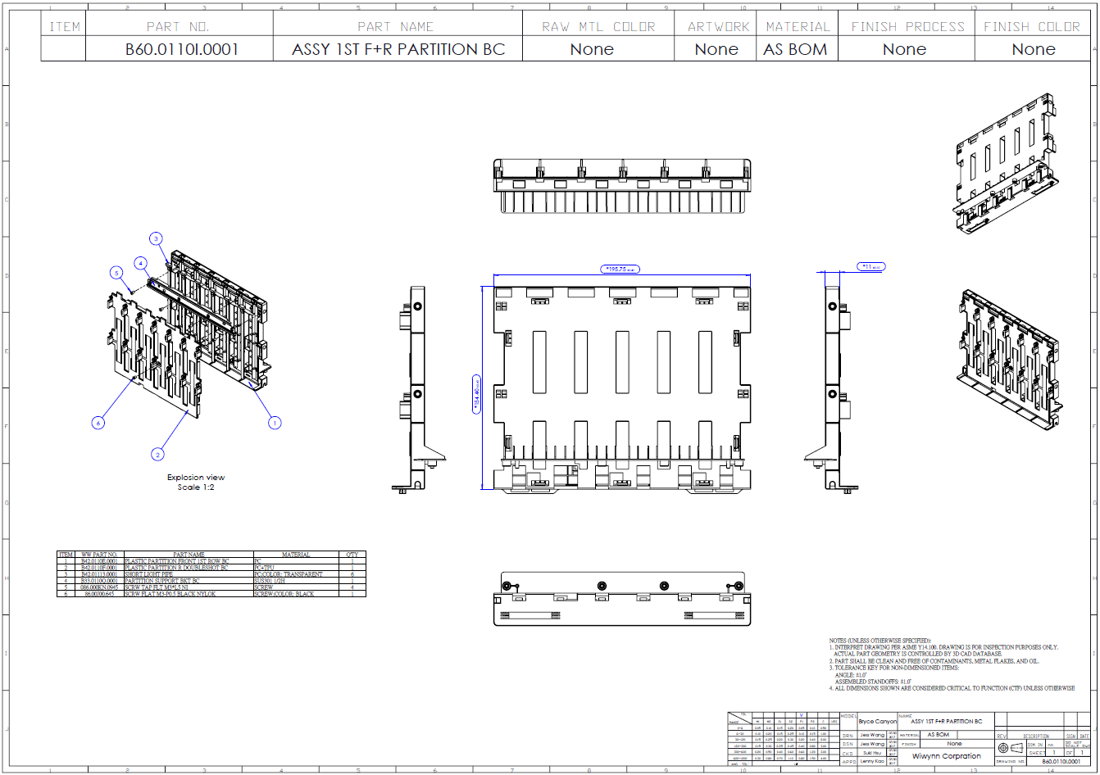
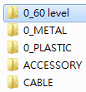
ME CAD(2D)

Slide 17
Lightning Contribution

Slide 18
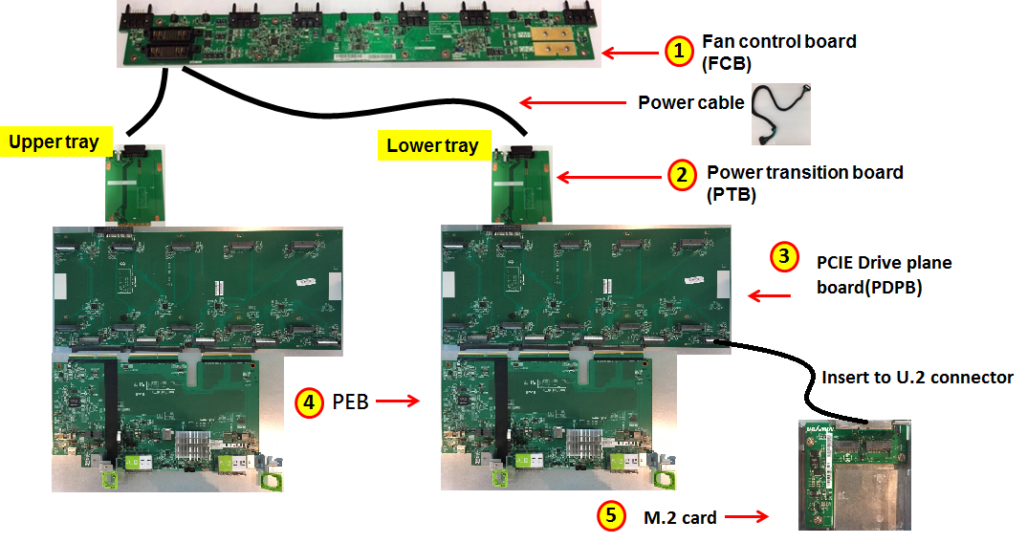
System topology
Lightning system have 5 types board, including FCB, PTB, PDPB, PEB, M.2 card, total 5 pcs PCBAs.
Notes:
For this page, I’ll introduce the Lightning system topology to you.
Lightning system have 5 types boards, including FCB, PTB, PDPB, PEB, M.2 card, total 5 pcs PCBAs.
FCB : This board could connects the six fan modules and transfer the power to PTB from bus bar clip.
PTB : Transfer the power from FCB to PDPB and PEB board.
PDPB : This board could support 15 U.2 NVMe SSDs (15mm or 7mm) or 30 M.2 NVMe SSDs (22110 or 2280)
PEB : There is one PCIe Gen3 Switch on PEB board, support up to 2 PCIe 3.0 (x16) port.
Connect to Re-timer card (which inserting into server PCIe slot)
The PCIe Gen3 switch to fan out to the SSDs on the PDPB.
Also it contains one BMC chip running OpenBMC firmware on PEB will provide the enclosure management functionality on the Lightning tray and chassis.
5. M.2 : M.2 Card could install 2 M.2 NVMe SSDs, which insert to U.2 connector

Slide 19
Design Files
The following folders are included in the zip file
Schematic:
Contain designed DSN files (Cadence OrCAD) and .pdf files
Layout and Stackup:
Contain designed BRD files (Allegro) and Excel files show detail stack up / Equal length table / SI constraints information
BOMs (Bill of material):
An excel file shows full component information. (Including EE & ME)
Manufacture files:
Gerber files for PCB manufacture and Excel files show component coordinates / Test coverage percentage.
Component Placement Map:
Contain component placement of top/bot view.
ME CAD(3D & 2D):
Contain all system Solidworks files and neutral file. (STEP)
Contain all chassis assemblies, metals, plastics, accessories, cables 2D files.
oBMC:
https://github.com/facebook/openbmc

Slide 20
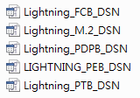
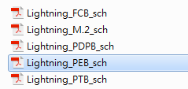
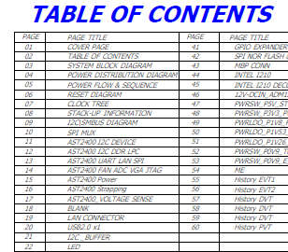
Schematic

Slide 21
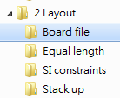
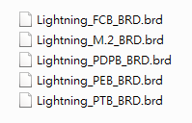
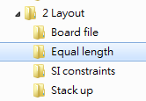
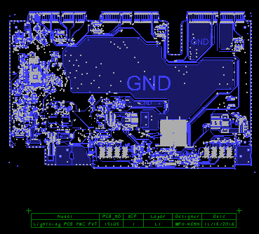
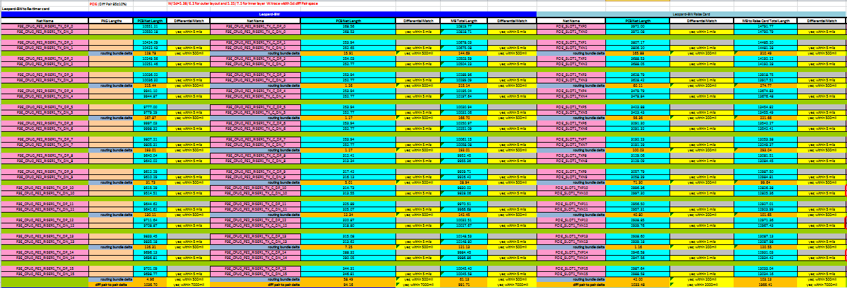
Board file and Equal Length

Slide 22
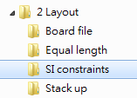
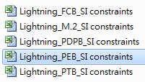
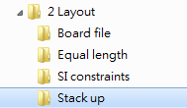
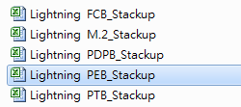
SI constraints and Stackup

Slide 23
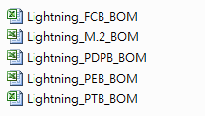
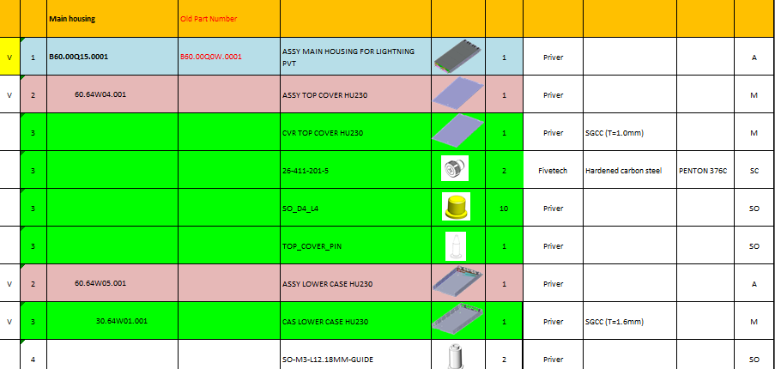
BOMs (EE & ME)

Slide 24
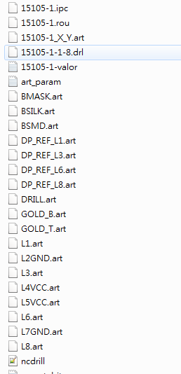
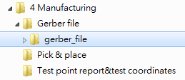
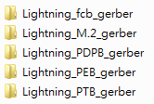
Manufacture Files _ Gerber

Slide 25
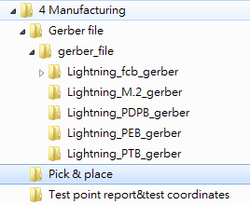
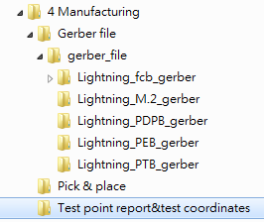
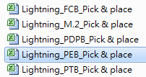
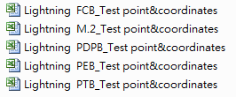
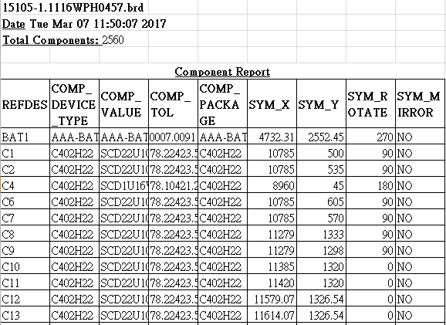
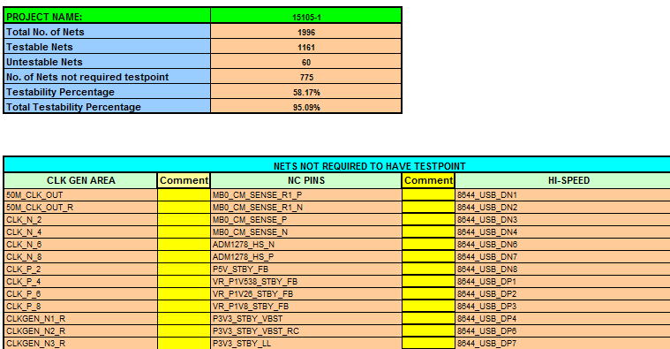
Manufacture Files _ Pick & Place / Test point report

Slide 26
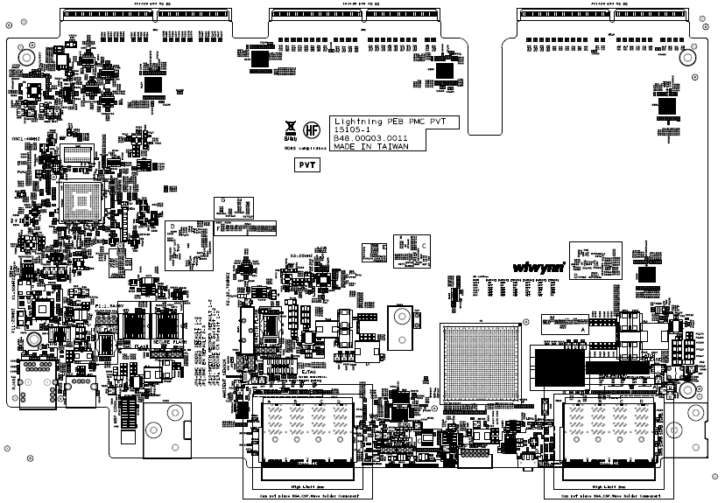
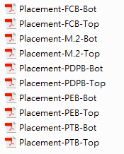
Placement Map

Slide 27
ME CAD(2D & 3D files)

Slide 28
Thank you

