Slide 1
OCP Accelerator Module Design Spec Review

Slide 2
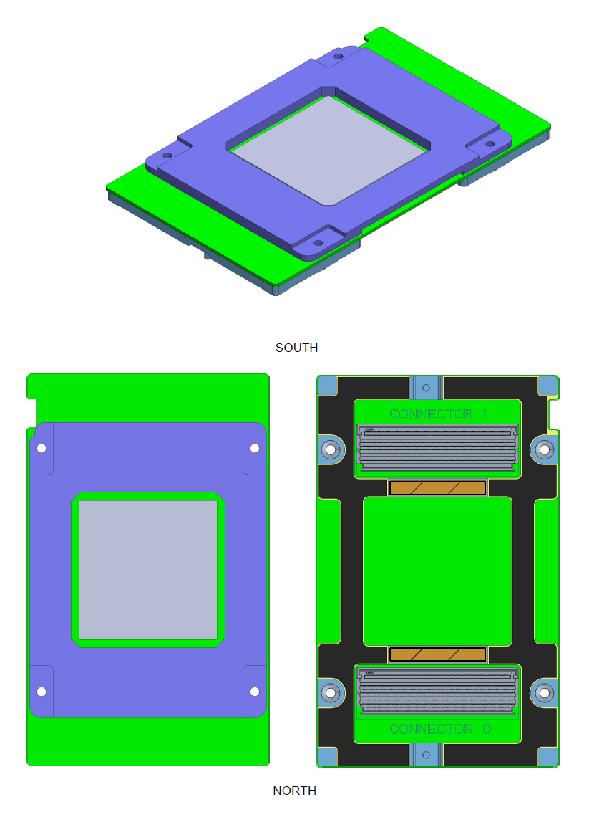
Overview
102mm x 165mm
Support both 12V and 48V as input
Up to 350w(12V) and up to 700w(48V) TDP
Support single or multiple ASIC(s) per Module
Up to 8X16 links(Host + interconnect)
Support 1 or 2 X16 High speed link(s) to host
Up to 7 X16 high speed interconnect links
Supports up to 440W (air cooled) and 700W (liquid cooled)
System management and debug interfaces
Up to 8* Modules per system
Notes:
Based on open standard, everybody can design to it.
Will be common

Slide 3
Module Power
Support both 12V and 48V as input
12V to support up to 350w TDP
48V to support up to 700w TDP
Power Rail | Voltage Tolerance | # of pins | Current Capability | Status
P12V | 11V min to 13.2V max | 27 | 27A (when at 11V) | Normal Power
P12V Mandatory | 11V min to 13.2V max | 5 | 5A (when at 11V) | Normal Power
P48V | 44V min to 60V max | 16 | 16A (when at 44V) | Normal Power
P3.3V | 3.3V±10% (max) | 2 | 2A | Normal Power

Slide 4
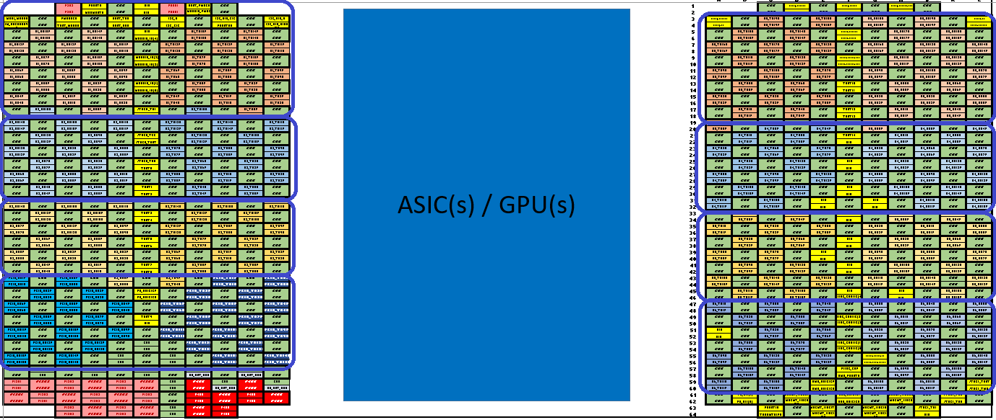
Module Pin Map
SerDes 1 X16
SerDes R X20
SerDes 2 X16
SerDes 4 X16
SerDes 5 X16
SerDes 3 X16
Host X16
SerDes 6 X16
Power

Slide 5
System Management/Debugging
Sensor reporting
Error monitoring/Reporting
Firmware Update
Power Capping
FRU Information
IO Calibration
JTAG/I2C/UART interfaces for debugging

Slide 6
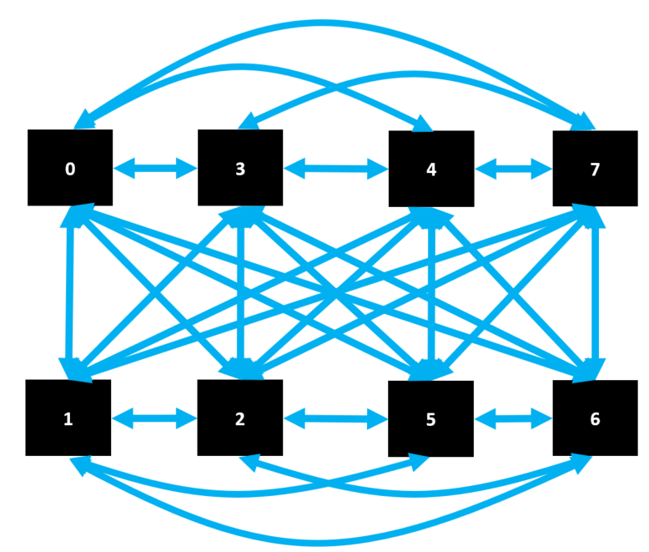
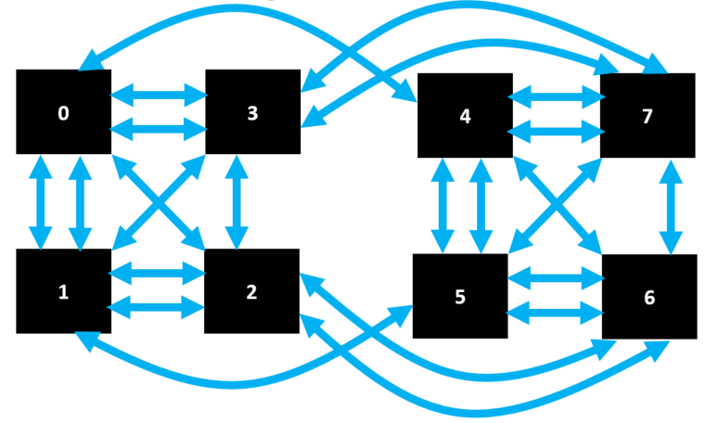
Interconnect Topology Examples
8 modules with 6 links per module
Hybrid Mesh Cube
8 modules with 7 links per module
Fully Connected

Slide 7
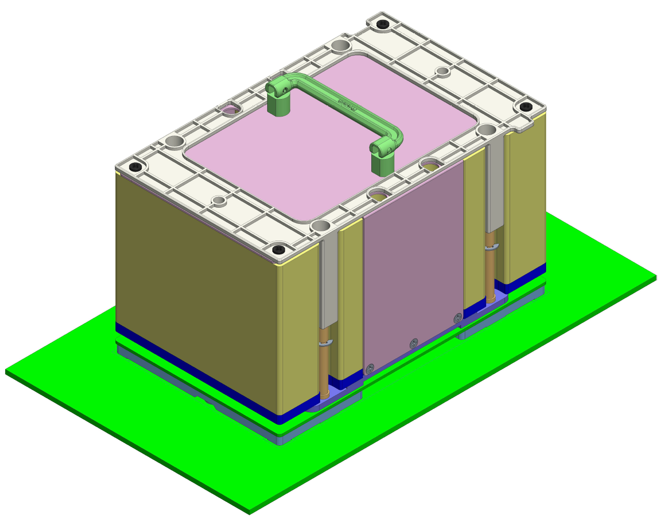
Overview: ME/Thermal
Example die
Top stiffener
Provide a basic framework such that OAM from different vendors can be used in the same system.
Provide a full reference design such that redesign is minimal.
OAM PCB
Bottom stiffener
Notch
Top handle
Reference heatsink
Mounting screws
Baseboard PCB
Notes:
Two main goals: provide framework such that OAM from different vendors can be easily swapped in the same system. Provide a full reference design such that redesign is minimal.
Parts of OAM itself, supplied by OAM vendor. Parts of Reference Assembly – Heatsink + baseboard parts, designed for each system.

Slide 8
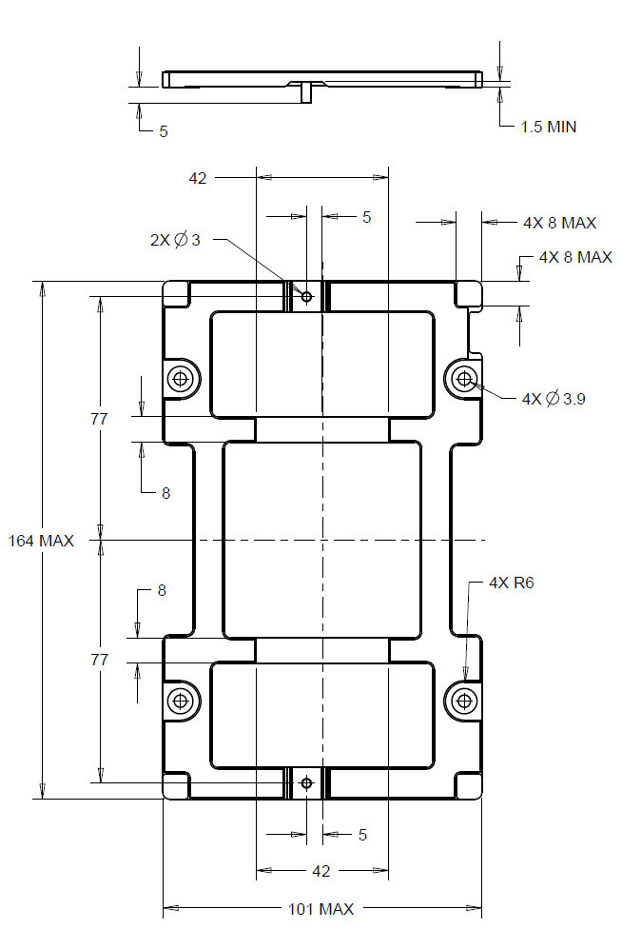
ME Requirements – OAM Bottom Stiffener
FRONT VIEW
5±0.15mm stiffener as required by connector
3mm alignment pins that extend 10mm below OAM PCB surface
Die spring (rectangular profile coil spring) to provide unmate force
EMI gaskets for grounding to baseboard
Top stiffener
OAM PCB
Bottom Stiffener
SIDE VIEW, FULL ASSEMBLY
(BOTTOM STIFFENER IN BLUE)
System Baseboard
BOTTOM VIEW
Notes:
No restrictions on top stiffener – that is up to the OAM vendor, but we have some requirements on the bottom stiffener.
Stiffener height and tolerance is required by Molex Mirror Mezz connector – this is a tight tolerance and so spec will include some recommendations on mylar and adhesive assembly such that this tolerance can be held.
Two alignment pins to provide keying and help with final alignment.
Four die springs sit in the stiffener counterbores and provide assistance during unmating. Unmate forces for this module measured at ____lbs.
Two EMI gaskets on the stiffener to ground to baseboard.

Slide 9
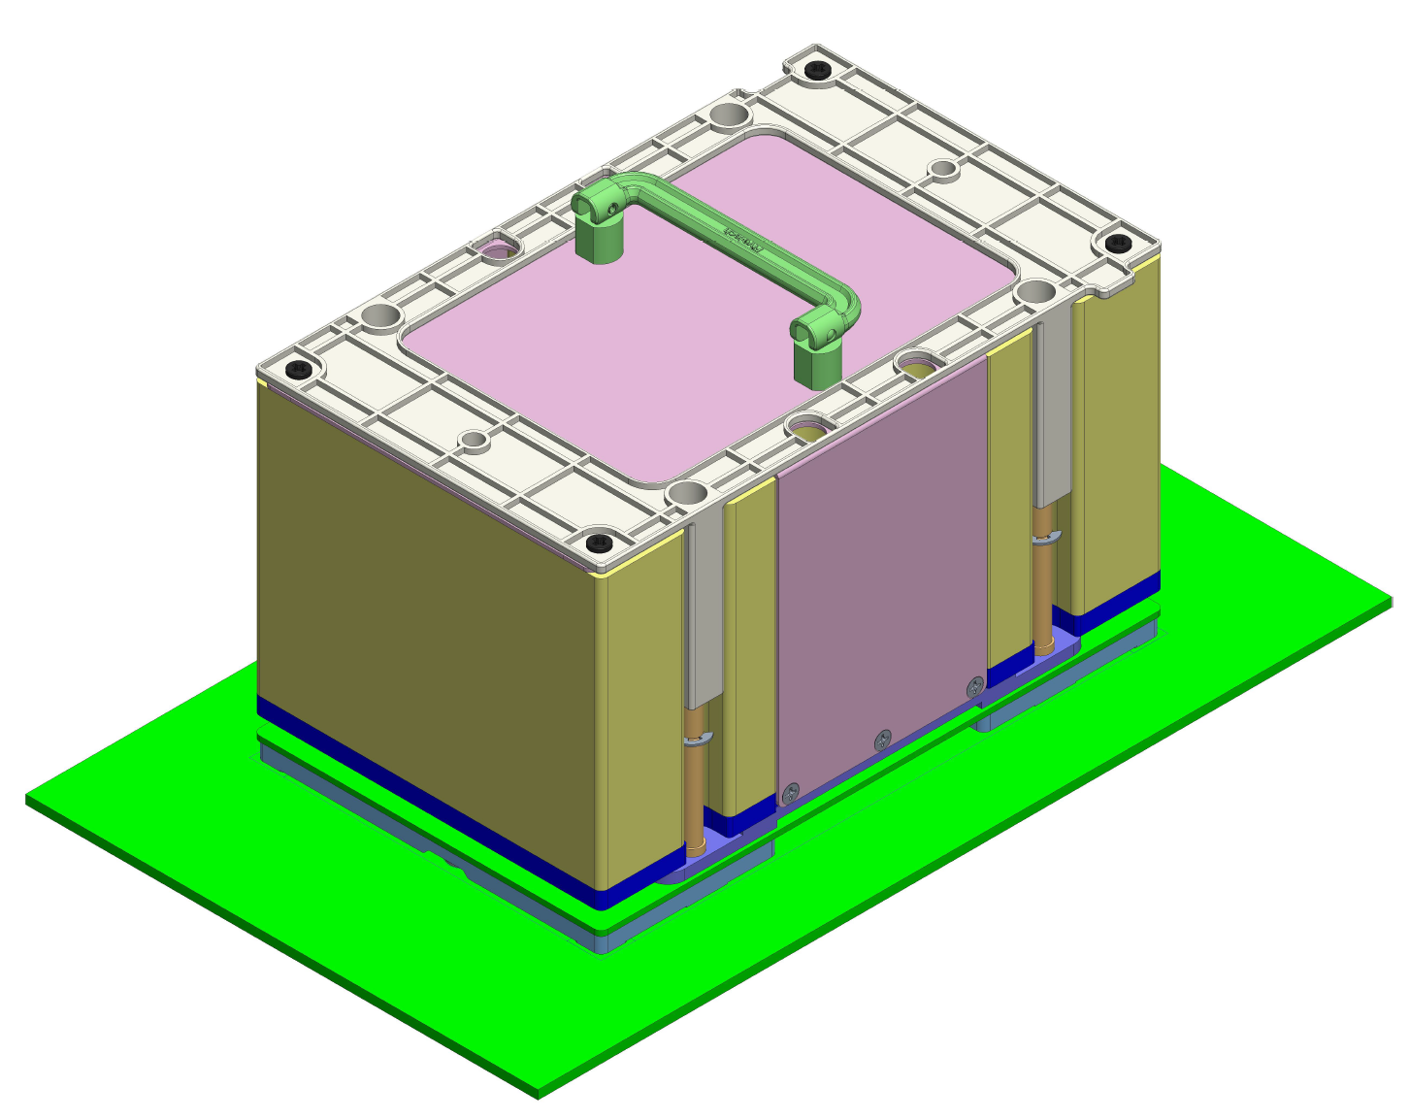
ME Recommendations – HS Reference Design
Top handle to accommodate handling for tight pitch and large weight (max 2kg)
Long M3.5 mounting screw design for easy serviceability

Slide 10
Next Steps
OAM as an OCP Accelerator Module supporting multiple suppliers
Universal Baseboard (UBB) supporting multiple interconnect topologies
Tray supporting different UBBs
Chassis supporting different Trays
Chassis and Rack Management supporting all Trays, UBBs, and OAMs as well as the Hosting Head Node
Join our sub-group: https://ocp-all.groups.io/g/OCP-OAM

