Slide 2
OCP
Open Bridge Rack > OBR
Denis Blouin
Belden
Product Line Manager, Infrastructure Solutions
denis.blouin@belden.com, 803-493-2634

Slide 3
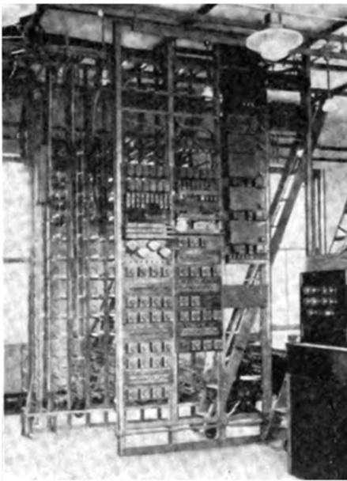
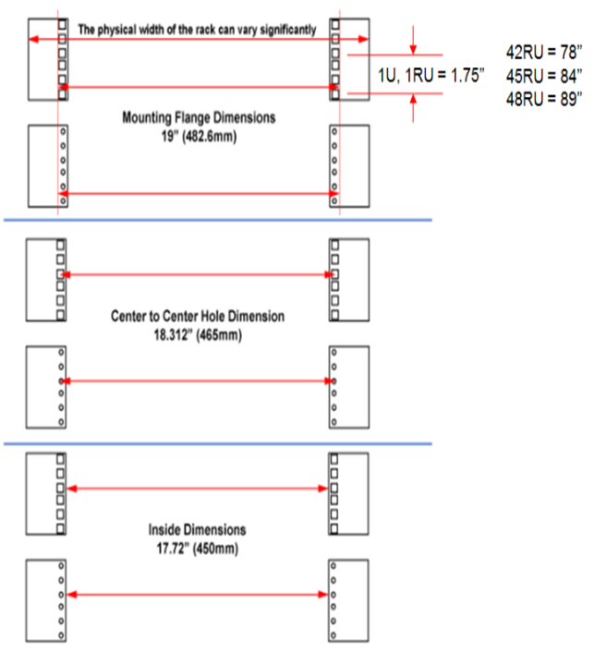
19” mount std … EIA-310-E (1934 > 2005)

Slide 4
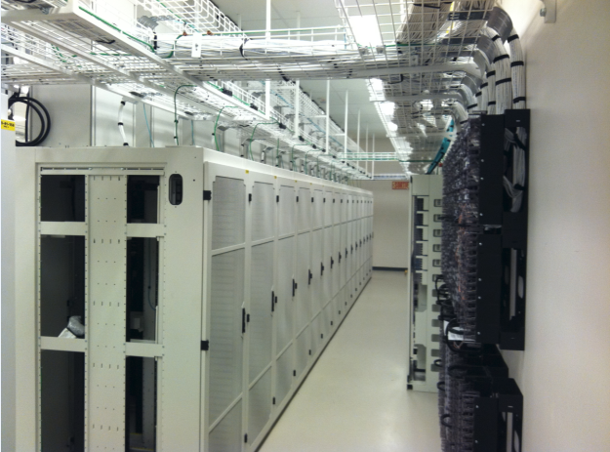
Broader adoption … leveraging existing infrastructure; at your own pace … Allowing installed rack to be converted to OCP standard … Most installed rack in last 2-3 years are wider (28-30”) and deeper (48”), prone to conversion to OCP compatibility

Slide 5
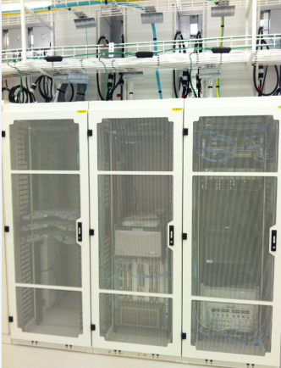
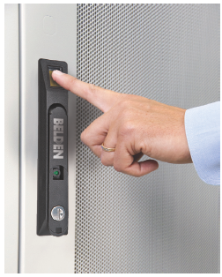
Broader adoption … industry specific security regulations Rack allowing meeting specific security, access requirements

Slide 6
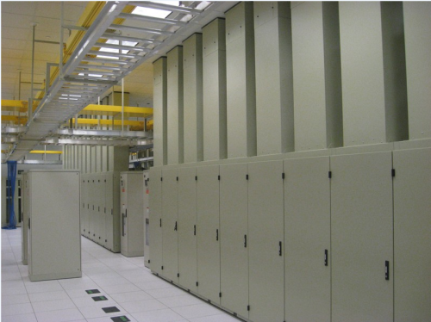
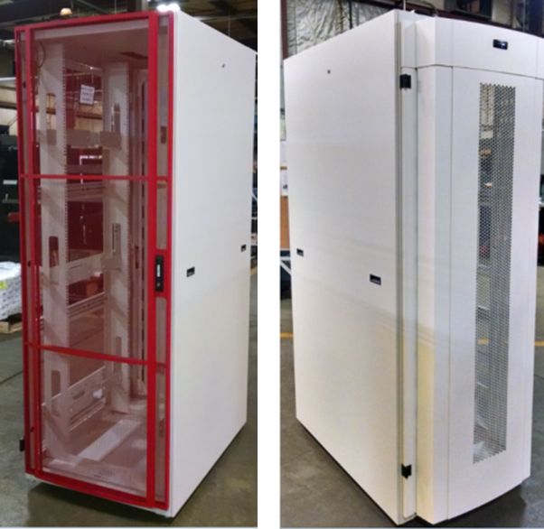
Broader OCP adoption … cooling and air handling compatibility … rack allowing integration into various cooling approach …

Slide 7
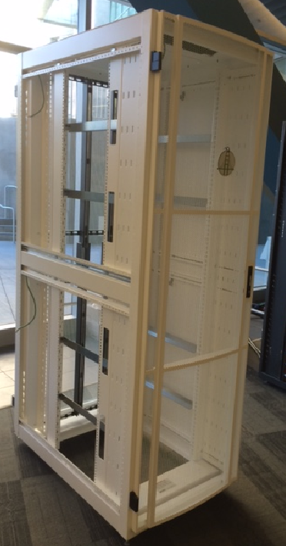
Belden Open Bridge Rack - OBR
Compliant with EAI & Open rack standard
28”W x 48”D x 89”H (40 OU – 48 RU)
710mm x 1220mm x 2260mm
Field conversion EIA>OCP>EIA>OCP
+/- 40 min. operation
1000 kg dynamic load capacity, 1350 kg static load (on going testing)

Slide 8
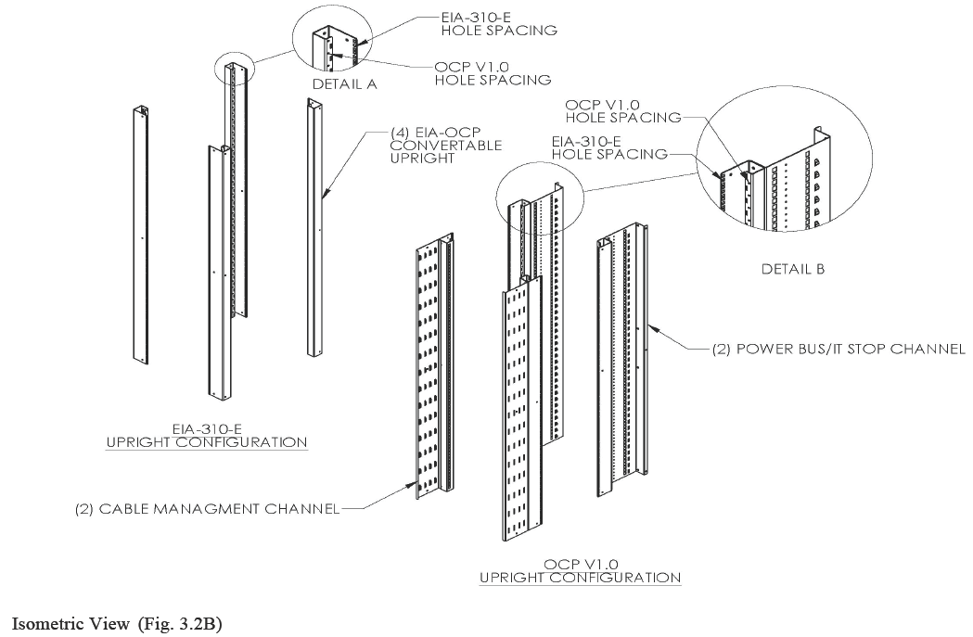
OBR rack conversion components … Quick conversion from EIA to OCP ….

Slide 9
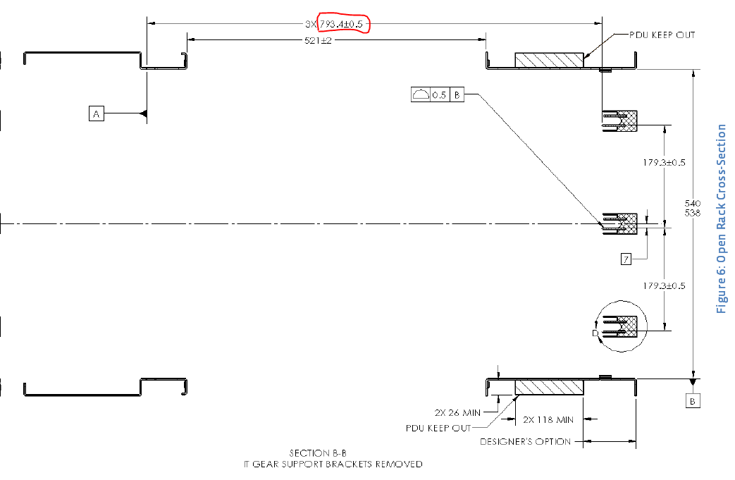
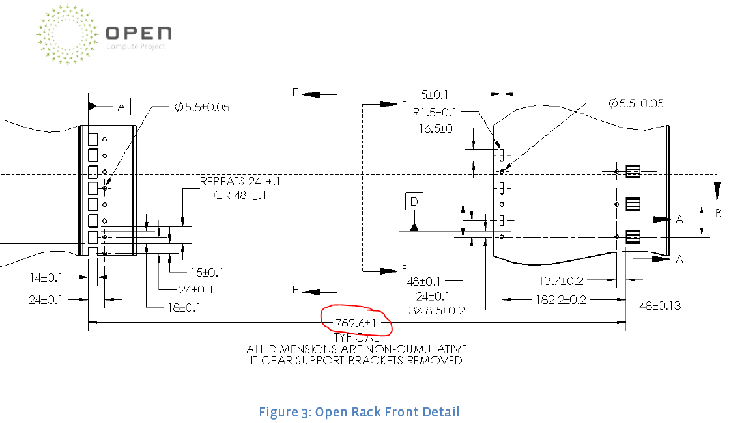
Key OCP dimensions… front to rear relative rail positioning critical, major difference to EIA-310
Open Rack Cross Section
Rack Columns
Ref. Open Rack Standard V1.1,
p.8 Figure 6: Open Rack Cross-Section
Ref. Open Rack Standard V1.1,
p.6 Figure 3: Open Rack Front Detail

Slide 10
Belden Open Bridge Rack - OBR
Compliant with EAI & Open rack standard
Field conversion EIA>OCP>EIA>OCP
+/- 40 min.
1000 kg dynamic load capacity, 1350 kg static load (on going testing)
Rail location tool insuring all rack meeting OCP requirements

Slide 11
Denis Blouin Mechanical Eng., Belden
PLM Infrastructure Solution Products
denis.blouin@belden.com
803-493-2634
Thank you !

