Slide 2
SERVER
OCP NIC Community Update November 2020
Sub-group Project wiki: https://www.opencompute.org/wiki/Server/Mezz
Mailing List: https://ocp-all.groups.io/g/OCP-NIC
NIC3.0

Slide 3
Agenda
OCP Tech Week
Tall Form Factor
Specification updates
Working session

Slide 4
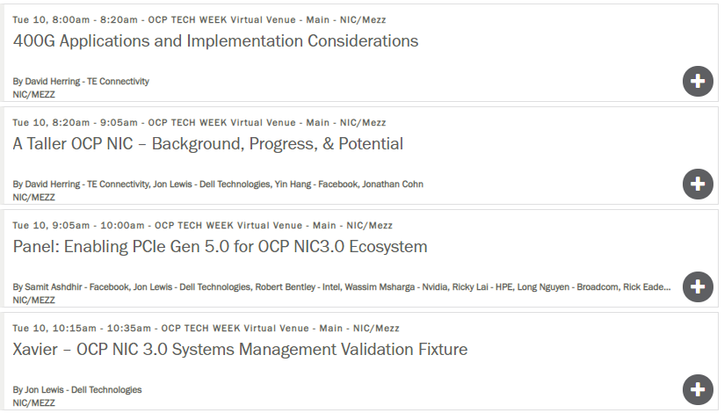
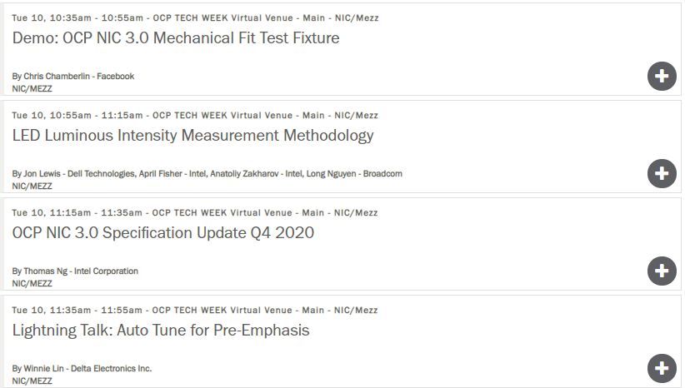
OCP Tech Week – NIC track
Tuesday, November 10, 8am-12pm PST
Spec Compliance
Scale Bandwidth
Spec

Slide 5
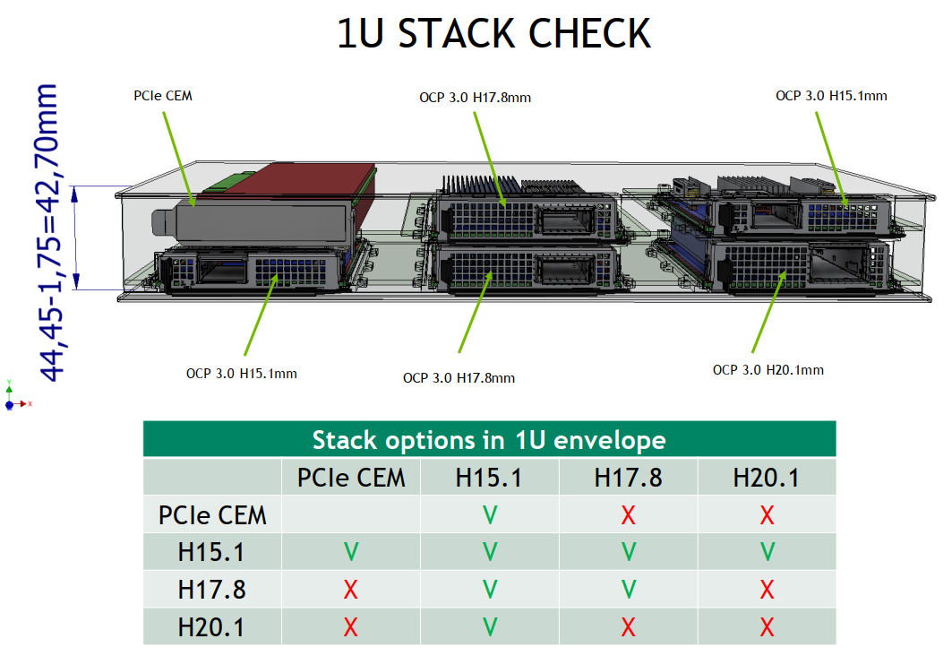
Tall Form Factor
H17.8mm
+ Allow uniformed dual stacking
+ Support QSFP-DD & OSFP-RHS ..
+ Allow non-NIC mini-SAS HD use-case
- Unable to support PCIe CEM stacking
H20.1mm
- Only can dual stack with H15.1mm
+ Support OSFP, OSFP-RHS & QSFP-DD ..
+ Allow non-NIC mini-SAS HD use-case
- Unable to support PCIe CEM stacking
For 400G & beyond, thermal challenge of next speed bump is non-trivial but is tall form factor the only solution?
For 400G & beyond, supporting QSFP-DD & OSFP-RHS is the trend. However, majority of NICs in the near term is not 400G yet. Spec definition is a forward looking but form factor could co-exist for a long time

Slide 6
Specification updates for NIC3.0 Rev1.1

Slide 7
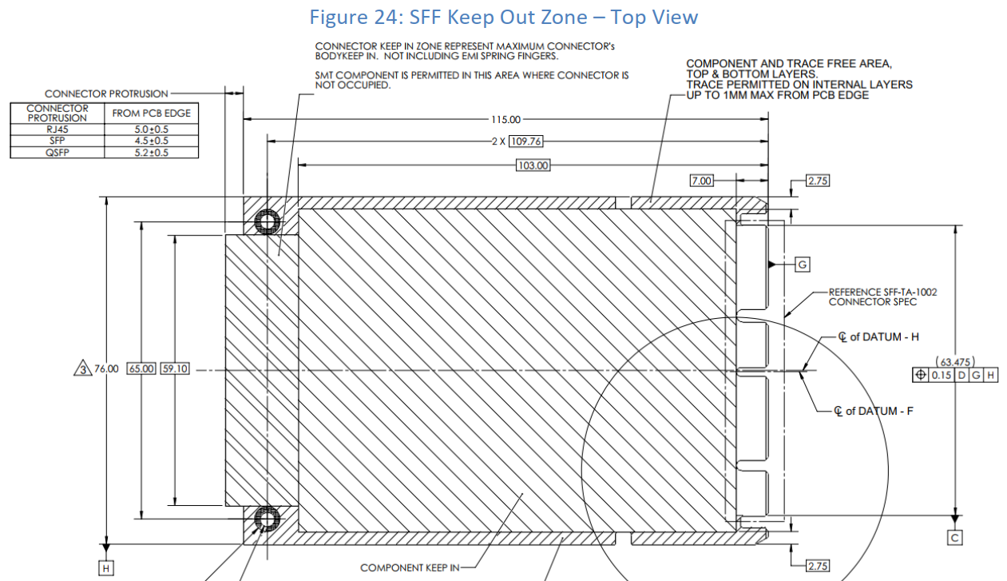
Specification updates for NIC3.0 Rev1.1

Slide 8
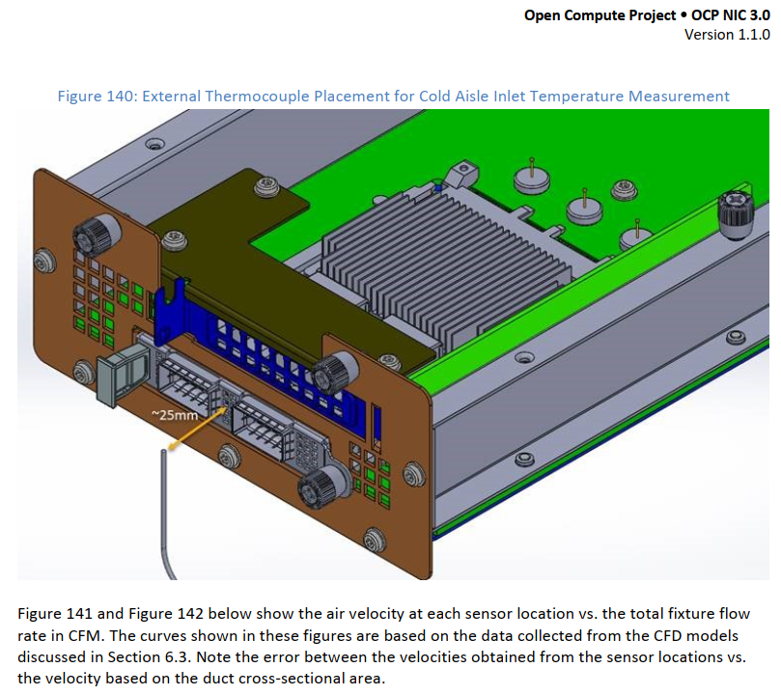
New inlet temperature sensor recommendation during validation

Slide 9
Gentle reminders
Remember to submit your OCP Tech Week final slide deck to FNtech portal by 5pm pacific today (11/4/2020)

Slide 11
Expanding thermal tier data?

Slide 12
Expanding thermal tier data?

Slide 13
Expanding thermal tier data?
COLD AISLE
HOT AISLE
AUX ONLY

