Slide 3
Multi-node platform
Network options and server management
Yan Zhao
FACEBOOK HARDWARE ENGINEER

Slide 4
Platform definition
Open platform that hosts 4x high performance 1S Servers
Modular design for flexibility and serviceability
Aggregated single network connection
Flexible server management
Open Rack V2 and Cubby chassis

Slide 5
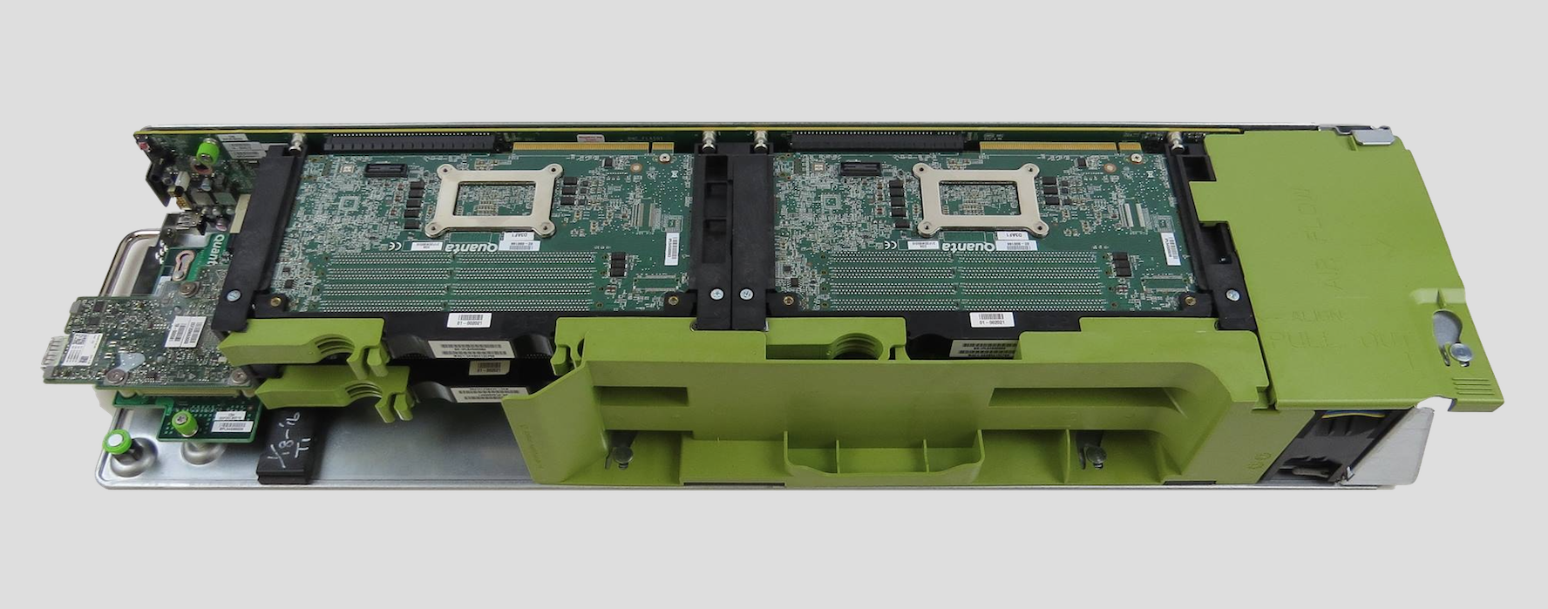
Yosemite multi-node platform

Slide 6
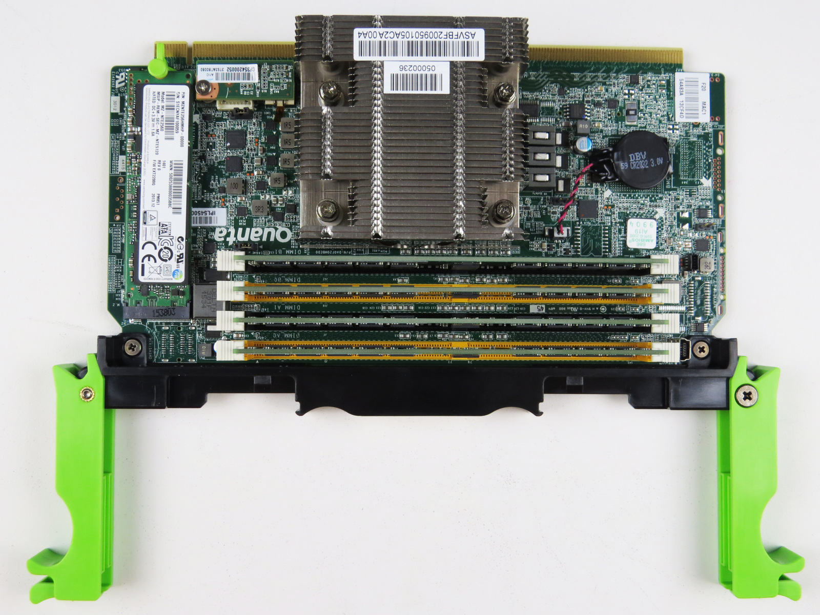
Mono Lake 1S server

Slide 7
Platform architecture
Slot4
Slot3
Slot2
Slot1
PCIe or 10G-KR
Hot-Swap
Controller
12V_STBY
12V_RACK
1S Server
OCP V2
Mezz Card
QSFP28 DAC
4x10G
40G
50G
Management
SideBand
BMC

Slide 8
4x10G KR 40G ToR 4x10G mode
Slot4
Slot3
Slot2
Slot1
1S Server
10G-KR
OCP V2
KR Mezz
10G-KR
NIC
QSFP
4x10G
NIC SMBus
Management
BMC

Slide 9
40G Multi-host 40G ToR single port
Slot4
Slot3
Slot2
Slot1
OCP V2
Multi-Host
MIC Mezz
PCIe Gen3 X2
1S Server
QSFP, 4 lanes
40G
Management
NC-SI or SMBus
BMC

Slide 10
50G Multi-host 100G ToR half port
Slot4
Slot3
Slot2
Slot1
OCP V2
Multi-Host
NIC Mezz
PCIe Gen3 X2
1S Server
QSFP28, 2 lanes
50G
Management
NC-SI or SMBus
BMC

Slide 11
Server management – OpenBMC
1S Server
SMBus
Slot1
Bridge IC
PCIe Gen3x2
1S Server
SMBus
Slot2
PCIe Gen3x2
OPEN
BMC
Bridge IC
OCP 2.0
Multi-Host
Mezz Card
NC-SI
QSFP28
(1 IP Addr)
1S Server
1 QSFP 28
DAC
(2x 25G or 4x 10G)
SMBus
Slot3
PCIe Gen3x2
Bridge IC
1S Server
PCIe Gen3x2
SMBus
Slot4
Bridge IC

Slide 12
Server management – BMC
1S Server
vBMC-1
SMBus
Slot1
Bridge IC
PCIe Gen3x2
vBMC-2
1S Server
SMBus
Slot2
PCIe Gen3x2
BMC
Bridge IC
OCP 2.0
Multi-Host
Mezz Card
NC-SI
QSFP28
(4 IP Addr)
1S Server
1 QSFP 28
DAC
(2x 25G or 4x 10G)
SMBus
Slot3
PCIe Gen3x2
vBMC-3
Bridge IC
1S Server
PCIe Gen3x2
vBMC-4
SMBus
Slot4
Bridge IC

Slide 13
Thank you

