Slide 2
Ensuring Intoperability and Open APIs
For Open Networking Systems
David Woolf
UNH-IOL
Craig Thompson
Finisar

Slide 3
Agenda
Part 1 - Ensuring Interoperability
UNH-IOL
Open Networking Integrators List Program
What we test
What’s Next
Part 2 – Open APIs
University of New Hampshire InterOperability Laboratory

Slide 4
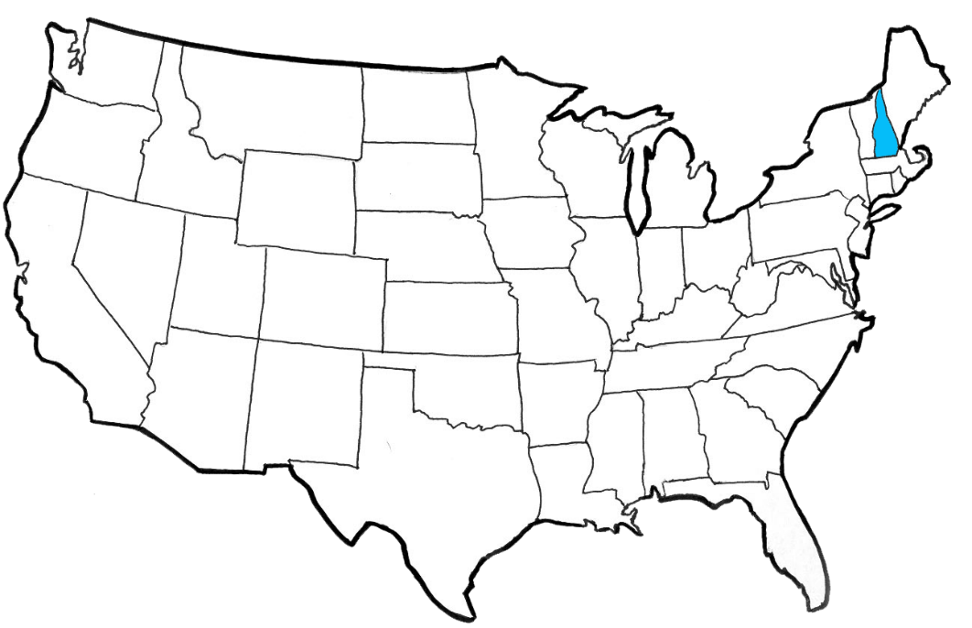
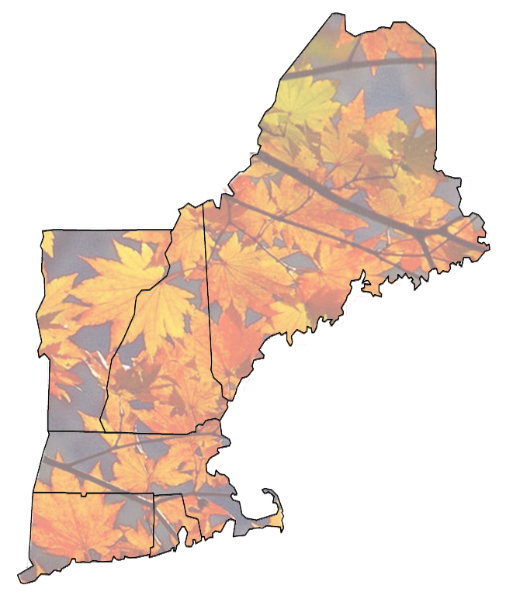
University Of New Hampshire
Portland, ME
Durham, NH
Founded in 1866
Main campus located in Durham, New Hampshire, USA
12000+ undergraduate students, 2000+ graduate students
Boston, MA
University of New Hampshire InterOperability Laboratory

Slide 5
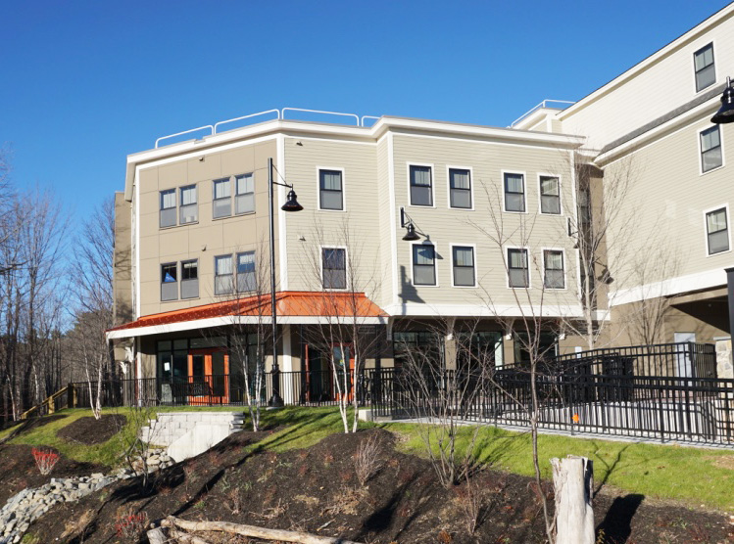
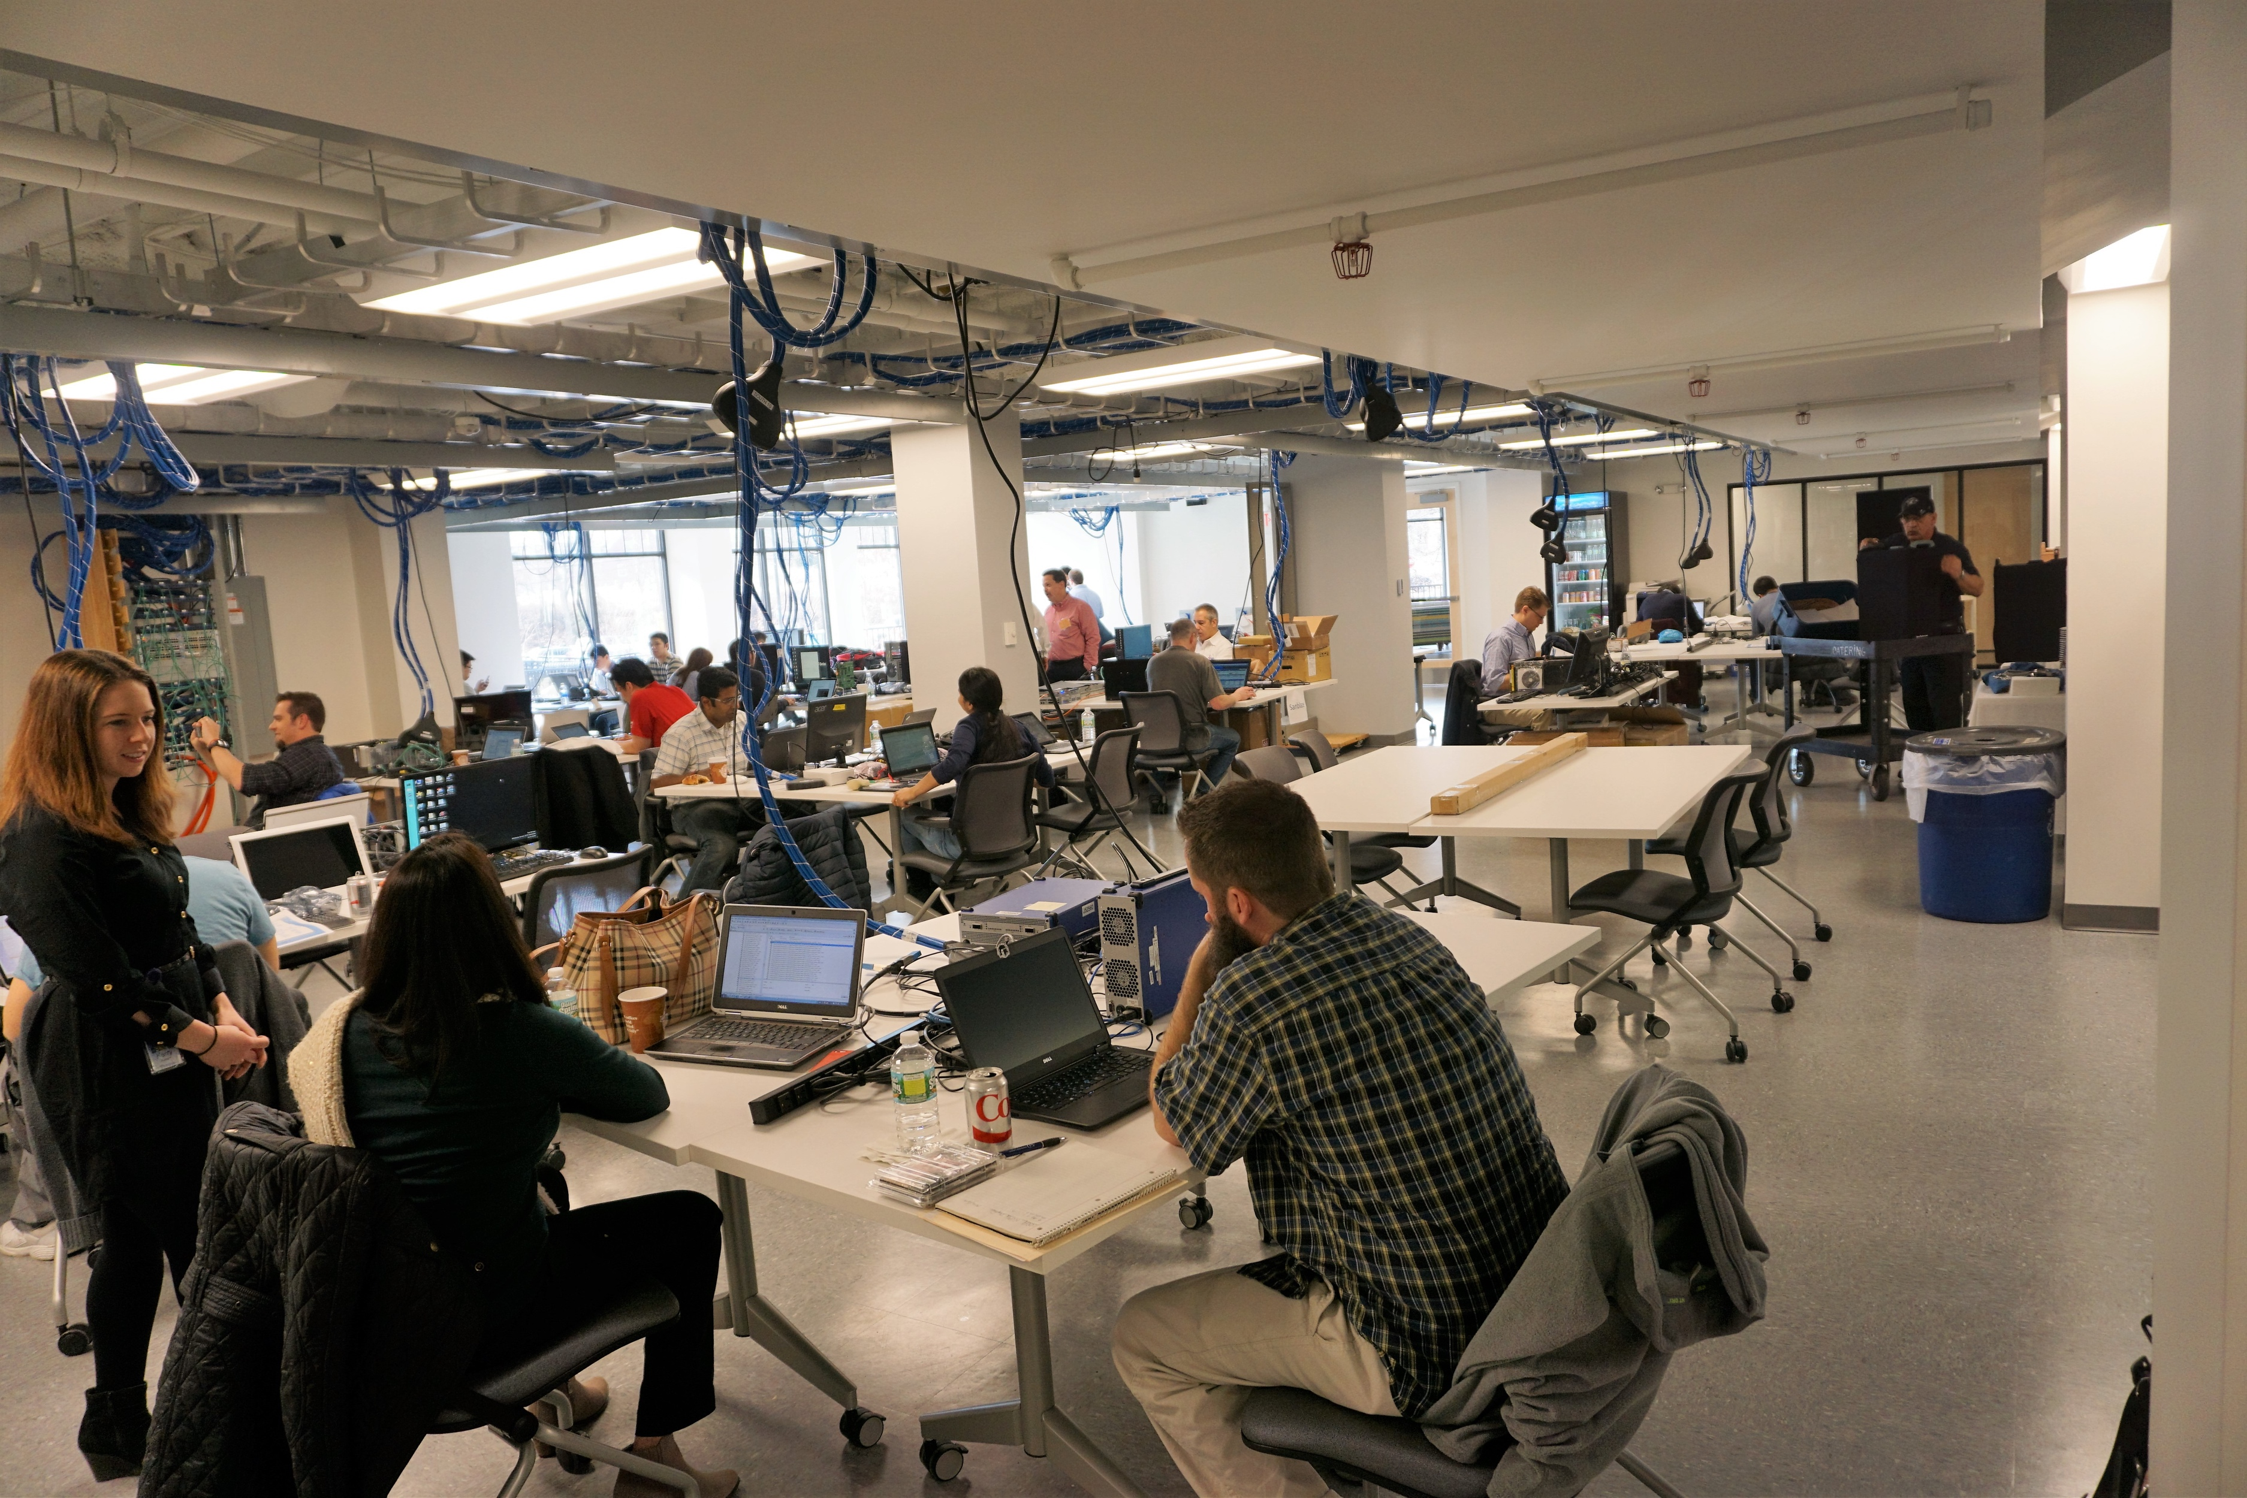
Brief overview of the UNH-IOL
InterOperability Laboratory
The UNH-IOL is a non-profit neutral, third-party laboratory dedicated to testing data networking technologies through industry collaboration.
Performing communications testing since 1988
UNH-IOL Tests are listed on iol.unh.edu for public review.
Industry leading test facility for data, telecom, mobile and storage networking technology & consumer electronics.
28,000 sq. ft lab facility
6,000 sq. ft pre-wired space dedicated to Plugfests.
>100 Employees, >20 full time staff.
University of New Hampshire InterOperability Laboratory

Slide 6
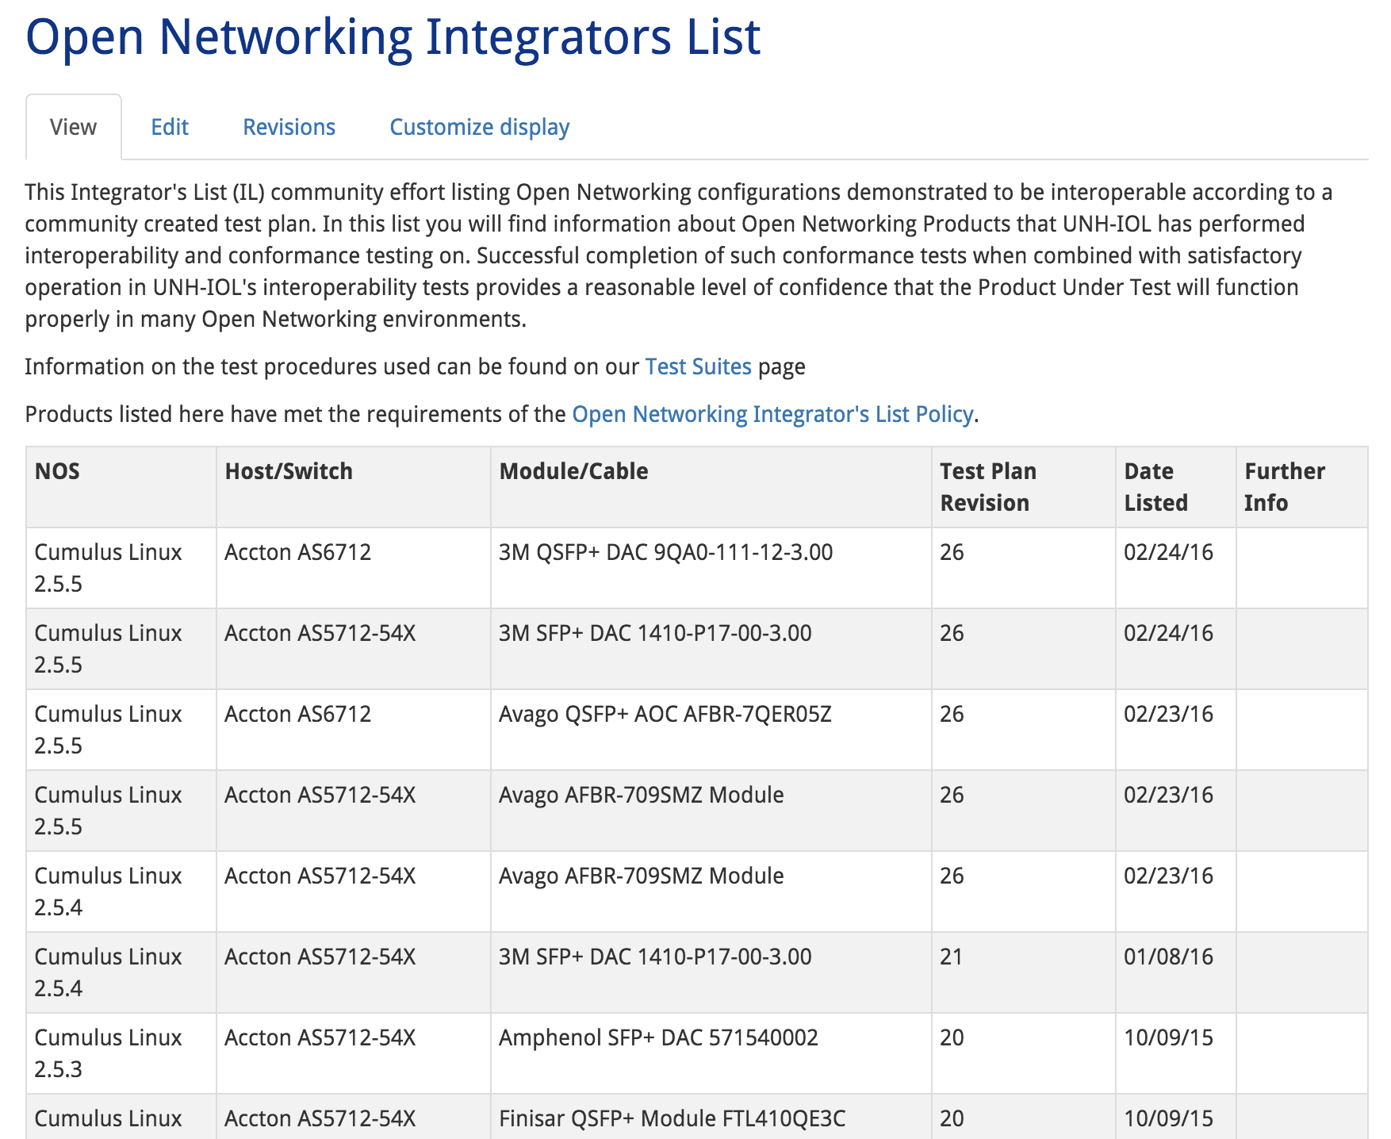
Open Networking Integrators List Program
Prove Open Networking solutions are reliable
Show results and working configurations publicly
Put tools and configurations online so anyone can replicate our testing.
Publish configurations of Open Networking solutions that pass community defined interop and conformance tests on the Open Networking Integrators List

Slide 7
More Info on the Integrators List
Whitepaper
https://www.iol.unh.edu/OCPWhitePaper
Test Plan
http://files.opencompute.org/oc/public.php?service=files&t=d78a201f9f78e6e66035368a2314f95b
Integrators List
https://www.iol.unh.edu/registry/opennetworking

Slide 8
What we test
6 - Interoperability
3 - Passive Cable conformance
2 - Management of Module
1 - ONIE
5 - Host Electricals
4 - AOC and Module conformance

Slide 9
Group 1: ONIE
Run OCE tool
Setup HTTP Server, install and uninstall NOS over HTTP.
Doesn’t replace full ONIE testing, but….
UNH-IOL is launching full ONIE testing soon.

Slide 10
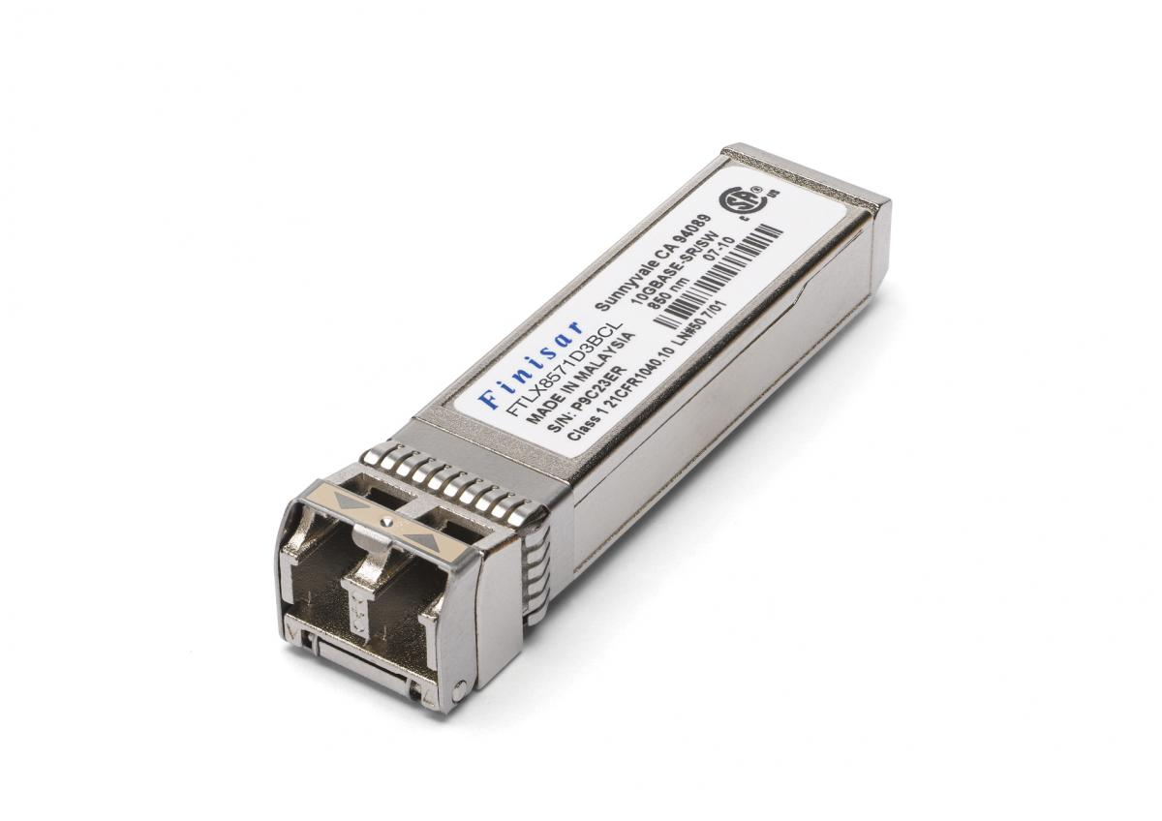
Group 2: Management of Module
Physical Compatibility of SFP+ and QSFP+ modules
Read EEPROM with reader and through NOS, compare.
Will add OOM tests in the future.
This will be a key differentiator for OCP technology

Slide 11
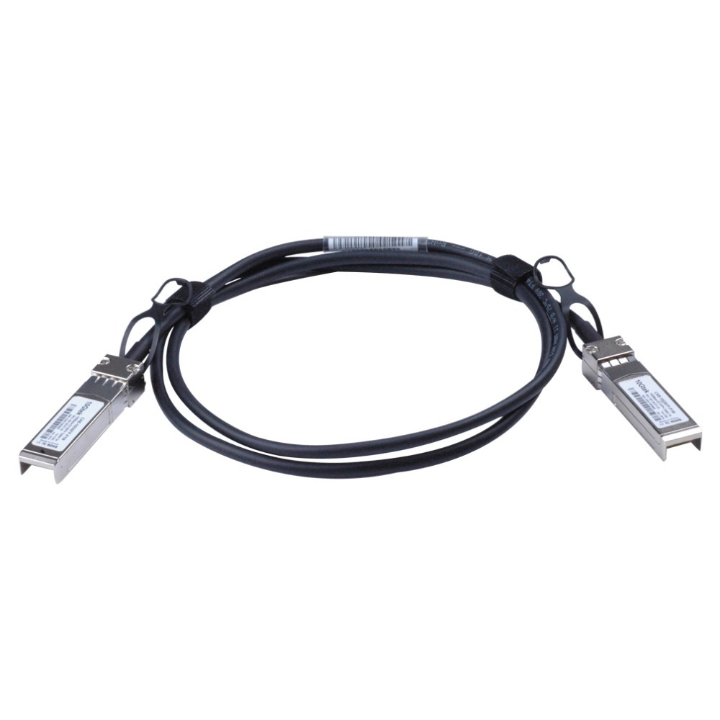
Group 3: Passive Cable Testing
Use VNA to measure return loss as defined in IEEE spec
Performed for both SFP+ and QSFP+ cables.
More detailed tests available at UNH-IOL, but not part of Open Networking Integrators List program.

Slide 12
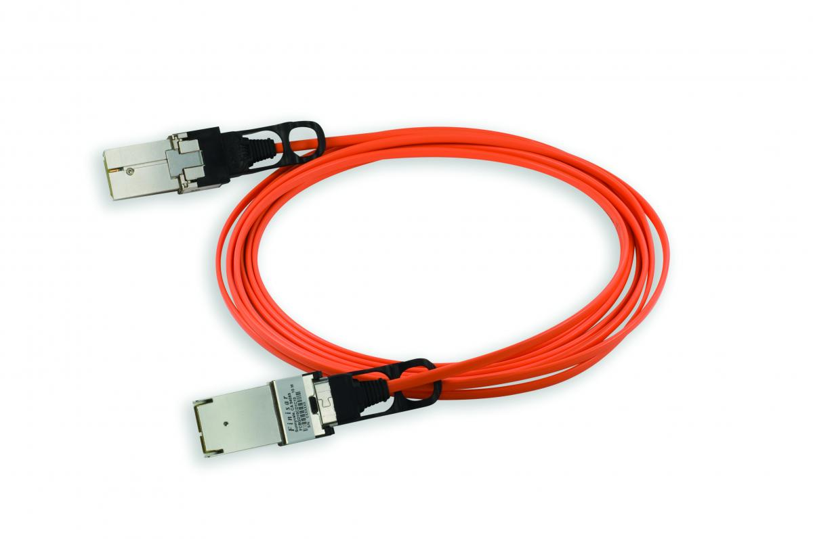
Group 4: AOC and Module Compliance
Use pattern generator to push PRBS31 pattern through the AOC or Module+Fiber.
Ensure the eye is conformant.
Both SFP+ and QSFP+
More detailed tests available at UNH-IOL, but not part of Open Networking Integrators List program.

Slide 13
Group 5: Host Electricals
Install NOS
Parameters change depending on NOS programming of hardware
Input/output return loss and Eye mask for 10/40G
More detailed tests available at UNH-IOL, but not part of Open Networking Integrators List program.

Slide 14
Group 6: Interoperability
4 parts to interop
Baseline performance
Link Discovery on Power on
BER over 1 hr
BER stress (Snake) test

Slide 15
Group 6: Interoperability
Baseline performance
Determine rate where packets are not dropped
Link Discovery on Power on
Cycle through various power on scenarios
Packet Error Rate Estimation
Ensure BER maintained over 1 hour.

Slide 16
Group 6: Interoperability
Stress (Snake) test, ensure no packets dropped

Slide 17
Group 6: Interoperability
Test being demonstrated in Expo: Edge-Core booth D4
Thank you to demo participants:

Slide 18
What’s Next
Plugfest May 2-5, 2016 at UNH-IOL
Continued additions to Open Networking Integrators List through weekly member testing at UNH-IOL.
Addition of LR Optics to Interop Program
Addition of NICS to Interop Program
Addition of 25G Program
Addition of 100G to Interop Program

Slide 19
More Info
Whitepaper
https://www.iol.unh.edu/OCPWhitePaper
Test Plan
http://files.opencompute.org/oc/public.php?service=files&t=d78a201f9f78e6e66035368a2314f95b
Integrators List
https://www.iol.unh.edu/registry/opennetworking
Contact
david@iol.unh.edu

