Slide 1
QCT Rackgo X Yosemite V2
2018/08/22

Slide 2
Agenda
Overview
High Level Features
Why We Need this Product
Mechanical View-System Level
Mechanical View-Sled Level
Mechanical View-Server Card Level
Block Diagram of System-Yosemite Valley V2
Block Diagram of Server Card-Twin Lakes
Design Enhancement
Compatible Components List & User Guide
Design Files Contribution(TBD)
OCP Tenets/Principles(TBD)
Summary(TBD)

Slide 3
Overview
Introduction
‘’Rackgo X Yosemite Valley V2’’ is new generation platform that enables with Intel Xeon Processor Skylake-D Product Family. It hosts up to 4 OCP compliant 1P server cards that called Twin Lakes. And Yosemite V2 system implements a horizontally installed baseboard to install 1P server card vertically with new V-cubby.
Contributions
Design package
Product submission to Marketplace
Specification Reference
Facebook Multi-Node Server Platform: Yosemite V2 Design Specification v1.0 spec

Slide 4
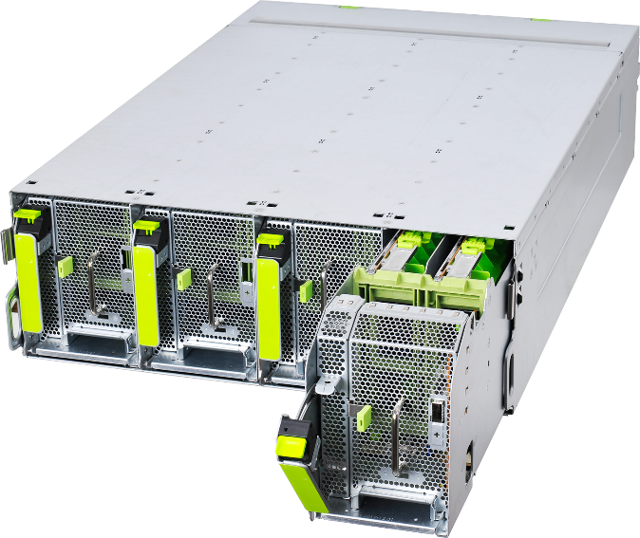
Why We Need this Product
We are facing the requirement of high computing capability than before
More and more computing capability requirement than before for various application, for example, AI(artificial intelligence)
What this product intend to solve
Compare to Yosemite V1, V2 increase the density from 12 Server cards to 16 with using next generation CPU on board.

Slide 5
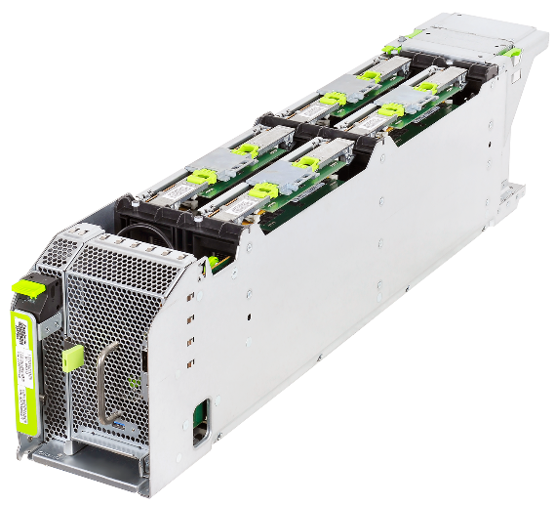
High Level Features
Function | Description
Processor | Intel Skylake-D, Xeon processor, up to 18 cores, TDP up to 105W. TL will only support 85W.
Memory | Four channels, two DIMMs per channel DDR4 RDIMM Max Mem. cap. 128GB. 16GB*8 or 32GB*4
External I/O Connections | 32 x PCIe Gen3 Lanes (CPU) 6 * X4 to gold finger. 2 * X4 to high-speed storage drive M.2 connector on TL. 20xGen3 over HSIO (PCH) 1* X4 PCIe for Mellanox CX-4 LX mezzine. 1*USB 3.0 for DCI only. 1*PCIe X1 for VGA. One USB 2.0 to baseboard Serial Port (Tx/Rx only) I2C Management Power On/Off, Reset
Storage | 3 * M.2 connectors. One for boot drive(PCIe or SATA). Two for high-speed storage drive(PCIe).

Slide 6
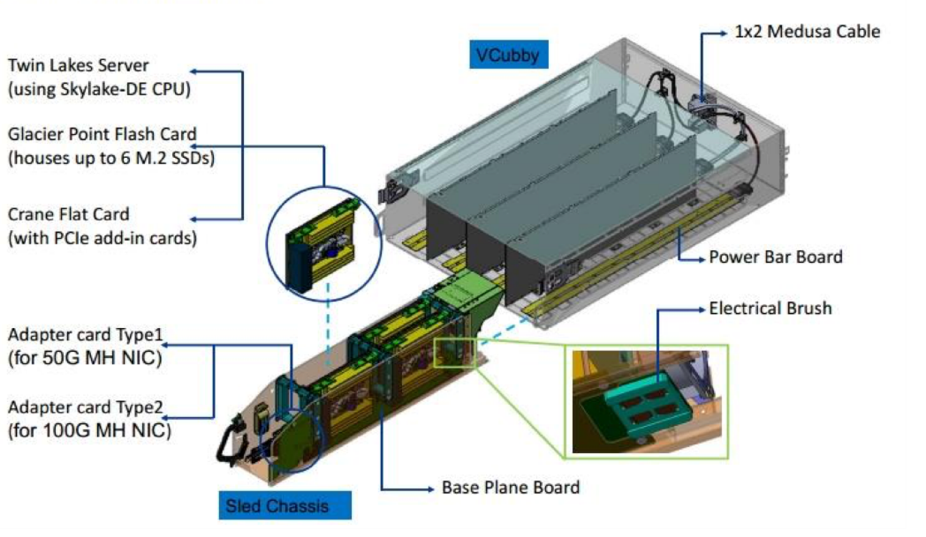
Mechanical View-System Level

Slide 7
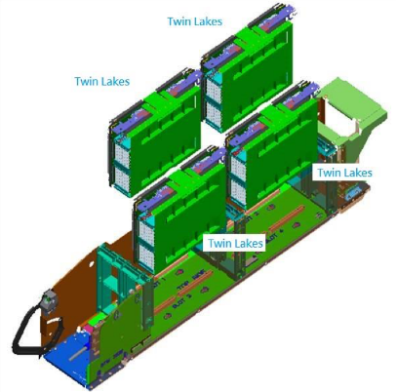
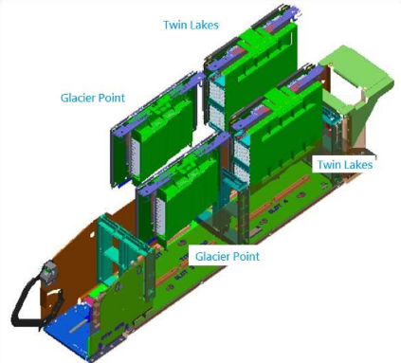
Mechanical View-Sled Level
All Computes
Different Configuration
2xComputes w/ 2x M.2 carrier cards

Slide 8
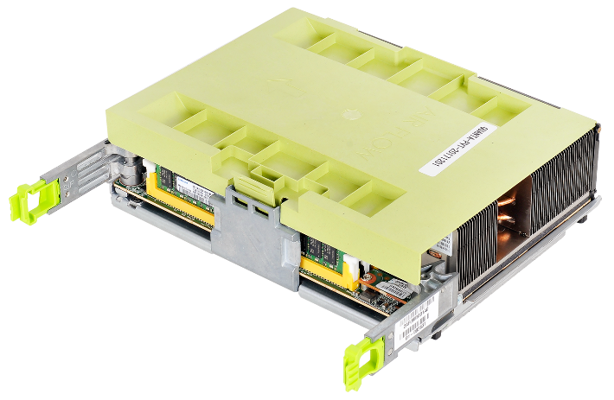
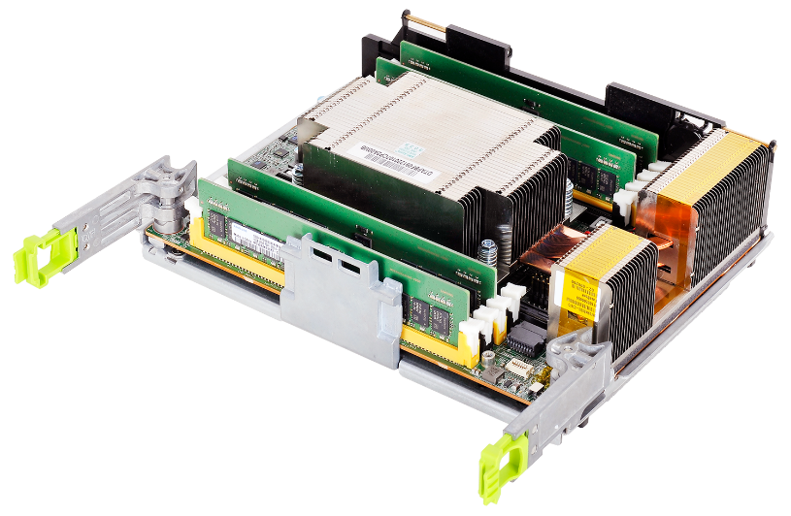
Mechanical View-Server Card Level
1P Server Card-
Twin Lakes

Slide 9
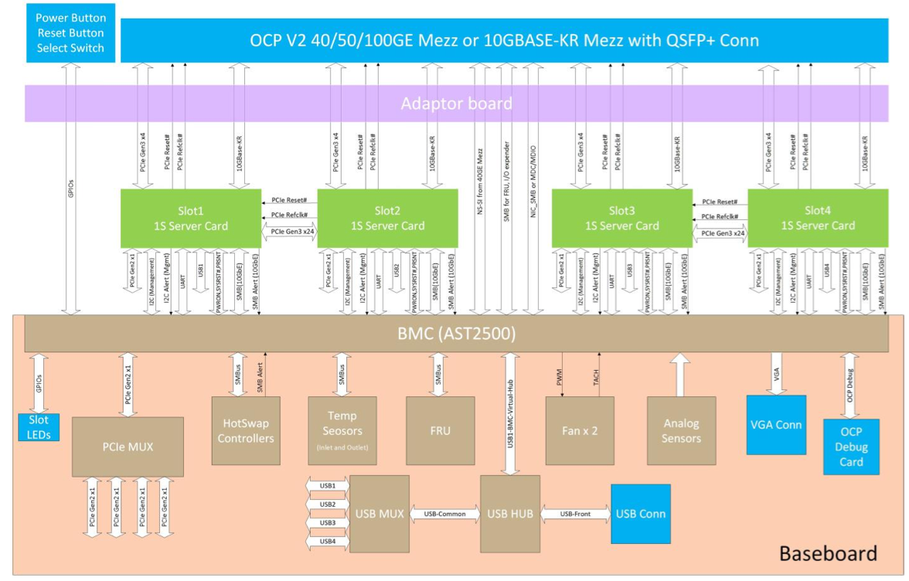
Block Diagram of System-Yosemite Valley V2

Slide 10
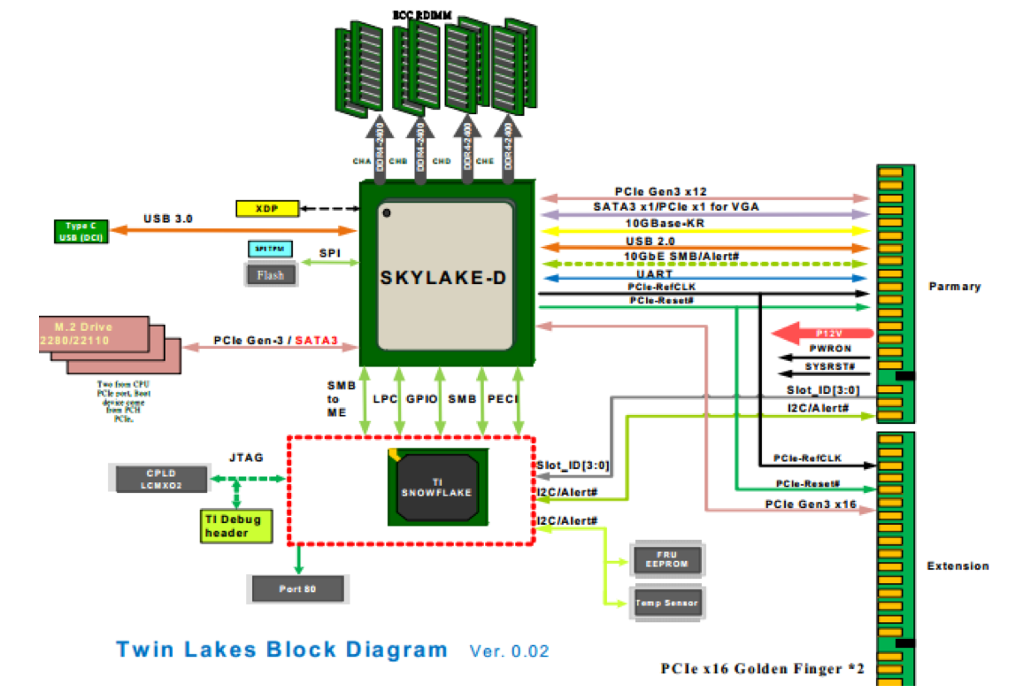
Block Diagram of Server Card-Twin Lakes

Slide 11
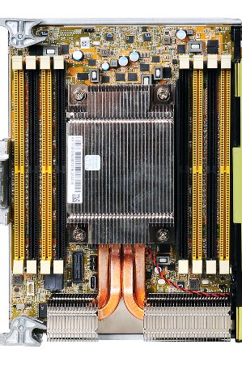
Design Enhancement
8 DIMM per server card compare to V1 (4xDIMM slots)
Install server card vertically with new V-cubby compare to V1 Cubby chassis (horizontally)

Slide 12
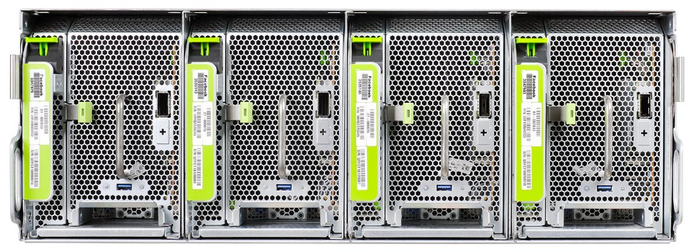
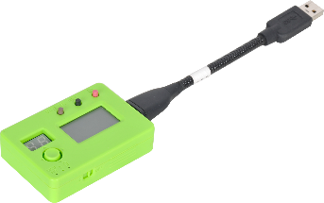
Compatible Components List & User Guide
‘’QCT Rackgo X OCP Debug Card with LCD’’ can be worked with this system
QCT Rackgo X OCP Debug Card with LCD
Rackgo X Yosemite Valley V2

Slide 13
Thanks!!!
Notes:
13

