Slide 2
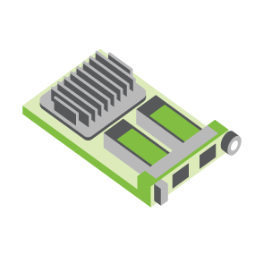
SERVER
OCP NIC Community Update August 2022
Sub-group Project wiki: https://www.opencompute.org/wiki/Server/Mezz
Mailing List: https://ocp-all.groups.io/g/OCP-NIC
NIC3.0

Slide 3
Agenda
OCP Global Summit 2022
OCP Experience Lab 2022
SI Test Fixture Update
Thermal Test Fixture Update
Future topics

Slide 4
OCP Global Summit 2022
There are 6 abstracts related to NIC has been tentatively accepted for presentation.
Final decision to be made after reviewing presentation materials
Draft presentation needs to be submitted by August 26
ID | Title
2841 | OCP NIC 3.0 Design Specification Update
2788 | Leveraging Existing OCP NIC Interconnect for PCIe Gen 6 Architectures.
2617 | OCP NIC 3.0: Present and The Future
2683 | Advanced thermal testing and characterization for pluggable IO
2705 | New TSFF test fixture airflow measurements and definitions
2783 | SmartNIC & OCP NIC-3 in Modular Hardware Systems (DC-MHS)

Slide 5
OCP Experience Lab in OCP Summit
There is a space for in-person NIC 3.0 demo
If you are interested, let us know
All NIC 3.0 compliant product demonstration are welcome. Especially calling for TSFF and non-NIC product demo

Slide 6
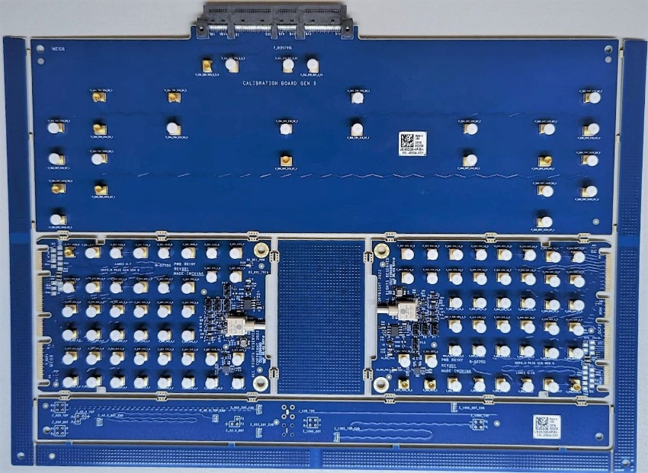
PCIe® 5.0 SI Test Fixtures
CLB 5.0 32GT/s status:
Based on 4.0 design
ECAD completed & ordered July 29th
Anti-pads removed
Additional trace tuning to mitigate discontinuities based on measured data
BOM kit ready for assembly; Seeking PCB complete date
CBB 5.0 32GT/s status:
Based on 4.0 design
Updates to align with PCI-SIG®
Route tuning starts once CLB verified in lab
OCP NIC 3.0 SFF CLB 5.0 prototype
Calibration
CLB board 1
CLB board 2
Impedance Coupon
Jason

Slide 7
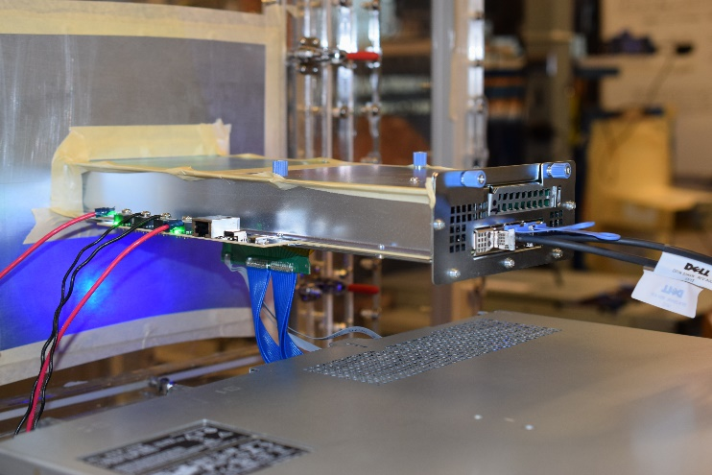
PCIe® 5.0 Thermal Test Fixture (TTF)
The TTF was designed to support speeds up to PCIe® 5.0 32GT/s
Uses very low-loss material
Cable assembly must be updated for 32GT/s signaling transmission
Received 1 of 2 cable assemblies
Lab experimentation requires NIC 3.0 PCIE Gen5 unit
OCP NIC 3.0 TTF in use
Example cable assembly from Samtec
Request for a contributor to supply a Gen5 card for validation
Jason

Slide 8
Future topics
Pick up on PCIe Gen6 crosstalk recommendation
USB3.0 support on NIC 3.0. Intent to resolve inability to go beyond 100Mbps NCSI
Case study regarding a larger NIC size

Slide 9
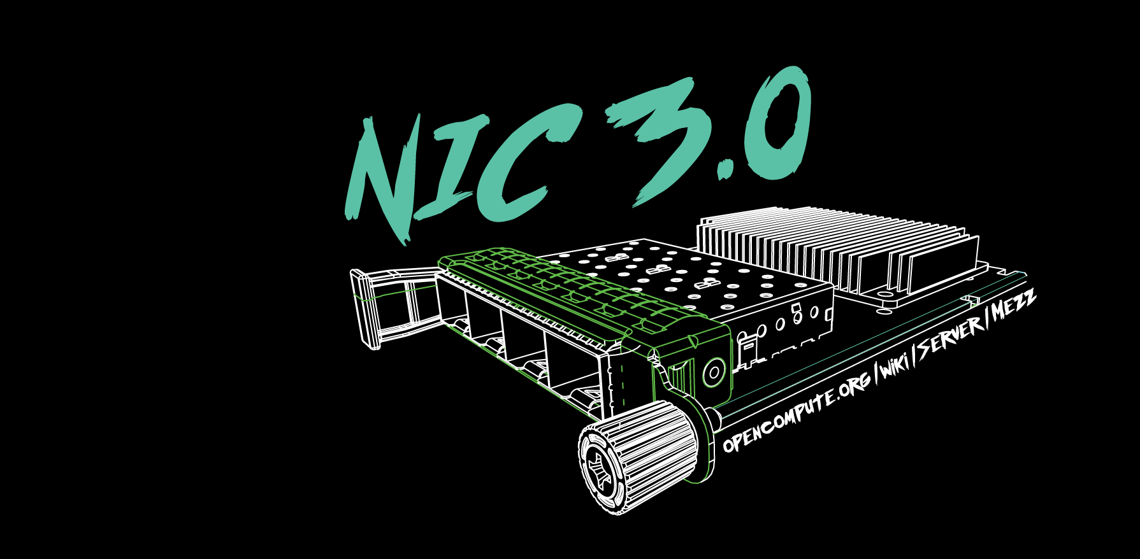

Slide 10
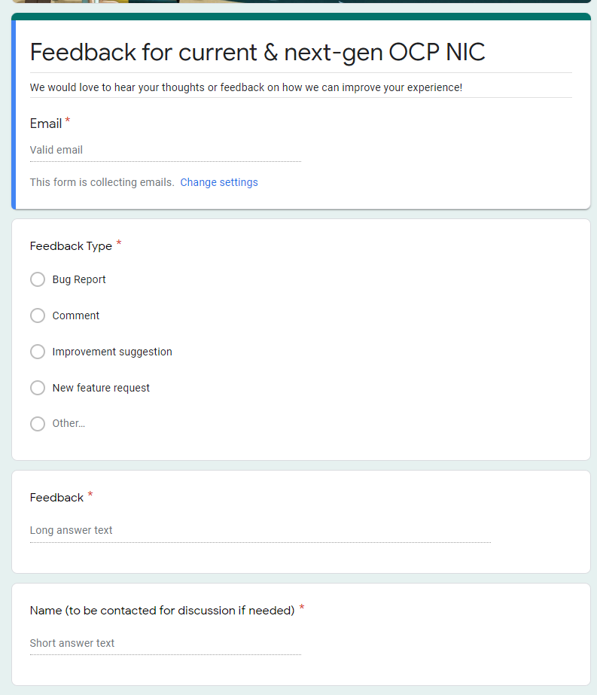
Gather feedback throughout the year
Provide your feedback at: https://tinyurl.com/feedback2ocpnic

