Slide 2
Redfish and OCP Topics
Jeff Autor
Co-Chair, DMTF SPMF
Distinguished Technologist, Hewlett Packard Enterprise

Slide 3
Disclaimer
The information in this presentation represents a snapshot of work in progress within the DMTF.
This information is subject to change without notice. The standard specifications remain the normative reference for all information.
For additional information, see the Distributed Management Task Force (DMTF) website.

Slide 4
Scalable Platforms Management Forum
Created in September 2014 – now 22 member companies
Co-Chairs: Jeff Autor (HPE), Paul Vancil (Dell)
Promoters: Broadcom Limited, Dell, EMC, Emerson, Hewlett Packard Enterprise, Intel, Lenovo, Microsoft, Supermicro, VMWare
Supporters: AMI, Fujitsu, HGST, Huawei, IBM, Insyde Software, Mellanox, NetApp, Oracle, Microsemi, Qualcomm, Seagate
Charter: Create and publish an open industry-standard specification and schema that meets the expectations of Cloud and Web-based IT professionals for scalable platform hardware management utilizing existing tool chains as well as being usable by personnel with minimal experience.
Alliance Partnerships
OpenCompute Project
UEFI - Collaborating on Firmware Update and Host Interface work
SNIA – Collaborating on Storage modeling / alignment between SSM and Redfish

Slide 5
Redfish Specification
RESTful interface over HTTPS in JSON format based on OData v4
Usable by client applications and browser-based GUIs
A secure, multi-node capable replacement for previous interfaces
Schema-backed human-readable output
Covers popular use cases and customer requirements
Intended to meet OCP Remote Machine Management requirements

Slide 6
Redfish v1.0 Specification & Schema
Retrieve “IPMI class” data
Basic server identification and asset info
Health state
Temperature sensors and fans
Power supply, power consumption and thresholds
Discovery
Service endpoint (network-based discovery)
System topology (rack/chassis/server/node)
Basic I/O infrastructure data
Host NIC MAC address(es) for LOM devices
Simple hard drive status / fault reporting
Security
Session-based, leverages HTTPS
Perform Common Actions
Reboot / power cycle server
Change boot order / device
Set power thresholds
Access and Notification
Serial console access via SSH
Event notification method(s)
Logging method(s)
BMC infrastructure
View / configure BMC network settings
Manage local BMC user accounts

Slide 7
Redfish releases
v1.00 Released August 2015
Specification and Schema files
v1.01 Errata Release November 2015
Clarifications to specification, corrected errors in schemas
v1.10 Schema release November 2015
Additions to ComputerSystem, Chassis
v1.02 Errata – in Progress
Will correct schema naming issues (all schemas will be revised)
Clarifications to specification
Expected in Spring 2016 (March/April)
Releases planned for Schema and Specification
Summer 2016 (July/August)
Fall 2016 (November)

Slide 8
SPMF Work in Progress
Significant expansion to data model coverage
PCIe devices
Storage subsystems
Network Adapters / Controllers
DIMM / NV-DIMM inventory
“Task Force” sub-groups created to tackle specific topics
Host (OS) Interface to Redfish – working with DMTF PMCI
Firmware Update – working with UEFI and DMTF PMCI
Storage – working with SNIA
Privilege Mapping
“Integration recipe” target for Redfish implementations
Strong desire for an OCP HW Management conforming property list
Other groups welcome to suggest target recipes

Slide 9
Redfish Ecosystem – Tool Development underway
Github public repository
Coming soon!
Client Library
Common utility support functions
Discovery, Enumeration, etc.
Event subscription
Typical tasks
Power on/off/reboot
Gather thermal data
Languages under consideration
Python
Java
PowerShell
Other possibilities…
Command Line Utility
Similar to IPMItool
Designed for end users
Calls Client library
Conformance Test Suite
Schema-aware tool for testing
Checklist for vendors and customers
Avoid spec interpretation conflicts
Schema Dev Tools
CSDL Validator
CSDL to JSON-Schema converter

Slide 10
“Catfish” Mockup for OCP
Mockup of a monolithic server with a Redfish implementation aligned with OCP Remote Machine Management Spec 1.01
One ComputerSystem
One Chassis
One Manager
Provides basic management features :
Power-on/off/reset
Boot to Pxe, HDD, BIOSsetup (boot override)
4 temp sensors per DCMI (CPU1, CPU2, Board, Inlet)
Simple Power Reading, and DCMI Power Limiting
Fan Monitoring w/ redundancy
Set asset tag and Indicator LED
Basic inventory (serial#, model, SKU, Vendor, BIOSver…)
User Management
BMC management: get/set IP, version, enable/disable protocols

Slide 11
“Catfish” mockup discussion
What Catfish does not have that Redfish 1.0 model supports:
No PSUs in model (RMM spec did not include PSUs)
No ProcessorInfo, MemoryInfo, StorageInfo, System-EthernetInterfaceInfo
No Tasks
JsonSchema and Registries collections left out (since that is optional)
No EventService
Remote Machine Management spec used basic PET alerts
Discussion
Opportunity to define some Redfish ‘Integration Recipes’ that specify
What APIs and properties are supported / required
How to capture

Slide 12
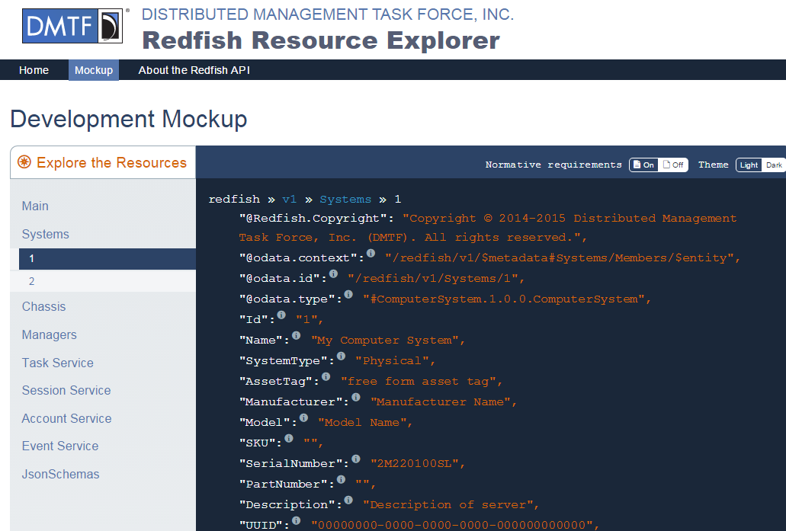
Redfish Resource Explorer
Browser-based Educational tool part of the DMTF web site for Redfish
Explore “mockups” of the Redfish data model
Navigate via links through the model to various resources
Text descriptions are taken directly from the schema files for consistency
http://redfish.dmtf.org

Slide 13
More information and Providing Feedback
Download Specification and Schema: http://www.dmtf.org/redfish
Redfish Developer Information Site: http://redfish.dmtf.org
BrightTalk webinars: https://www.dmtf.org/education/webinars
Introduction to Redfish (25min)
Redfish Data Model Deep Dive (55min)
Modeling the Redfish Way (60min)
Provide feedback through the DMTF feedback portal, on both published specification and “Work in Progress”: http://www.dmtf.org/standards/feedback
Coming Soon – public User Group / Forum
Join the SPMF
By Joining the DMTF and SPMF, you can shape the standard
http://www.dmtf.org/join/spmf

Slide 15
Introduction to the Redfish data model
All resources linked from a Service Entry point (root)
Always located at URL: /redfish/v1/
Major resource types structured in ‘collections’ to allow for standalone, multi-node, or aggregated rack-level systems
Additional related resources fan out from members within these collections
ComputerSystem: properties expected from an OS console
Items needed to run the “computer”
Roughly a logical view of a computer system as seen from the OS
Chassis: properties needed to locate the unit with your hands
Items needed to identify, install or service the “computer”
Roughly a physical view of a computer system as seen by a human
Managers: properties needed to perform administrative functions
aka: the systems management subsystem (BMC)

Slide 16
Resource map (highlights)
/redfish/v1/
/redfish/v1/Systems
Root Resource
Collection of Systems
/redfish/v1/Systems/<id>
1..n
Server Information
Links to all content
“Logical” view of the system
Model #, Serial #, Boot Order, NIC MAC, status, etc.
Session Service
/redfish/v1/Chassis
Processors
Account Service
Collection of Chassis
Disks
JSON Schemas
“Physical” view of the system
NICs
Event Service
/redfish/v1/Chassis/<id>
/redfish/v1/Managers
1..n
Chassis
Collection of Managers
Chassis global physical asset info
BMC functionality
Power
Thermal
/redfish/v1/Managers/<id>
1..n
BMC
System Manager operations
Services
Logs

