Slide 1
OCP Server thermal specs
Discussion for the possibilities
Victor Avelar
Schneider Electric Data Center Science Center

Slide 2
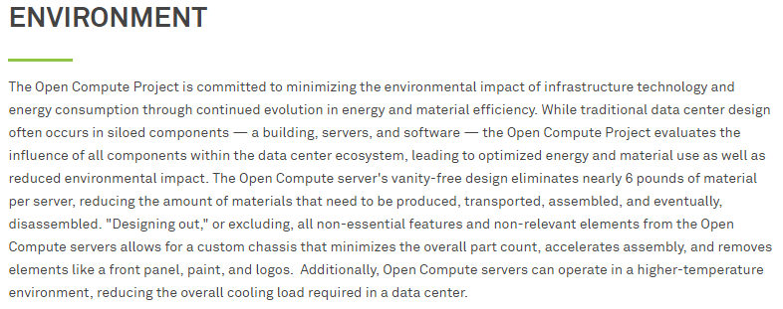
From the Open Compute website…..
Are there design specs to achieve this?

Slide 3
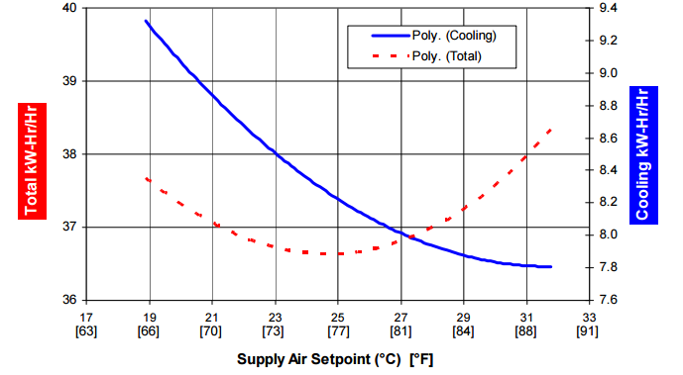
Energy Impact of Increased Server Inlet Temperature APC & Dell White Paper (WP138)
Can an OCP server spec help move the red line down & to the right?

Slide 4
The Unexpected Impact of Raising Data Center Temperatures APC White Paper 221
Improved server thermal specs (CFM / kW) can help here

