Slide 1
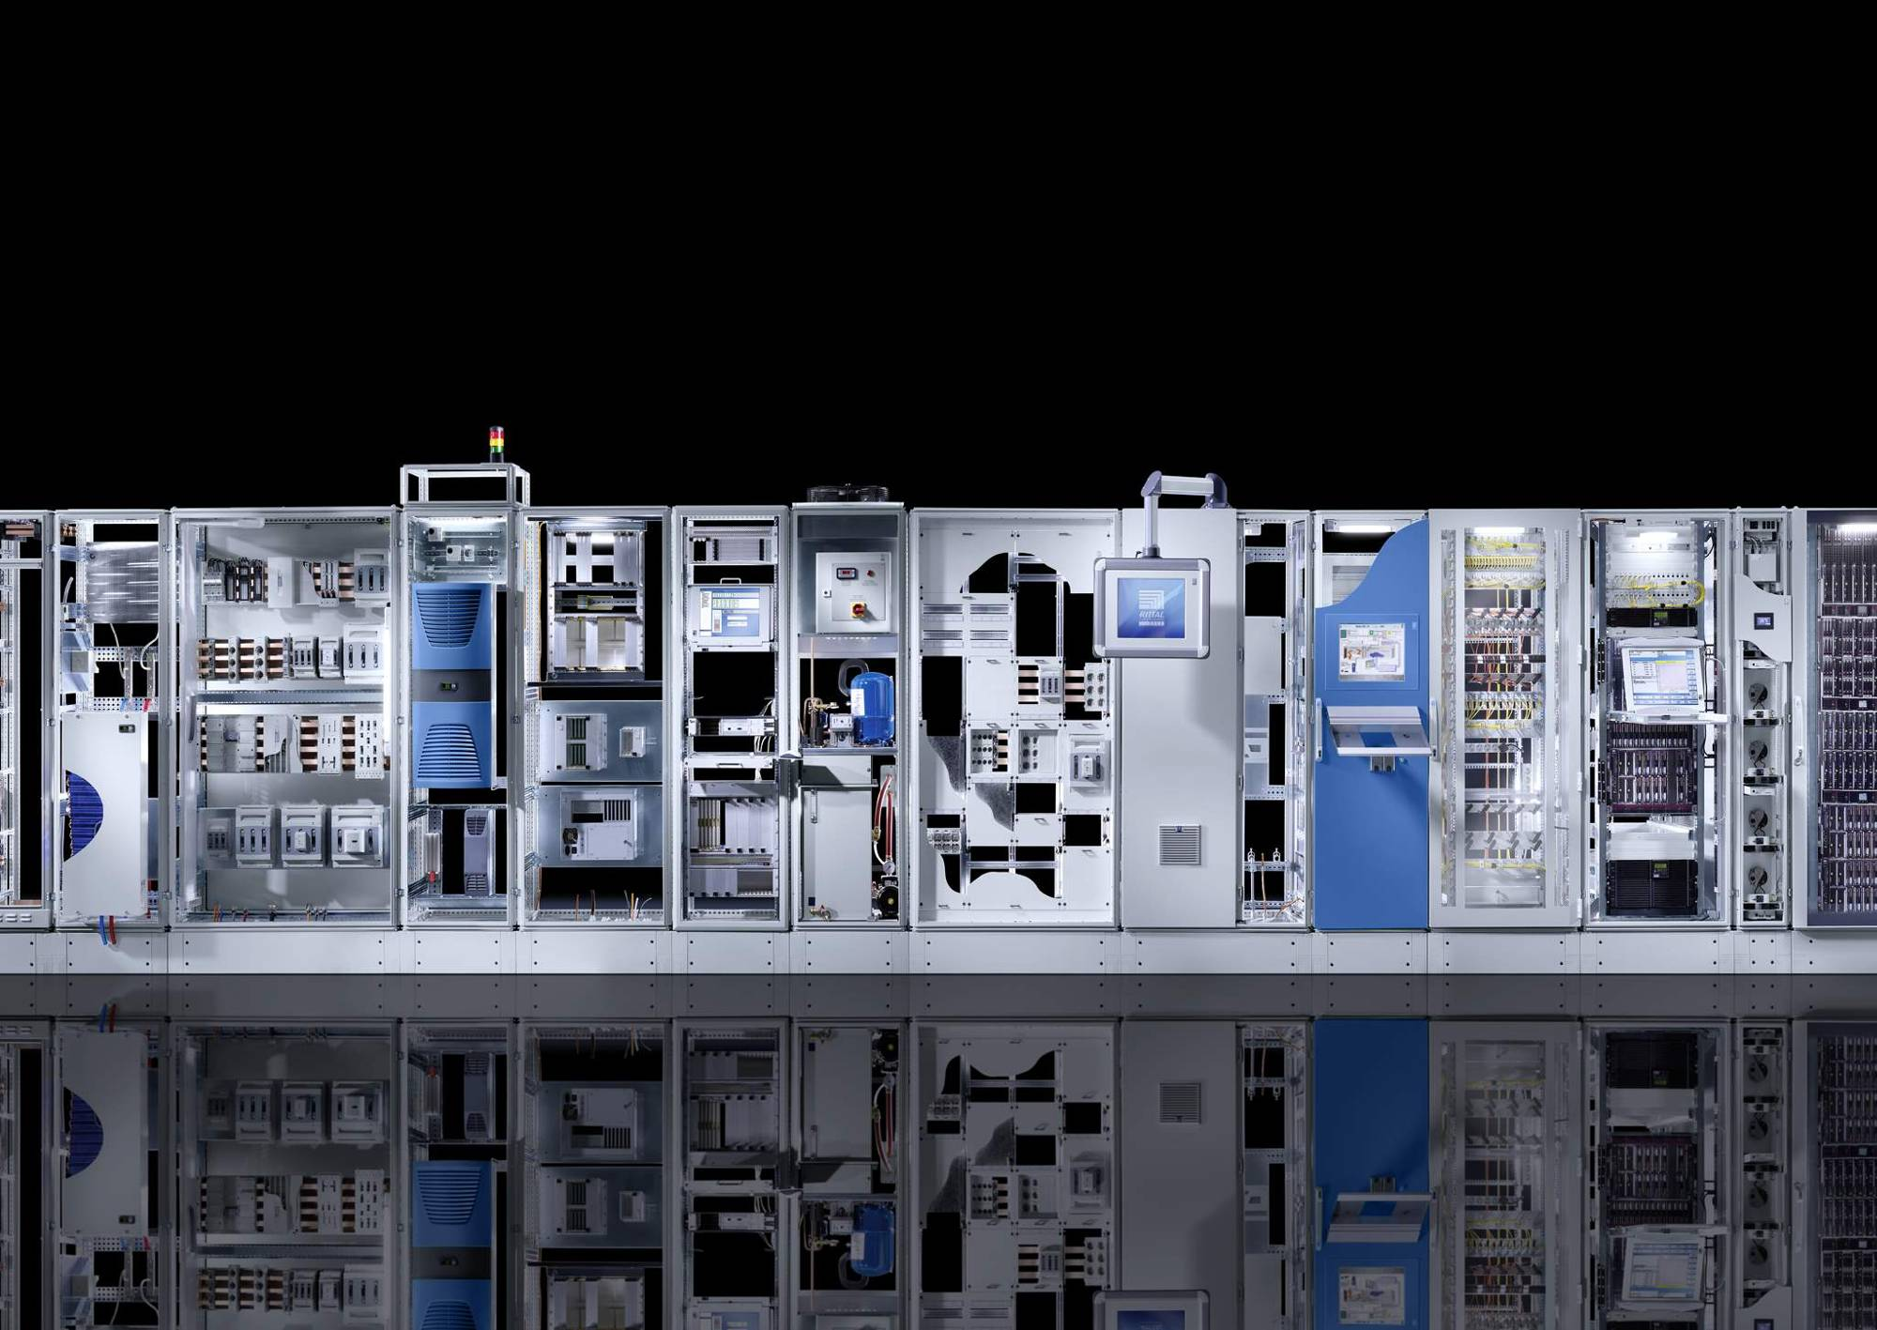
Rittal – The System. Faster – better – everywhere.
Open Rack Standard V2 Specification Proposal:
‘Independent Busbar’
Rittal-CSM/D.Winsor/Sept 2017

Slide 2
OCP Specification
Propose and discuss requirements for the addition to or creation of a specification detailing the interface between Busbar and Enclosure to standardise across the market place enabling a common approach from all suppliers and ease of adoption.
48V added to the Latest OCP specification
Results in potential for 8 SKU levels
In reality only 6 SKU in general terms.
 | 12VDC |  |  |  | 48VDC
Depth | Shallow (30”) |  | Deep (44”) |  | Shallow (30”) |  | Deep (44”)
Power Rating | 13.2kW | 36+kW | 13.2kW | 36+kW | 15kW | 36kW | 15kW | 36kW
Busbar format | No perceived demand for a 12vDC system in a shallow rack |  | 1x busbar solution | Develop the frame to add 3 x busbar systems from low power version | 1x busbar solution | 1x busbar solution | 1x busbar solution | 1x busbar solution
Rittal / D.Winsor /Sept 2017

Slide 3
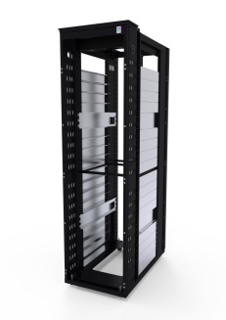
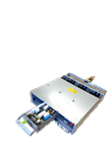
OCP Specification SKU variants
12V/48V
Deep/Shallow
Hi/Low power
1OU Power Shelf
42 Locations
12V/48V
Deep/Shallow
Hi/Low power
3OU Power Shelf
14 Locations
12V potential 112 variants
48V potential 224 variants
Rittal / D.Winsor /Sept 2017

Slide 4
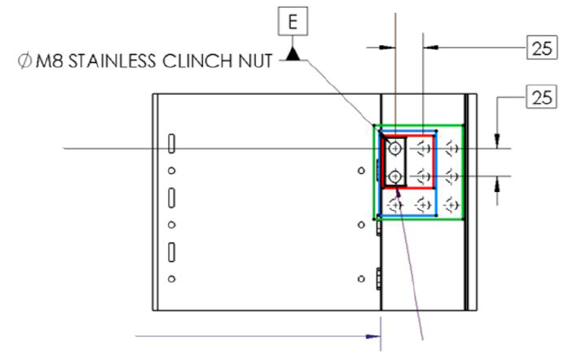
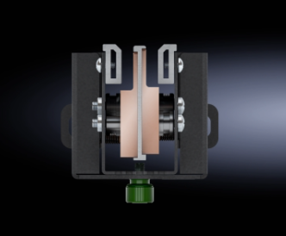
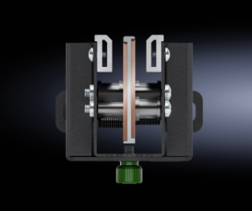
OCP Specification Busbar Interface
Future discussions to be had on Power shelf locations/size/ interface method to help reduce variants in manufacture to enable busbar to cope with variability of customers configs.
Busbar has potential to become independent to the rack specification.
Ensuring the Busbar to Rack interface is common across manufacturers platforms is the first step to ensuring interchangeability of hardware to help reduce variants through manufacture and offer controlled variability to the marketplace.
48VDC/36kW
48VDC/15kW
12VDC/13.2kW
Busbar current options
Rittal / D.Winsor /Sept 2017

Slide 5
OCP Specification Busbar interchangeability

Slide 6
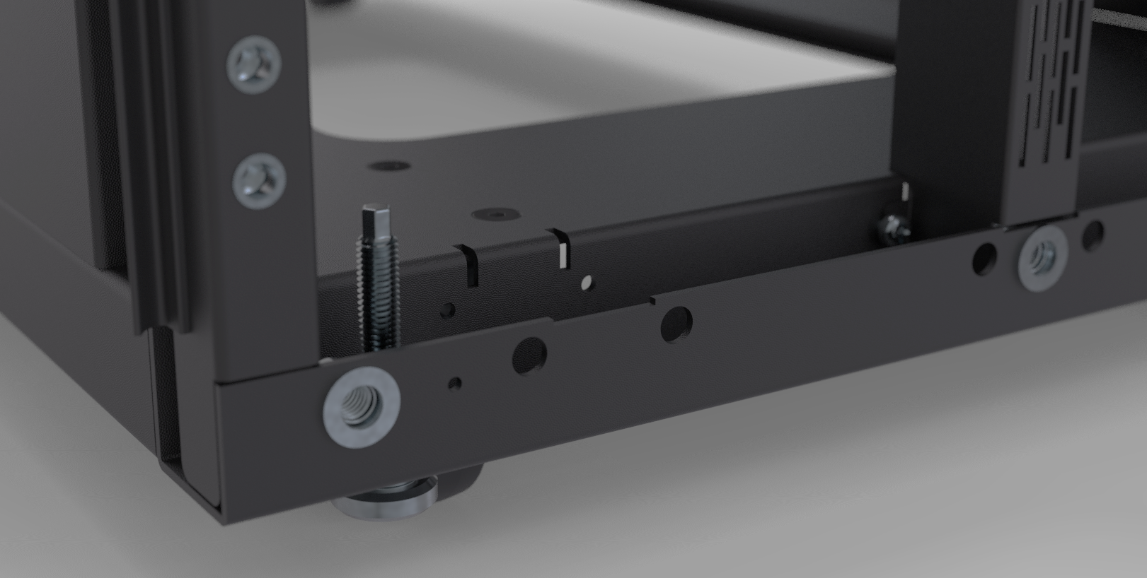
OCP Specification Busbar Interface lower specification

Slide 7
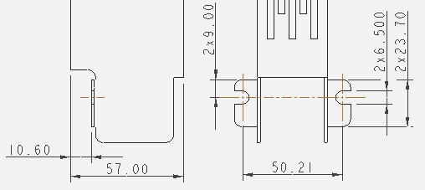
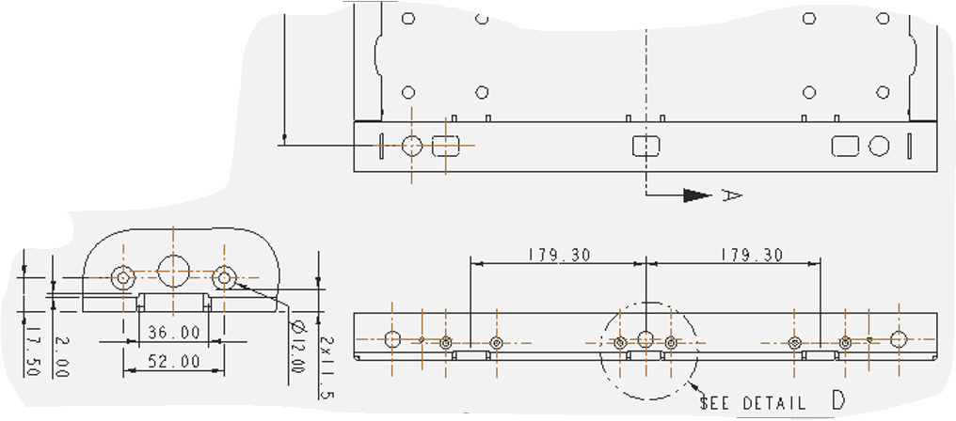
OCP Specification Busbar Interface lower specification
Lower Busbar to Rack interface, common across manufacturers platforms, to be specified in Open Rack Standard.
Secured in position with 2 off M6 thread forming screws @ 5Nm
Busbar interface
Rack interface

Slide 8
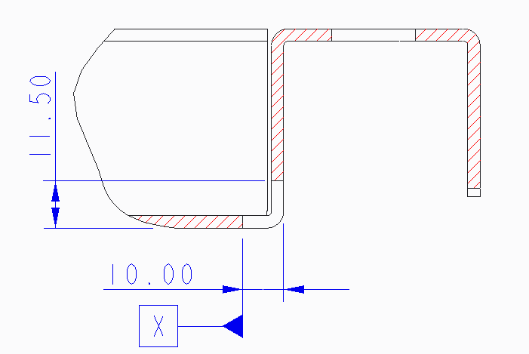
OCP Specification Busbar Interface lower specification
Controlled by piercing
Notes:
Dim A 793.4 / 652.6

Slide 9
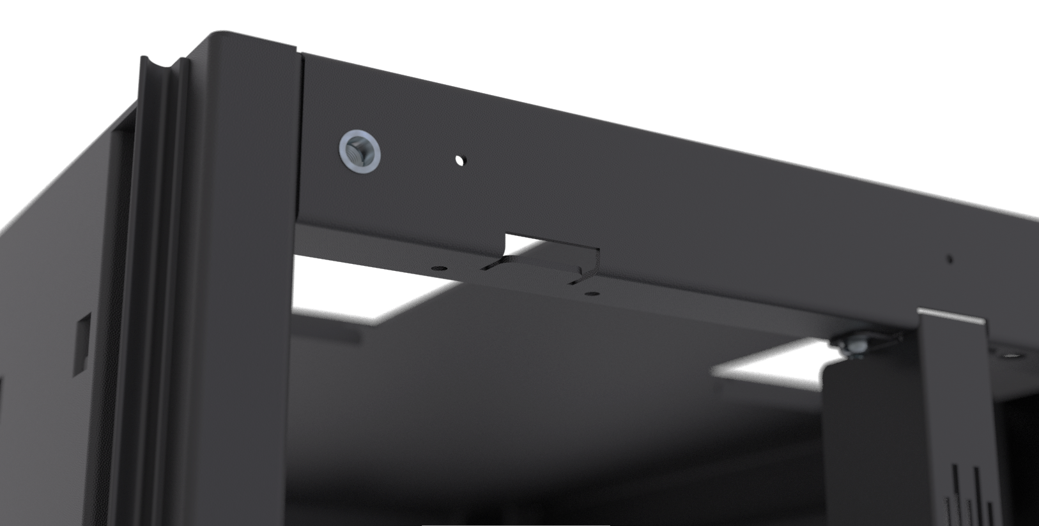
OCP Specification Busbar Interface upper specification

Slide 10
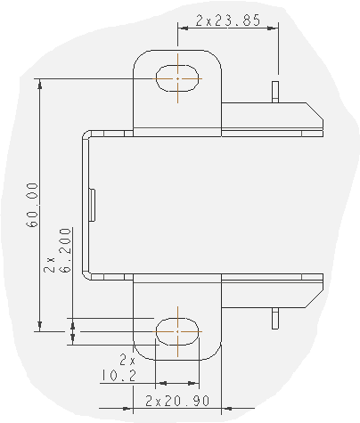
OCP Specification Busbar Interface upper specification
Secured in same manner as lower position, with 2 off M6 thread forming screws @ 5Nm
Rack interface
Busbar interface

Slide 11
OCP Specification Busbar Interface support members
Rack structure capable of supporting central and upper/lower braces
12V central support brace
48V top/btm support brace

Slide 12
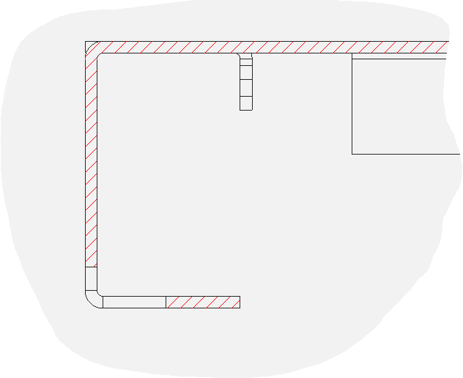
OCP Specification Busbar Interface upper specification
Controlled by jig.
To control Dim A at the top of the busbar becomes more difficult due to piercings being on different planes due to folded section of canopy (accumulation of tolerance).
If Busbars are always to be fitted at Rack manufacturers site and supplied as complete rack unit this poses no issue as jig will control dimension.
However if Busbars are to be complete standalone item, which can be ordered separately from the rack and therefore fitted by the end user as upgrades etc. the top fixing feature needs to eliminate this tolerance accumulation. This can be done by extending the busbar assembly so it interfaces with the same pierced plane that the frame verticals engage into.
Busbar to be procured separately to the Rack?
Do we envisage any need for half height Busbar?

