Slide 1
OCP Mezz 3.0 Mechanical Recommendations
Andrew Junkins / Liang Long Chen / I Lang Cheng
2018-08-28

Slide 2
Lenovo Position
Lenovo supports enumeration #14
Weighing all pros/cons, this is best direction – but mechanical details are critical to broad adoption success
Appears compatible with traditional rear IO general purpose server architectures.
Lenovo has experience with similar solution in our Grantley ThinkServer systems: AnyFabric IO module
Appears compatible with Scorpio architecture
Major Challenges/Concerns:
Transceiver thermals – with constraints outlined on following pages, cage heat-sinks not feasible. Concern for rear IO applications
EMI solution – space very limited to make robust seal

Slide 3
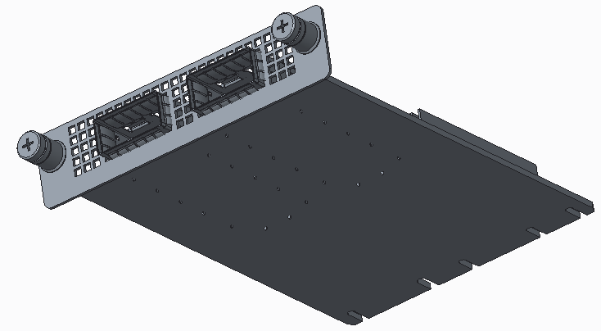
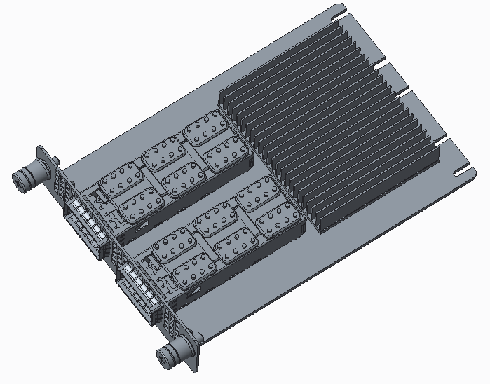
Enum-14 Proposed Enhancement
G
Increase side KO width to 4.2 mm, both sides (see slide 4)
Should these also be defined as ground pads?
Increase length to ~120 mm
110 will be extremely challenging for NIC vendors
Avoid/minimize outriggers overhanging with chassis bulkhead/face-plate.
To maximize MB beachfront availability
Quarter-turn feasible? Wing-nut style touch-point?
OEM neutral color for touch-points?
Connector - TBD
Require Mylar shield (or similar) to protect bottom side components during system installation/removal
Will require KO for Mylar attachment points
Needs to be thin, ~0.25-0.30 mm
Port LEDs should be included
right angle LEDs and avoidance of light pipes preferred
RJ45 latches to be on top side of ports
F
D
A
B
C
E

Slide 4
Guidance System: X-axis Assumptions
Feature to be symmetric
3.5 mm
Module Guides – attached to MB, MB tray, or chassis
NIC PCB
4.2 mm (PCB KO, both sides)
0.40~0.6 mm (nominal gap range)
End View

Slide 5
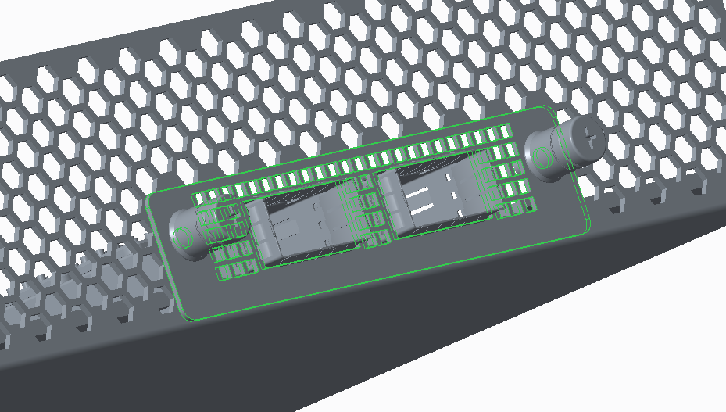
PCBA Keep-out and Faceplate Constraints Proposals
H
J
I
PCB top surface
K
EMI/ESD solution need consideration between OCP rear bracket and chassis rear wall
＜ 12 mm (1U driven: cannot interfere with PCIe card keep out)
＜ 5.2 mm (1U driven: edge cannot extend below chassis base bottom surface)
PCB top side KO ＜ 10 mm (1U driven: rear wall flange clearance during installation/removal) ←Note this precludes port heat-sinks!
PCB bottom side KO ＜ 1.5 mm (1U driven: to clear chassis base during installation/removal)

Slide 6
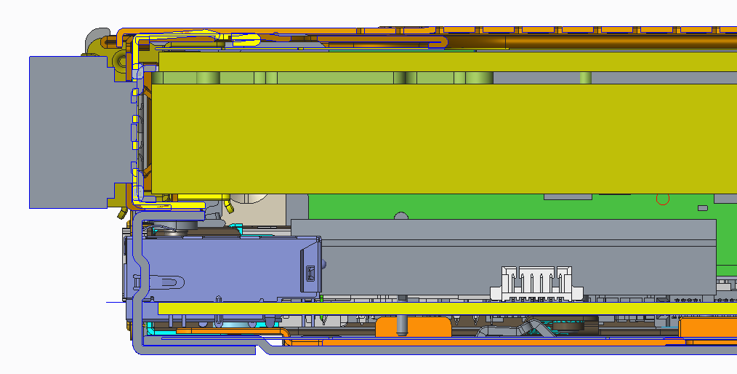
SR630 1U: rear wall x-section viewed from left
PCIe Card
12.89-14.29
10.82
2.8
0
Motherboard
1.57
4.37
6.87
Chassis bottom
2.5

Slide 7
Enumeration 14 Dimensions – as delivered from FB
14.2mm
9.91mm
12.21mm
11.75mm
5.23mm

Slide 8
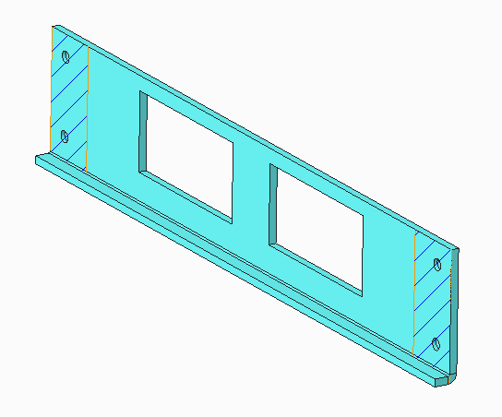
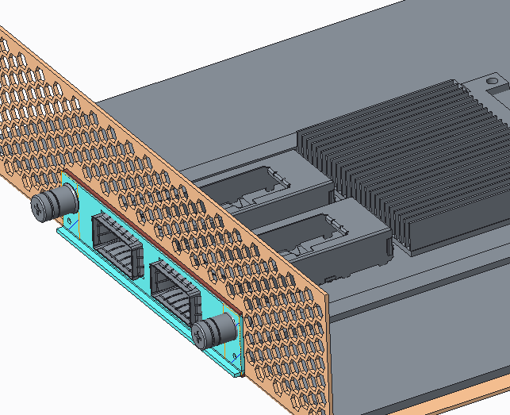
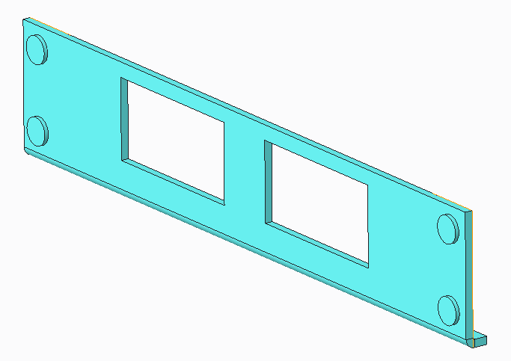
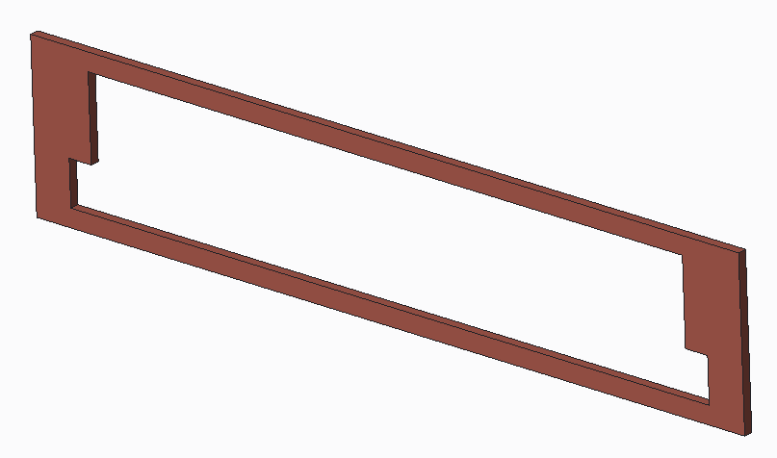
Dual port QSFP
Bracket - Exterior
Flange for stiffness,
1.0mm thk stock
Bracket - Interior
Features to set gasket gap
Chassis EMI Gasket

Slide 9
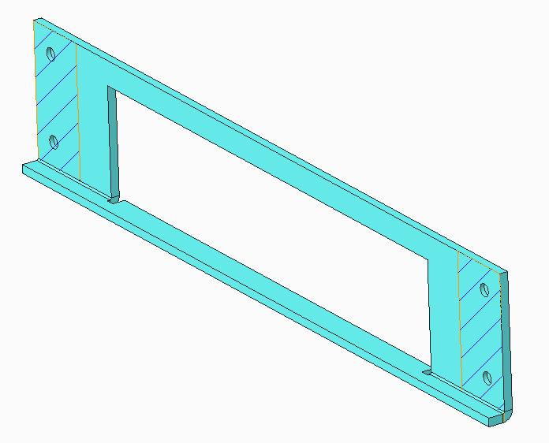
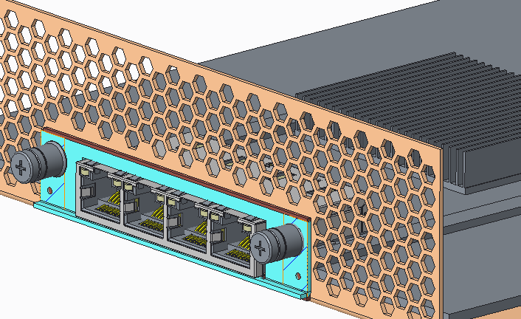
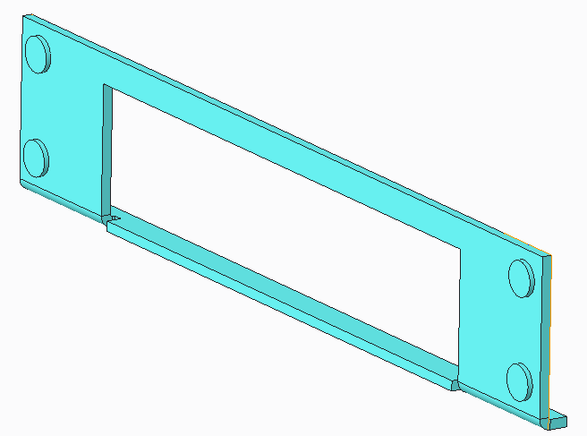
Quad port 10BaseT
Bracket - Exterior
Flange for stiffness,
1.0mm thk stock
Sink mount RJ45
Bracket - Interior
Chassis EMI Gasket
Features to set gasket gap

Slide 10
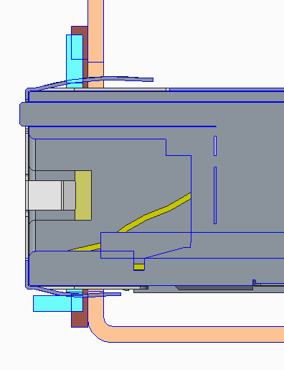
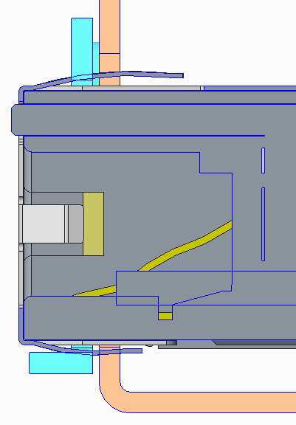
10BaseT – EMI Gasket Interface
EMI sealing is a concern – lack of robust interface
Side View
X-sections
1.65mm
EMI surface overlap
1.25mm
EMI Gasket –
Apply to chassis

Slide 11
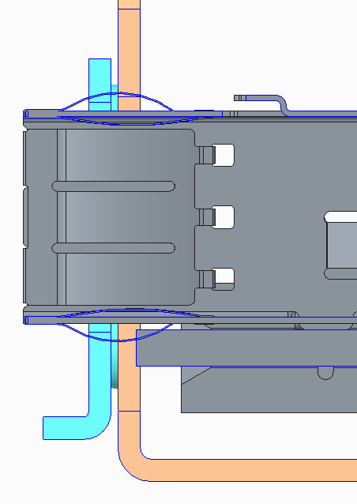
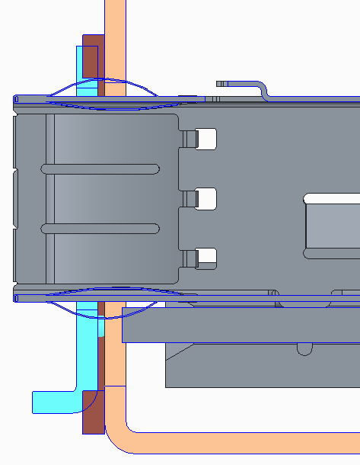
QSFP – EMI Gasket Interface
EMI sealing is a concern – lack of robust interface
Side View
X-sections
1.65mm
EMI surface overlap
Overlap from tangent of bend line
EMI Gasket –
Apply to chassis

Slide 12
Back Up

Slide 13
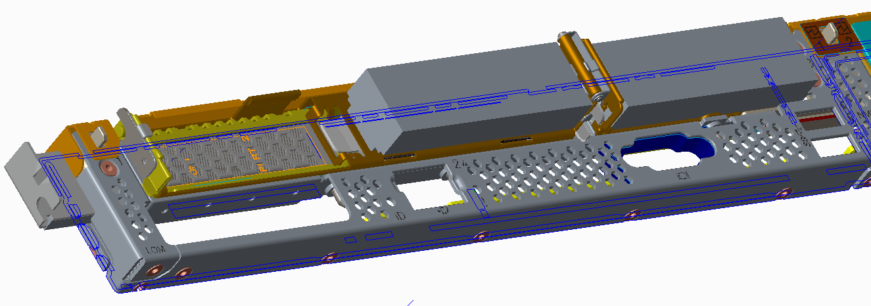
SR630 1U: Rear Wall Construction X-section View
Rear wall (bottom side)
Chassis base (top side)
Planar PCB
Rear wall bar
Rear wall (bottom side)

Slide 14
SR630 1U: rear wall x-section viewed from front
LP PCB
LP PCB
LP PCB
LP Top KO
Rear wall bar
LP Bottom KO
LP Bottom KO
12.7mm
10.8mm
14.3mm
Planar PCB
12.9mm
Chassis base
Rear wall
2.8mm

Slide 15
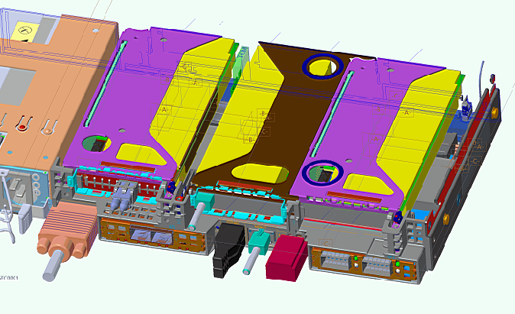
ThinkServer RD550 1U: Rear View with AnyFabric
AnyFabric: x8 PCIe module with rear installation, blind-mate to Mb
AnyFabric modules

