Slide 2
OpenDCRE
Next-Generation Data Center Management
Andrew Cencini & Steven White
VP Engineering / Chief Architect
Vapor IO

Slide 3
Agenda
Overview & Motivation
Hardware
Software
Features
Demo

Slide 4
OpenDCRE – Overview
OpenDCRE: Open Data Center Runtime Environment.
Combination of open-source hardware and software for out of band data center telemetry and management.
Built by Vapor IO and contributed to the community.
Multiple form factors and broad vendor support.
Modern, flexible, easy-to-use.
Uses power line and/or LAN as communications channels

Slide 5
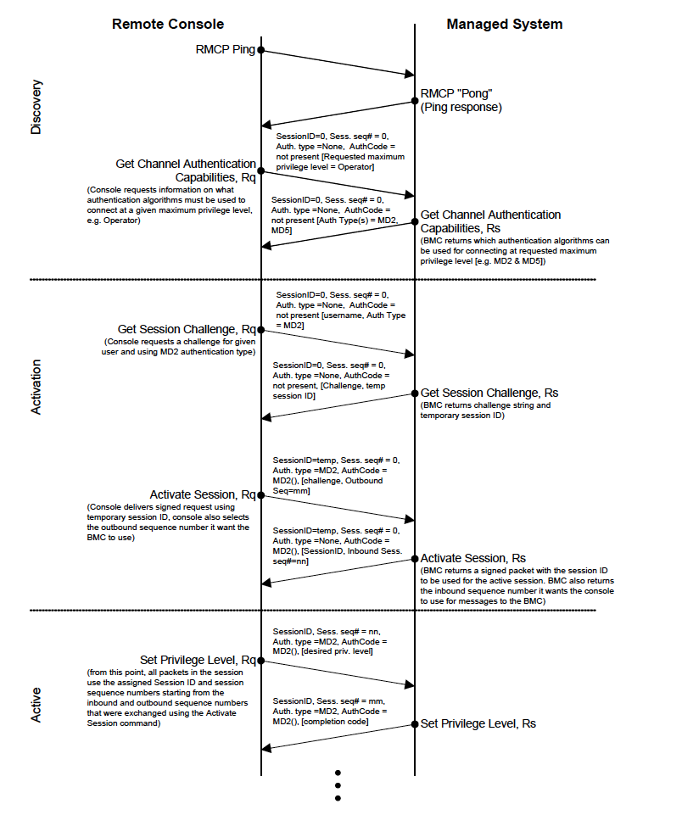
OpenDCRE - Motivation
Out-of-Band Management (IPMI) is painful
Legacy binary protocol (IPMI 1.0: 1998)
Complex and opaque (IPMI 2.0 Spec, 644 pages)
Varied tool support
Requires BMC (Baseboard Management Controller)
Requires OOB Switch, Cabling
OpenDCRE is not painful!
Securable, GPLv2 RESTful API, hardware and
Linux Distribution for data center management.
NO BMC, TOR Switch, Cabling (PLC Comms)
IPMI 2.0 Specification, Intel (2013)

Slide 6
OpenDCRE - Motivation
The world runs on REST
DevOps tasks tend to fall into the same broad categories
Sensor reading
Power control
Inventory/Provisioning
OCP OpenRack bus bar makes for great communications channel
Related work:
Redfish (HP)
OpenBMC (Facebook)
http://i.imgur.com/o0lb2ek.jpg

Slide 7
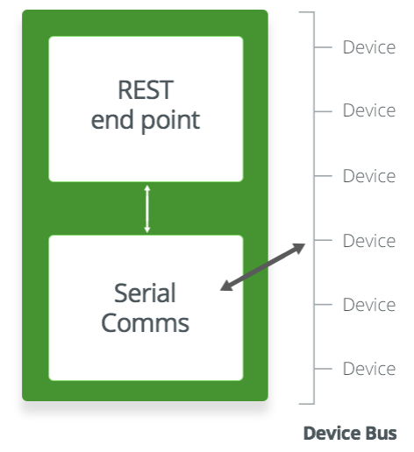
OpenDCRE - Software
OpenDCRE
Runs as Docker container on OpenMistOS
Serial Communications via GPIO to HAT
HAT uses PLC to communicate with device bus
REST Endpoint for interacting with bus:
Scan, read sensors, power control, etc.
Can drop in TLS Certs for SSL, integrate with OAuth via config as well (Nginx/uwsgi)
Emulator included for evaluation w/o HW
Configurable (JSON), automatically runs in absence of HAT
GPLv2, integrated into OMOS.

Slide 8
OpenDCRE – API/Features
Version: Get HW/API/SW version
Scan: Enumerate items connected to the bus
Read: Read and interpret a given sensor or device attached to bus
Temperature, humidity, fan speed, power consumption
Power: Turn power on, off, cycle, and get status
Voltage, current, on/off, over/under voltage/current
Asset: Asset and hardware information
Boot Target: Set/get boot target for PXE/HDD boot for provisioning, etc.
LED: Toggle chassis LED for visual location/verification, remote service
Fan: Control fan speed

Slide 9
OpenDCRE REST API Examples
https://host:port/opendcre/1.2/power/1/1[/{on|off|cycle|shutdown|status}]
https://host:port/opendcre/1.2/read/thermistor/1/2
https://host:port/opendcre/1.2/asset/1/5
https://host:port/opendcre/1.2/led/1/7[/{on|off}]
https://host:port/opendcre/1.2/fan_speed[/speed_rpm]

Slide 10
OpenDCRE – The Gateway Drug…
OpenDCRE v1.2 – IPMI 1.5/2.0 Support
All features of OpenDCRE
Auth: None, Password, MD2, MD5, RAKP_HMAC_SHA1
Integrity: None, HMAC_SHA1_96
Encryption: None, AES_CBC_128
Virtually unlimited #BMCs from single OpenDCRE endpoint
Redfish & OpenBMC support coming soon
http://sr.photos3.fotosearch.com/bthumb/CSP/CSP991/k12456743.jpg

Slide 11
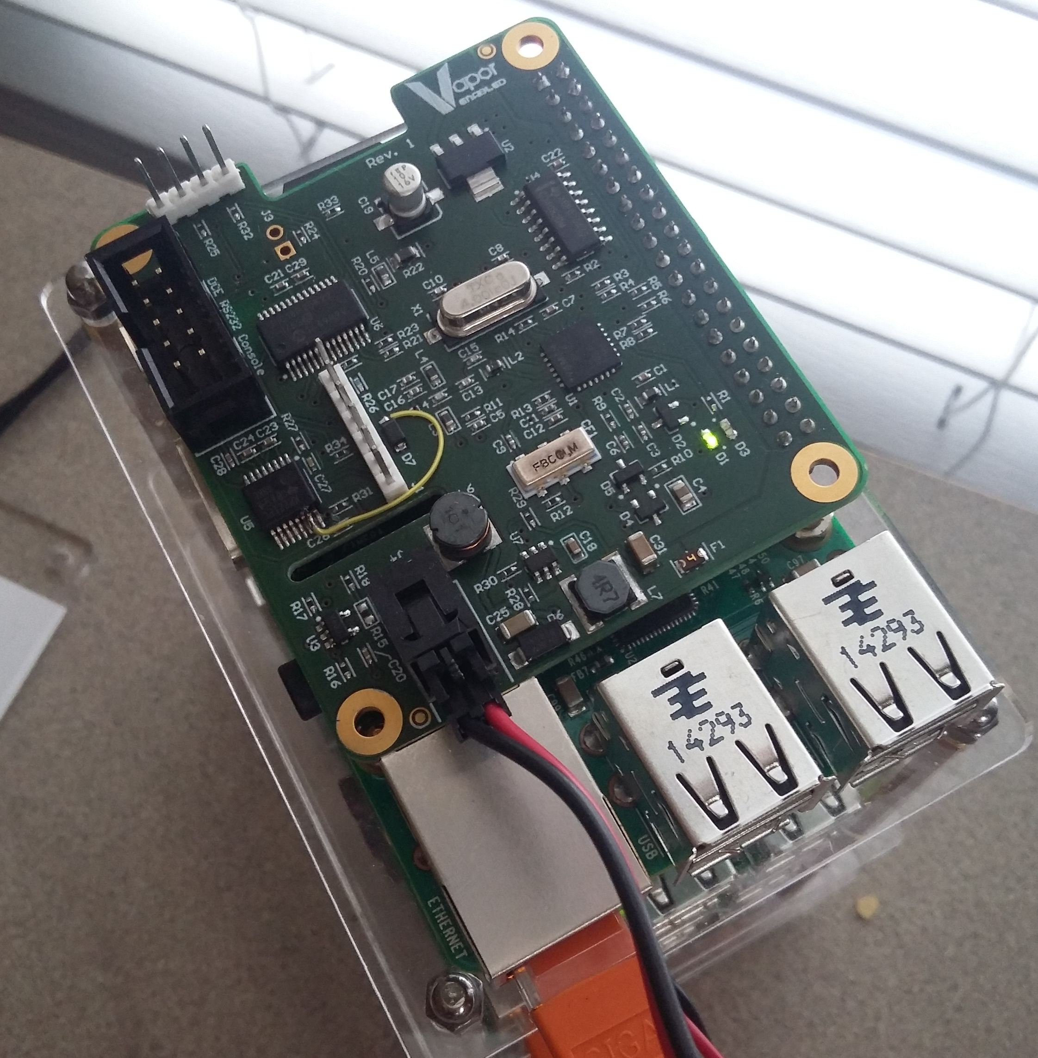
OpenDCRE - Hardware
Raspberry Pi 2 Model B
OpenDCRE HAT Board
Power-Line Communications (PLC)
Sensors/Devices
Temperature (thermistor)
Power Control (OCP)
Other hardware – fans, LED, etc.
Open-Source HW (OCP)

Slide 12
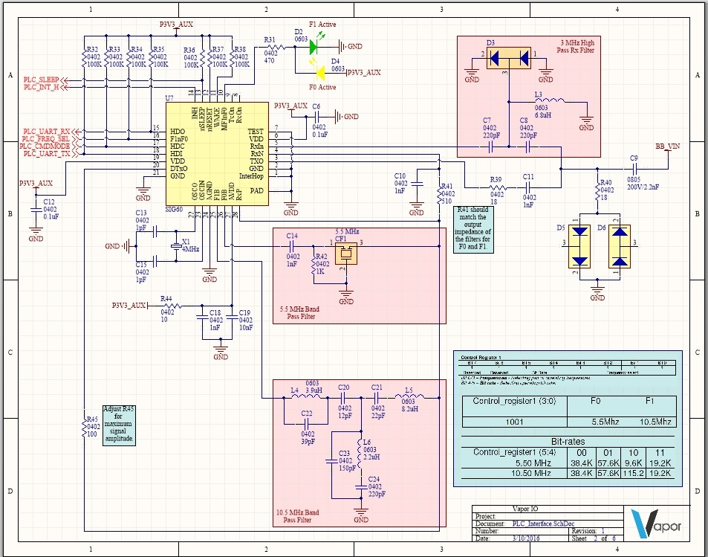
Power Line Communications
Based on Yamar SIG60
Tightly integrated design
Two frequency choices
Optimized for noisy 12VDC automotive environments
Simple control through a UART connection with 4 additional GPIO
Low power with sleep capability

Slide 13
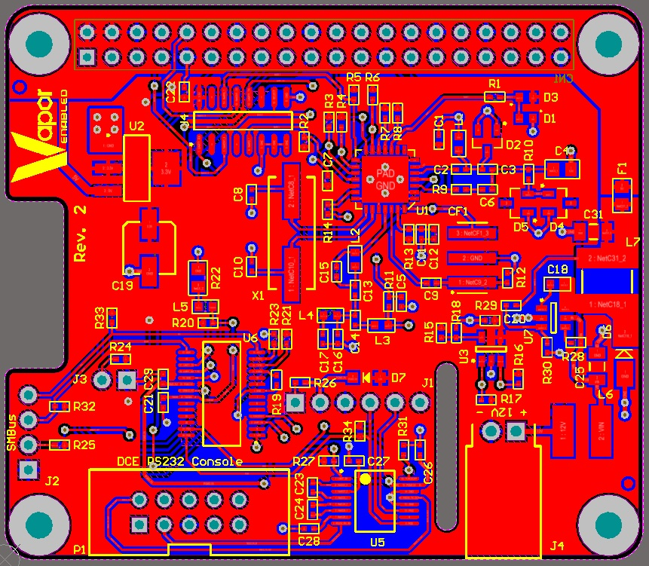
PCB Layout
Pi HAT (Hardware Attached on Top) compliant form factor
EEPROM for identification and auto-configuration in the operating system
Simple 2 layer layout
Only top side components
Connections for RS232 and SMBus
Switching between PLC and onboard microcontroller for firmware development
Powered completely from 12VDC

Slide 14
OpenDCRE - Demo

Slide 15
Future
OpenDCRE 1.2 Release – March 10, 2016
Community contributions – additional device types, sensors, etc.
Additional form factors to be announced
OpenMistOS for Raspberry Pi – wheezy to jessie migration.
Docker-compose support.
Additional integrations (OpenStack, etc.).
Further support for 19” environments, Redfish, OpenBMC.
GitHub: https://github.com/vapor-ware/opendcre

Slide 16
Thank You
Questions?
Contact:
Andrew Cencini
andrew@vapor.io
Steven White
steven@vapor.io

Slide 17
Thank You

