Slide 1
BIG SUR
An OCP GP-GPU Server
Kevin Lee
Technical Program Manager, Facebook
Marcos Peixoto
Infra Product Partnerships ManaGer, Facebook

Slide 2
What is Machine Learning?

Slide 3
How do computers solve these problems?
Artificial Neural Networks
Basic model has not evolved much since the 1950s
The first learning machine: Frank Rosenblatt’s Mark I Perceptron, built at Cornell in 1958
The vast majority of practical applications of machine learning today use template matching

Slide 4
Use cases:
Image Recognition and caption
Audio Fingerprinting
Speech Recognition
Language understanding and modeling
Machine Translation
Video Classification

Slide 5
Additional GP-GPU use cases:
Oil and Gas - Seismic processing
Banking / Financial – Fraud detection
Automotive - Self driving cars
Medical/Pharma - Diagnosis, Drug discoveries
Defense / Intelligence – Weapon simulations, Homeland security
Data Science / Analytics – Comb thru Big Data

Slide 6
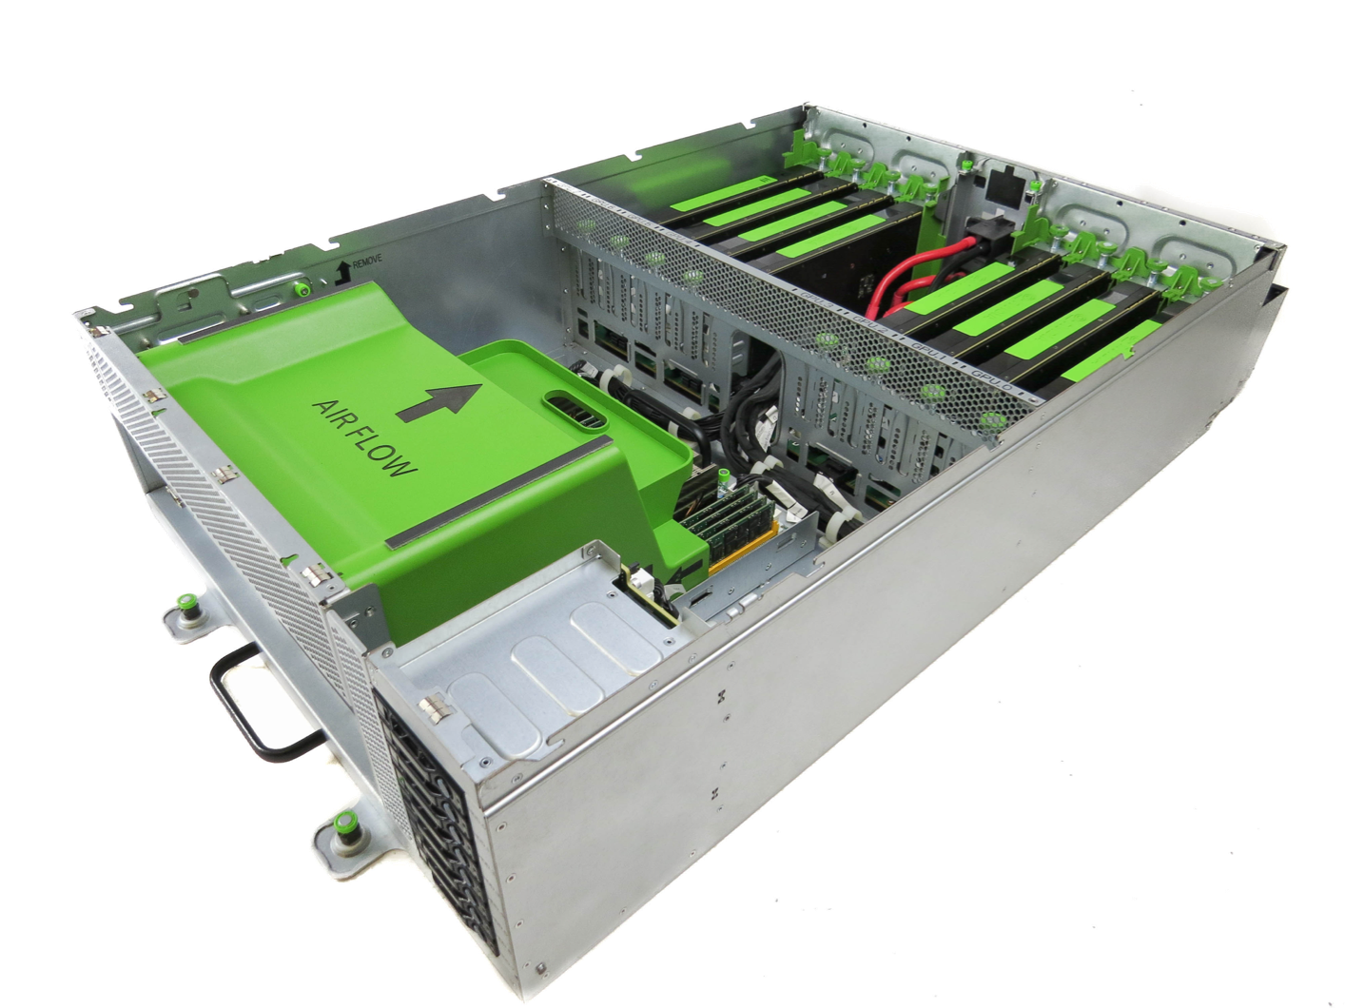
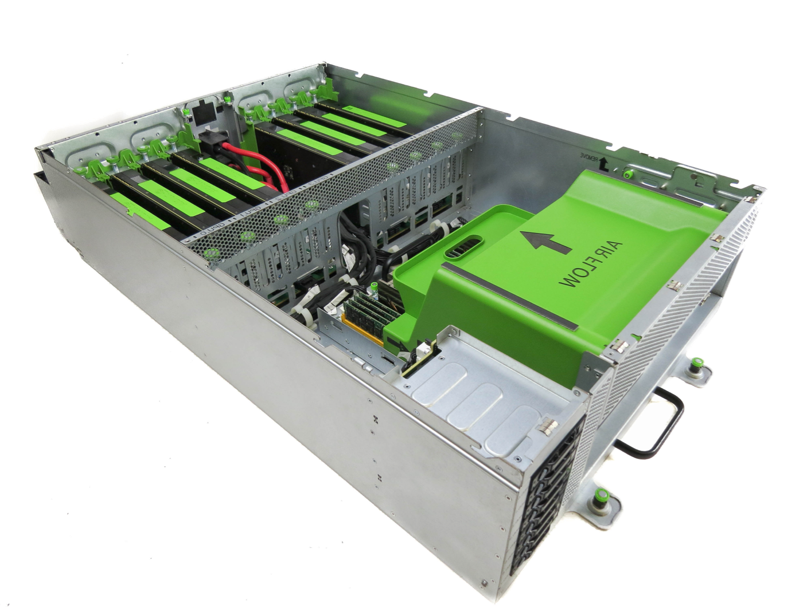
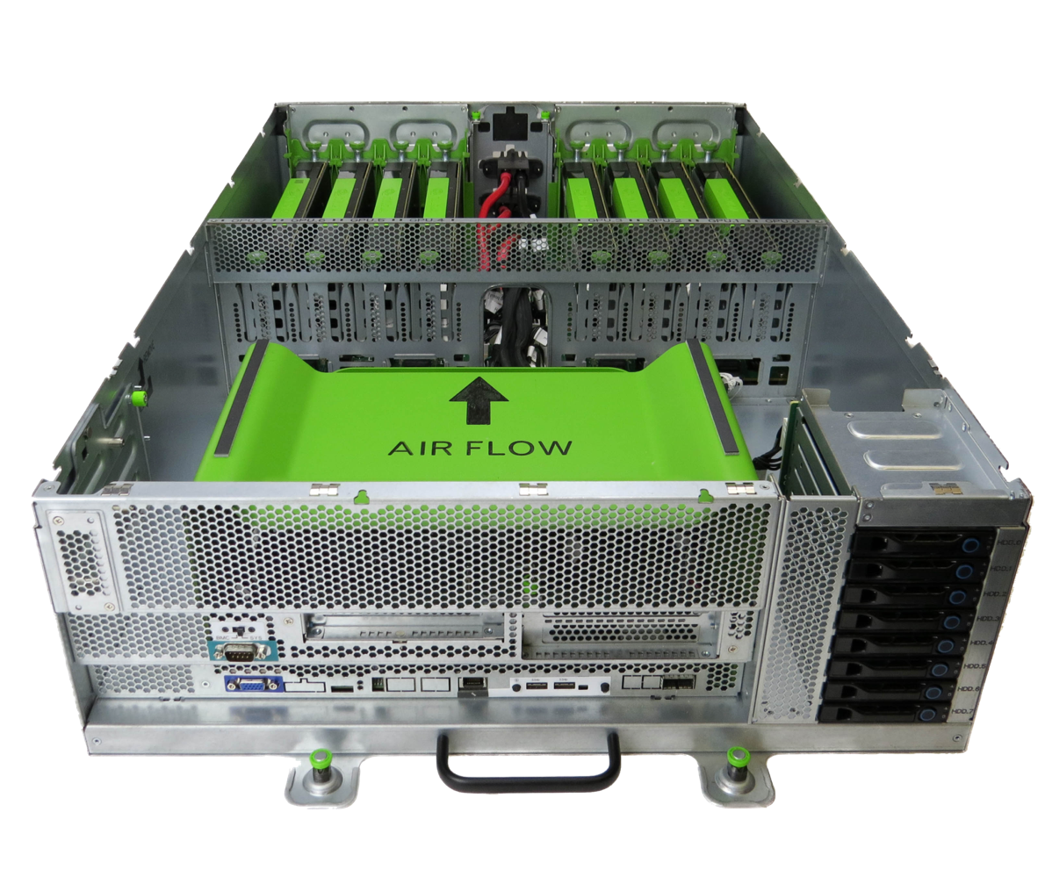
Big Sur

Slide 7
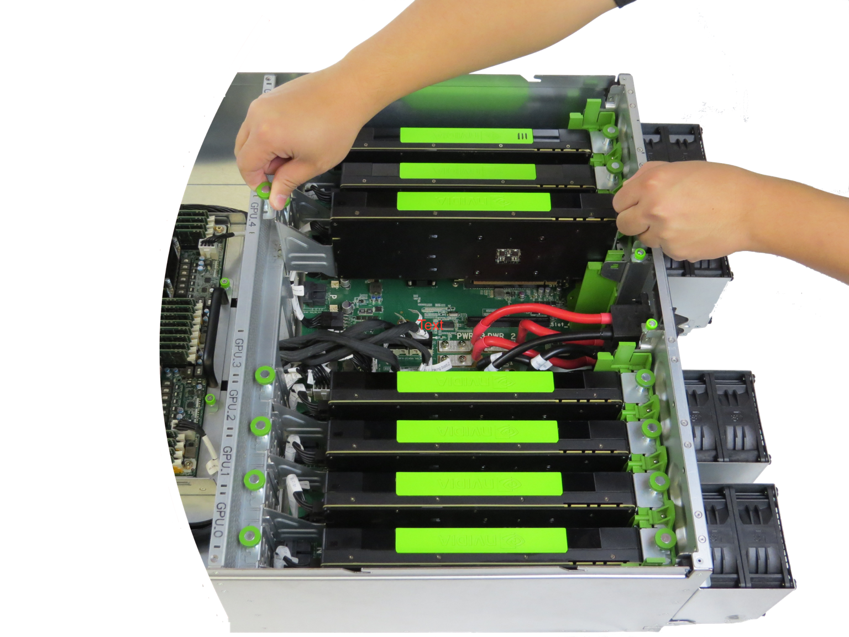
Big Sur
Specifications
Supports up to 8 PCI-e Gen3 full height, dual-slot cards
Designed to support dual socket SSI EEB compliant server motherboard
Can host up to 300W acceleration cards per slot
Open Rack v2 compatible; 4OU chassis
8 x 2.5” SATA drives

Slide 8
Power
SAS/STA
Lanes
SMB
PCIE
PCIE x16 Riser Slot
Big Sur
1x2MINISAS HD*2
X16 PCIE
1x2MINISAS HD*2
PCIE x16 Riser Slot
PEX8796
PCIE x16 Riser card
PCIE x16 Riser Slot
PCIE x16 Riser Slot
Architecture
1x2 MINSAS HD *2
Motherboard
PCIE x16 Riser Slot
PCIE x16 Riser Slot
PEX8796
PCIE x16 Riser Slot
PCIE x16 Riser Slot
3
1x2 MINSAS HD *2
major areas:
SMB_PMBUS
5Pin CONN
SMB_PMBUS
5Pin CONN
SMB_PMBUS
HOT SWAP
BMC
SMB_IPMB
CA9548A
PCA9548A
SMB_Slot 0-7
7Pin CONN
SMB_IPMB
7Pin CONN
SMB_IPMB
PCA9548A
Motherboard
Linking board
HDD/SSD backplane
P12V,PSV,PSV_STBY_P3V3
MINISAS CONN *2
W83795G
SATA Lanes x8
VR
P1V8
VR
P12V
Temp
sensor
VR
P0V9
VR
PSV_STBY
FRU
1x2 MINSAS HD
VR
P3V3
VR
P3V3_STBY
HDDx8
P12V,PSV
VR
PSV
FAN
FRU
Temp
sensor
SMB_BP
4Pin CONN
SMB_9548A
4Pin CONN
SMB_9548A
HDD Back Plane
GPGPU Linking Board

Slide 9
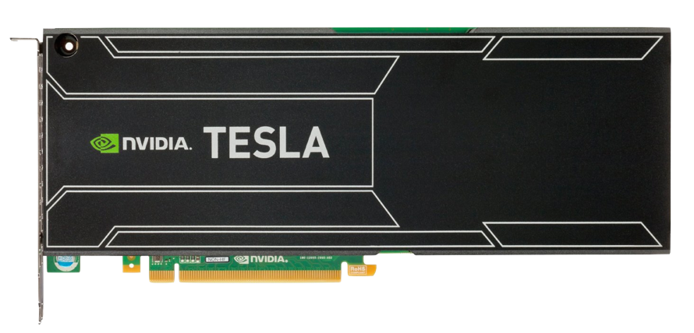
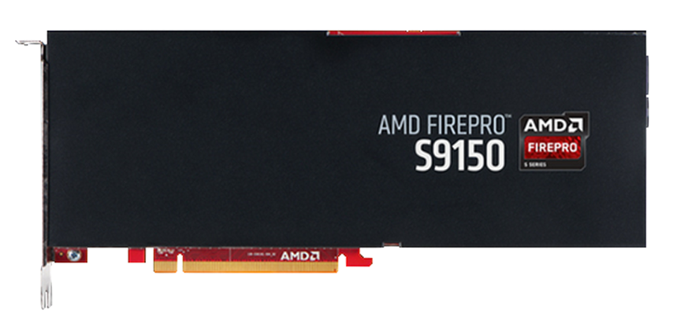
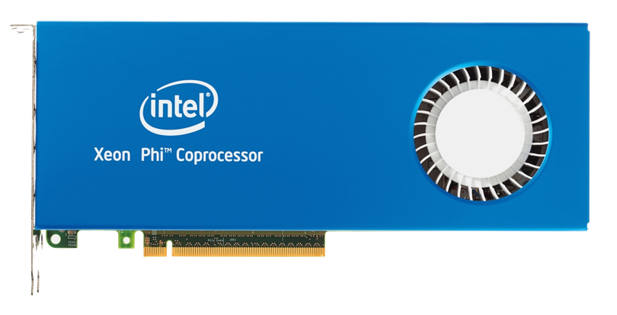
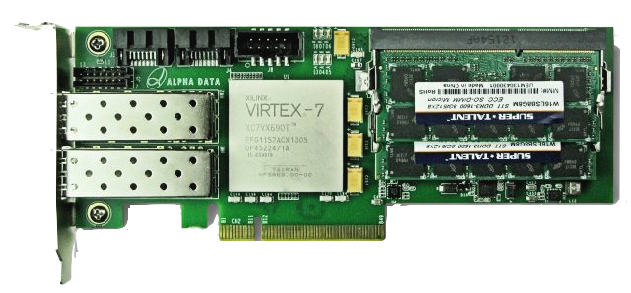
Big Sur
Modularity
Supports up to 8 PCI-e Gen3 full height, dual-slot cards

Slide 10
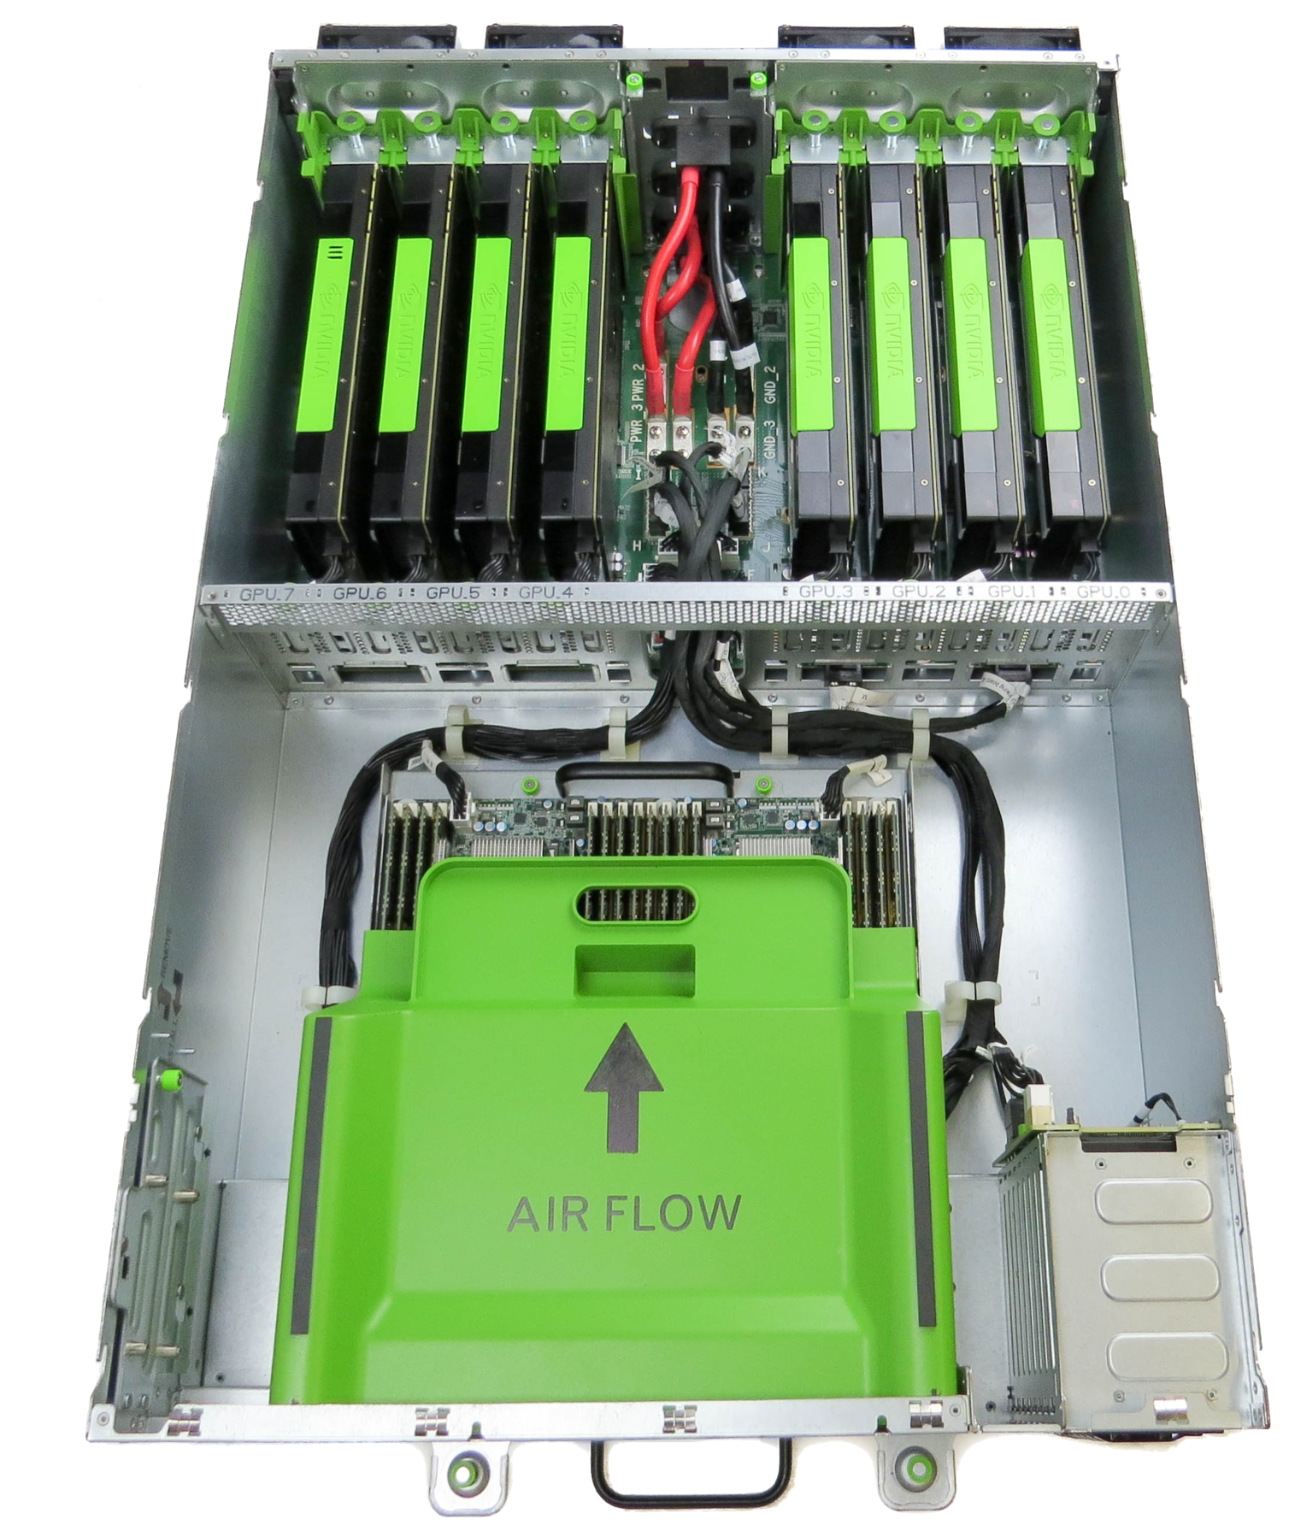
Big Sur
Modularity
Supports dual socket SSI EEB compliant server motherboards
12in (305mm)
13in (330mm)

Slide 11
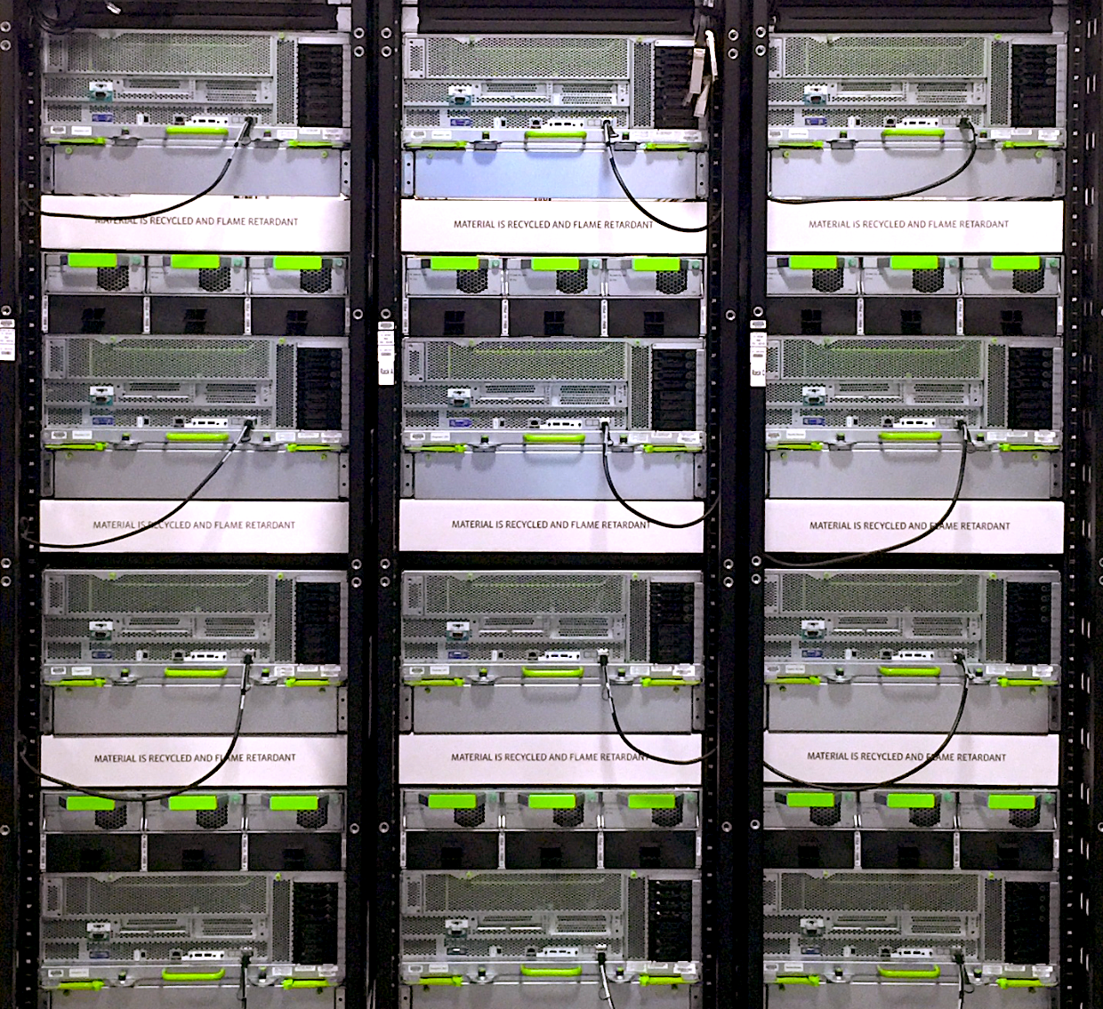
Big Sur
Modularity
Open Rack v2 compatible

Slide 12
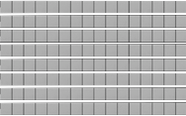
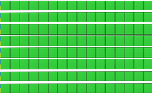
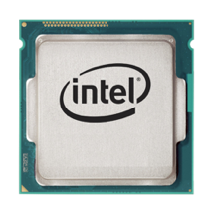
Big Sur
Flexible topology
System
Memory
GPU0
Memory
GPU1
Memory
GPU2
Memory
GPU3
Memory
Direct memory access
Direct memory transfers
One address space for CPU and GPU memory
0x0000
0xFFFF
Load/Store
GPU0
GPU1
GPU2
GPU3
CPU
PCI-e

Slide 13
Big Sur
Flexible topology (GPUs)
Balanced config
NIC
x16
GPU0
x8
x16
GPU1
PEX8796
x16
GPU2
x16
GPU3
x16
x16
x16
GPU4
x16
GPU5
PEX8796
x16
x16
GPU6
x8
GPU7
RAID

Slide 14
Big Sur
Flexible topology (GPUs)
Balanced config
NIC
x16
GPU0
x8
x16
GPU1
PEX8796
x16
GPU2
x16
GPU3
x16
x16
x16
GPU4
x16
GPU5
PEX8796
x16
x16
GPU6
x8
GPU7
RAID

Slide 15
Big Sur
Flexible topology (GPUs)
Balanced config
Common config
NIC
x16
GPU0
NIC
x16
GPU0
x8
x16
GPU1
x8
x16
GPU1
PEX8796
x16
GPU2
PEX8796
x16
GPU2
x16
GPU3
x16
GPU3
x16
x16
x16
x16
GPU4
x16
GPU5
PEX8796
x16
x16
GPU4
x16
GPU6
x16
x16
GPU7
PEX8796
GPU5
x16
x16
GPU6
x8
GPU7
x8
RAID
RAID

Slide 16
Big Sur
Flexible topology (GPUs)
Balanced config
Common config
Cascaded config
NIC
x16
GPU0
NIC
x16
GPU0
NIC
x16
GPU0
x8
x16
GPU1
x8
x16
GPU1
x8
x16
GPU1
PEX8796
x16
GPU2
PEX8796
x16
GPU2
PEX8796
x16
GPU2
x16
GPU3
x16
GPU3
x16
GPU3
x16
x16
x16
x16
GPU4
x16
x16
GPU4
x16
x16
PEX8796
GPU5
PEX8796
GPU5
x16
x16
x16
GPU6
x16
GPU4
x16
GPU6
x16
GPU7
x16
GPU5
GPU7
PEX8796
x16
x16
GPU6
x8
GPU7
x8
x8
RAID
RAID
RAID

Slide 17
Big Sur
Flexible topology (NICs)
Balanced config
Balanced config (Optimized for RDMA)
NIC
x16
GPU0
x16
GPU0
x8
x16
GPU1
x16
GPU1
x16
GPU2
PEX8796
x16
GPU2
PEX8796
x16
x16
GPU3
x16
x16
GPU3
x16
NIC
x16
GPU4
x16
x16
GPU4
x16
x16
x16
PEX8796
GPU5
PEX8796
GPU5
x16
x16
x16
GPU6
x16
GPU6
x8
x8
x16
GPU7
RAID
GPU7
RAID
NIC

Slide 18
Big Sur
Flexible topology (NICs)
Common config
NIC
x16
GPU0
x8
x16
GPU1
PEX8796
x16
GPU2
x16
GPU3
x16
x16
x16
GPU4
x16
GPU5
PEX8796
x16
x16
GPU6
GPU7
x8
RAID

Slide 19
Big Sur
Flexible topology (NICs)
Cascaded config
Cascaded config (Optimized for RDMA)
NIC
x16
GPU0
x16
GPU0
x8
x16
GPU1
x16
GPU1
PEX8796
x16
GPU2
x16
GPU2
x16
PEX8796
x16
x16
GPU3
GPU3
x16
GPU4
x16
x16
GPU4
x16
GPU5
x16
GPU5
PEX8796
x16
PEX8796
x16
x16
GPU6
x16
GPU6
GPU7
x16
GPU7
NIC
x8
x8
RAID
RAID

Slide 20
GPU0
x16
GPU1
x16
Big Sur
GPU2
x16
PEX8796
GPU3
x16
x16
x16
Flexible topology (NICs)
GPU4
GPU5
x16
x16
PEX8796
Cascaded config (optimized for RDMA)
GPU6
x16
GPU7
x16
NIC
x16
x8
RAID
x16
GPU0
GPU0
x16
x16
GPU1
GPU1
x16
x16
GPU2
SWITCH
GPU2
x16
PEX8796
PEX8796
x16
x16
GPU3
GPU3
x16
x16
GPU4
GPU4
x16
x16
x16
GPU5
GPU5
x16
PEX8796
x16
x16
PEX8796
x16
GPU6
GPU6
x16
x16
GPU7
GPU7
x16
x16
NIC
NIC
x16
x8
x8
RAID
RAID

Slide 21
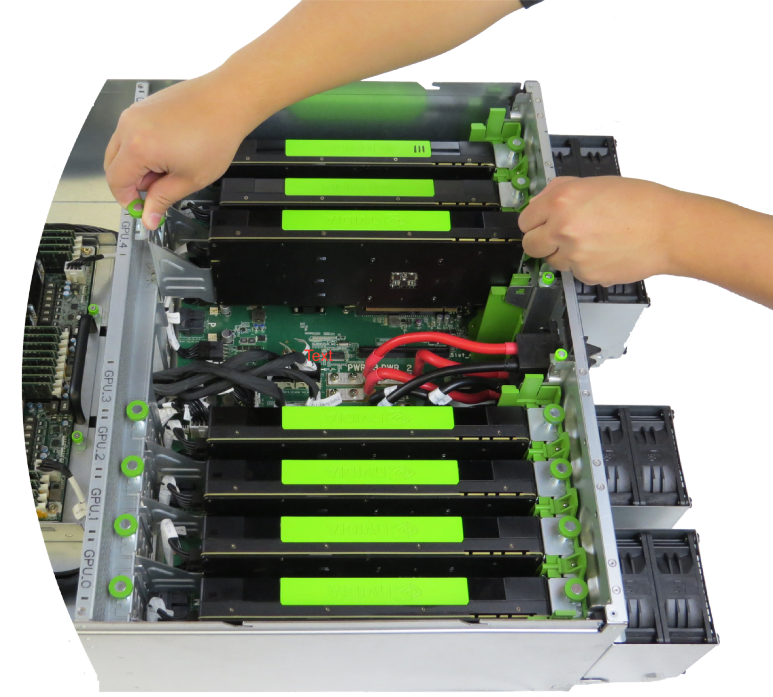
Big Sur
Design methodology
Serviceability
Thermal efficiency
Performance

Slide 22
Big Sur
Hot swappable fan modules
Design methodology
Removable GPU baseboard
GPU removal using 2 thumb screws
Cables to change topologies
Serviceability
Removable motherboard tray
Rails for in-rack servicing
2.5” drive carriers

Slide 23
Big Sur
4 large 92x76 mm dual fan modules
Design methodology
GPUs placed in series
Thermal efficiency
Optimized air duct
4OU chassis

Slide 24
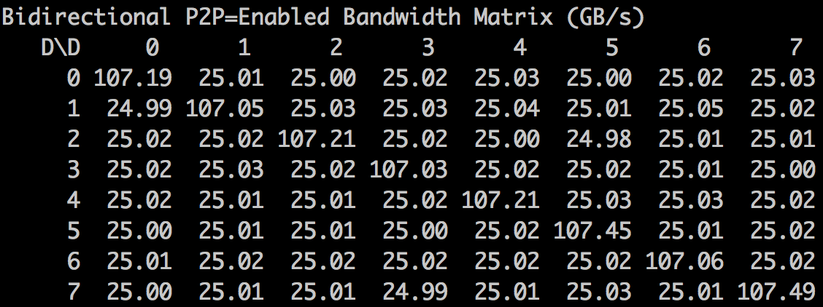
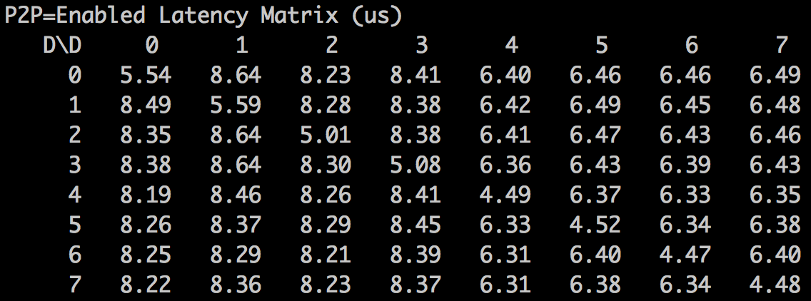
Big Sur
Nvidia Tesla M40 Peer to Peer Test
Design methodology
Performance
High bandwidth
Low latency
Notes:
Bidirectional P2P=Enabled Bandwidth Matrix (GB/s)
D\D 0 1 2 3 4 5 6 7
0 106.98 25.01 25.02 25.01 25.00 24.99 25.01 25.01
1 25.04 106.94 25.03 25.01 25.02 25.04 25.02 25.02
2 25.03 25.02 107.10 25.01 25.03 25.00 25.04 25.03
3 25.03 25.04 25.01 107.01 25.01 25.01 25.01 25.03
4 25.01 25.02 25.01 25.01 107.44 25.02 25.02 25.02
5 25.01 24.99 25.01 25.00 25.00 107.42 25.03 25.01
6 24.98 25.00 25.01 25.00 25.02 25.02 107.41 25.01
7 24.99 25.01 25.01 25.01 25.01 25.04 25.02 107.42
P2P=Enabled Latency Matrix (us)
D\D 0 1 2 3 4 5 6 7
0 5.51 8.32 7.96 8.06 6.68 6.82 6.86 6.78
1 7.99 5.16 7.96 8.10 6.83 6.70 6.68 6.68
2 8.01 8.16 5.02 8.04 6.66 6.66 6.84 6.86
3 7.92 7.93 7.79 5.10 6.81 6.88 6.80 6.72
4 7.88 8.16 7.79 8.19 4.48 6.69 6.75 6.76
5 7.96 8.17 7.91 7.93 6.73 4.51 6.93 6.82
6 7.91 8.11 7.94 8.26 6.88 6.72 4.48 6.73
7 8.04 8.22 7.88 8.11 6.78 6.89 6.90 4.49

Slide 25
Thank You

