Slide 2
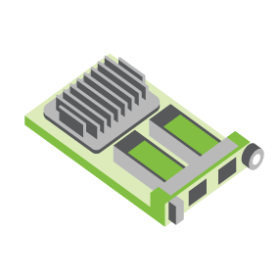
SERVER
OCP NIC Community Update March 2022
For Server Workgroup Sub-group Project wiki: https://www.opencompute.org/wiki/Server/Mezz
Mailing List: https://ocp-all.groups.io/g/OCP-NIC
NIC3.0

Slide 3
Agenda
TSFF mechanical files
PCIe Gen5 SI test fixture update
PCIe Gen6
Next-gen Speeds feedback

Slide 4
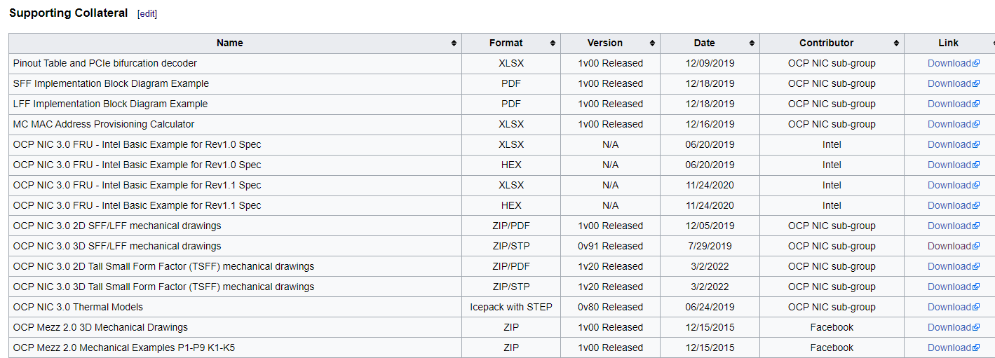
Mechanical 2D & 3D TSFF files in Wiki

Slide 5
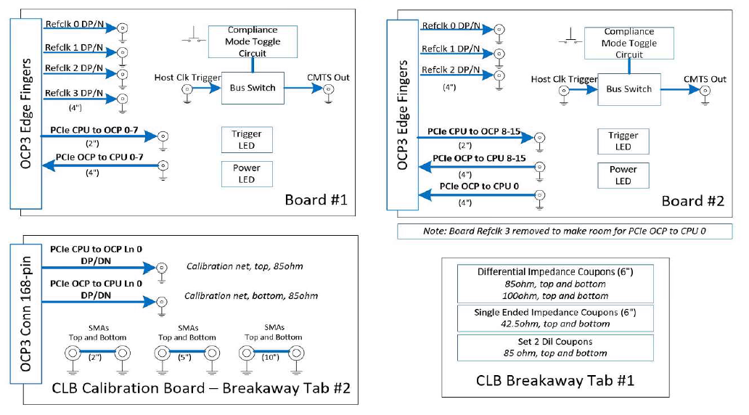
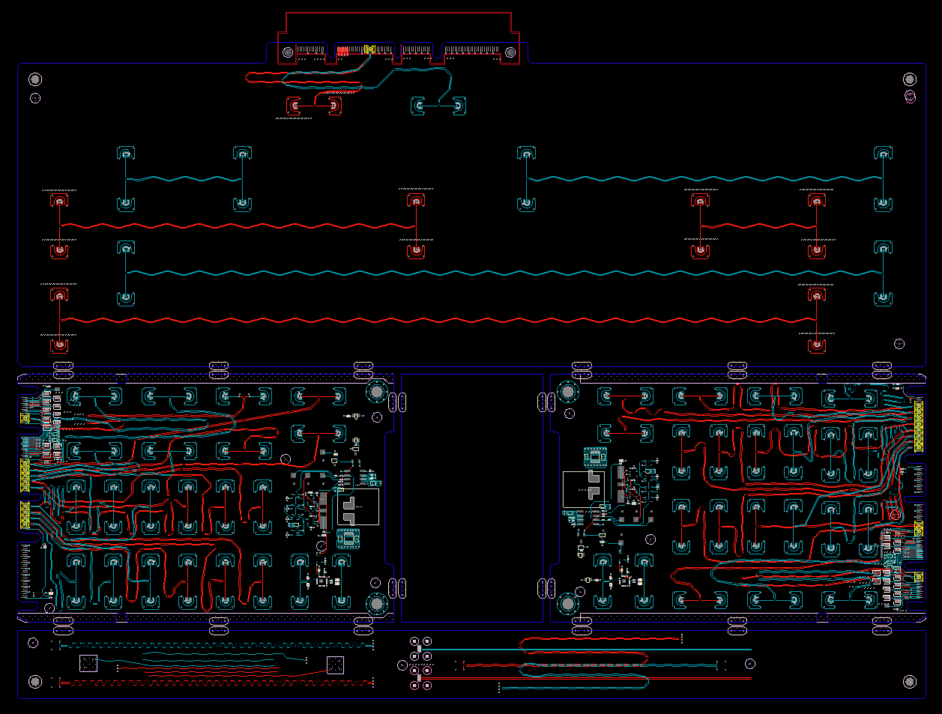
SI PCIe Gen5 test fixture update
Netlist block diagram
CLB Gen5 status:
Gerbered in January
PCB arrives to assembler ~ March 15
Assembly complete ~ end of March
CBB Gen 5 Status:
Based on Gen4 design
Updates to align with PCI CEM
Ready for review ~ end of March
OCP3 SFF CLB Gen5 ECAD
Calibration
CLB board 1
CLB board 2
Impedance Coupon

Slide 6
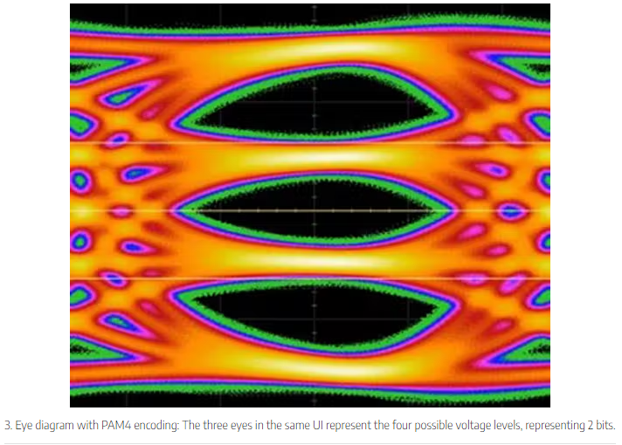
PCIe Gen6
PCIe6 doubling bandwidth from PCIe5 thru signaling change. PCIe6 with PAM4 vs PCIe5 with NRZ signaling
PAM4 is more sensitive to noise
SFF-TA-1002 did not have 64G PAM4 (PCIe gen6) insertion loss and total crosstalk defined yet
It does have 32G NRZ defined
A good read regarding PCIe generation differences https://www.electronicdesign.com/industrial-automation/article/21136215/intel-whats-the-difference-going-from-pcie-30-to-pcie-60

Slide 7
Next-gen Speeds
Feedback requested
 | OCP NIC3.0 rev1.2 |  | OCP NIC3.0 next speed upgrade
Form Factor | SFF/TSFF | LFF | SFF/TSFF | LFF
PCIe | Up to PCIe Gen5 x16 | Up to PCIe Gen5 x32 | Up to PCIe Gen6 x16 | Up to PCIe Gen6 x32
Port speed | Up to 400G | Up to 800G | Up to 800G | Up to 1600G
NCSI OOB | 100 Mbps RMII | 100 Mbps RMII | 100 Mbps? RMII? | 100 Mbps? RMII?
SMBus | 100kHz SMBus 2.0 | 100kHz SMBus 2.0 | 1MHz? SMBus 3.0? | 1MHz? SMBus 3.0?
USB | USB2.0 | USB2.0 | USB2.0 | USB2.0

Slide 8
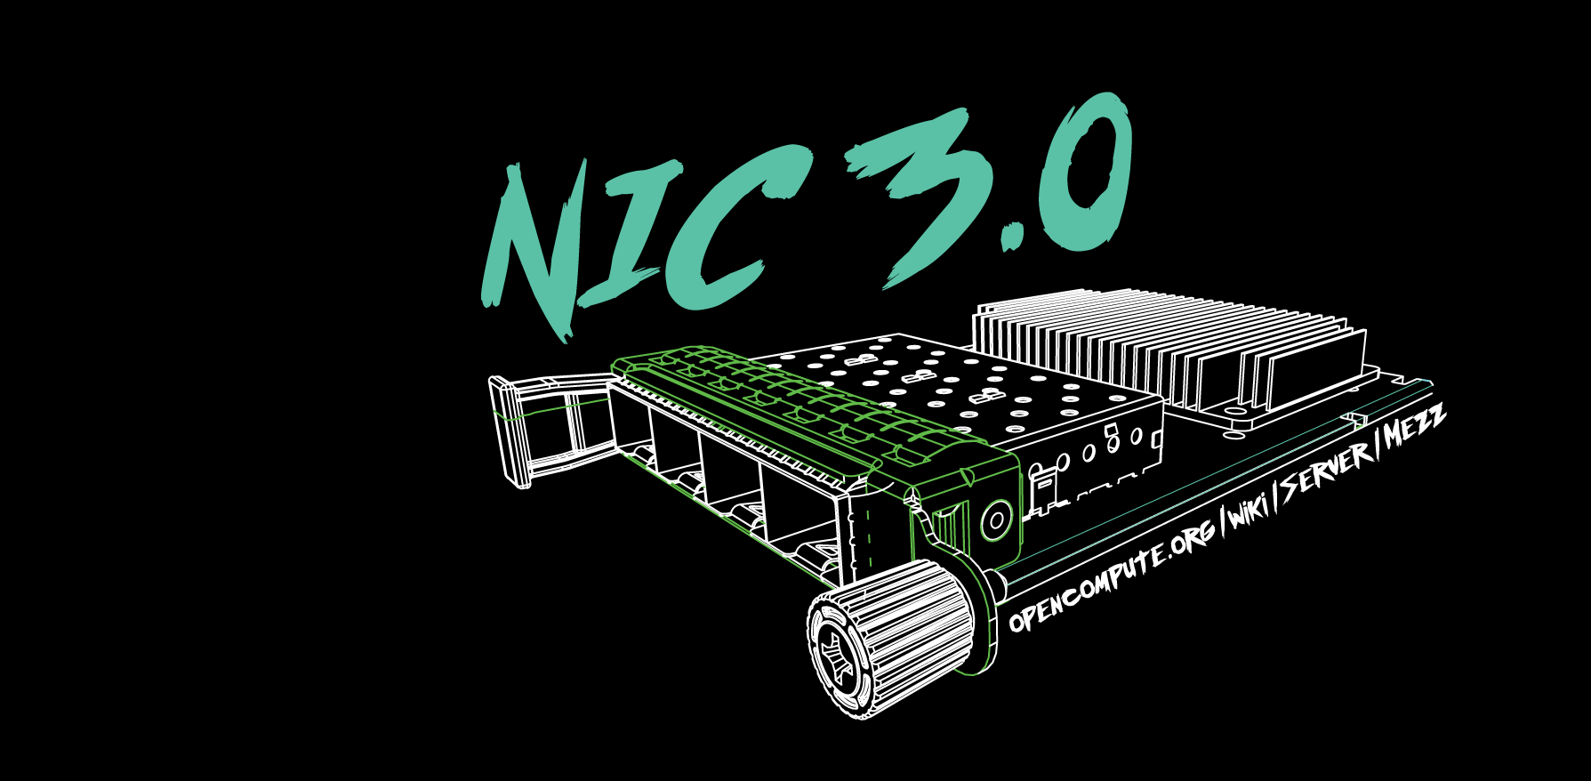

Slide 9
General 2022 Discussion bin list
SFF/TSFF Thermal test fixture with PCIe Gen5
DMTF NIC self-shutdown recommendation
1G NCSI/RGMII side-band support
Next-gen speeds
PCIe Gen6 support
PCI-SIG spec at rev0.7
800G Ethernet port
Elegant cable-up solution
Zion uses 4C+ vertical connector to 4C+ saddle mount connector cable

Slide 10
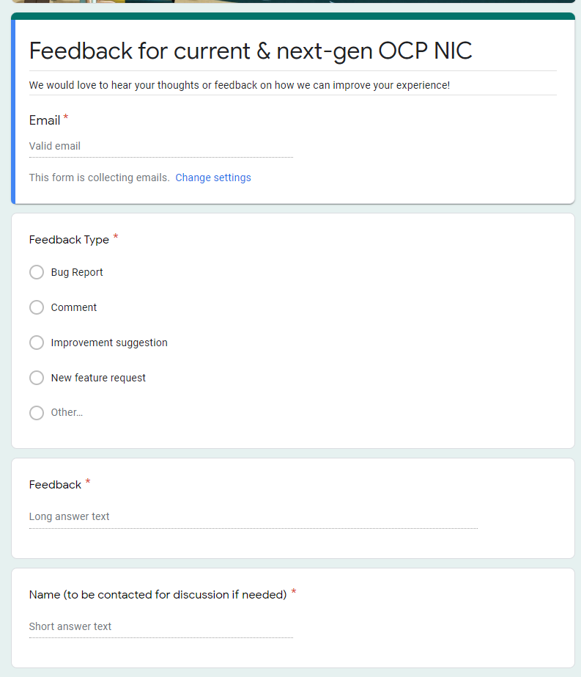
Gather feedback throughout the year
Provide your feedback at: https://tinyurl.com/feedback2ocpnic

