Slide 2
ENG. WORKSHOP: Specification for OCP - Telecom Sled
Jeff Sharpe
Sr. Product/Strategy Manager
ADLINK Technologies
jeff.sharpe@adlinktech.com

Slide 3
Agenda
Who is ADLINK?
Basis and DNA of OCP CG 19” Openrack OpenSled Specification
Benefits of OpenSled specification
OCP CG OpenSled specification overview

Slide 4
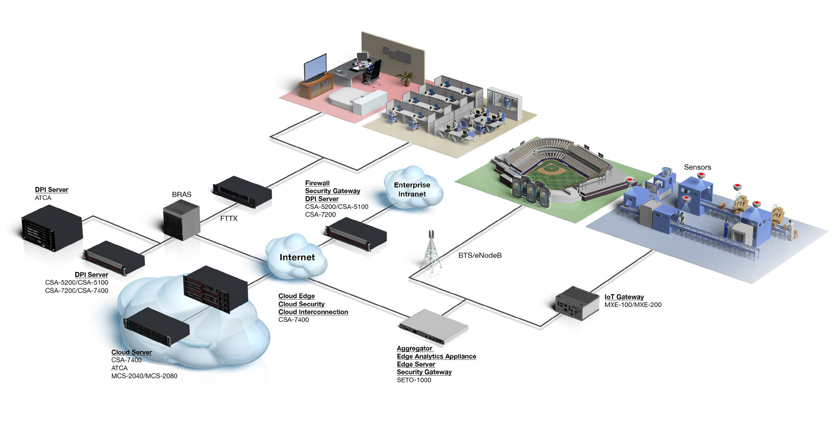
ADLINK End-to-End Solutions Application Ready Platforms
Private Cloud, HCI &
Networking
vCPE
Video Streaming,
Transcoding
Network Security
BRAS & DPI
Industrial
IoT
IoT Edge & Analytics
Telecom Network Solutions
Mobile Edge Computing

Slide 5
Standards Leadership & Technology Partners
We develop and innovate standards; we don’t just implement them
Intel® IoT Solutions Alliance Premier Member
ETSI MEC & NFV Committee Member
Wireless Innovation Forum Member
Open Compute Project (OCP) Member
Industrial Internet Consortium Member
OpenFog Consortium Member
OpenEdge Computing Consortium Member
TIP Community Member
Future Airborne Capability Environment (FACE ) Consortium Member
Communications Platform Trade Assoc. Member
Open NFV Community Member
PICMG Executive Member
PC/104 Embedded Consortium Affiliate Member
SGeT Founding Member
PXISA Sponsor Member
AXIe Consortium Strategic Member
Automated Imaging Association (AIA) Member
Wind River Hardware/Software Partner
AMD Premier Embedded Partner
NXP Partner
Montavista Partner

Slide 6
Next Generation Systems for Next Generation Networks
Decomposed of SW & HW
Decomposed of HW Resource (Compute, Storage, Network, I/O)
Large scale deployed in Cloud；
Deployed at network edge
Many types of systems using common platform sleds
Open Spec, Carrier Grade NFV Platform
Provide Real-time, High Performance, Reliable NFV Solution
Built NEBs ready
Embedded with carrier-grade software options
HW Accelerators to burst virtualization and all kinds of application performance for private cloud infrastructure
Utilization of multi-host controllers and switches for Cloud/Fog options
Modular | Industrial | Cloud Architecture
Carrier Grade NFV Cloud Platform

Slide 7
Committed to Open Standards
MICA development and strategy is to replace existing ATCA, Proprietary and RMS technology
ADLINK and our customers recognize the importance of open standards and open architecture.
MICA is built on an open architecture with a large eco-system of partners and suppliers
ADLINK represents the product as a Open Standard and provide the specifications of the MICA product to customers, partners and standards committees
Based on Intel’s Open Converged Modular Architecture which was originally developed by Intel as a stepping stone of RSA.
Currently providing the OCP CG Openrack MICA spec as a specialized sled enabling a multitude of options for custom, specialized solutions
Enables HW acceleration, additional silicon options, pre-integrated software, and the ability to reuse common sleds for a multitude of types of systems

Slide 8
Focusing on Edge Computing Use Cases
WebTv/Video
Video Communication
Flickr
Resolution
User
Requests
Proximity Proof
Geolocation
Bandwidth Indication
Content Scaling
Augmentation
Edge
Compute
Text2Speech
Speech2Text
Video2Text
Translation
Augmented Reality
Face Recognition
Site Recognition
Media
Transformation
Content
vCPE
Dedicated Routing
Enterprise Networks
Proactive
Caching
Edge Based CDN
Geo Information
Preloading
Distributed Database
Private
Networking
Local Connectivity
Edge Content Delivery
Social Events
Local Aides
Alerts
Edge
Broadcasting
Transparent
Caching
Proximity Caching
GPS
Cryptography
Cloudlets
Compute
Big Data
Car2Car
RAN Data
Monitoring
IoT
Offloading
Aggregation
VoIP
Video
Audio
Transcoding
Sensor
Data

Slide 9
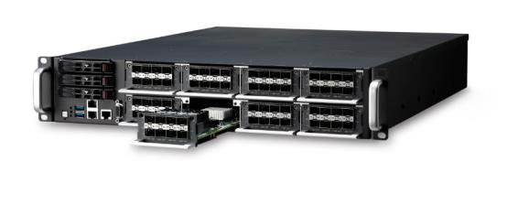
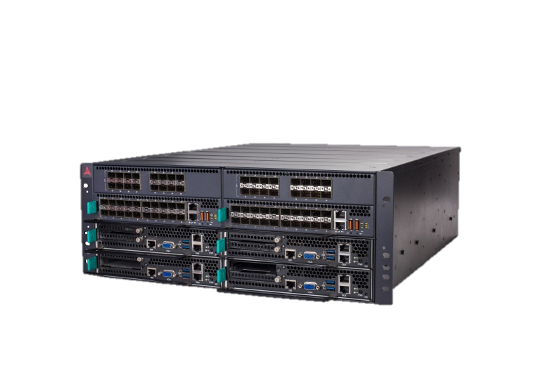
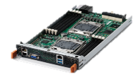
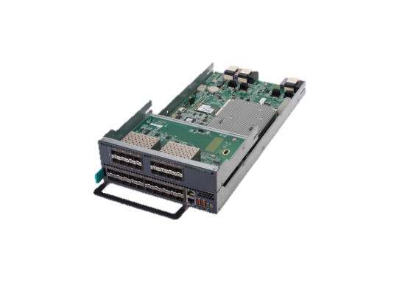
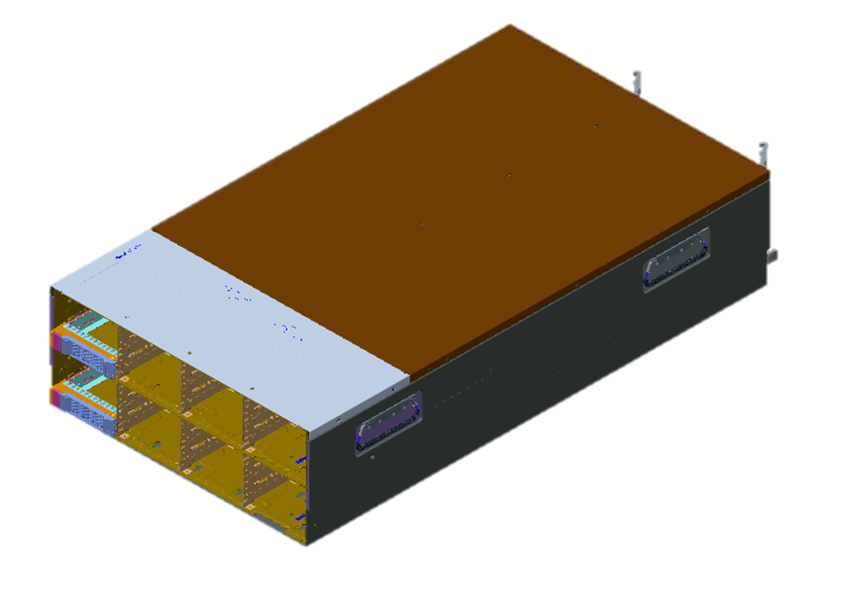
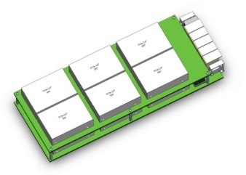
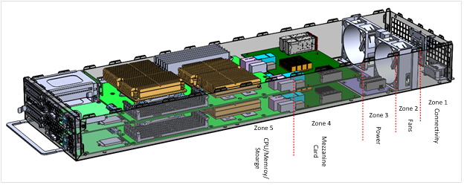
Mix & Match Common Modules: Rich system configuration choices
CSA-7200
8 NIMs,
128 Eth Ports
Rich I/O
1x MCN-2600
8x NIMs
CSA-7400
4 Compute Nodes,
360G Throughput
High Compute Performance
&Throughput
4x MCN-2600
2x MXN-3610/4100
24*3.5’ HDD
CSA-7x00
24*HDD+
1* CSA-7400
Large Storage, Storage, Compute, Switch Hyper Converged
2x MCN-2600
Common
Modules
OCP-T Compute Sled
2 Compute Nodes,
Notes:
2U, 19’, 430mm chassis
Redundancy hot swap DC PSUs;
Hot swap Fans
Front to rear air-cooling
4x 3.5’ SATA/SAS hot swap HDDs;
I/O board to provide 3x1GE, and RAID Controller function

Slide 10
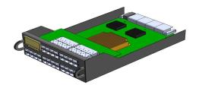
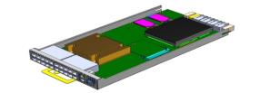
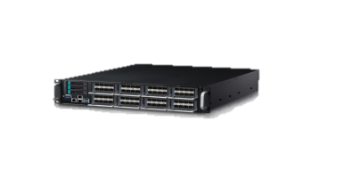
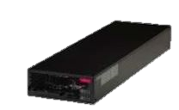
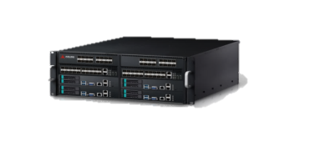
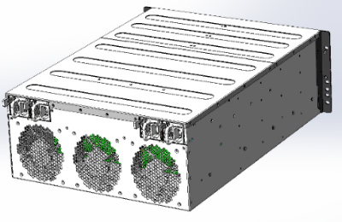
Next Gen.- Network Communication Platform
Flexible Modular Building Blocks
Compute Nodes
Broadwell, Skylake, Purley (Skylake + FPGA)
½ and ¼ width sleds for needed core density
Flexibility: mix and match E3 and E5
Integrated NFVi Software and Platform S/W
MCN-2600
Broadwell
MCN-2610T
Purley
MCN-1500
(Greenlow GT4e)
MCN-1510
Purley
Switching Nodes
Intel Red Rock Canyon & Broadcom PEX
Extension trays for flexible I/O configs
System Management and wide range of SW
Planning: HW Accelerators & ARM
MXN-3610 (RRC)
MXN-3620 (PCIe switch)
I/O Nodes
Optional Network Interface Modules
Optical, copper, w and w/o bypass
¼ width size to support large I/O options
CSA-Z5C4F
CSA-ZBX10
CSA-Z5C2F
CSA-Z5C8F+
CSA-Z4X01
Complete Systems
19” - 2U 4U and OCP-Telecom versions
Data Center 2U
AC/DC power, NEBS ready, customizable
Multiple options based on required solution
MCS-2080
CSA-7200/7400
OCP CG OpenRack
HCI

Slide 11
Application Use Cases for MICA
High CPU/IO needs
Modular, Flexible, open standard sled & ecosystem,
cost efficient with RRC features (integrated 100G NIC & switches), high-density
CSA-7400 or derivatives good fit, scalable & stackable to high-end (to multiple Tbps)
Low CPU/High IO needs
Modular, Flexible, open standard sled & ecosystem
CSA-7200 or derivative a good fit
High CPU, Flexible configurations
SW ecosystem like WR TiS integration
CSA-7400 & the stack-up OCP CG OpenRack a good fit
Additional Silicon
CSA-7200 or derivative a good fit
Hi-density all-in-one box with compute, switch & storage, IO, open standard sled
CSA-7400C with local storage or with shared/storage sled a good fit
First high-density GT4e platform capable of H.265/4K transcoding, PCIe expansion for external storage & others (FPGA etc)

Slide 12
Scope for OCP CG OpenRack 19"
Sled for Frame/appliance layouts
Current OCP CG OpenRack 19" Spec:
OCP CG OpenRack 19" frame, Power, Interconnect & Sled dimension spec submitted by Radisys:
Current spec defines the dimensions of 2 “Sleds”, ½ and Full Width 2U Sleds
Pre-defines interfaces and DC Power requirements into Frame
Does not specify characteristics of the Sled internal component layout
ADLINK Proposed OCP CG OpenRack 19" Sled Spec:
Specs are used as a guideline for appliance delivery that is based on Modular Industrial Compute Architecture - CPU, Appliance, Future Switching (MR-IOV Pex and Multi-Host controllers as examples)
Sled spec defines zones, what the zones are for and parameters for zones and use MICA as reference). Power, Mezzanine and interconnections between components are defined
Both ½ width and Full Width Sled Spec planned

Slide 13
OCP CG 19” OpenRack OpenSled
Benefits
Sets a common structure enabling more than just an X86 Environment on a open Architecture
Enables a OpenSled design for OCP CG OpenRack 19" suppliers to design and manufacture their own sleds for multi-purpose use cases
Provides both ½ Width and Full Width Sleds (Q2 Defined) for a multitude of options
Defines the zones of each Sled for operators to feel confident that the Sled is open, however provides many options for Sled use cases
Enables the front part of the sled (Zone 5) and the Mezzanine (Zone 4) for Server, ARM, HW acceleration, Front Panel options, Storage, etc.
Future Mezzanine enables ability to add multi-host controllers, MR-IOV capabilities, switching and HW acceleration for additional capabilities.
Utilizes Radisys’ best in class spec for Frame and Sled interconnection, power and physical dimensions.

Slide 14
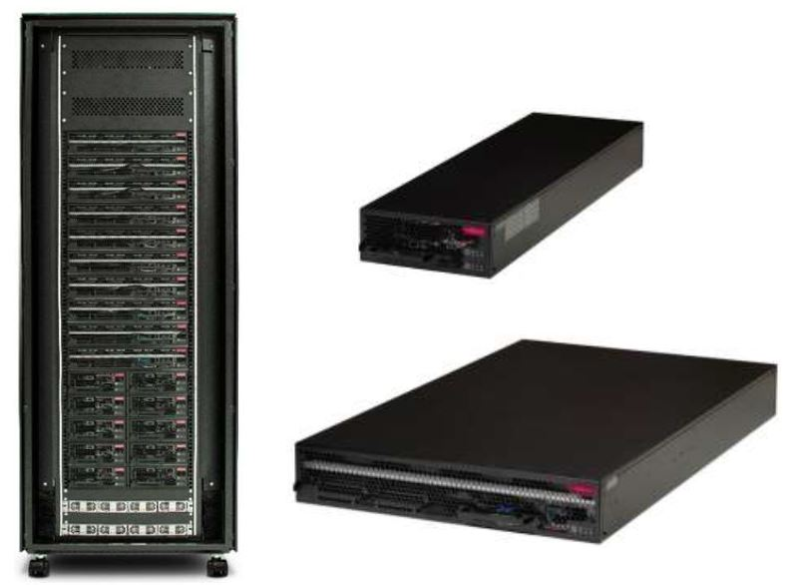
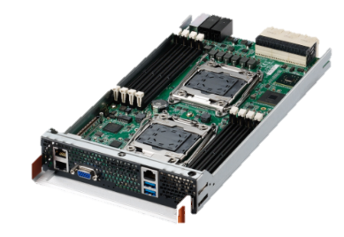
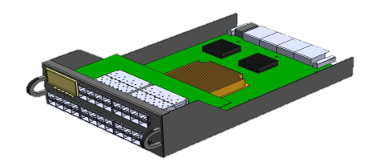
OCP Telecom Standardization based on MICA
Reusable MICA Sleds
19” OCP CG OpenRack 19" Frames
“Sleds” for OCP CG OpenRack 19"
OCP CG OpenRack 19" Specification
Sled Spec:
Sled Zones & Layout
Sled Power
Sled I/O
Sled Environmental
½ Width
Full Width

Slide 15
Open Sled Zone Specification
ADLINK OCP CG OpenRack 19 Spec Defines to the Industry:
Sled Zones, Dimensions & Layout for ½ width sleds
Full Width sled to be defined later in conjunction with Microsoft’s current sled spec
Sled Power requirements
Sled I/O options for the Mezzanine and NIC
Sled Environmental for cooling, shock, vibration, and heat dissipation
Interface definitions between each zone
Enables flexibility for I/O and Silicon

Slide 16
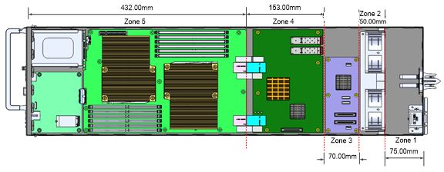
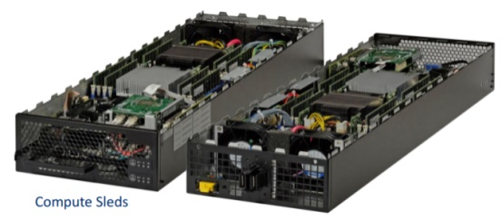
Proposed OCP CG OpenRack 19"
OCP CG OpenRack 19" Sled Zones
Definition for ½ width and full width OpenSleds
Zone 1 - Open Air for environmental area
Zone 2 - Cooling and air flow definitions/requirements
Zone 3 – Power module specifications and board layout
Zone 4 – Mezzanine for NIC to ToR, provides additional options for acceleration and custom
Zone 5 – Server/Memory/Storage and optional front panel definition. 4 CPU’s (2 MICA sleds)

Slide 17
OpenSled Design
Defining the sled based on CG OpenRack 19 Frame spec
Front view allowing additional/optional connectivity, Hot Swappable Storage access – removable or hinged front panel
Rear panel is defined by Radisys’ CG OpenRack 19 Frame spec.
Top view of sled – defines internal components

Slide 18
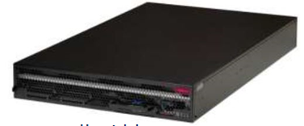
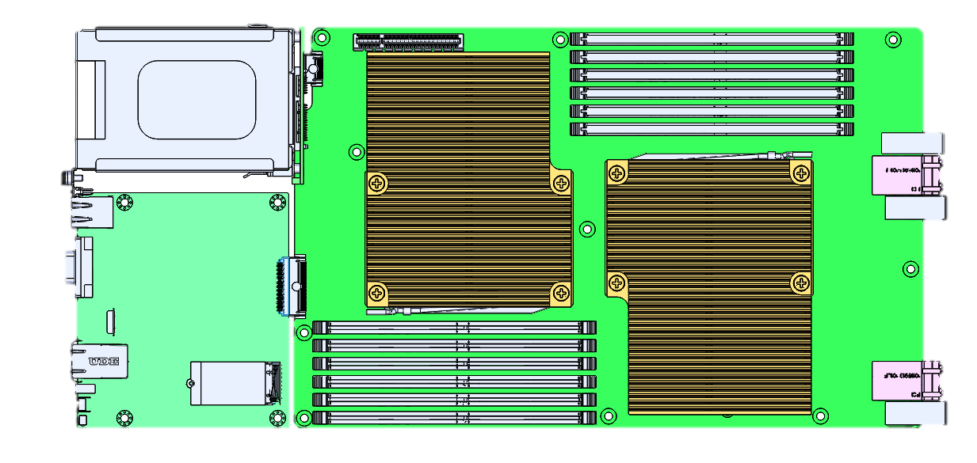
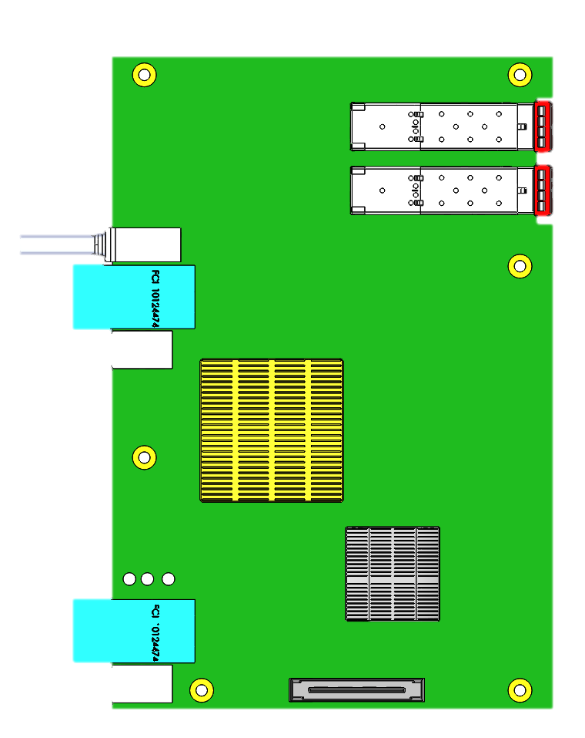
Full Width (2U) OCP CG OpenRack 19" Tray(TBD)
Full Mezzanine enabling passive connections for Sled switching. Multi-host controller, PCIe Switching within the Sled as a single appliance
Could be a complete storage sled as well.
Working with Microsoft who has defined the Server sled for full width
1x OCP Power
Bus Connector
8x Optical Data
Port Connector
1x OCP Power
Bus Connector
8x Optical Data
Port Connector

Slide 19
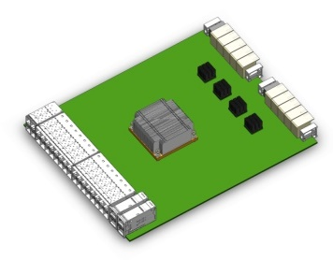
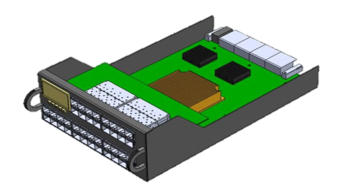
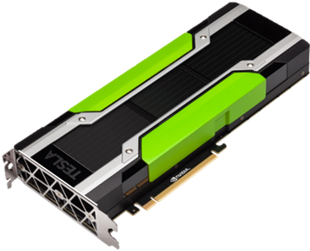
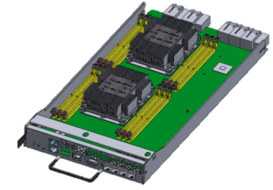
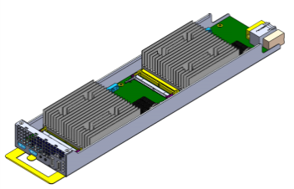
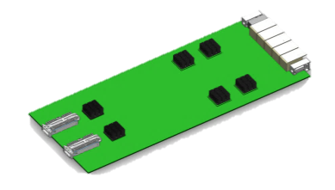
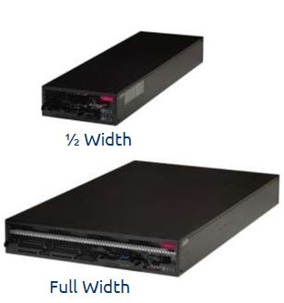
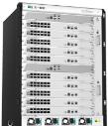
M.I.C.A. Plan of Intent (2017-2018)
(Subject to change, not committed)
Sleds & Add-on
Multiple Vendors
NFV/SDN/IoT Acceleration
Switching & I/O
SSD/HDD
Storage
GPGPU
Purley / FPGA / TickTock
5G Acceleration
Systems
OCP CG OpenRack 19
Custom 1U -xU
Continued Platform
s/w expansion
Hyper-Converged Infrastructure

Slide 20
Network Alliance program
Industrial leaders as part of our Modular Industrial Compute Alliance
Alliance
Chassis, Sleds,
Custom Systems
Application Partners
Integration, Testing & Support
Middleware

Slide 21
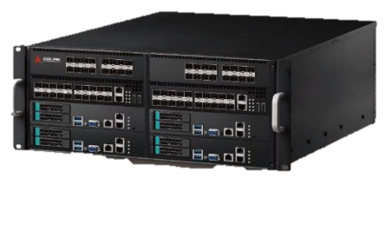
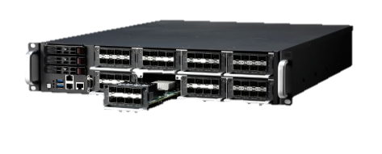
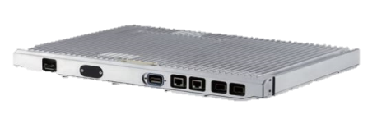
Expansion of Software requirements
vCPE
OpenSource
Analytics
Media
4
MEC Apps
VMs
Security
Middleware
ADLINK PacketManager (Layer 2/3 switch, VLAN, GRE, etc.)
Intel FPGA / DPDK

Slide 22
Conclusion
Collaborative effort for OCP CG OpenSled
Open Architectures: ADLINK is implementing Open Architectures for Edge Compute technologies
Expanding into other Open Architectures for reusability
Collaboration: We believe in collaboration, open architectures while working with industry leading eco-system partners/committees
Collaborating with other OCP members on CG full width OpenRack OpenSled
Spec Submitted: OCP CG OpenSled Spec enables an open architecture for multi-silicon, multi-use sleds that support’s the OCP CG 19” OpenRack spec
Incorporates ADLINK’s MICA architecture which can fit into many types of systems (HCI, 19” Appliance, Datacenter/MediaCenter, OCP CG 19” Openrack)
OCP CG 19” OpenRack OpenSled is based on deployed technology and integration complete by Q2’17
Investing in full width sled with multi-host controller concepts with collaboration with other OCP suppliers

