Slide 1
OCP document guideline
Retime card
Date: 2017/7/26

Slide 2
Agenda
Retimer card block diagram introduction
Design package guideline

Slide 3
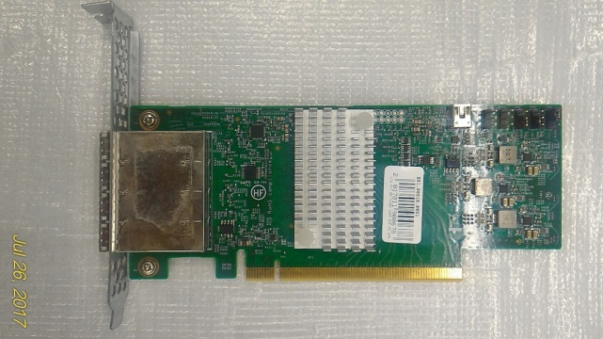
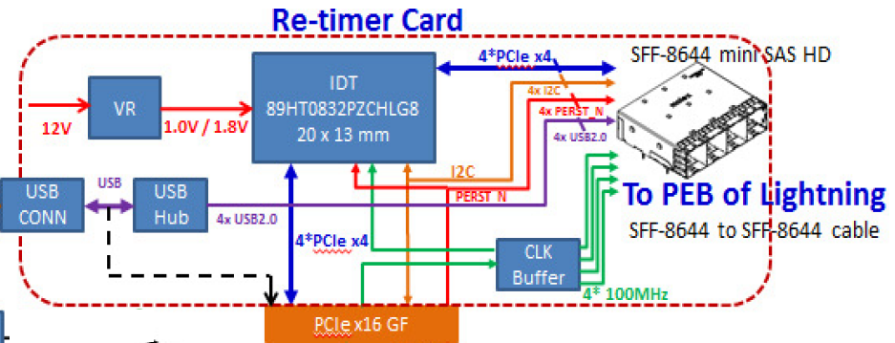
Block diagram
Retimer IC: IDT 89HT0832PZCHLG8

Slide 4
Design package guideline
There have six folder are included in design package, including:
Schematic: Contain designed DSN/PDF file (Cadence)
Layout:
Board file:Contain designed BRD file (Allegro)
Stack-up: A excel file shows detail stack up information.
Equal length: A excel file shows high speed signal intra-pair, inter-pair and bundle length matching.
SI constraints: A excel file shows all nets physical constraints setting.
3. BOM (Bill of material): A excel file shows full material information.
Manufacturing:
Gerber file: Contain Gerber file (CAM350)
Component placement map: Contain Component placement of top/ bot view.
Pick & place: Contain Component type, package and coordinates.
Test point: A file shows test coverage percentage

Slide 5
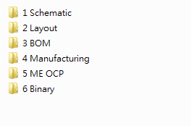
Design package
There have six folder are included in design package, including:
ME OCP:
Metal 2D: Contain bracket .dxf and .pdf file
Metal 3D STEP: Contain bracket.stp
Board Files: Contain board .dxf, emn and .pdf file.
Retimer card assembly .stp file
Retimer BOM OCP: A excel file shows mechanical parts(bracket, screw) list.
Binary:
Retimer IC configure file: A config bin file for IDT retimer chip.

Slide 6
Thank You

