Slide 1
SPIRAL Protocol Family
Xiaoyu Ruan and Will Stevens
{xiaoyu.ruan; william.a.stevens}@intel.com
For OCP security forum
Jan. 29, 2019

Slide 2
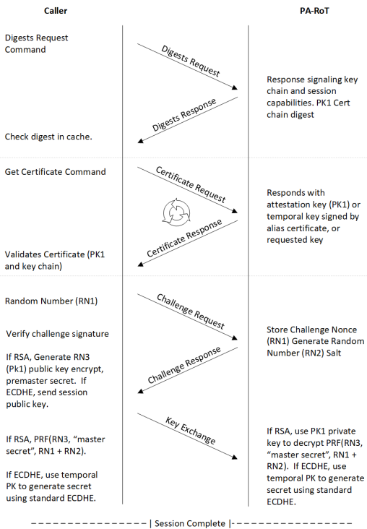
USB Type-C Authentication Protocol and Its Application in Cerberus
Image credit: Project Cerberus Challenge Protocol

Slide 3
A Good and straightforward Protocol. But Anything to Improve?
Authentication and key agreement require (expensive) asymmetric key operation every boot – RSA or ECC. Not prefect for performance sensitive applications, e.g., secure boot.
Easy problem! Just save the shared secret in secure NVM on both sides for future use.
What if responder does not have secure NVM? e.g., CPU
Our Goal: Design a protocol that
Does not require asymmetric operation after initial pairing between initiator and responder
Does not require secure NVM on responder

Slide 4
The Main Idea
Primary idea: responder wraps shared secret (SK) with its own secret key (SSTn) and sends to initiator to store.
Prerequisite: responder FW has a secret key from ROM. The secure key changes per FW security version SVN.
Responder flow during boot
* The fuse / PUF used for private credential derivation is leveraged for SSTn derivation.

Slide 5
SPIRAL-OneWay : Initiator Authenticates Responder
See Backup for flow when responder does not have DRNG

Slide 6
SPIRAL-TwoWay: Mutual Authentication
Responder is required to have DRNG in order to authenticate initiator.

Slide 7
Cerberus: Backward Compatibility / Discovery
Use one reserved bit in Device Capabilities Request and Response to indicate if SPIRAL is supported

Slide 8
Next Steps
Review at OCP, DMTF, and PCIe forums and discuss adoptions in their specifications.
Forum | Date | Status
DMTF | 1/22/2019 | Done. Reviewers from Intel, Lenovo, Cisco, HPE, Mellanox, Dell, Microchip, ARM, Marvell, Broadcom
OCP | 1/29/2019
PCIe | ??

Slide 9
Backup

Slide 10
SPIRAL-OneWay : When Responder Doesn’t Have DRNG

Slide 11
SPIRAL-Lite: For Constrained Responder Using Hash Certificate

Slide 12
Responder Credential – Seed, Seed Password, and Touchstone
Example for max responder SVN n = 3 and max Initiator SVN m = 4
hash
hash
hash
hash
hash
hash
hash
hash
hash
hash
hash
hash
hash
Credential | Seed | SP_3_4 | SP_3_3 | SP_3_2 | SP_3_1 | SP_2_4 | SP_2_3 | SP_2_2 | SP_2_1 | SP_1_4 | SP_1_3 | SP_1_2 | SP_1_1 | Touchstone
n | - | 3 | 3 | 3 | 3 | 2 | 2 | 2 | 2 | 1 | 1 | 1 | 1 | -
m | - | 4 | 3 | 2 | 1 | 4 | 3 | 2 | 1 | 4 | 3 | 2 | 1 | -
Responder ROM passes | Not passes to FW | to n=3 responder FW |  |  |  | to n=2 responder FW |  |  |  | to n=1 responder FW |  |  |  | Public value signed by CA
Responder FW sends |  | to m=4 initiator FW | to m=3 initiator FW | to m=2 initiator FW | to m=1 initiator FW | to m=4 initiator FW | to m=3 initiator FW | to m=2 initiator FW | to m=1 initiator FW | to m=4 initiator FW | to m=3 initiator FW | to m=2 initiator FW | to m=1 initiator FW | to initiator

Slide 13
SPIRAL vs. USB Authentication Protocol
Property | SPIRAL | USB Auth Protocol | USB Auth Protocol w. shared secret
Asymmetric operation at every boot | No | Yes | No
Responder credential | May be X.509 or hash-based* | X.509 | X.509
Secure storage on responder | Not required | Not required | Required
* See SPIRAL-Lite slides and whitepaper.

