Slide 2
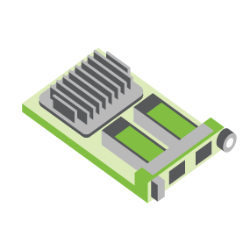
SERVER
OCP NIC Community Update August 2021
Sub-group Project wiki: https://www.opencompute.org/wiki/Server/Mezz
Mailing List: https://ocp-all.groups.io/g/OCP-NIC
NIC3.0

Slide 3
Agenda
OCP Global Summit
NIC3.0 spec update (draft)
SI Gen5 test fixture
Thermal workgroup update

Slide 4
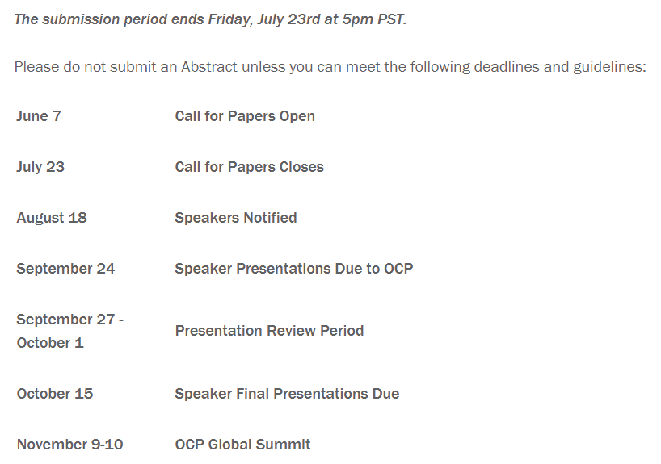
2021 OCP Global Summit - Workshop
https://www.opencompute.org/summit/global-summit/call-for-papers

Slide 5
2021 OCP Global Summit - Abstract
OCP NIC 3.0 DPU management
Nvidia
OCP NIC 3.0: Thermal Considerations
Facebook, Molex, Nvidia
Benefits of using FPGA based accelerators in Networking, Storage and Memory
Smart Modular Technology
OCP NIC: What's now and the future?
OCP NIC Sub-group
OCP 3.0 NIC TSFF implementation and advantages
Nvidia

Slide 7
OCP Global Summit Experience Lab demo
Several companies express initial interest regarding experience lab demo. Broadcom/Hemal will lead the preparation.
Demo can be hardware or software
New acceptance criteria from OCP Foundation might impact eligibility
Solicit TSFF, 2+ OCP NIC slots & non-NIC on top of our NICs demo
Cross group demo: ODSA + NIC adapter

Slide 8
NIC3.0 spec update (draft)
TSFF form factor and minor changes included in 1v11 RC review. Please feedback by August 4, 2021
- General – Changed “SFF” references to “SFF/TSFF” where applicable.
- General – Format all tables with repeated headers when they span multiple pages
- Section 1.2 – Added Molex to the acknowledgements section.
- Section 1.4 – Added TSFF, OSFP-RHS and QSFP-DD to the acronyms section.
- Section 1.6, 2.1.1 – Added text for TSFF and clarify TSFF shares the same mechanical outline as SFF.
- Section 1.7.1 – Added TSFF to the OCP NIC 3.0 Form Factor Dimensions table; add Max Z-height information.
- Section 1.7.2.x - Updated text "Up to PCIe Gen 5 (32 GT/s) support"
- Section 2.2 - Add QSFP-DD, OSFP-RHS for TSFF in Line side implementation. Add QSFP-DD, OSFP to standards cross reference table.
- Section 2.4.1, 2.4.2 – Updated faceplate subassembly drawing and BOM callouts.
- Section 2.4.4 – Added TSFF generic faceplate drawings. Drawings only contain dimensional deltas from SFF.
- Section 2.5.2 – Added TSFF keep out zones. Drawings only contain dimensional deltas from SFF. - Section 2.8.5 - Replaced Figure 56 - SFF Baseboard Chassis CTF dimensions (Rear Rail Guide View) as it was clipped in the previous release.
- Section 2.8.6, 2.8.7, 2.8.8, 2.8.9 – Added TSFF CTF dimensions for pull tab, ejector and internal lock board dimensions. Add TSFF baseboard CTF dimensions. Drawings only contain dimensional deltas from SFF. - Section 2.10 - Added TSFF Generic faceplate assembly CAD.
- Section 3.4.2, 3.5.4 – Clarified that the BIF[2:0]# pins shall not change states after AUX_PWR_EN is asserted.
- Section 3.4.4 – Clarified that the RBT_ISOLATE# signal shall not change state even when the NIC_PWR_GOOD signal is in the don't care state.
- Section 3.7.3 – Added note regarding the use of light pipes above I/O cage assemblies for TSFF and cage implementations.
- Section 3.11 – Clarified power down sequencing diagram - +12V_EDGE may optionally be disabled in ID Mode. This mirrors the same behavior for the power up sequencing diagram.
- Section 5.1 – Added note stating the SFF and TSFF timing parameters are the same since the cards may share the same PBA.
- Section 6.2.2, 6.2.5 – Added placeholder headings for the hot and cold aisle cooling graphs for TSFF.
- Section 6.4.2 – Added placeholder heading for the TSFF thermal test fixture.
- Section 6.4.5 – Added placeholder figure headings for the TSFF candlestick air velocity vs volume flow graphs.
- Section 7.1.3 – Updated Safety requirements. 60950-1 was withdrawn as of 12/20/2020. 62368-1 replaced 60950-1.

Slide 9
SI PCIe Gen5 test fixture update
Jason/Jon to provide an update on PCIe Gen5 test fixture

Slide 10
Thermal workgroup update
Good process on thermal alignment from workgroup
Alignment achieved:
aligned the models are comparable among MLNX dummy heater, Luxshare, and multilane model
aligned that the case temperature difference goes down when heatsink applies, wait the final simulation results from MLNX and Molex
aligned in the future that we can use multi-lane module to perform thermal validation
aligned to use Tcase closer to the hot spot as the monitor point instead of the average surface temp

Slide 11
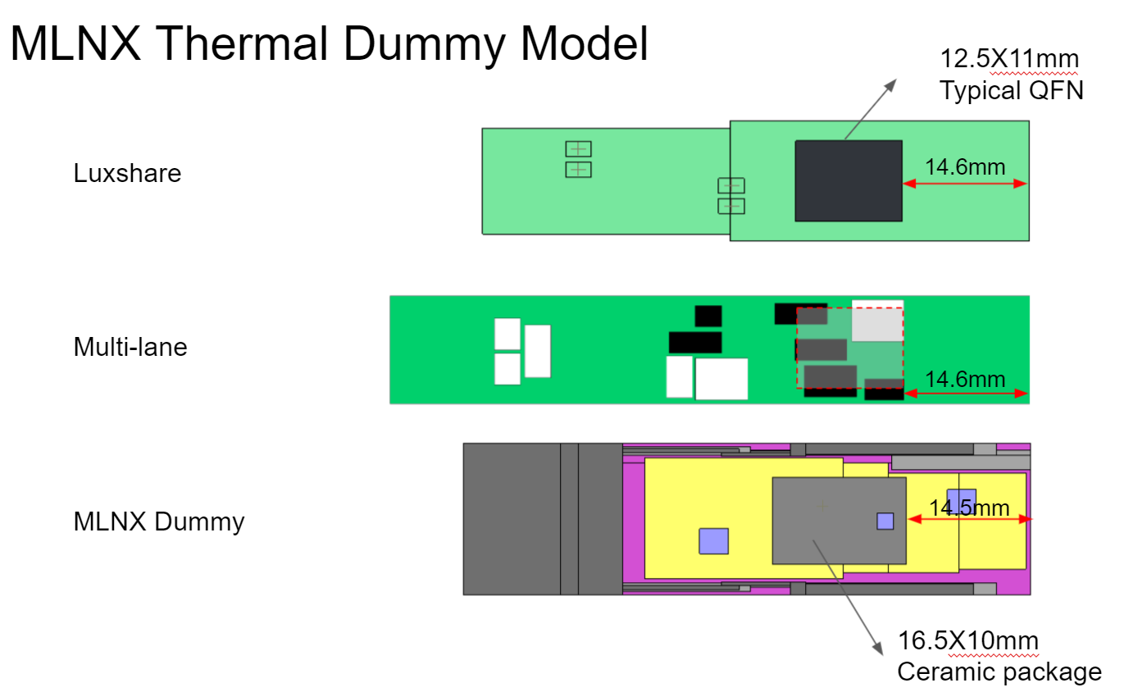
Thermal workgroup update
Large thermal gradient at top of module
Aligned to use Tcase near hot-stop instead of average surface temperature

Slide 12
Group name
We are used to call Mezzanine group
Then we are focused on NIC, so naturally we are being recognized as the OCP NIC group
What do you think we abstract our focus on NIC to something more generic?

Slide 13
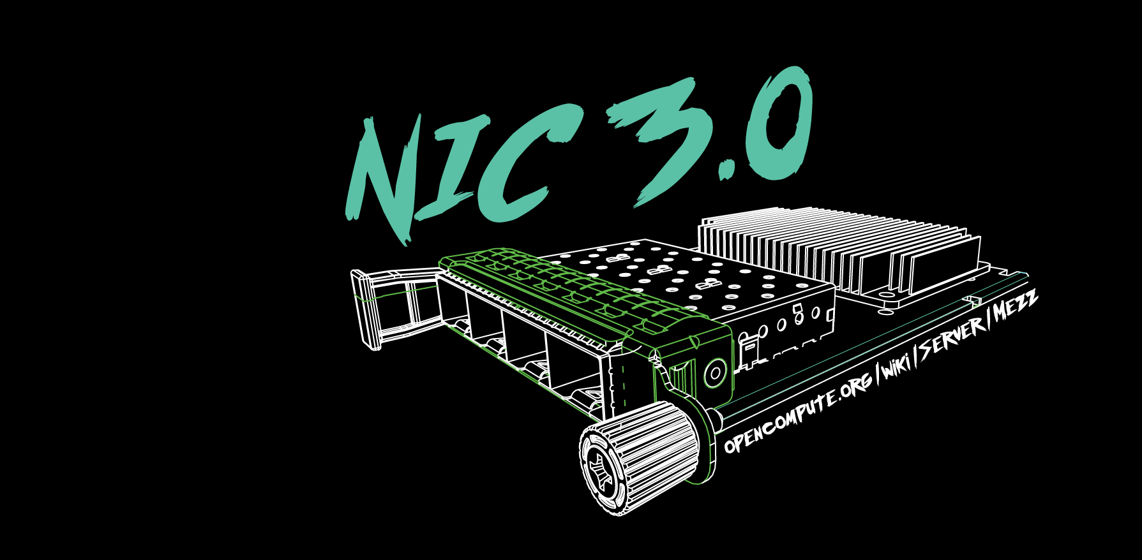

Slide 14
2021 OCP Global Summit - Demo
-2020-
OCP NIC Experience Lab demo coordination
2019: Facebook
2020: Intel & Nvidia
2021: Broadcom

