Slide 2
OCP NIC Community Update for Server Workgroup July 2020 OCP NIC Subgroup Sub-group Project wiki: https://www.opencompute.org/wiki/Server/Mezz Mailing List: https://ocp-all.groups.io/g/OCP-NIC
Server Workgroup

Slide 3
Agenda
OCP Engr Week
Signal integrity update
Mechanical update
Specification update

Slide 4
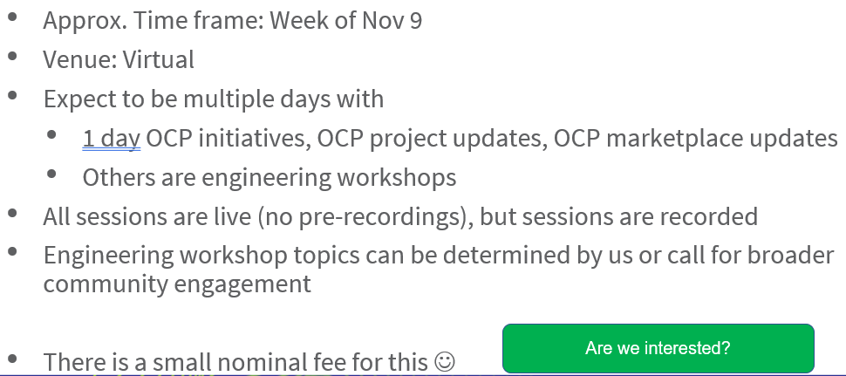
OCP Engr Week
NIC sub-group community response about OCP Engr Week is lukewarm.
Suspect due to:
NIC sub-group already running free Live Zoom “working session” in workshop discussion mode
Nominal fee for attendee is a hassle but not a showstopper
Overall NIC sub-group would have enough topics to share with wider audience for half day

Slide 5
Signal Integrity
From June’s server workgroup feedback, the request is to document PCIe Gen5 loss budget at current agreed upon value.
PCIe Gen5 insertion loss modification in rev1.01 of OCP NIC3.0 spec contributor review draft as below. Next stage is 2 weeks public review

Slide 6
Mechanical Test Fixture
Mechanical compliance test fixture initial 3D complete
It is single test fixture for SFF and LFF

Slide 7
Rev1.01 Spec updates summary
- Section 1.2 - Acknowledgements section updated. Company name updates.
- Section 1.6.2.1 – Minor update to clarify Primary connector is a 4C+ as defined in SFF-TA-1002 and consists of an “OCP Bay” and a “4C” region.
- Section 3.4.2 – Recommendation on the PRSNTB{0:3] strapping resistors for 0-200 Ohm.
- Section 3.4.5 – Scan Chain text/diagram updates
- Section 3.8.2/3.8.5 – Clarifications to +12V_EDGE in ID/Programming mode
- Section 3.9 – Clarification on the slot power envelope definition (assuming that is the same path the PCI SIG is going). Also add 50W power class.
- Section 4.4 – Add Warning/Critical/Fatal temperature threshold example text as discussed in the June NIC 3.0 monthly meeting.
- Section 4.10.3 – Modify offset 3 and add offset 24 to include definition on which ports are active during Aux Power Mode.
- Section 5.3.x – Add PCIe Gen5 text/fixture/test methodology updates

Slide 8
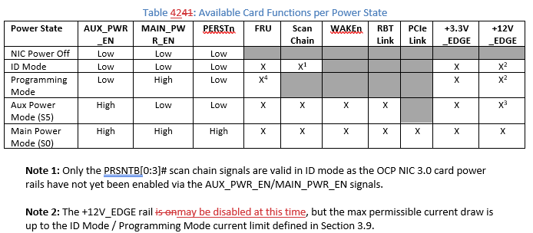
+12V_Edge during ID mode
We received feedback from server vendor there is cost savings if +12V_Edge is off during ID mode
We received feedback at least one NIC vendor seeing small voltage leakage from +3.3_Edge to +12V_Edge under nominal condition
Above is rev1.01 contributor draft wording. Expect this to be debated.

Slide 9
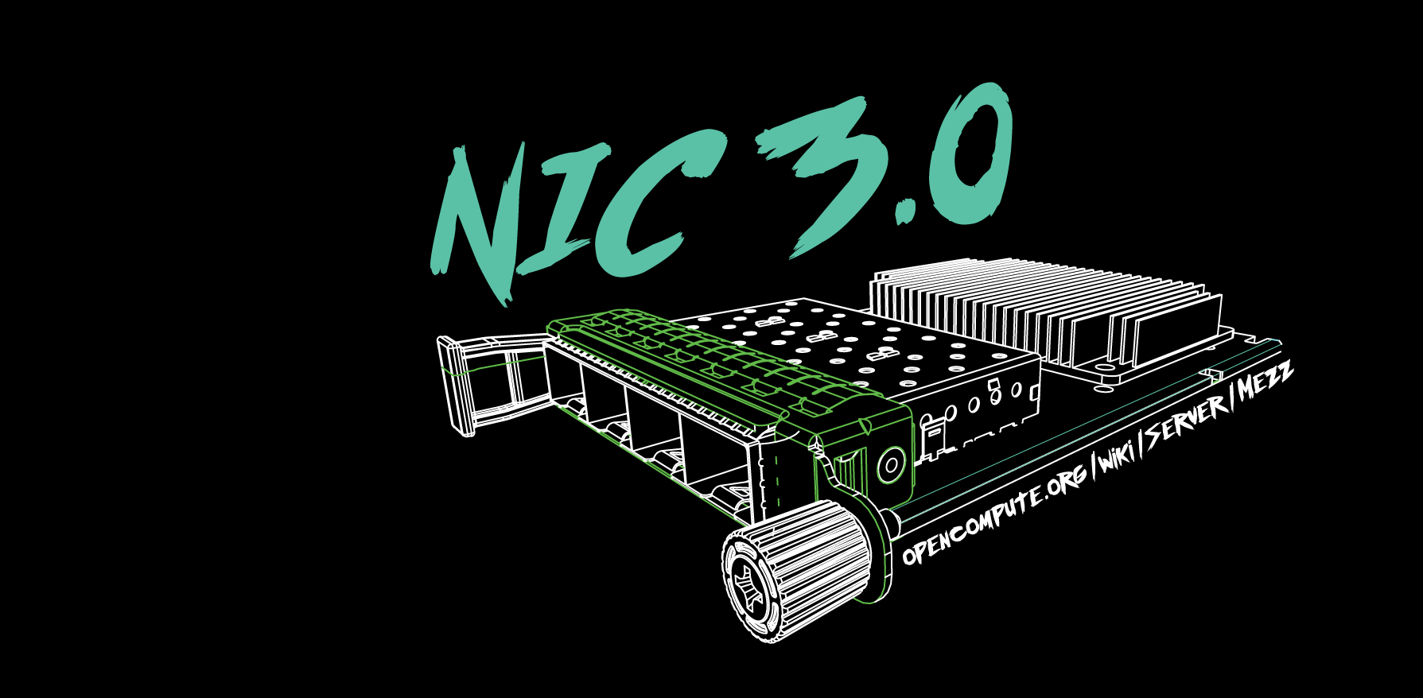
Q&A

Slide 10
March 4-5, 2020

