Slide 2
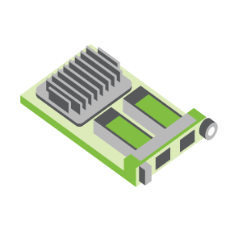
SERVER
OCP NIC Community Update March 2022 Sub-group Project wiki: https://www.opencompute.org/wiki/Server/Mezz
Mailing List: https://ocp-all.groups.io/g/OCP-NIC
NIC3.0

Slide 3
Agenda
OCP Leadership changes
April OCP Tech Week
Wiki Update
SI Test Fixture Update
Thermal Test Fixture Update

Slide 4
OCP Leadership change
OCP Foundation Chairperson change from Rebecca Weekly (Intel) to Anuraj Handa (Intel)
OCP Foundation new CEO, George Tchaparian
Server workgroup co-lead change from Shailaja Malladi (Microsoft) to Mark A Shaw (Microsoft)

Slide 5
OCP Tech Week
OCP Foundation 2-days Tech Week workshop
Mornings Pacific time
Trending towards end of April 2022
Virtual event
No fees

Slide 6
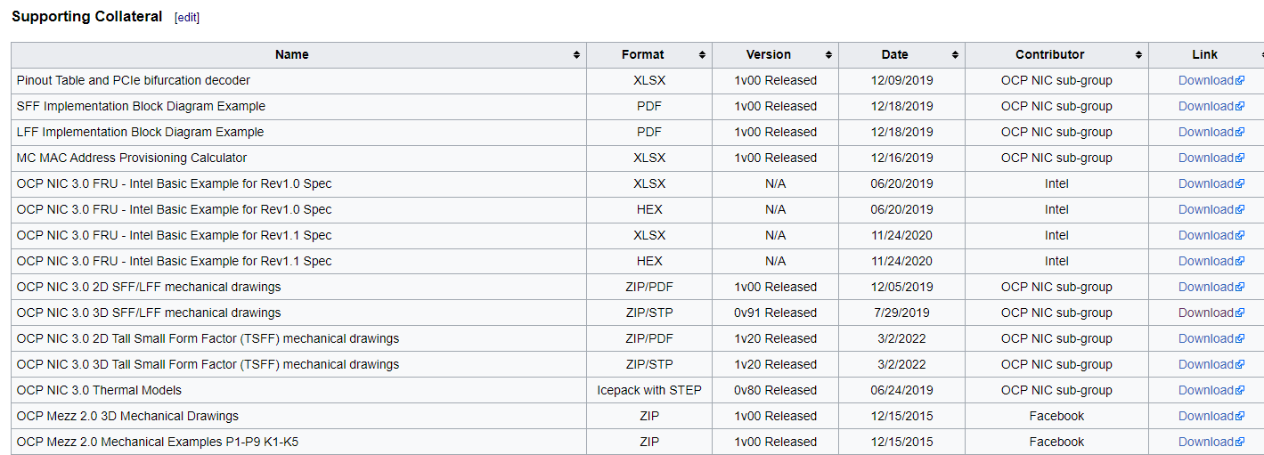
Mechanical 2D & 3D TSFF files in Wiki

Slide 7
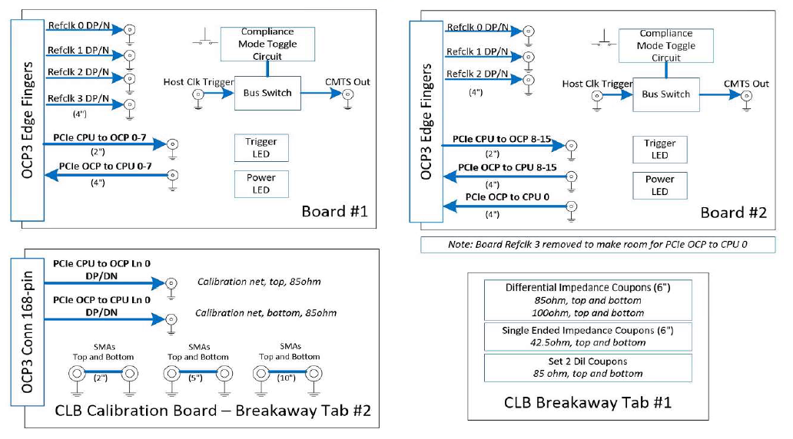
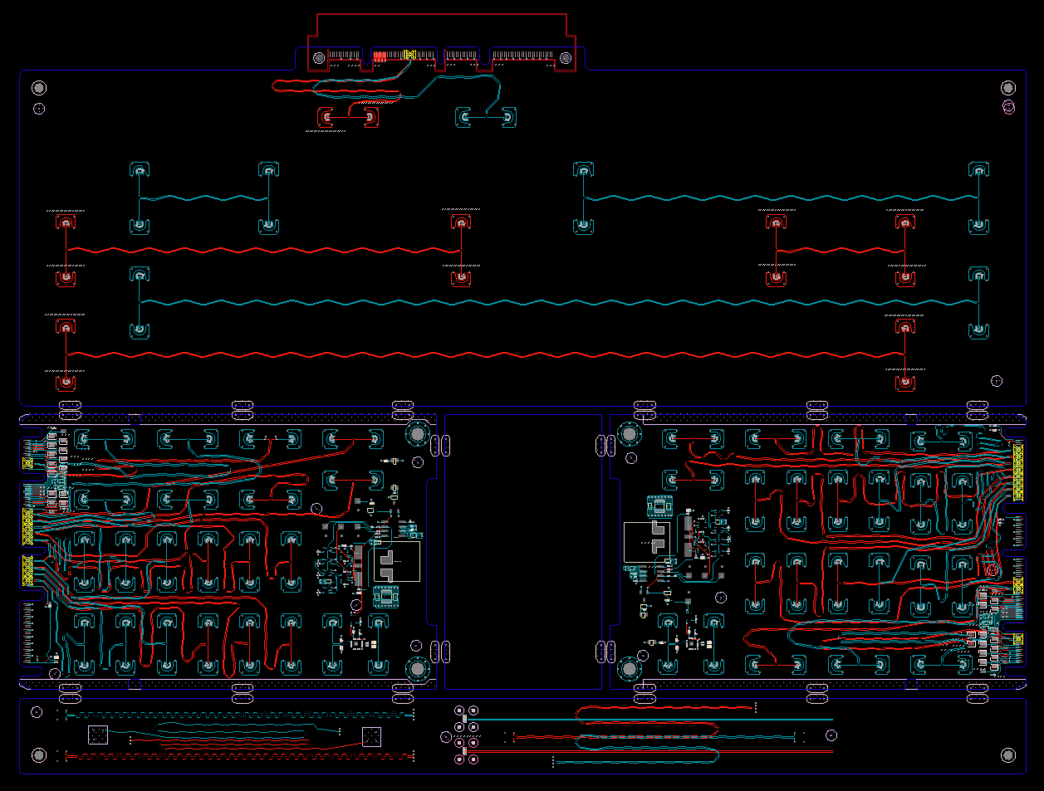
SI PCIe Gen5 test fixture update
Netlist block diagram
CLB Gen5 status:
Gerbered in January
PCB arrives to assembler ~ March 15
Assembly complete ~ end of March
CBB Gen 5 Status:
Based on Gen4 design
Updates to align with PCI CEM
Ready for review ~ end of March
OCP3 SFF CLB Gen5 ECAD
Calibration
CLB board 1
CLB board 2
Impedance Coupon

Slide 8
Thermal Test Fixture
Original Fixture intended to support SFF, modification for TSFF complete
Support for PCIe Gen5 is under investigation
Dell/Jason to investigate and share

Slide 9
PCIe Gen6
PCIe6 doubling bandwidth from PCIe5 thru signaling change. PCIe6 with PAM4 vs PCIe5 with NRZ signaling
PAM4 is more sensitive to noise
Suggest we first look at connector-goldfinger if our NIC3.0 definition still good for PCIe Gen6
A good read: https://www.electronicdesign.com/industrial-automation/article/21136215/intel-whats-the-difference-going-from-pcie-30-to-pcie-60

Slide 10
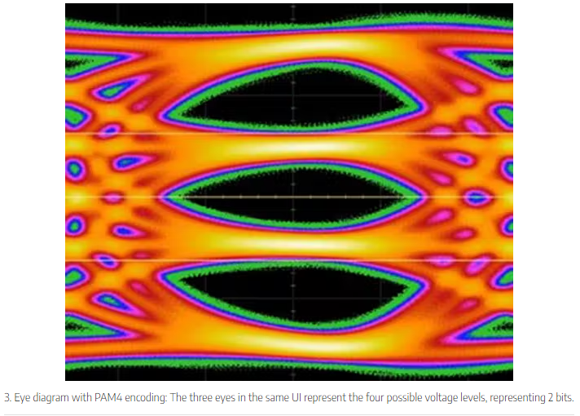
PCIe Gen6
PCIe6 doubling bandwidth from PCIe5 thru signaling change. PCIe6 with PAM4 vs PCIe5 with NRZ signaling
PAM4 is more sensitive to noise
Suggest we first look at connector-goldfinger if our NIC3.0 definition still good for PCIe Gen6
Diagram source & a good read: https://www.electronicdesign.com/industrial-automation/article/21136215/intel-whats-the-difference-going-from-pcie-30-to-pcie-60

Slide 11
Discussion bin list
DMTF NIC self-shutdown recommendation
Elegant cable-up solution
Zion uses 4C+ vertical connector to 4C+ saddle mount connector cable
1G NCSI/RGMII side-band support
PCIe Gen6 support
PCI-SIG spec at rev1.0*
800G Ethernet port
Additional side-band

Slide 12
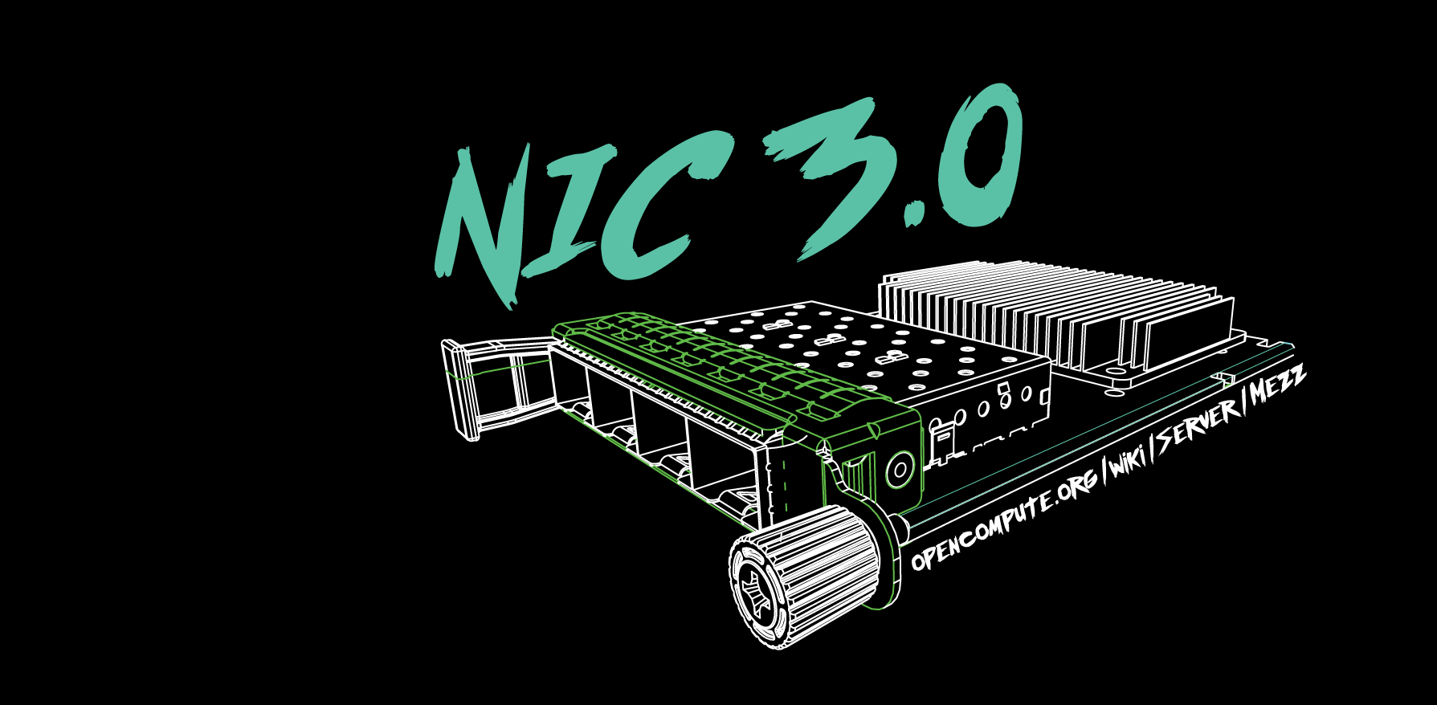

Slide 13
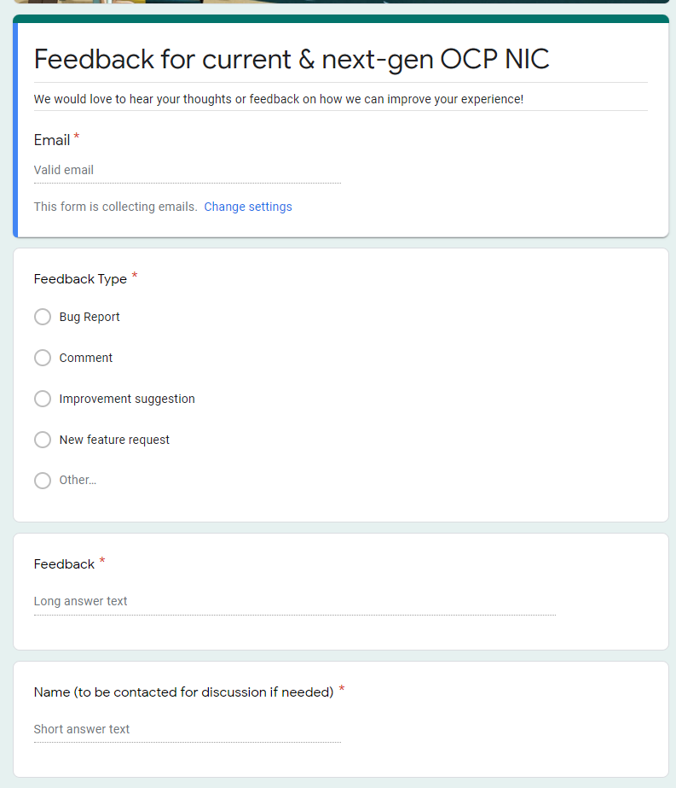
Gather feedback throughout the year
Provide your feedback at: https://tinyurl.com/feedback2ocpnic

Slide 14
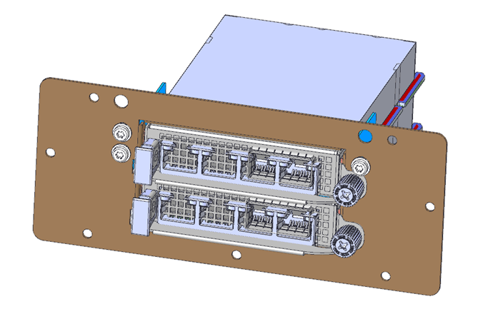
Thermal Test: TSFF TTF Status
Mechanical files received. Pending mechanical engineer peer review
Uses existing TTF with 3 different components to convert to TSFF.

Slide 15
NIC self-shutdown discussion
Get DMTF & HW management feedback
Discussion 1: NIC self shutdown as optional feature?
Discussion 2: NIC self shutdown as threshold?
Discussion 3: If NIC self shutdown implemented, it shall provide mechanism to enable/disable the feature?

Slide 16
NIC self-shutdown discussion
Discussion 1:
NIC self shutdown as optional feature
Keep as optional

Slide 17
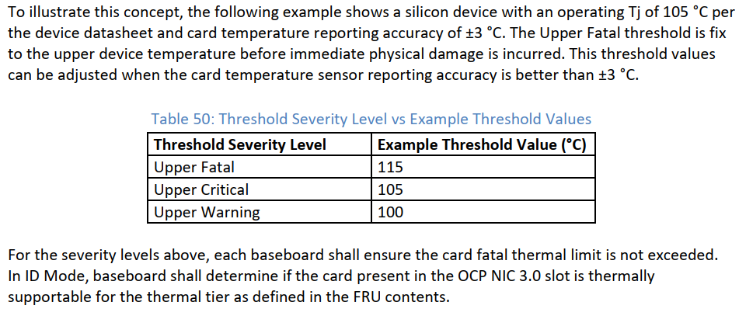
NIC self-shutdown discussion
Discussion 2:
NIC self shutdown as threshold
Change between to “at least”
Or remove this recommendation
Current recommendation

Slide 18
NIC self-shutdown discussion
Discussion 3:
If NIC self shutdown implemented, it shall provide mechanism to enable/disable the feature

