Slide 2
OCP NIC Community Update July 2020
OCP NIC Subgroup Sub-group Project wiki: https://www.opencompute.org/wiki/Server/Mezz Mailing List: https://ocp-all.groups.io/g/OCP-NIC
Server Workgroup

Slide 3
Agenda
Project lead news
Contributor list update
OCP Engr Week
Signal integrity discussion
Mechanical update
Specification update

Slide 4
Project Leads News
Project Name | Project Leadership
Data Center Facility | Rob Coyle (PCX) Anand Ramesh (Google)
Hardware Management | Hemal Shah (Broadcom) Bob Stevens (Dell)
Networking | Omar Baldonado (Facebook) Roopa Prabhu (Cumulus/NVidia)
Open System Firmware | Ryan O’Leary (Google) Anjaneya “Reddy” Chagam (Intel)
Rack and Power | Hamid Keyhani (Facebook) Caleb Lusk (Rittal)
Security | Bryan Kelly (Microsoft) Nate Klein (Google)
Server | John Stuewe (Dell) Siamak Tavallaei (Microsoft)
Storage | Jason Adrian (Microsoft) Dave Landsman (WD)
Telco | Marco Hokkanen (Nokia) Loren Staley (Edgecore)

Slide 5
Contributor list
With a heavy heart, per OCP foundation direction, Lenovo will cease to be contributing member listed in OCP NIC3.0 spec starting from June 19, 2020
I hope Lenovo will return in the near future

Slide 6
Gather interest for OCP Engr Week
Approx. Time frame: Late Oct or 2nd/3rd week of Nov
Venue: Virtual
Expect to be multiple days with
1 day OCP initiatives, OCP project updates, OCP marketplace updates
Others are engineering workshops
All sessions are live (no pre-recordings), but sessions are recorded
Engineering workshop topics can be determined by us or call for broader community engagement
There is a small nominal fee for this ☺
Are we interested?

Slide 7
Signal Integrity discussion
SIWG plan is draft spec with TBD budget for SFF in spec this month.
From server workgroup feedback, is it possible to document -8dB for SFF first then continue to find path to lower loss budget on SFF NIC
For LFF, the general agreement is no higher than -9.5dB. Are we comfortable to document this?

Slide 8
Mechanical Update
Mechanical compliance test fixtures

Slide 9
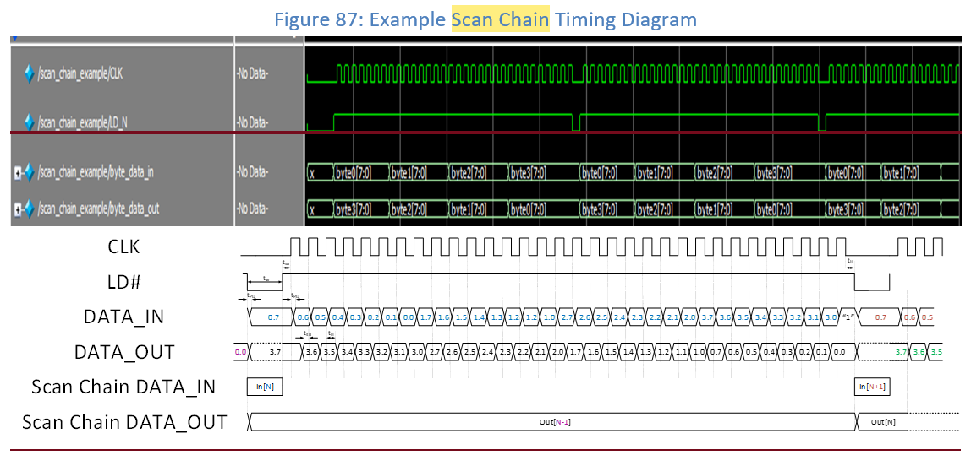
Specification update discussion

Slide 10
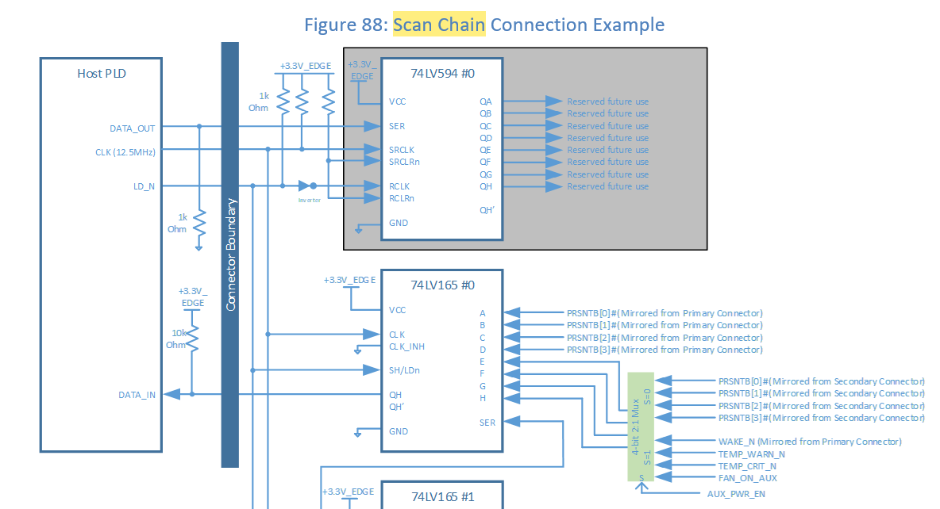
Specification update discussion

Slide 11
Q&A

Slide 12
March 4-5, 2020

