Slide 1
Thermal Model Description
Rev 01
4/27/2017
Yueming Li, Thermal Engineer, Facebook
John Fernandes, Thermal Engineer, Facebook
Jia Ning, Hardware Engineer, Facebook

Slide 2
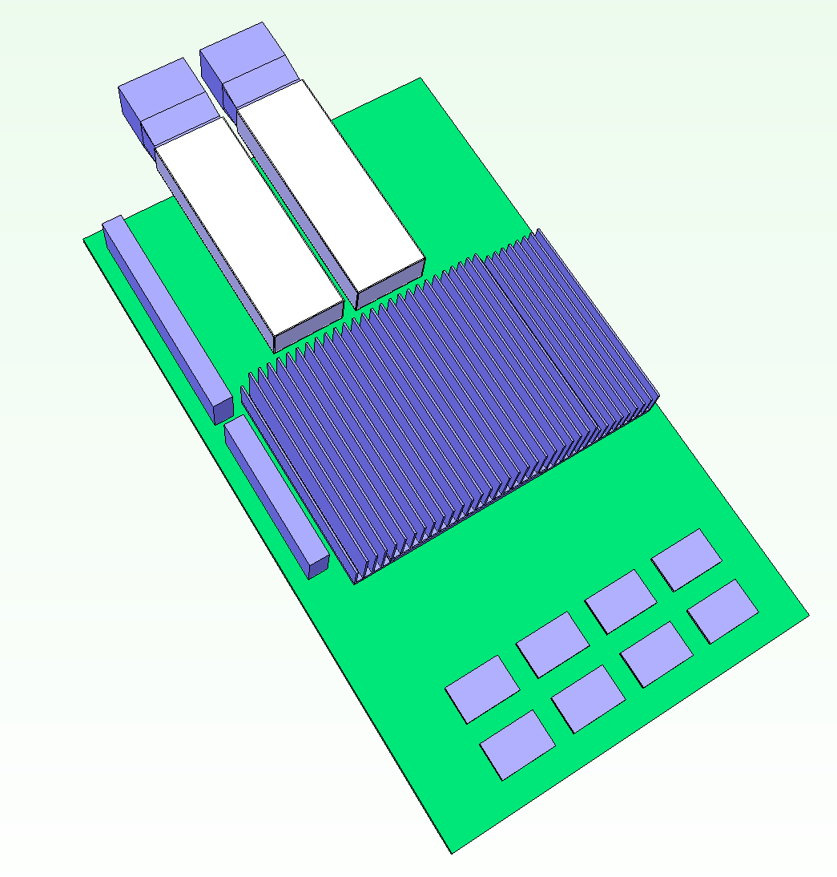
Fixed Parameters for CFD
QSFP @ 3.5W each
Use Enumeration #7 as starting point
DRAM
8*DRAMs @ 0.4W each
I/O module
2*QSFP optical module @ 3.5W each
ASIC size
With DRAM: 33*33mm
Without DRAM: 25*25mm
Airflow approach to card
Cold aisle: 35°C (towards I/O module)
Hot aisle: 55°C (towards DRAM/ASIC)
PCB top clearance
Follow Mezz 2.0 spec (2.9mm)
ASIC @ 20 ~ 30W
DRAM @ 0.4W each
Connector A
Connector B

Slide 3
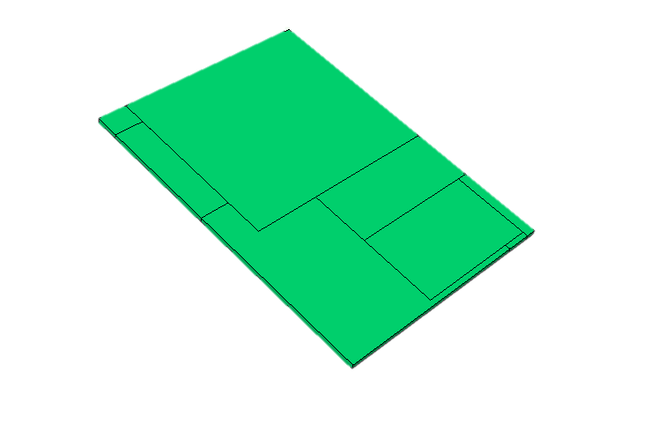
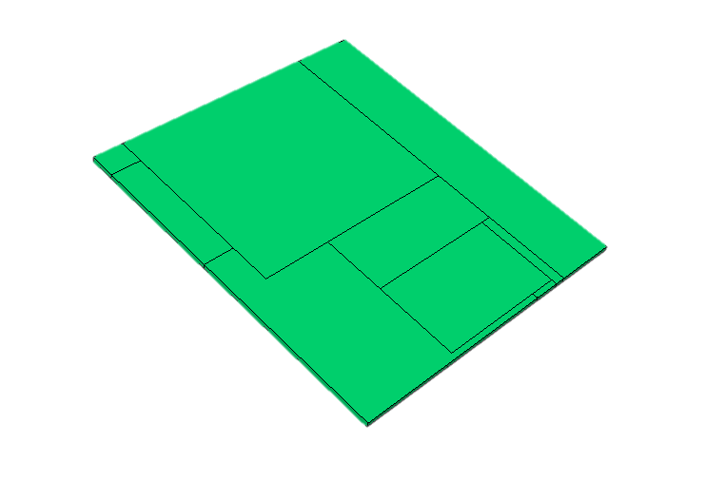
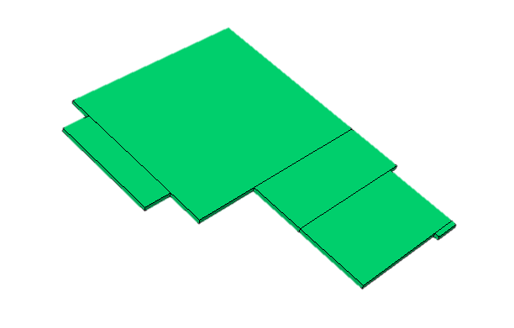
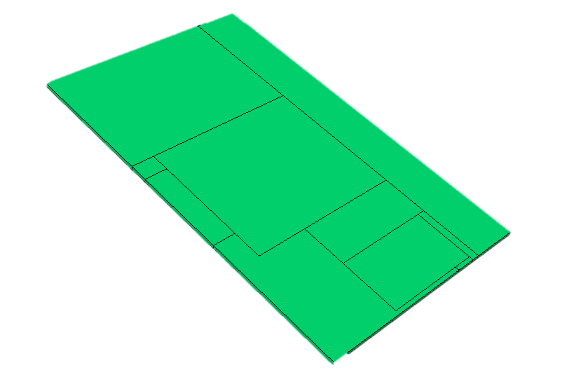
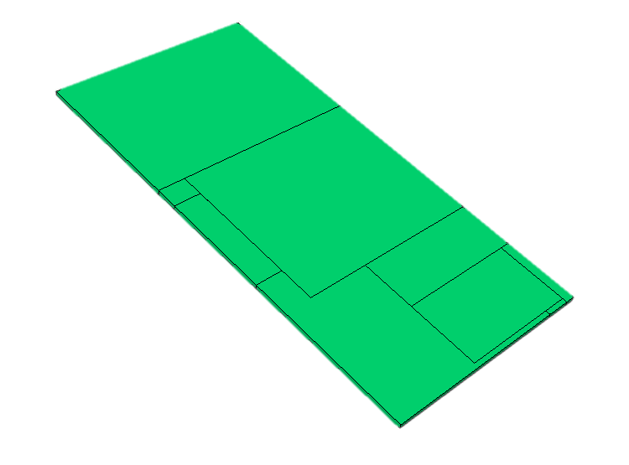
Variables for CFD
ASIC Power
Range from 15W to 35W
Mechanical
Baseboard size
4 Sizes in total: 7a, 7b, 7c, 7d
As start, choose two form factors: 7a and 7d
Connector height
Choose 8mm for 7a
Choose 12mm for 7d
Cutout size
I/O ports only for 7a
I/O ports + heat sink for 7d
Airflow direction
Cold aisle, hot aisle
LFM
150 ~ 300 LFM for cold aisle
150 ~ 500 LFM for hot aisle
7a: Smallest Form Factor
7b: Increase Width
Original Mezz 2.0
7c: Increase Depth
7d: Increase Both Width and Depth

Slide 4
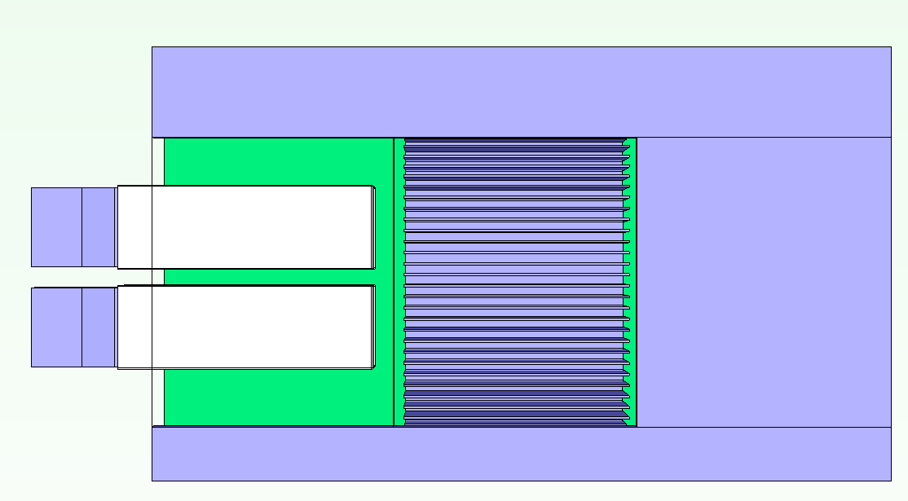
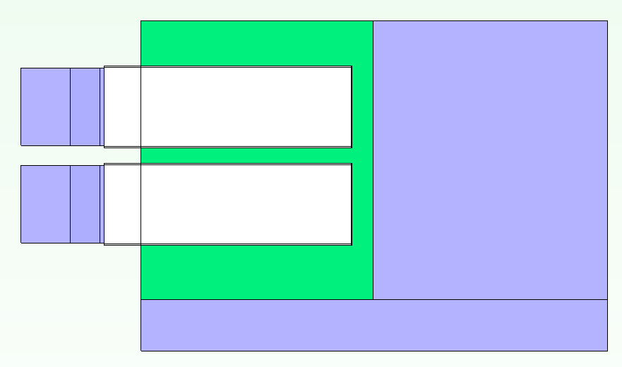
Cut-out Sizes
I/O ports only
The cutout for I/O will fit into all optical modules listed in Mezz 2.0 spec, including QSFP, RJ45 and SFP
Cutout width and depth are 65.79mm * 54.8mm
I/O ports + heat sink
Besides I/O cutout, additional heat sink cutout enables higher fins for ASIC
Cutout width and depth are 65.79mm* 110.05mm
110.05mm is the total depth of 7a mezzanine PCB
IO ports only cutout for 7a
IO ports + heat sink cutout for 7d

Slide 5
Cases for CFD - Input
Case # |  | Input parameters
 | I/O | ASIC 1 Power (W) | ASIC 1 Location | Connector Height (mm) | PCB Board Size | DRAM Location | Cut-out | Heat Sink + BGA Max Height | Airflow Direction or I/O Location
A1 | 2x QSFP-Bottom | 15 | Bottom | 8 | 7a | N/A | IO Ports Only | 7 | Cold-aisle
A2 | 2x QSFP-Bottom | 20 | Bottom | 8 | 7a | N/A | IO Ports Only | 7 | Cold-aisle
A3 | 2x QSFP-Bottom | 25 | Bottom | 8 | 7a | N/A | IO Ports Only | 7 | Cold-aisle
A4 | 2x QSFP-Bottom | 30 | Bottom | 8 | 7a | N/A | IO Ports Only | 7 | Cold-aisle
A5 | 2x QSFP-Bottom | 15 | Bottom | 8 | 7a | N/A | IO Ports Only | 7 | Hot-aisle
D1 | 2x QSFP-Bottom | 35 | Bottom | 12 | 7d | Bottom | IO Ports + Heat Sink | 16 | Cold-aisle
D2 | 2x QSFP-Bottom | 30 | Bottom | 12 | 7d | Bottom | IO Ports + Heat Sink | 16 | Cold-aisle
D3 | 2x QSFP-Bottom | 25 | Bottom | 12 | 7d | Bottom | IO Ports + Heat Sink | 16 | Cold-aisle
D4 | 2x QSFP-Bottom | 20 | Bottom | 12 | 7d | Bottom | IO Ports + Heat Sink | 16 | Cold-aisle
D5 | 2x QSFP-Bottom | 20 | Bottom | 12 | 7d | Bottom | IO Ports + Heat Sink | 16 | Hot-aisle
Please note
The objective is to study both ends of the spectrum as a starting point
Thermally least favorable configuration – 7a + “IO ports only” cut-out + 8mm connector
Thermally most favorable configuration – 7d + “IO ports + heat sink” cut-out + 12mm connector
Results might not give a solution, but should provide a clear direction for further thermal analysis

Slide 6
Cases for CFD - Output
Output parameters
ASIC Tcase_max (°C) |  |  |  |  |  | DRAM Tcase_max (°C) |  |  |  |  |  | I/O Module Tcase_max (°C)
105°C |  |  |  |  |  | 95°C |  |  |  |  |  | 85°C
150 | 200 | 250 | 300 | 400 | 500 | 150 | 200 | 250 | 300 | 400 | 500 | 150 | 200 | 250 | 300 | 400 | 500 | LFM
Table 1. Specs for components
Component | Tcase_max (°C)
DRAM | 95
QSFP | 85
ASIC | 105

Slide 7
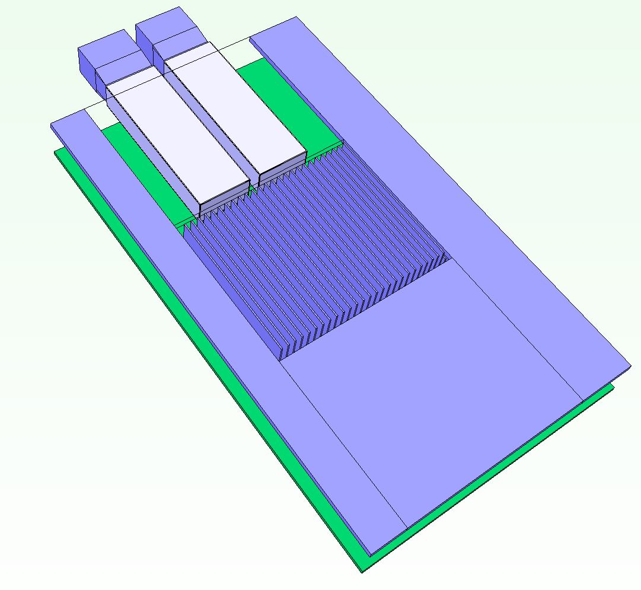
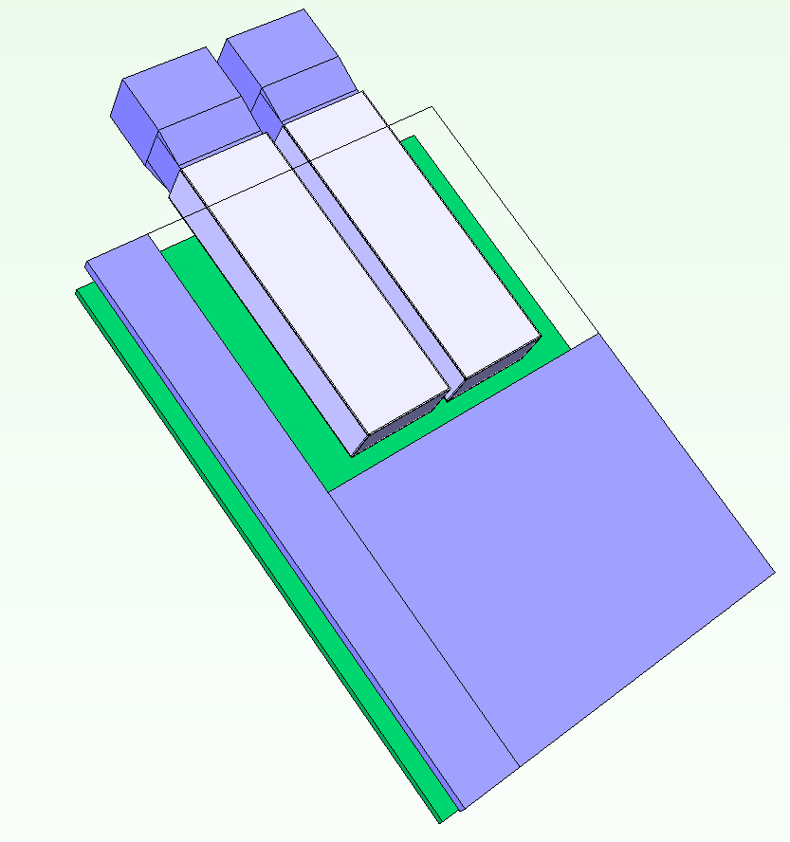
FloTherm Model
170426 Mezz 3.0 Case A1.pdml
170426 Mezz 3.0 Case D1.pdml
Please note the following initial definitions in the models
PCB layer definition for thermal conductivity
2-resistor models for ASIC and DRAM
Simplified block with embedded source for QSFP modules
Any feedback per the above would be greatly appreciated

