Slide 2
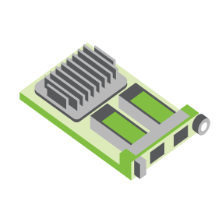
SERVER
OCP NIC Community Update
For server workgroup July 2021
Sub-group Project wiki: https://www.opencompute.org/wiki/Server/Mezz
Mailing List: https://ocp-all.groups.io/g/OCP-NIC
NIC3.0

Slide 3
Agenda
OCP Global Summit
Mechanical fit-test fixture
NIC3.0 spec update & review request
Workgroup update

Slide 4
OCP Global Summit Workshop & Experience Lab demo
4 abstracts submission
Several companies express initial interest regarding experience lab demo
Demo products is TBD, new acceptance criteria from OCP Foundation might impact eligibility

Slide 5
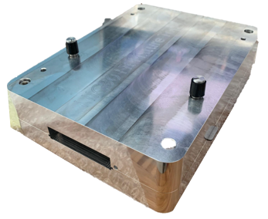
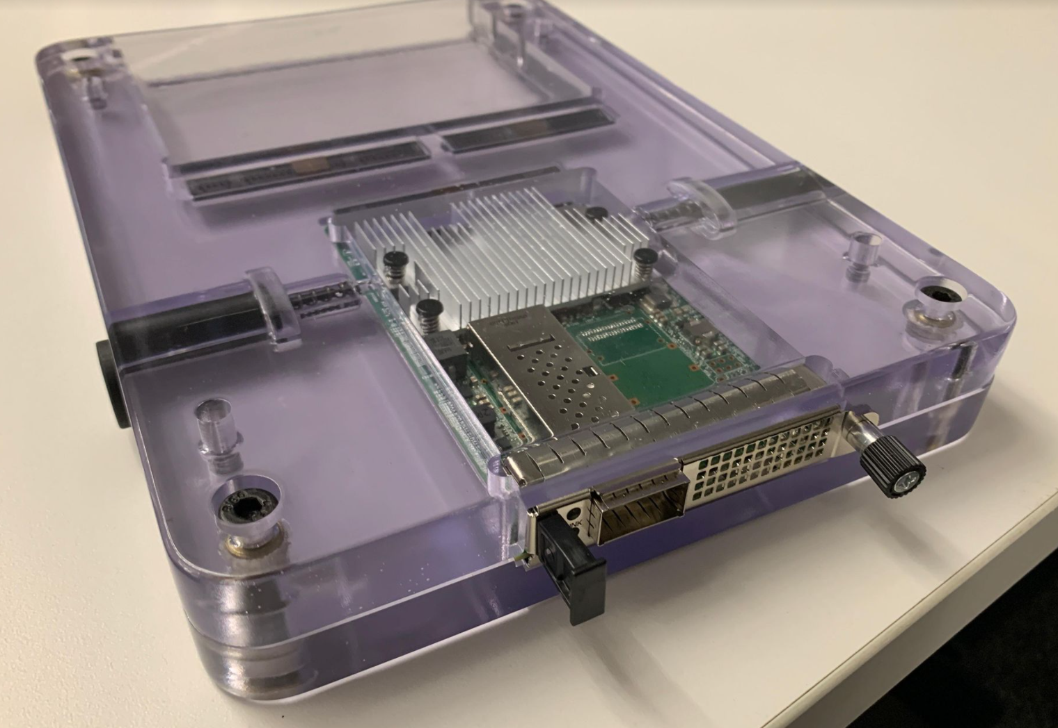
Mechanical Fit Test Fixture
All recipients confirmed received delivery package on 2nd rev mechanical fit test fixture
Some good feedbacks captured including a major one such as how to remove an internal latch NIC
1st rev
2nd rev

Slide 6
NIC3.0 spec update (draft)
TSFF form factor and minor changes included in 1v11 RC review. Please feedback by August 4, 2021
- General – Changed “SFF” references to “SFF/TSFF” where applicable.
- General – Format all tables with repeated headers when they span multiple pages
- Section 1.2 – Added Molex to the acknowledgements section.
- Section 1.4 – Added TSFF, OSFP-RHS and QSFP-DD to the acronyms section.
- Section 1.6, 2.1.1 – Added text for TSFF and clarify TSFF shares the same mechanical outline as SFF.
- Section 1.7.1 – Added TSFF to the OCP NIC 3.0 Form Factor Dimensions table; add Max Z-height information.
- Section 1.7.2.x - Updated text "Up to PCIe Gen 5 (32 GT/s) support"
- Section 2.2 - Add QSFP-DD, OSFP-RHS for TSFF in Line side implementation. Add QSFP-DD, OSFP to standards cross reference table.
- Section 2.4.1, 2.4.2 – Updated faceplate subassembly drawing and BOM callouts.
- Section 2.4.4 – Added TSFF generic faceplate drawings. Drawings only contain dimensional deltas from SFF.
- Section 2.5.2 – Added TSFF keep out zones. Drawings only contain dimensional deltas from SFF. - Section 2.8.5 - Replaced Figure 56 - SFF Baseboard Chassis CTF dimensions (Rear Rail Guide View) as it was clipped in the previous release.
- Section 2.8.6, 2.8.7, 2.8.8, 2.8.9 – Added TSFF CTF dimensions for pull tab, ejector and internal lock board dimensions. Add TSFF baseboard CTF dimensions. Drawings only contain dimensional deltas from SFF. - Section 2.10 - Added TSFF Generic faceplate assembly CAD.
- Section 3.4.2, 3.5.4 – Clarified that the BIF[2:0]# pins shall not change states after AUX_PWR_EN is asserted.
- Section 3.4.4 – Clarified that the RBT_ISOLATE# signal shall not change state even when the NIC_PWR_GOOD signal is in the don't care state.
- Section 3.7.3 – Added note regarding the use of light pipes above I/O cage assemblies for TSFF and cage implementations.
- Section 3.11 – Clarified power down sequencing diagram - +12V_EDGE may optionally be disabled in ID Mode. This mirrors the same behavior for the power up sequencing diagram.
- Section 5.1 – Added note stating the SFF and TSFF timing parameters are the same since the cards may share the same PBA.
- Section 6.2.2, 6.2.5 – Added placeholder headings for the hot and cold aisle cooling graphs for TSFF.
- Section 6.4.2 – Added placeholder heading for the TSFF thermal test fixture.
- Section 6.4.5 – Added placeholder figure headings for the TSFF candlestick air velocity vs volume flow graphs.
- Section 7.1.3 – Updated Safety requirements. 60950-1 was withdrawn as of 12/20/2020. 62368-1 replaced 60950-1.

Slide 7
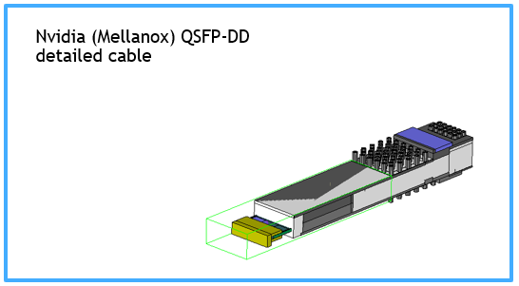
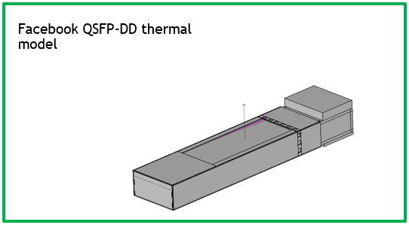
Workgroup update
SI WG:
OCP NIC PCIe Gen5 test fixture has a little delay due to manufacturing issue. Expect to be resolved next month.
Thermal WG:
Nvidia shared pluggable module model for discussion
Gathering Luxshare & Amphenol model to compare together
Goal is to align common temperature monitoring location

Slide 8
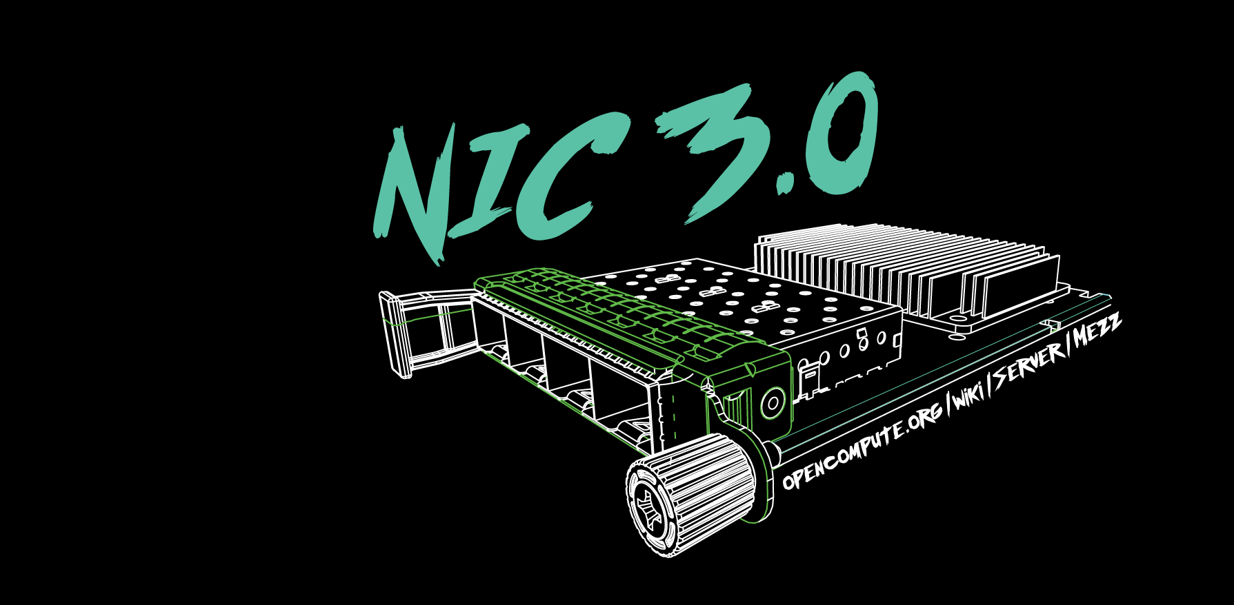

Slide 9
2021 OCP Global Summit - Demo
-2020-
OCP NIC Experience Lab demo coordination
2019: Facebook
2020: Intel & Nvidia
2021: Broadcom

