Slide 2
OCP NIC Community Update March 2020
OCP NIC Subgroup Sub-group Project wiki: https://www.opencompute.org/wiki/Server/Mezz Mailing List: https://ocp-all.groups.io/g/OCP-NIC
Server Workgroup

Slide 3
Agenda
Virtual Global Summit 2020
Community update
Specification clarification
Mechanical update
Signal Integrity update

Slide 4
Virtual Global Summit 2020
If you have not heard, it is in Week of May 11, 2020
What you can expect:
This will be a rich, interactive experience that can be accessed from anywhere in the world, that incorporates all the key components of our Global Summit, including keynote sessions, executive tracks, an Expo Hall with Expo Hall talks, Engineering Workshops, the OCP Experience Center and the OCP Future Technologies Symposium. This format will allow us to reach a larger audience, with increased functionality for Q&A, panel discussions, live chat, and one-on-one connections with key constituencies that you expect from our Summit.
Notes:
innovate

Slide 5
Community updates
Tektronix & Xilinx show interest in our workgroup. Would share more when their interest and ours align.

Slide 6
Specification clarification
Aux Fan enable
Warning & Critical temperature

Slide 7
Mechanical update
Some ODM reports ejector latch is loose when NIC implement latest spec guidance using clinch nut
Mechanical compliance keep-in/keep-out jig volunteer

Slide 8
Signal Integrity update
PCIe Gen5 budget datapoints

Slide 9
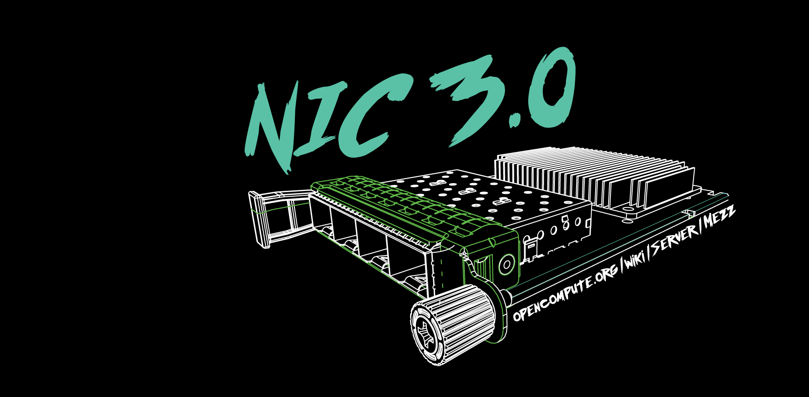
Q&A

Slide 10
March 4-5, 2020

