Slide 2
KEYNOTE: INDICATOR SPECIFICATION PROPOSAL
Michael Haken, Mechanical Engineer, Facebook.

Slide 3
Objective
Adopt an OCP specification where indicators are clearly visible, consistent, accommodate color-blind data center personnel, only communicate actionable information, and do not conflict with other diagnostic tools.

Slide 4
Guiding Principals
Indicators Should:
Be Consistent – common symbols, LED colors, intensity, message
Have a Purpose – must provide actionable information
Be Simple – no decoder ring necessary
Never Conflict with Indicators on other Products

Slide 5
Indicator Colors

Slide 6
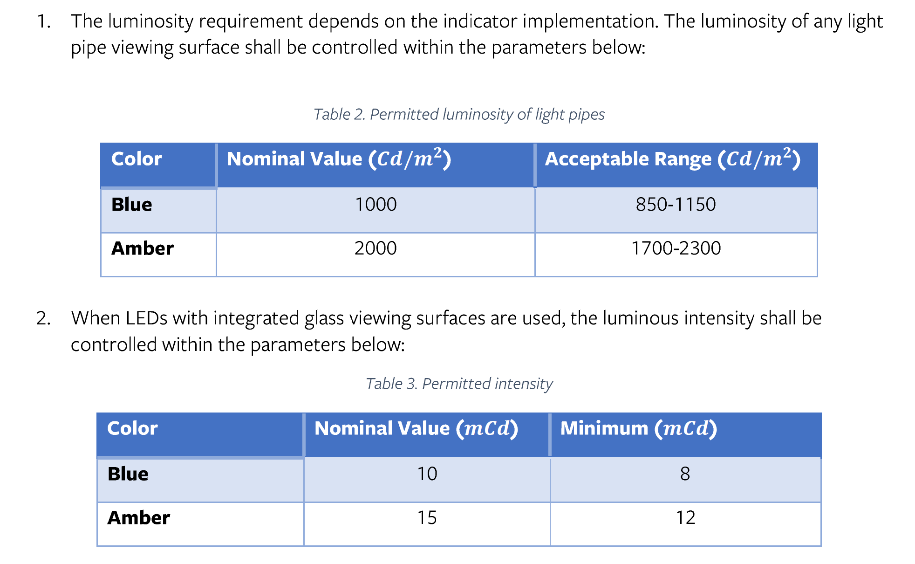
Indicator Intensity

Slide 7
Indicator Intensity – View Angle
+/-40 degree view angle horizontally and vertically
+/- 25% Luminosity intensity within this range
+/- 55 degree view angle whenever possible
Indicator cross-talk should not cause an increase of more than 20 Cd/m^2 in adjacent indicators

Slide 8
Indicator Behaviors

Slide 9
Indicator Placement
Indicators should be visible on the front or rear panel of a system when viewing the panel from a perpendicular direction.
Indicators should always be surrounded by a panel to reduce background visual noise and provide a location for printed legends.
Indicator pairs must be arranged as: blue-left/amber-right, or blue-above/amber-below

Slide 10
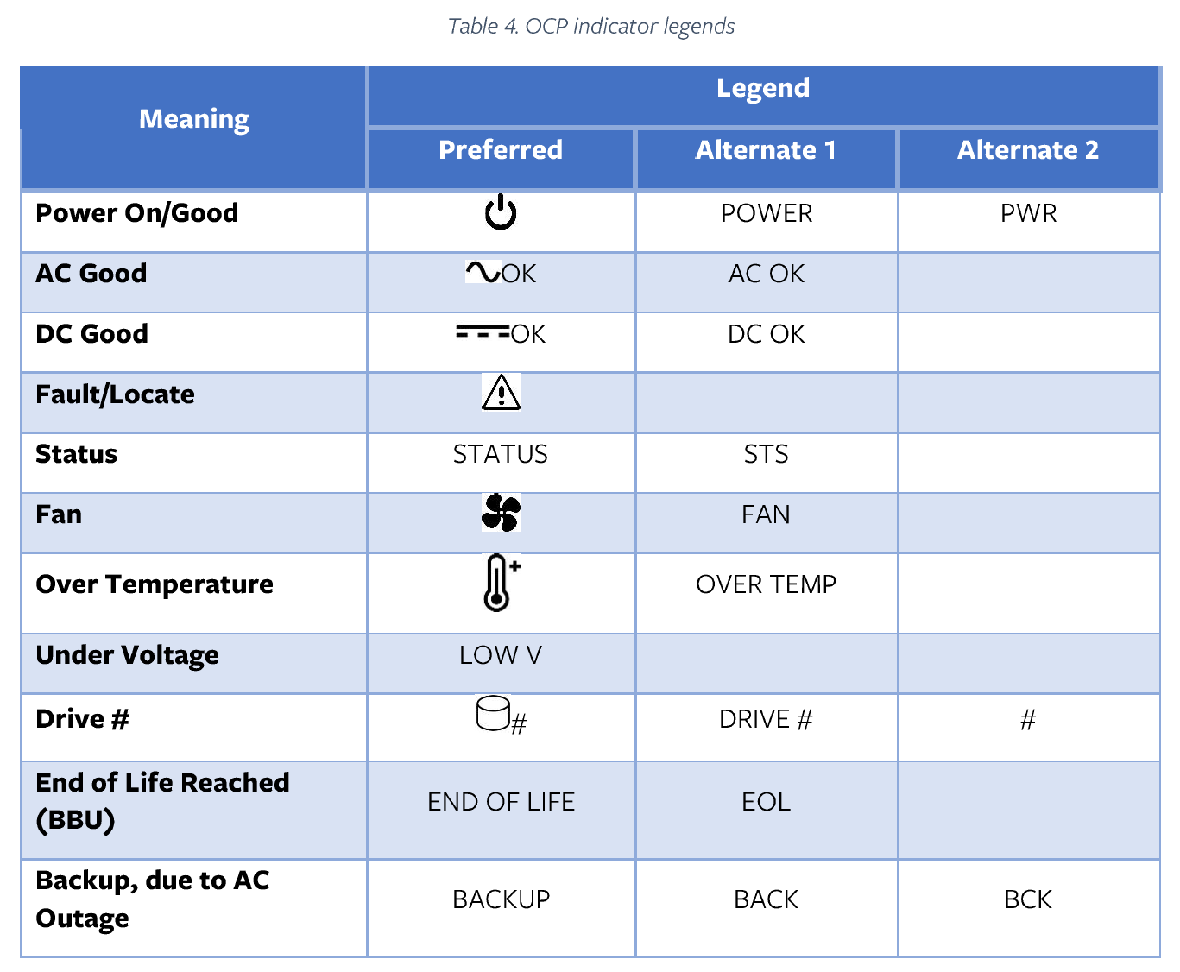
Indicator Nomenclature

Slide 11
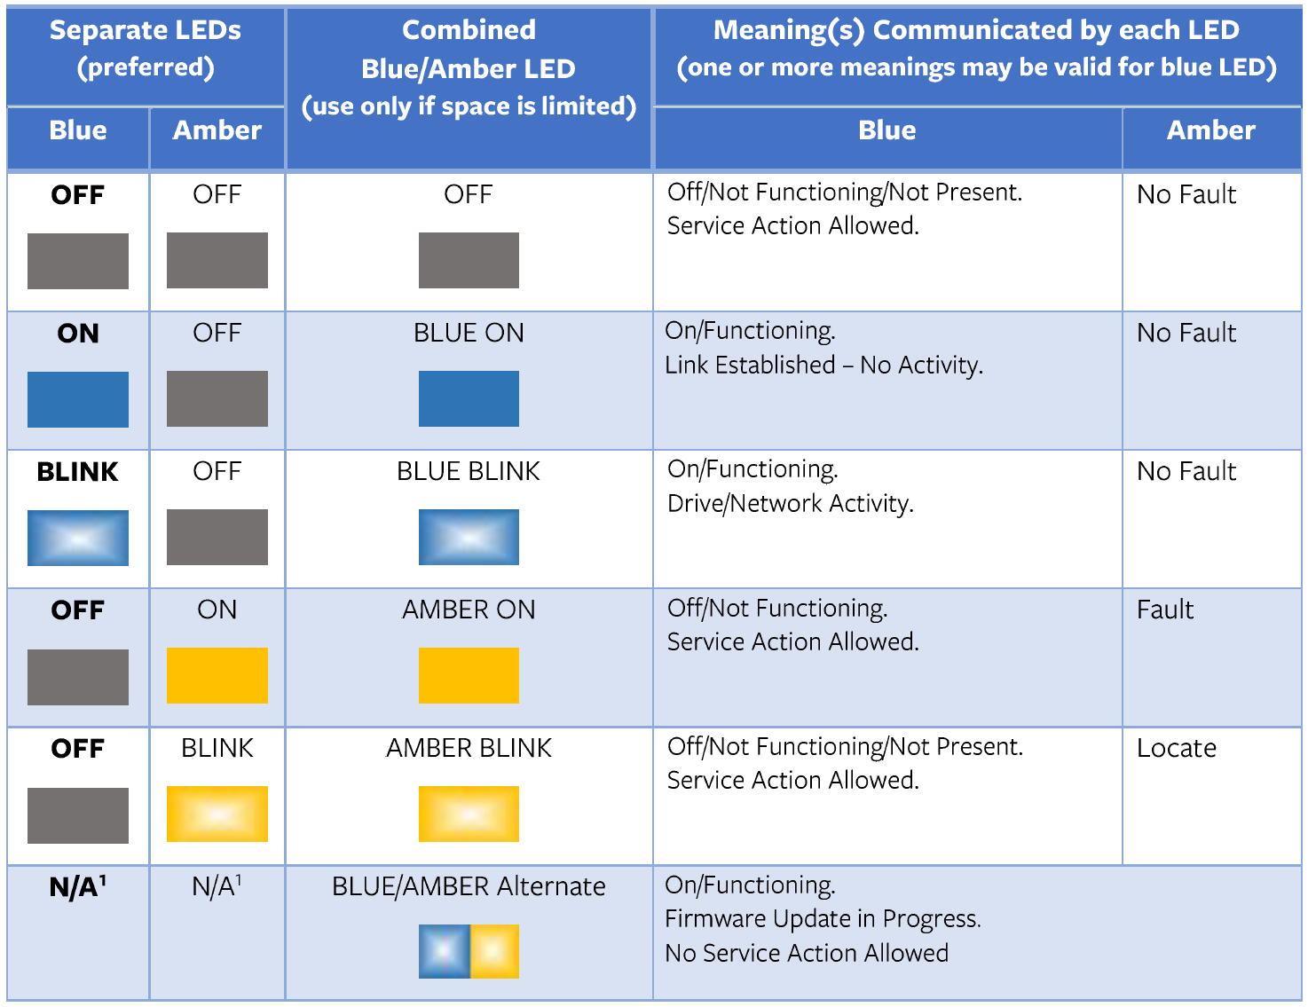
Indicator States

Slide 12
Indicator States As Applied to Specific Hardware

Slide 13
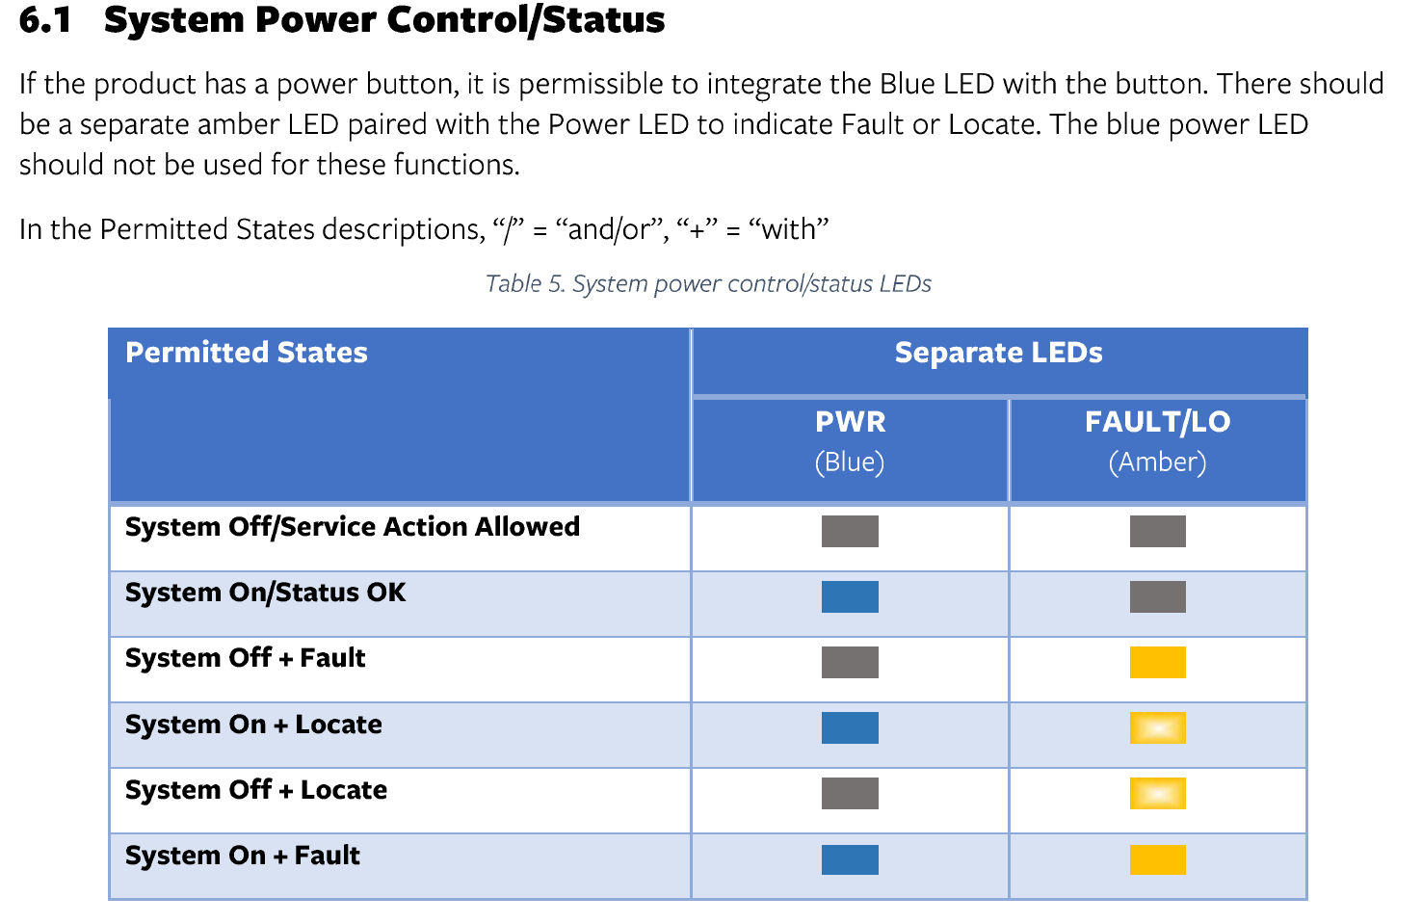

Slide 14
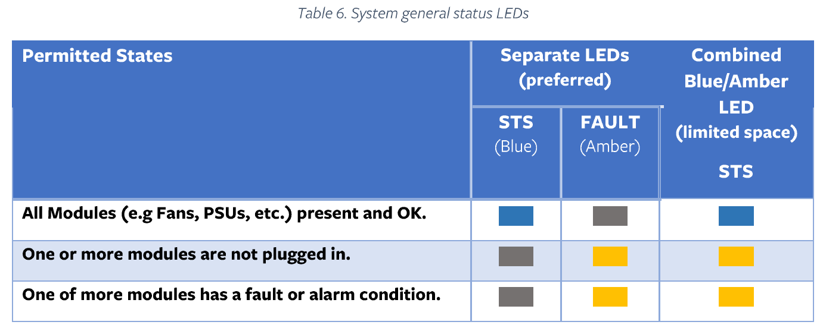

Slide 15
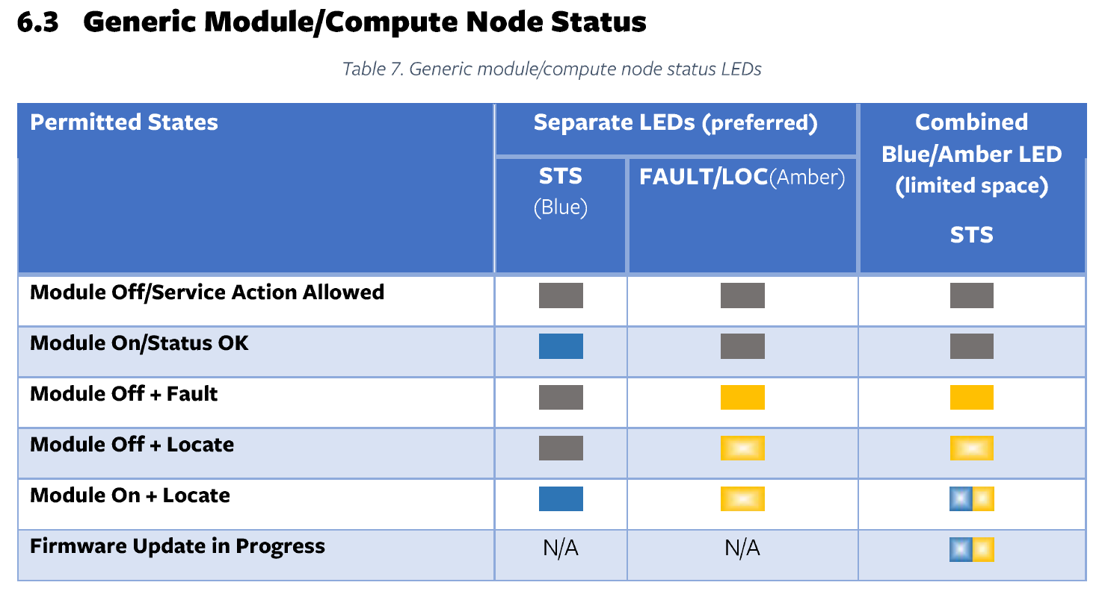

Slide 16
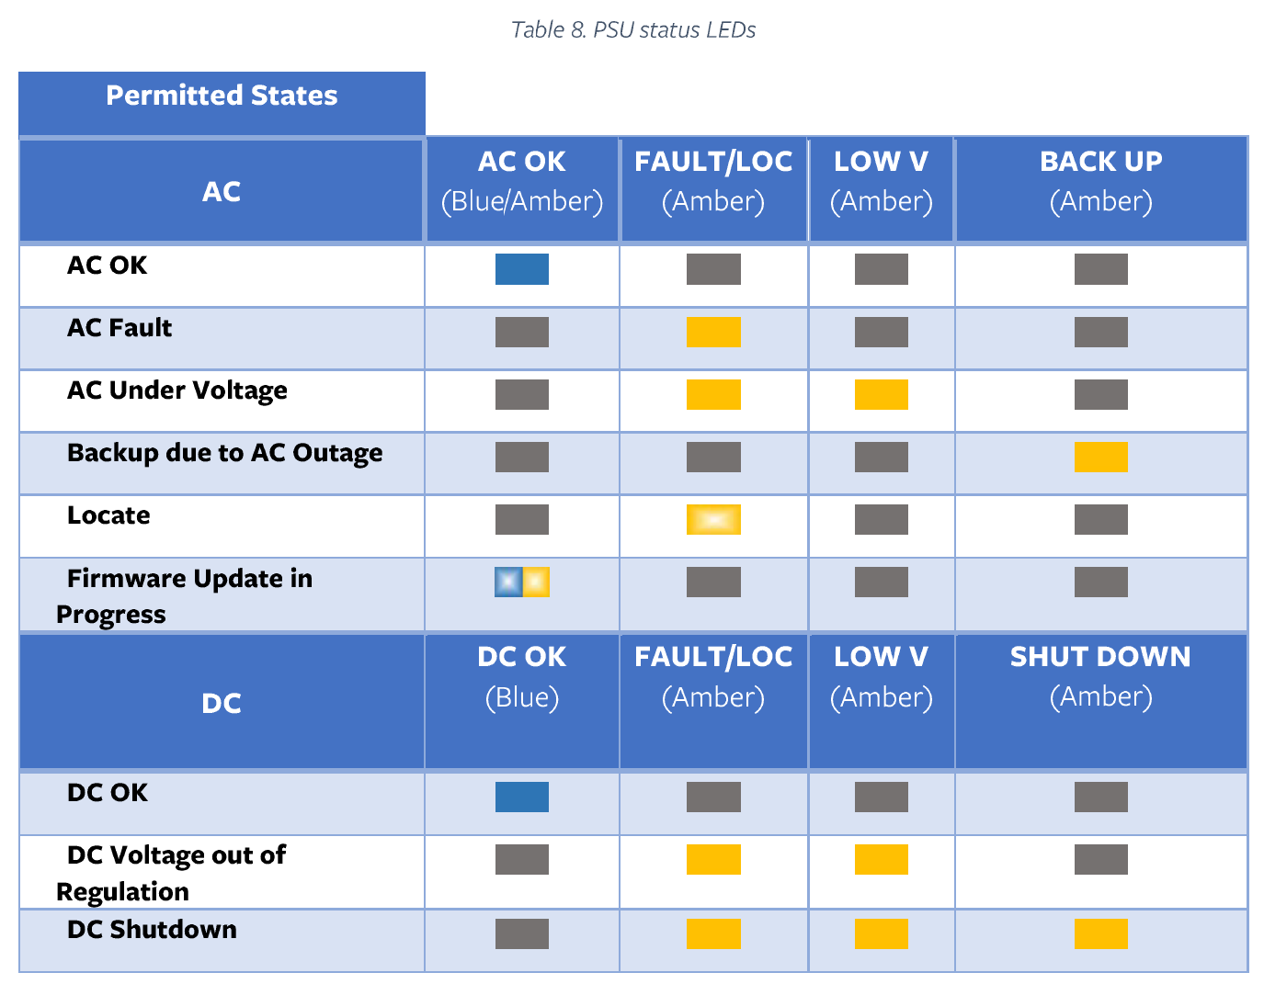

Slide 17
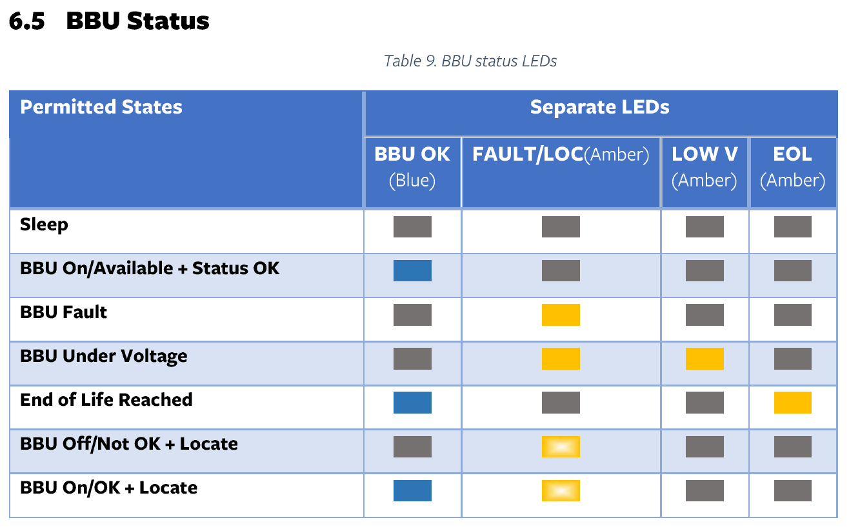

Slide 18
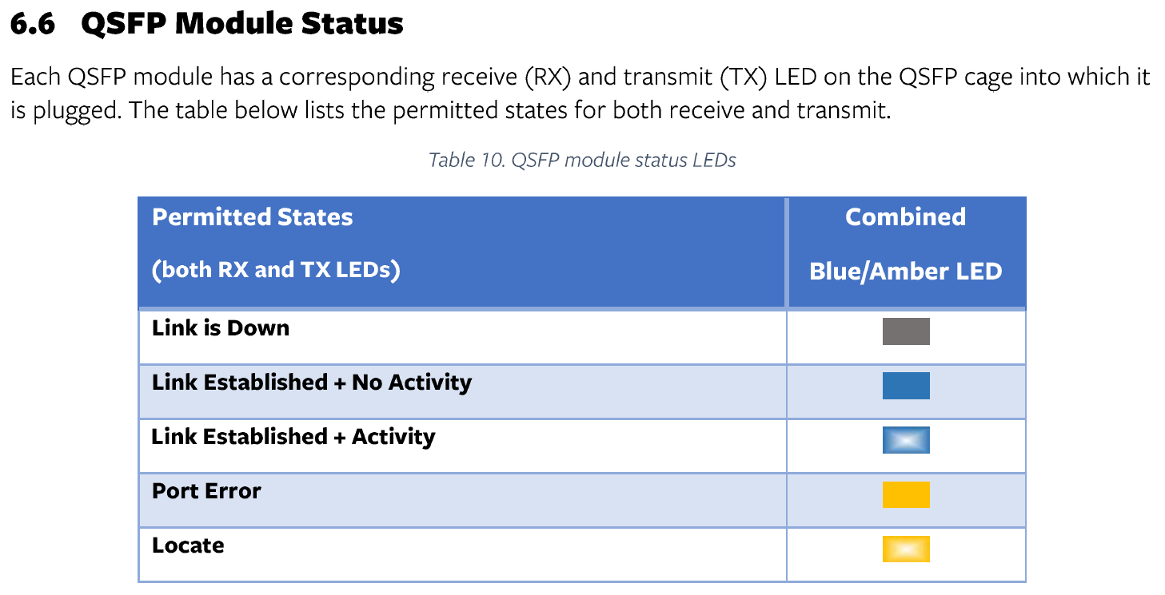

Slide 19
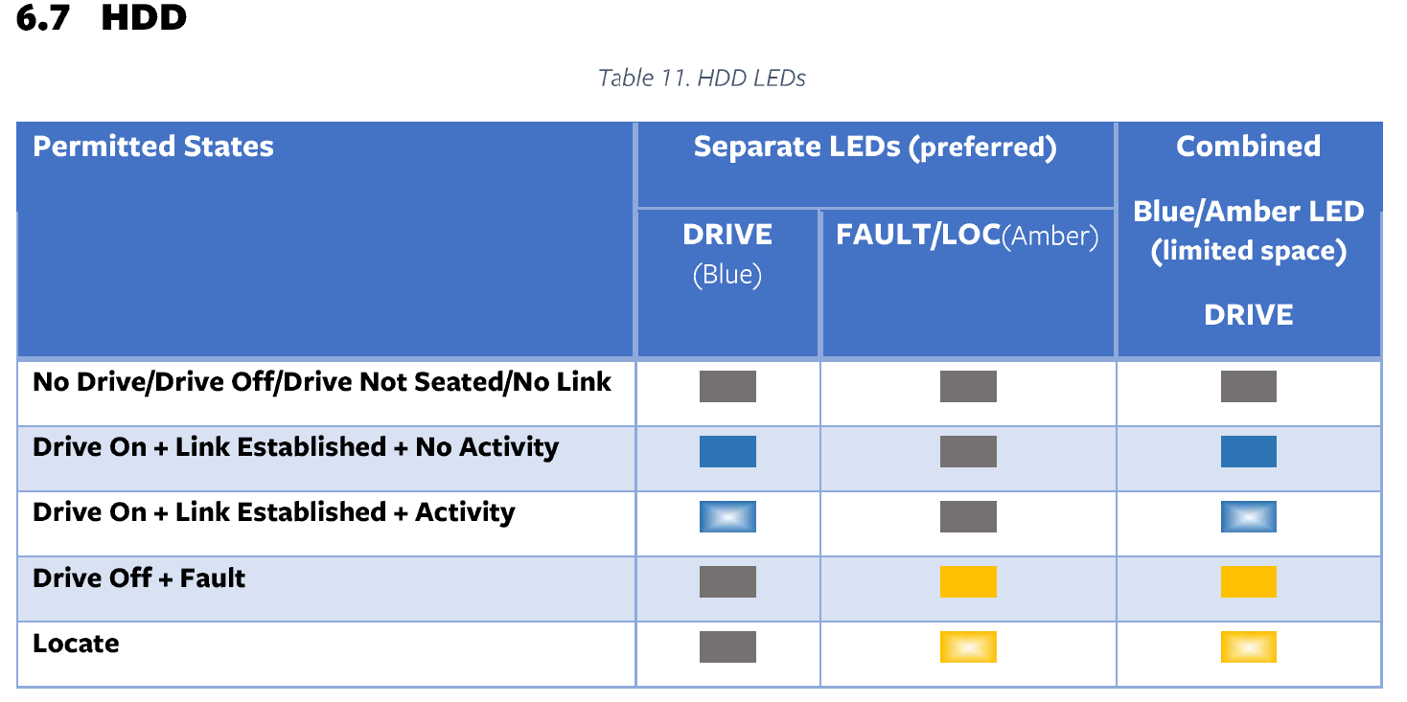

Slide 20
