Slide 1
OCP NIC 3.0 - Spec update version 1.2.1 (draft)
Mechanical update
11/3/2022

Slide 2
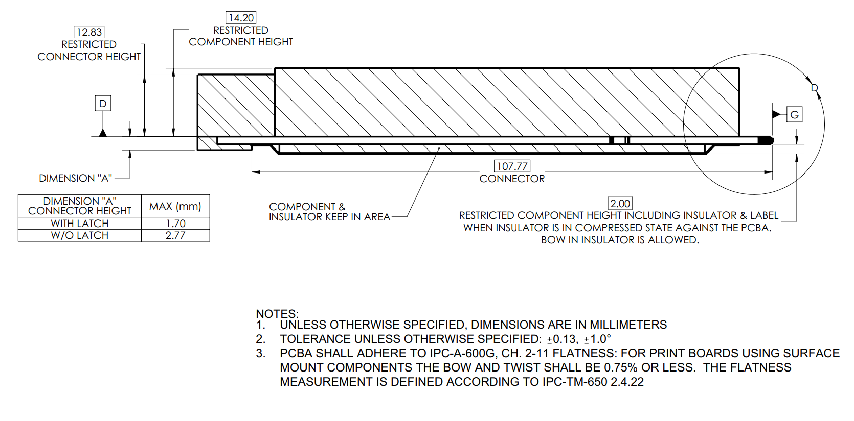
From
bv
bv
To
Note: matching figure 31 for consistency

Slide 3
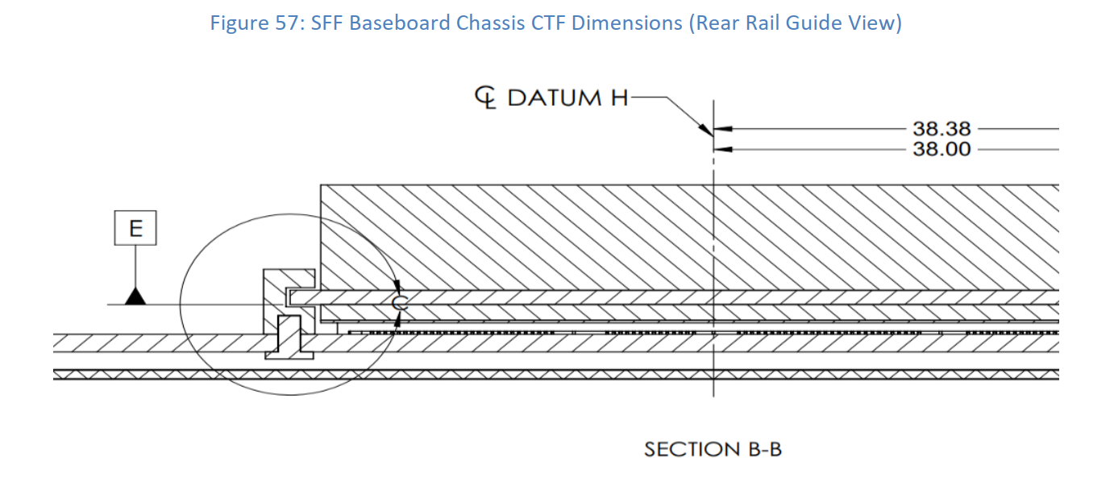
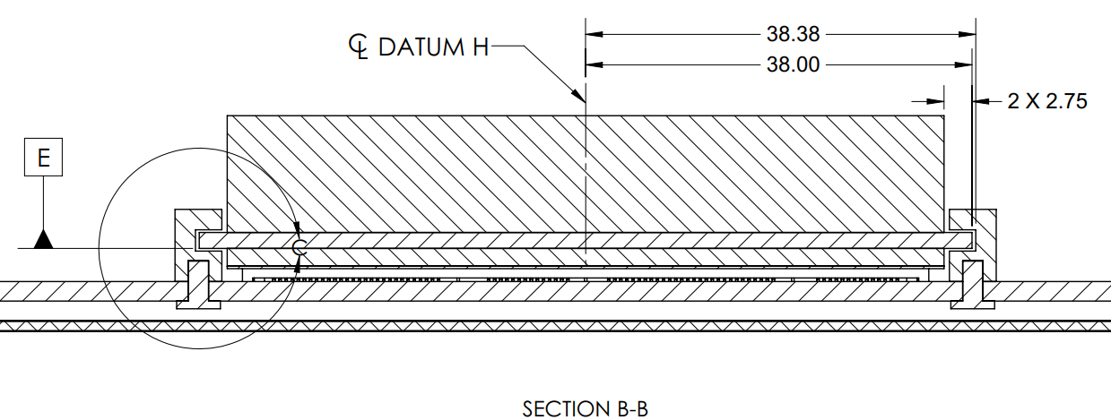
From
To

