Slide 2
OCP NIC Community Update for Server Workgroup August 2020 OCP NIC Subgroup Sub-group Project wiki: https://www.opencompute.org/wiki/Server/Mezz Mailing List: https://ocp-all.groups.io/g/OCP-NIC
Server Workgroup

Slide 3
Agenda
Revamped Mezz Wiki
OCP Tech Week
Signal Integrity Update
Mechanical update
Specification update
Taller SFF

Slide 4
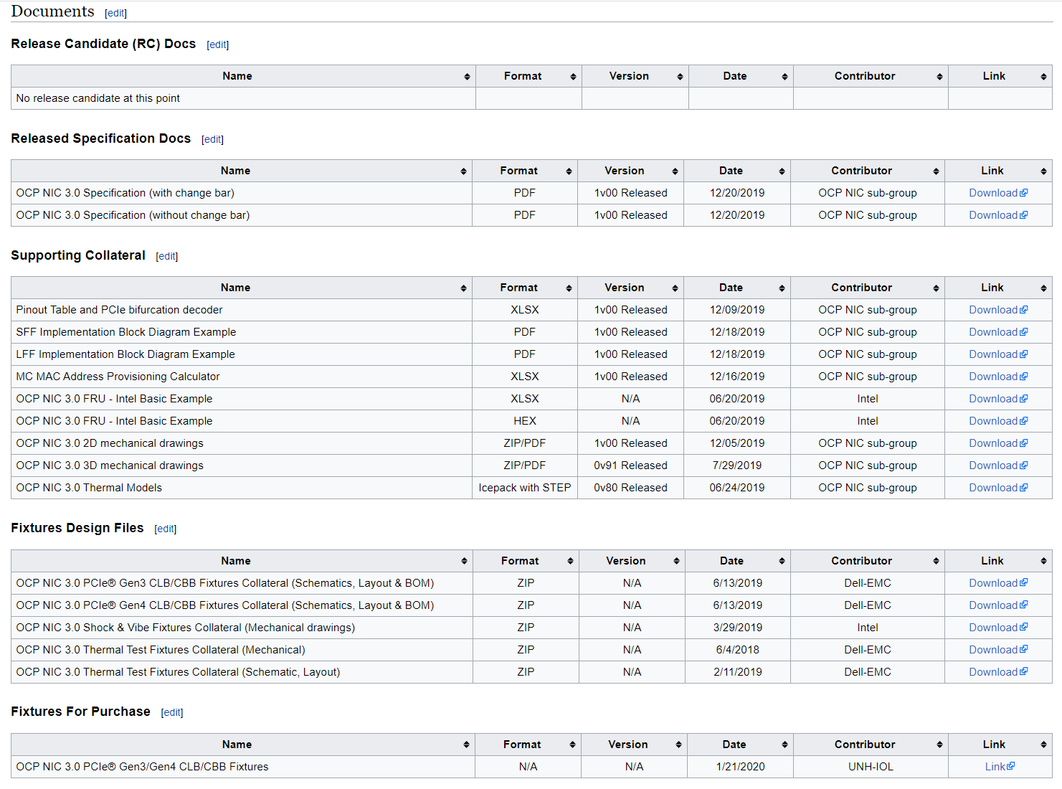
Revamped wiki
Release Candidate for Public Review
Official Release Spec
Collaterals
Fixture Design Files
Fixture for Purchase

Slide 5
Revamped wiki

Slide 6
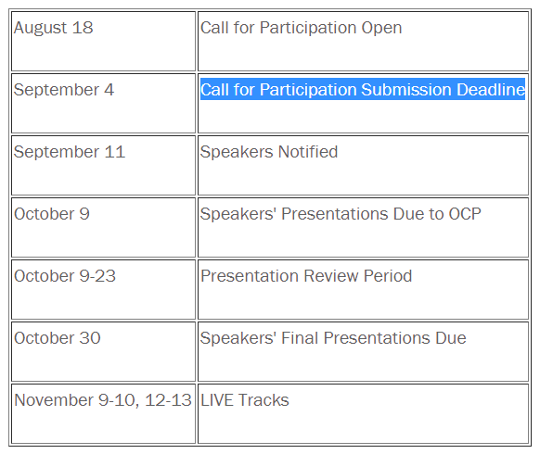
OCP Tech Week
Dates: Nov 9-10; Nov 12-13
NIC track in Tuesday Nov10 8am-12pm (PST)
Submission deadline Sept 9 (in 2 weeks)

Slide 7
Signal Integrity Update
SI workgroup recommends NIC Insertion Loss parameters for PCIe Gen5 as below:
SFF: -7.0dB @ 16GHz
LFF: -9.5dB @ 16GHz
As reference, PCIe CEM insertion loss is -9.5dB @ 16GHz
Next step, review in NIC sub-group monthly meeting then open for 2 weeks public review / feedback
DRAFT

Slide 8
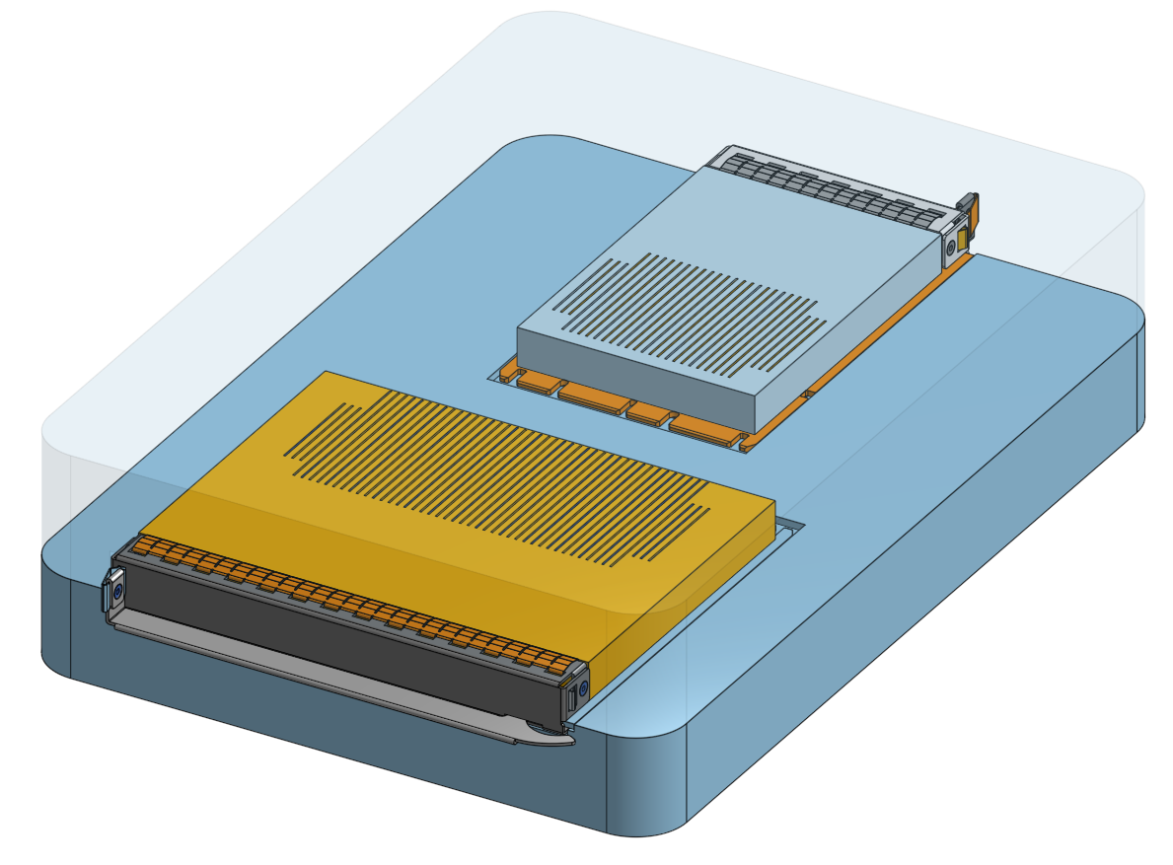
Mechanical Update
Initial mechanical compliance fixture 3D as below
Feedback from NIC sub-group to use 4C & 4C+ connector for mating
Fixture would be able to check X, Y & Z critical dimensions
Fixture would be transparent for easy identification of UUT interference (if any)

Slide 9
Specification update
Rev1.01 draft still under contributor review.
Discussion from NIC working session conclude changes around 12V_Edge being optionally OFF during ID_mode & Programming_mode needs additional validation data from multiple NIC vendors
Plan to close within contributors early next month in September NIC working session

Slide 10
Taller SFF
With NIC3.0 SFF extending to support PCIe Gen5, x16 lanes is enough to drive 400Gb line rate
NIC3.0 dimension today unable to support OSFP or adequately cool QSFP-DD due to Z-height restrictions
As announced during OCP global summit, NIC sub-group would investigate taller SFF.
We will be starting this work in next week’s working session

Slide 11
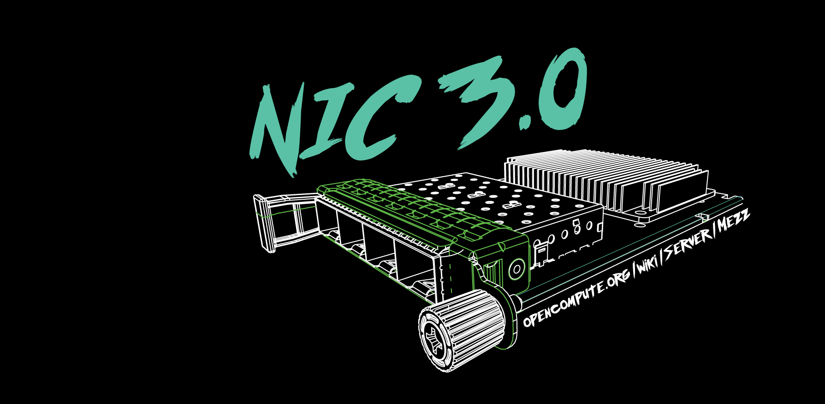

Slide 12
March 4-5, 2020

