Slide 2
OCP NIC Community Update for Server Workgroup January 2020
OCP NIC Subgroup Sub-group Project wiki: https://www.opencompute.org/wiki/Server/Mezz Mailing List: https://ocp-all.groups.io/g/OCP-NIC
Server Workgroup

Slide 3
Agenda
Introducing ZT systems
NIC 3.0 specification update (1v00)
Mezz 2.0 specification update (1v1)
Time slot poll & NIC 3.0 survey
2020 OCP Global Summit Workshop
2020 OCP Global Summit OCP Experience Lab

Slide 4
Introducing ZT systems
ZT systems as the 15th contributing company signed CLA with intent to contribute CAD drawings of internal locking mechanism
It shall go thru process of contributing companies review and community review process

Slide 5
NIC 3.0 Specification Update (1v00)
OCP NIC 3.0 specification revision 1v00 has been released!
https://www.opencompute.org/wiki/Server/Mezz#Documents
Updated
New Doc

Slide 6
Mezz2.0 Specification Update (1v1)
OCP Mezz 2.0 specification update to rev1.1 to include Type-5 has been approved by Incubation Committee

Slide 7
Time slot poll & NIC 3.0 survey
Monthly meeting time slot poll
Intent to re-evaluate existing time slot for community members
Keeping existing time slot!

Slide 8
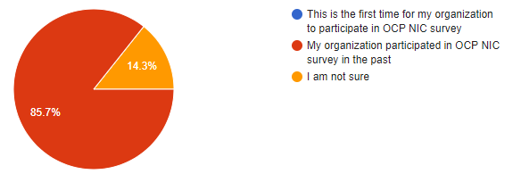
Time slot poll & NIC 3.0 survey
3rd OCP NIC 3.0 survey sent on Jan 15th
Intent to gauge trends of OCP NIC 3.0 adoption and community feedback about next 6-12 months focus areas
Link: Jan'2020 OCP NIC Ecosystem Survey

Slide 9
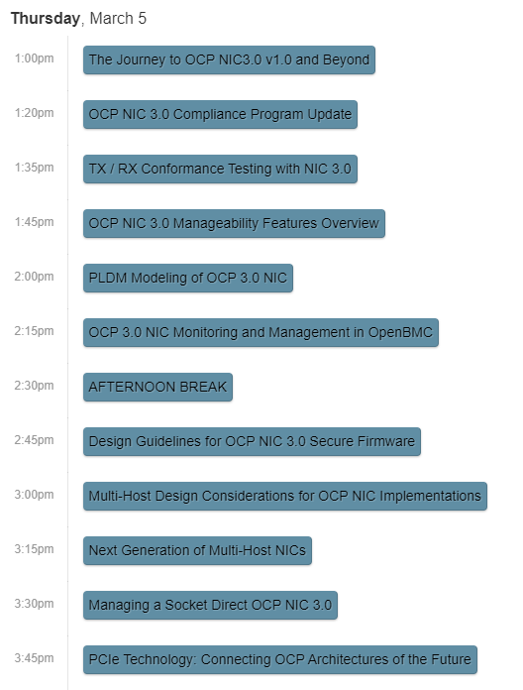
2020 OCP Global Summit Workshop
March 4th-5th, 2020 @
San Jose Convention Center
NIC and HPC shares 3hrs afternoon slot on the 5th.
11 out of 17 abstracts tentatively selected to proceed for draft presentation review.
Submitter(s) are encouraged to ask Speaker Manager and/or Track for the tentative estimated time allocated for each session.

Slide 10
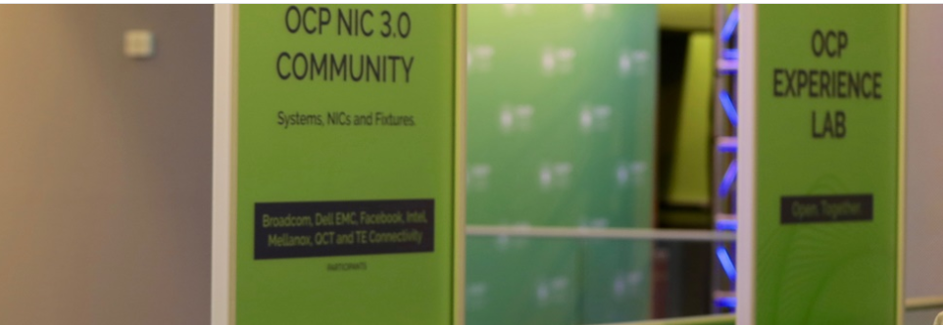
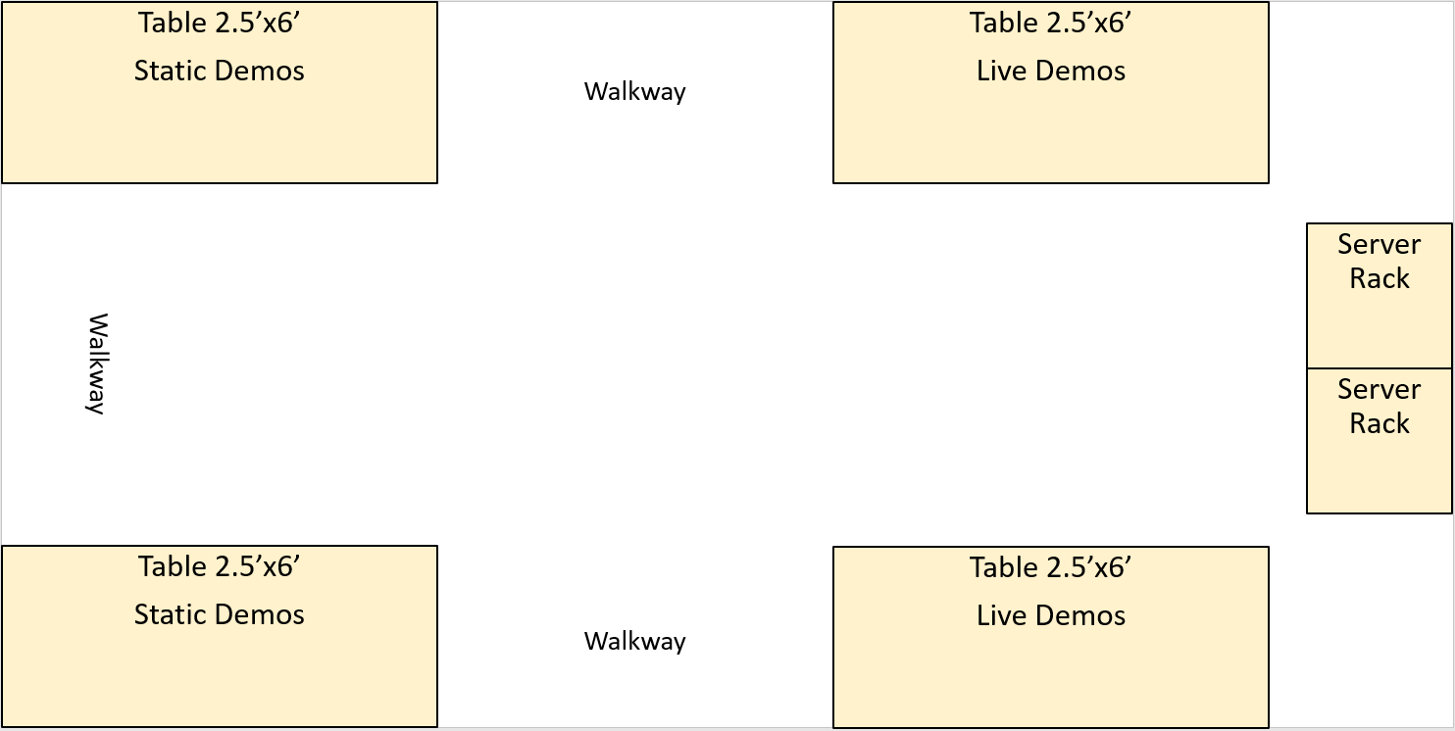
2020 Global Summit OCP Experience Lab
Returning for 2020!
Interact with members of the OCP community
Showcase OCP NIC 3.0 live & static hardware / fixtures
Lightning talks
9 companies participating so far
Contact our co-leads by 1/24 if you are interested
April Fisher april.e.fisher@intel.com
Elad Wind elad@mellanox.com
Proposal
https://www.opencompute.org/summit/global-summit/ocp-experience-lab

Slide 11
Q&A

Slide 12
March 4-5, 2020

