Slide 2
OCP NIC Community Update for Server Workgroup Nov 2019
OCP NIC Subgroup Sub-group Project wiki: https://www.opencompute.org/wiki/Server/Mezz Mailing List: https://ocp-all.groups.io/g/OCP-NIC
Server Workgroup

Slide 3
OCP NIC 3.0 Updated documents
Updated
New Doc
Notes:
Clinch nut for ejector latch
Additional MAC address label example

Slide 4
November’2019 activities
Spec updated to rev0.92. Release Candidate in wiki for review.
Face-to-face working session held in Dell Round Rock facility to discussion path to rev1.00, signal integrity, compliance and 6-12 months plan
Existing CLB/CBB has impedance mismatch issue near SMP connectors. New CLB/CBB design in progress to improve.
OCP foundation triggers HW licensing signature to curb potential loophole from just declaration in NIC3.0 spec

Slide 5
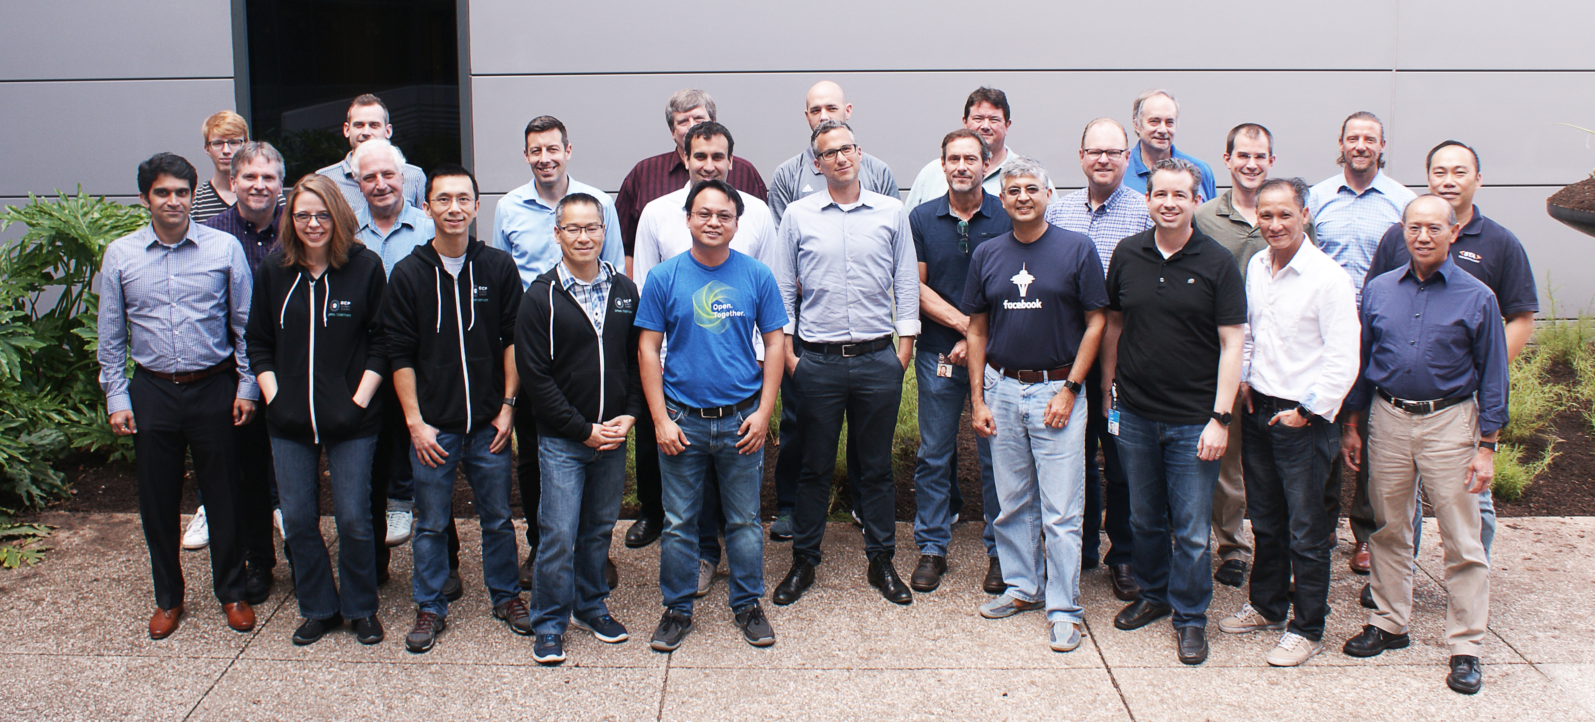
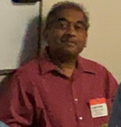
November Working Session Group Picture (held at Dell Round Rock Facility)
Representatives from:
Amphenol, Broadcom, Dell, Facebook, Hewlett Packard Enterprise, Intel, Marvell, Mellanox, TE connectivity, University of New Hampshire

Slide 6
November Eating Working Session (morning, starbucks coffee & round rock donuts) We ran out of space!

Slide 7
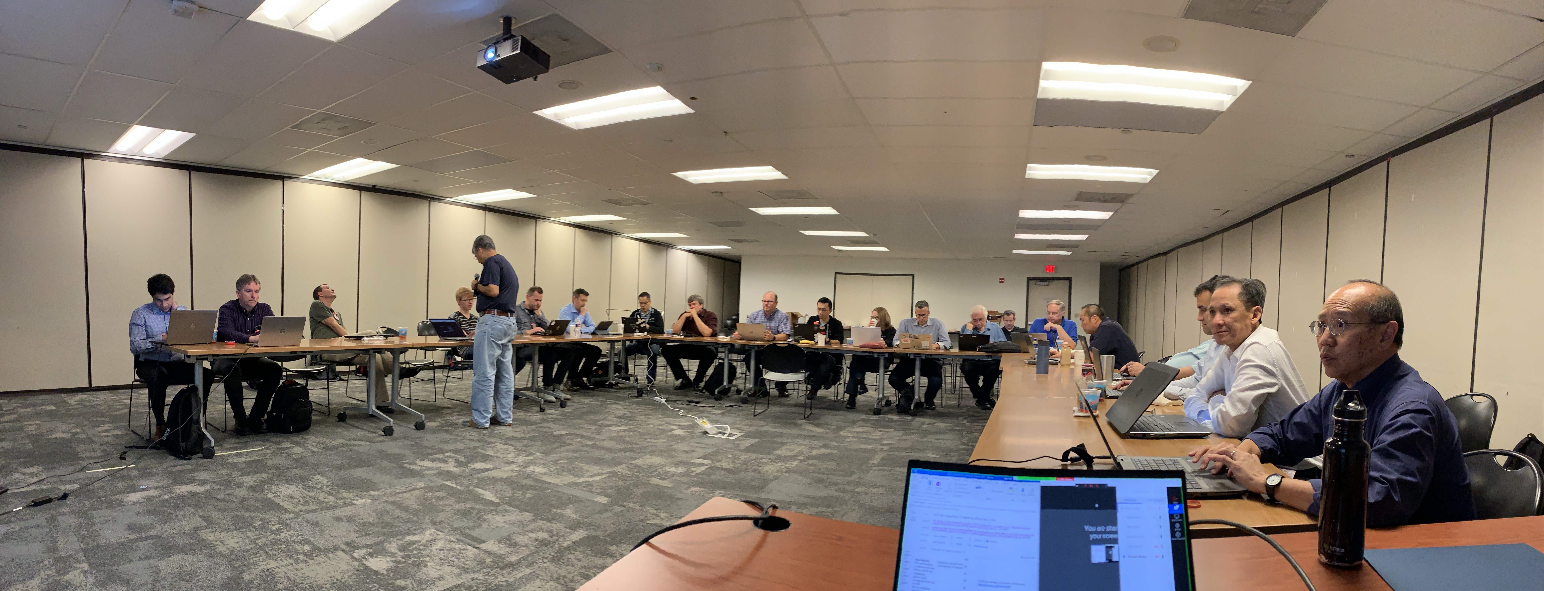
November Working Session (afternoon, after Chuy’s TexMex)

Slide 8
Call for March’2020 OCP Global summit NIC workshop submission
This is a friendly reminder that the Call for Participation for our 2020 Global Summit is open. Due to the Thanksgiving holiday, we are extending the deadline to Tuesday, Dec 3 at 5pm PST.
Please remember that we are using Linklings this year for submissions and the system will close promptly at 5pm PST on Dec 3. Late submissions will not be accepted.
Click here for all the details and instructions on how to submit.

Slide 9
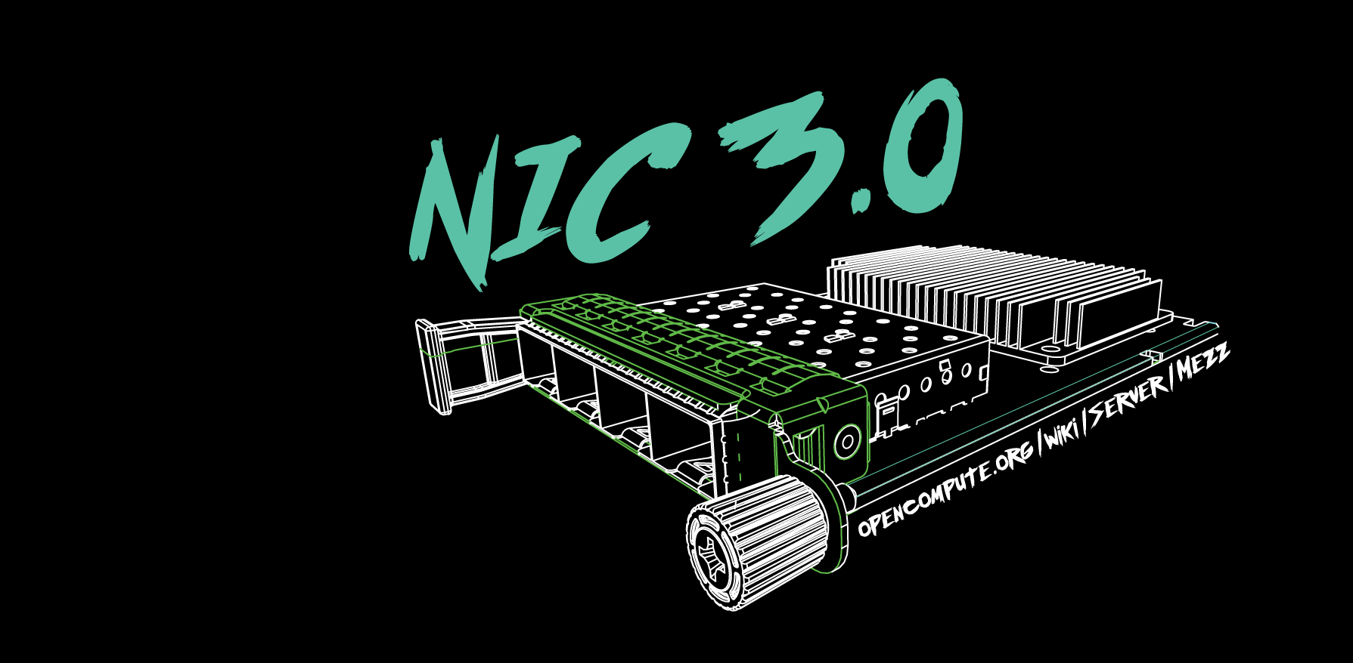
Q&A

