Slide 1
OCP External PCIe(NVMe & CXL) Connectivity Subgroup Proposal
Mohamad El-Batal – Seagate - OCTO
Richard Pitwon – Seagate - SRG
Dr. Deyu Zhou – IIVI
Albert Chen – Amphenol
Sharon Law – Molex
Jignesh Shah – Samtec
Brian Costello – TE
Lee Cleveland - Broadcom
Richard Ward – Astera-Labs
Justin Mutschler – Serialcables
Nhat Nguyen – Ayar-Labs
… others

Slide 2
Proposal Overview
TOR Ethernet Switch
Disaggregated DAS-Storage & Pooled-Memory appliances, using NVMe and CXL protocols, both require intra-rack level connectivity with copper and optical cost-competitive short reach links from 1-10 Meters
We propose establishing an OCP Subgroup that is tasked with defining the various connectivity solution requirements and release a specification to enable the industry with a unified PCIe external connectivity solution
Compute Blades
GPUs
DRAM
CXL
EM
SCM
NVMe
SSDs
HDDs

Slide 3
OCP Working Group Charter
Research the standard Server-node/blade optimal connectivity options
Document the Storage JBOD & JBOF NVMe connectivity requirements
Explore the Pooled Memory JBOM optimal connectivity and latencies
Identify Commonalities and Differences between Storage and Memory appliance connectivity requirements
Use existing industry optical and copper cables/connectors to leverage volume production cost optimized components
Explore available cost/performance optimized Electrical and Optical silicon solutions that can meet the PCIe NVMe and CXL requirements
Produce a detailed OCP External PCIe(NVMe/CXL) Connectivity requirement specification
Memory
SSD
HDD

Slide 4
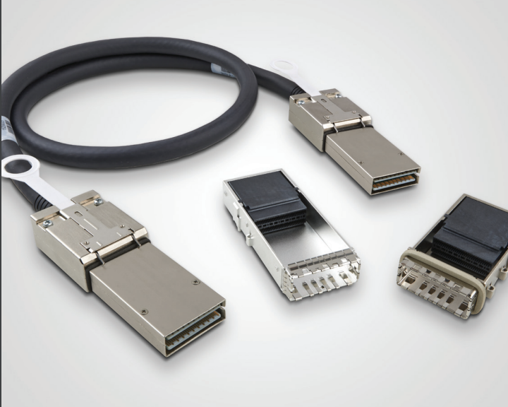
CDFP Doesn’t Meet the NVMe & CXL PCIe Cable Needs
Direct Attached Storage(DAS) NVMe JBOD/JBOF as well as Compute Express Link(CXL) pooled memory expansion need better external host node PCIe physical layer connectivity:
The older SFF8674 PCIe external connector doesn’t work beyond PCIe Gen4 x4 and doesn’t meet the industry needs
The PCIe-SIG proposed CDFP connector with x8 and x16 will not extend at PCIe Gen5 speeds beyond 1-Meter at 10⁽⁻¹²⁾ BER, and will likely struggle even further with PCIe Gen6 passive only connectivity solutions
The issue with CDFP connector is being limited to Direct Attached Cable(DAC) and lacking support for Active Electrical Cable(AEC) and Active Optical Cable(AOC) capability since it is built with two separate Tx and Rx PCBs and no room for unified optical or electronic transceivers
Denser and more advanced optical connectivity technologies solutions will be proposed and discussed by the working group members

Slide 5
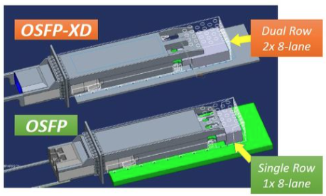
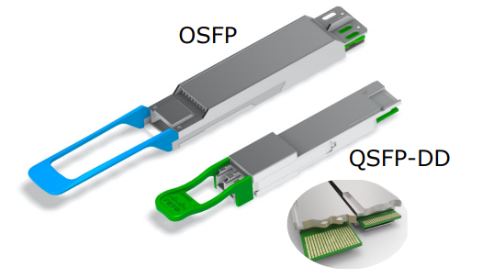
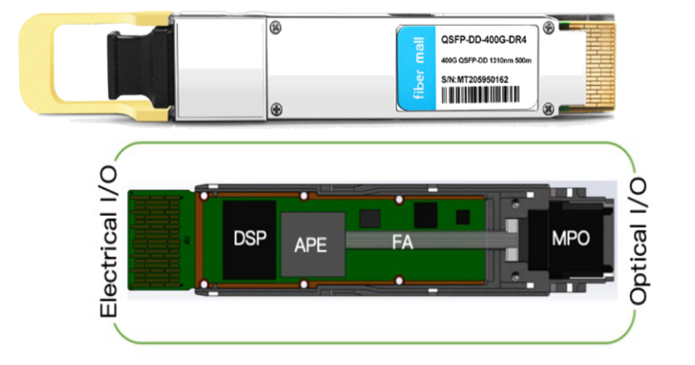
Possible Solutions with QSFP-DD/OSFP-XD Connectors
PCIe Gen5 Cabling:
x4 Full-Duplex Tx/Rx of 32Gbps using 56Gbps NRZ SR4 → 200Gbps QSFP
AEC & AOC Power budget of <2.5W per QSFP
Bit Error Rate(BER) of 10⁽⁻¹²⁾ PCIe Gen5 Requirement
x8 Full-Duplex Tx/Rx of 32Gbps using 56Gbps NRZ SR8 → 400Gbps QSFP-DD/OSFP
AEC & AOC Power budget of <5W per QSFP
Bit Error Rate(BER) of 10⁽⁻¹²⁾ PCIe Gen5 Requirement
x16 Full-Duplex Tx/Rx of 32Gbps using 56Gbps NRZ SR16 → 800Gbps OSFP-XD
AEC & AOC Power budget of <10W per QSFP
Bit Error Rate(BER) of 10⁽⁻¹²⁾ PCIe Gen5 Requirement
PCIe Gen6 Cabling:
x4 Full-Duplex Tx/Rx of 64Gbps using 112Gbps PAM4 SR4 → 400Gbps QSFP
AEC & AOC Power budget of <5W per QSFP-DD
Bit Error Rate(BER) of 10⁽⁻⁶⁾ PCIe Gen6 Requirement
x8 Full-Duplex Tx/Rx of 64Gbps using 112Gbps PAM4 SR8 → 800Gbps QSFP-DD/OSFP
AEC & AOC Power budget of <10W per QSFP-DD
Bit Error Rate(BER) of 10⁽⁻⁶⁾ PCIe Gen6 Requirement
x16 Full-Duplex Tx/Rx of 64Gbps using 112Gbps PAM4 SR16 → 1.6Tbps OSFP-XD
AEC & AOC Power budget of <20W per QSFP-DD
Bit Error Rate(BER) of 10⁽⁻⁶⁾ PCIe Gen6 Requirement
Can’t use FEC for CXL, due to ns latency sensitive, but could use FEC for NVMe BER needs of 10⁽⁻¹²⁾

Slide 6
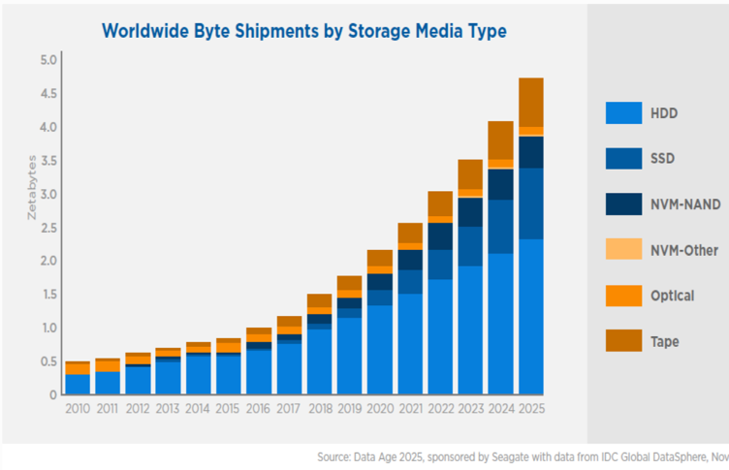
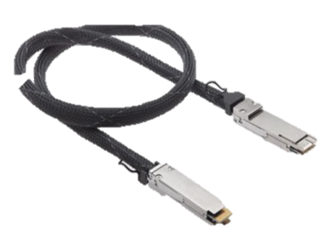
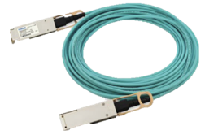
NVMe & CXL PCIe Cabling Market Analysis
Identified two Intra-Rack markets for PCIe Cables w/ ~$600M/year potential revenue:
NVMe DAS SSD & HDD Storage JBOD connectivity to Compute Nodes
HDD Storage Market by 2025 ~3 Zettabytes
SSD Storage Market by 2025 ~1 Zettabyte
~200Mu HDDs plus ~50Mu SSDs are sold Yearly
>200Mu will go in JBODs/JBOFs with ~50 Device per box → ~4Mu JBODs
Datacenters update their storage infrastructure once each ~4-5 years
Assuming ~4 cables per JBOD/JBOF we expect ~4Mu cables per year
AOC represent 1/4th of the cables over >3M length at ~$200 per cable → ~$200M
AEC represent 1/4th of the cables 1M-3M length at ~$100 per cable → ~$100M
DAC represent 1/2 of the cables ~1M length at ~$50 per cable → ~$100M
CXL Pooled Memory connectivity to Compute Nodes
Market size is still unknow, but expected to require ~20 cables per memory pool
Assuming ~100K Memory Pooling Appliances per year → ~2Mu Cables/year
AOC represent 1/4th of the cables over >3M length at ~$200 per cable → ~$100M
AEC represent 1/4th of the cables 1M-3M length at ~$100 per cable → ~$50M
DAC represent 1/2 of the cables ~1M length at ~$50 per cable → ~$50M
Note: All prices are approximate targets averaged across different cable width that may or may not be achievable and are used for rough modeling only

Slide 7
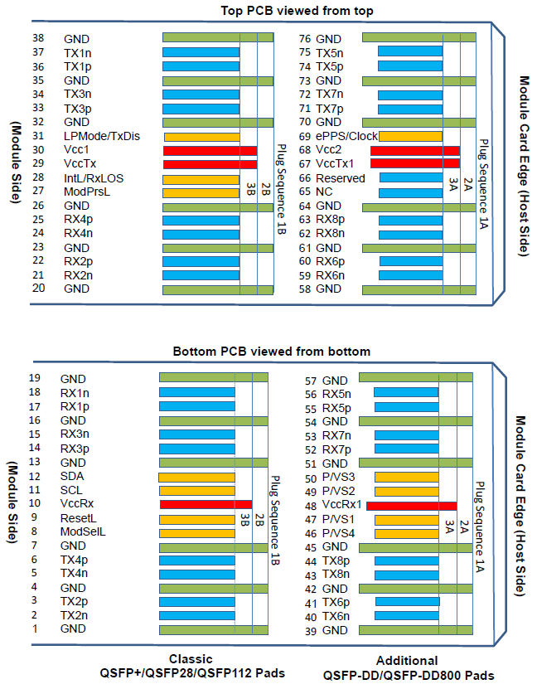
Options with QSFP-DD
x8 Full-Duplex Tx/Rx
x4 Full-Duplex Tx/Rx (half-populated)
4-pos Vendor Specific Definition (VSx)
Single-PCB solution
Support for DAC, AEC, and AOC
Support for 26-32AWG Twin-ax Cable
Available with Riding Heat Sink (RHS)
13.8mm
Form Factor Outline
Port Profile
8.5mm
60mm

Slide 8
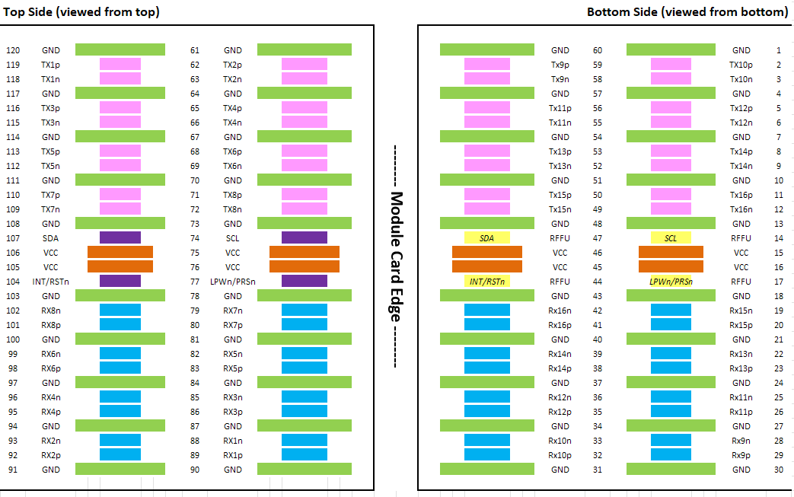
Options with OSFP-XD
x16 Full-Duplex Tx/Rx
x8 Full-Duplex Tx/Rx (half-populated)
4-pos Reserved For Future Use (RFFU)
Single-PCB solution
Support for DAC, AEC, and AOC
Support for 26-32AWG Twin-ax Cable
Available with Integrated Heat Sink (IHS) or Riding Heat Sink (RHS)
Source: https://osfpmsa.org/assets/pdf/OSFP1600_and_OSFP-XD.pdf
https://osfpmsa.org/assets/pdf/OSFP_Module_Specification_Rev5_0.pdf
22.8mm
Form Factor Outline
Port Profile
10.5mm*
95mm
*w/ RHS

Slide 9
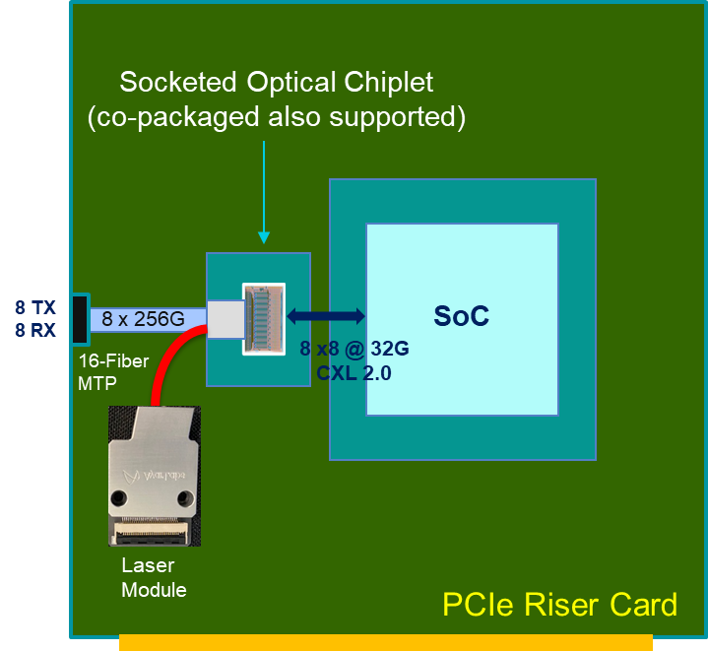
Possible Solutions with CW-WDM MSA
CXL 1.1/2.0:
Fully integrated electro-optical chiplet supporting up to 8 WDM optical ports
Each port is a x8 link
Full-duplex Tx/Rx at 32 Gbps
Each port has 8λ per Tx/Rx fiber, based on the CW-WDM MSA
Port bandwidth is 256 Gbps, up to 2 Tbps per chiplet
Bit Error Rate (BER) of 10⁽⁻¹²⁾ meeting PCIe Gen5 requirement. No FEC required.
<1W per dual-port (x16) chiplet
Redriver-based chiplet taking advantage of PCIe5 MR/LR SerDes on host ASIC
Latency around 1ns (electrical interface to optical interface)
CXL 3.0:
Scalable architecture
Data rate at 64 Gbps
Support PAM4 modulation scheme
CW-WDM MSA supports 16λ and 32λ per fiber

Slide 10
Thank you
mohamad.elbatal@seagate.com

