Slide 1
Outdoor Computing RuggedPOD update for Telcos
Horizon Computing Solutions
And a crazy Open Compute community

Slide 2
Technology statement and vision
“Software is eating the world, yet hardware is still shaping it”

Slide 3
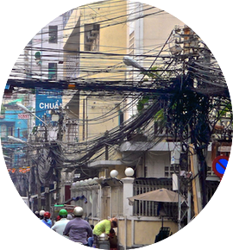
Why outdoor Computing building blocks ?
True Free Cooling
No Water Usage
Ultimate PUE of 1
CUE optimized
Use the unusable
Building roofs
Fields, low temp and high humidity ready
Only way to scale
Instant deployment
Fast dismantling
Highly flexible
Disaster recovery ready
x86 and ARM ready
Add on to your infrastructure
Bare metal, Openstack ready
No buildings
Fully recyclable
Less energy
Everywhere
Fast and Easy
Standard
Eco Friendly

Slide 4
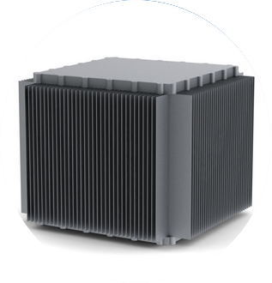
RuggedPOD the first outdoor building block
Open Hardware project released under the Open Compute License and GPL for the software side
Sponsored by various industrial partners including Horizon, Numergy, Enter and Western Digital
Driven by a talented team of system architects, including some who worked on deploying the biggest supercomputers in the world
First public demo during OCP Europe Summit in Paris France october 2014

Slide 5
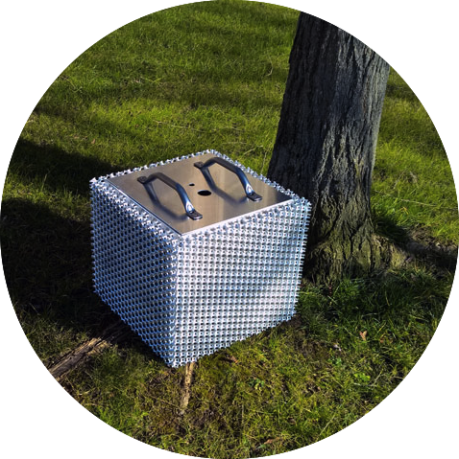
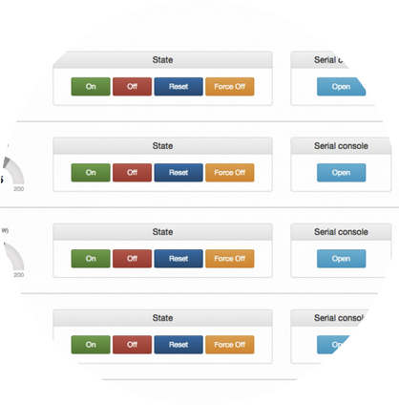
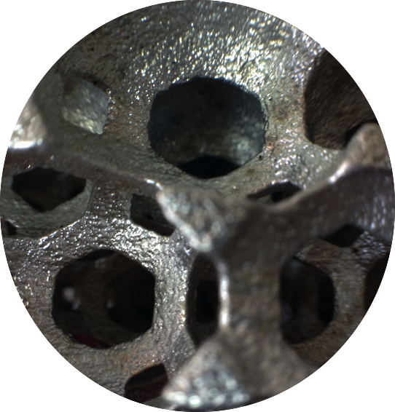
RuggedPOD v1 by Horizon
Global Outdoor solution industrialized by Horizon
Up to x4 ATX/mATX/mITX boards
Up to x1 3.5 HDD SATA 6Gbps per board
Up to x1 2.5 SSD SATA 6Gbps per board
1Gbps, x4 1 Gbps, or x1 10 Gbps
Up to 1kW Thermal performance
Available with mineral or organic oil
Support from -45 to +45 C degrees
(rerating apply after 35 C degrees)
Small and elegant chassis based on pure
Aluminum (tank) and stainless steel (bottom and top). Fully recyclable. IP68 compliant
50x50x50 cm box
Build to last, 5 years outdoor warranty
Modern remote management interface based on OCP / OCS ReST open API and advance web and remote CLI
Cellular cooling technology to lower total weight and reduce raw material efficiency with better cooling performances

Slide 6
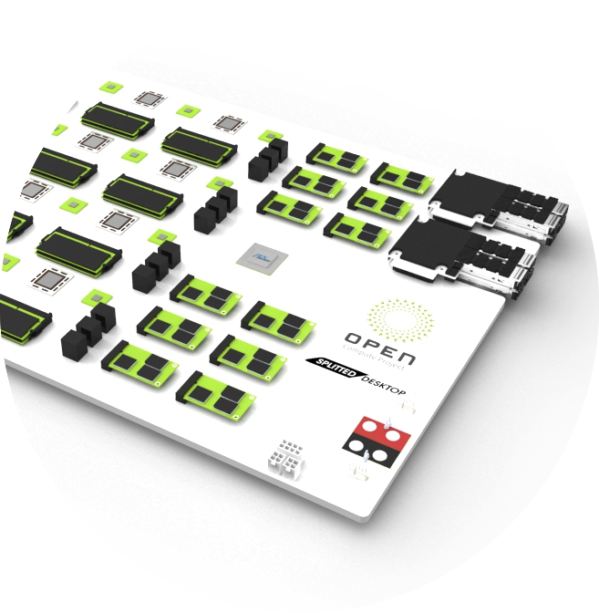
RuggedPOD Roadmap
March 2015
RuggedPOD v1 launch during OCP Summit 2015
Active R&D community program with pre-order
October 2015
General availability with storage and network nodes
December 2015
First x4 nodes DaaP delivery
June 2015
First compute systems delivery for early adopters
1 $US VM deployment starts

Slide 7
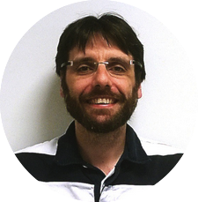
Enter and Horizon partnership
“RuggedPOD is designed for disruptive companies willing to shake the Cloud by respecting our environment and providing the right pricing level. We are extremely happy to partner with Enter to reach this goal and start deployment during summer 2015.”
Jean-Marie Verdun – Horizon Computing Solutions general manager
Let’s be disruptive and build a cheap and efficient Cloud
“As a disruptive pan european Cloud company we must introduce to the market key technologies which could help our customers to lower there cost, and improve there efficiency. RuggedPOD is one of them, and we are impatient to open the first VMs.”
Ivan Botta – Enter president

Slide 8
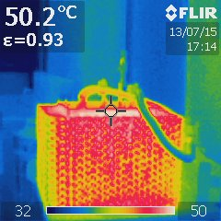
Teamwork
First RuggedPOD delivered to Enter in June 2015
Tremendous thermal results: dT < 20 C
Full load for 2 weeks with peak ambiant at 41 C in Milano

Slide 9
Building a POD for Telco
Telco is moving to TCP/IP 4G/LTE bringing tremendous opportunities to move from a proprietary approach to an open world.
Could it be possible to build up a full BBU and Core Network infrastructure in Software ? Using which platform ?

Slide 10
RuggedPOD and Amarisoft solution
Amarisoft
French based company
Deliver state-of-the-art LTE software stack including eNodeB, EPC and UE running live on x86 CPU (ASIC-less and DSP-less).
Help Operators to regain control of their mobile infrastructure from Telco Vendors.
Break existing business model and spark the LTE mobile revolution

Slide 11
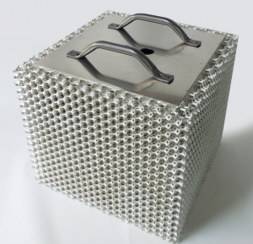
We live in a software world, let’s do some crazy one on top of RuggedPOD
World First 4G Software stack running on a x86.
eNodeB (FDD & TDD, CA, Handover, MIMO, VoLTE, eMBMS, …)
Tiny EPC, tiny IMS, eMBMS gateway
Bandwidths: 1.4, 3, 5, 10, 15 and 20 Mhz. All LTE frequency bands.
- UE stack.
4G Phones/USB keys

Slide 12
Performance indication
We are delighted to be at the edge of 3GPP standard and continue to innovate at a fast pace.
UE software
Simulation of 1000 UEs on air with one PC
20 Mhz MIMO 2x2 cell on 2 physical cores of an 2.7Ghz i7:
- 150 Mb/s
- 33% CPU usage out of the 3-cores total capacity
- support of sse4.2, AVX, AVX2. Soon to come AVX512
- Electric power consumption: lower than 31W
Features from releases 8 to 12 (CA, 256QAM, eMBMS, VoLTE, …)

Slide 13
Early adopters
Tiers 1 C-RAN / NFV: Execute the eNodeB inside a virtual Machine on standard x86 hardware.
Last mile, DAS: Controlling multiple cells in a building with rackable PC.
Labs R&D, University: get your own LTE network on desk.
Security, Emergency and Private Mobile Radio: Embedded ASIC-less PC based system.
Capacity testing: Simulate 1000 UEs on one 4-cores CPU.
New operator’s players: Coming from the « data » world…

Slide 14
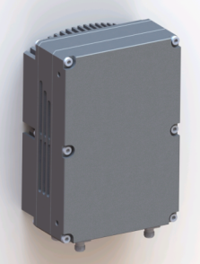
Demo Architecture
Internet
and/or
S1 link
Ethernet
CPRI
RRHs
MIMO 2x2
CPRI
Rugged POD
Up to 96 cores
Up to 48 Cells
Up to 16 Macros (3 sectors)
RRHs
MIMO 2x2
Ethernet

Slide 15
Who is behind this technology
Franck Spinelli successfully launched 2 companies (still in business) before Amarisoft.
Fabrice Bellard is a worldwide well-known guru in software. (The father of ffmpeg and qemu -> KVM).
Jean-Marie Verdun is a computer architect who worked on the biggest supercomputer in the world.
Jean-Jacques Chanut is mechanical and thermal engineer on RuggedPOD
Farshia Kamaloudine is electrical engineer on RuggedPOD
Maxime Terras is network architect and firmware engineer on RuggePOD
Solofo Ramanghali is a passionnated HPC engineer
Thibaud Ecarot is a PhD student working on POD simulation environment

Slide 16
What is next for RuggedPOD ?
Build automated datacenter
Move the technology to the industrial state in North America / Europe and emerging countries
Integrate CDN functions
Integrate real time video encoder to the edge (partnership with Vantrix in Canada)

Slide 17
Deployment strategy: Top of the rack style
Compute
Compute
10 m Max
Compute
Compute
Compute
x2 10Gbps uplink
Storage
Storage
Storage
x2 10Gbps uplink
Net
Net
Net
Net
Net
Net
Net
x24 10Gbps downlink
x24 10Gbps uplink
Storage
Storage
POD deployed in columns
1 POD every 50 cm
Max POD per column: 24
RJ45 copper based connexion 10Gbps each
Compute
Compute
10 m Max
Compute
Compute

Slide 18
Deployment strategy: 2D Torus style
Compute
Compute
Compute
Compute
Compute
Compute
Compute
x2 10Gbps uplink
Storage
x2 10Gbps uplink
Storage
Storage
Storage
Net
None
Compute
Compute
Compute
POD deployed in mesh
Virtually no size limit
RJ45 copper based connexion 10Gbps each 2m standard cables
Compute
Compute
Compute

Slide 19
Storage POD
360 mm
30 mm
3.5 inches
drives
x40 drives configured in a
2 layers of 20 drives each
x20 drives connected to each micro server
Use port multipliers
1:5 -> 6 SATA connection per micro servers
Use x1 Marvell 88SE9235 for SATA input on microservers
Total Bandwidth: 24Gb/s on I/O per server -> 150MB/s per drive
150 mm
360 mm
Storage
Ctrl based
On uServer

Slide 20
Storage POD at a glance
320 TB
600 W
40Gbps

