Slide 2
OCP NIC Community Update August 2020
OCP NIC Subgroup Sub-group Project wiki: https://www.opencompute.org/wiki/Server/Mezz Mailing List: https://ocp-all.groups.io/g/OCP-NIC
Server Workgroup

Slide 3
Agenda
OCP Tech Week (was: OCP Engr Workshop)
Signal Integrity Update
Mechanical update
Specification update
OCP Terminology Guideline for Inclusiveness & Openness

Slide 4
OCP Tech Week
Dates: Nov 9-10; Nov 12-13
NIC track in Tuesday/Thursday 8am-12pm (PST)
April, Damien, Jia, Thomas would be coordinating for NIC track
High Level Track Requirements & Descriptions | Mon, Aug 3rd
Tentative Agenda | Mon, Aug 24th
Registration Opens | TBD
Published Agenda (80% Firm) | Fri, Sept. 18
Draft Presentation Submission | Fri, Oct. 9
Presentation Review | Fri, Oct. 9 – Fri, Oct. 23
FInal Presentation | Fri, Oct. 30
Go Live Date | Mon, Nov. 9

Slide 5
OCP Tech Week (topics)
Topics | Presenters
Taller SFF
PCIe Gen5 | SI workgroup?
NIC/Platform IL budget working model? | SI workgroup?
LED measurement methodology
Specification summary post rev1?
Xavier sideband board introduction | Dell?
Mechanical compliance fixtures | Mech workgroup?
We have 4 hrs timeslot for community sharing

Slide 6
Signal Integrity Update
Analysis by NIC developers (Intel, BRCM, MLNX) is indicating OCP NIC3.0 SFF PCIe Gen5.0 loss between -6.5dB and -7.0dB (Rev1.01 draft spec mentioned not more than -8.0dB)
NIC developers are further analyzing to propose loss budget in this month’s SI WG meeting on 8/19/2020
Once SFF loss budget is finalized, SI WG will kick-off test methodology to accommodate loss delta from PCI-SIG CEM
OCP NIC 3.0 LFF PCIe Gen5.0 channel loss will be aligned to PCI-SIG CEM spec of -9.5dB

Slide 7
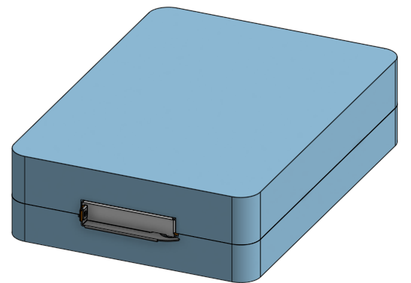
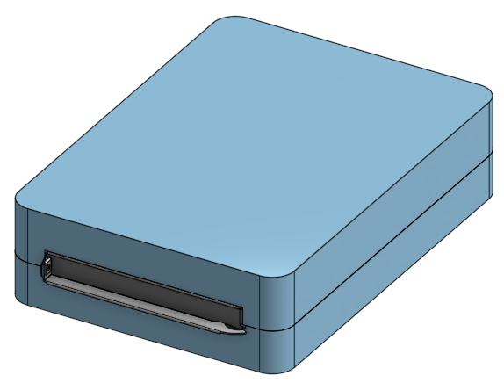
Mechanical Update
Initial mechanical compliance fixture 3D complete
Design will be discussed in tomorrow’s working session
Teaser picture of the fixture as below

Slide 8
Specification update
Rev1.01 draft under contributor review. Look for email from Thomas Ng
Reviewer questions & responses has been low
Suggest to read thru rev1.01 +12V_Edge during ID_mode modification and bring your feedback into working session discussion tomorrow
It should have implication to NIC vendors
It may have implication to system integrators

Slide 9
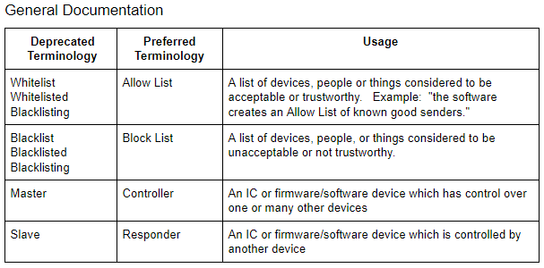
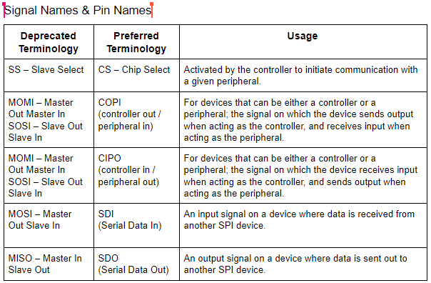
OCP Terminology Guidelines for Inclusion & Openness
OCP foundation started to provide guideline for common terminology yet could be sensitive
Notes:
https://urldefense.proofpoint.com/v2/url?u=https-3A__docs.google.com_document_d_1Hi46-2DPVcywW8NQBsBTdgC24ZybHl6dF6RYe-2Dzrj3xhk_edit-23heading-3Dh.ac7fwtjsxlrh&d=DwMFaQ&c=5VD0RTtNlTh3ycd41b3MUw&r=q1FhLOonHbrMa6HIwi0yiw&m=VHZuO2sGXraOfMjlvaZQ7uU1X8qvMmR4w9COywgeaq4&s=9jwSO0ZwTz61XY2IFnBrrMIWEVa8Zv_rxyvcGGUk2g4&e=

Slide 10
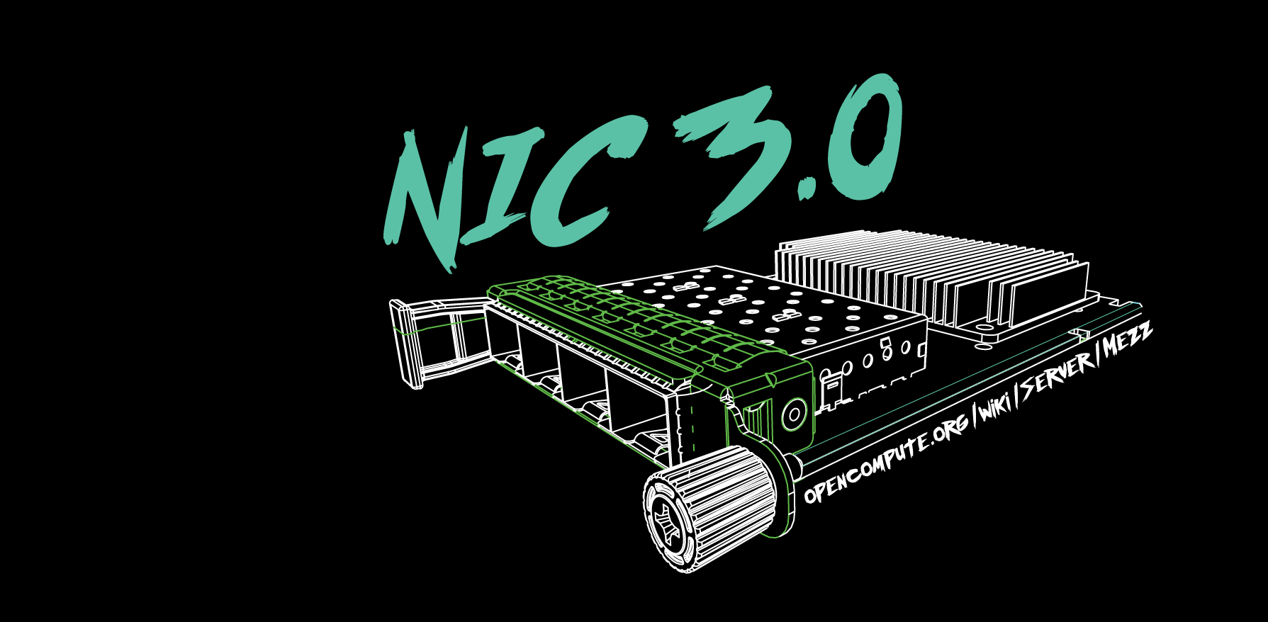

Slide 11
March 4-5, 2020

