Slide 2
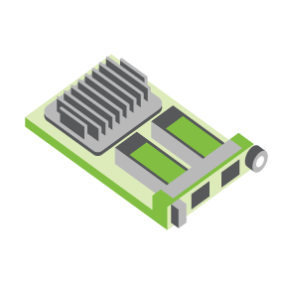
SERVER
OCP NIC Community Update August 2021
For Server Workgroup
Sub-group Project wiki: https://www.opencompute.org/wiki/Server/Mezz
Mailing List: https://ocp-all.groups.io/g/OCP-NIC
NIC3.0

Slide 3
Agenda
OCP Global Summit
NIC3.0 spec update (draft)
SI Gen5 test fixture
Thermal workgroup update

Slide 4
2021 OCP Global Summit – Selected Abstracts
OCP NIC 3.0: Thermal Considerations
Facebook, Molex, Nvidia
OCP NIC: What's now and the future?
OCP NIC Sub-group
OCP 3.0 NIC TSFF implementation and advantages
Nvidia
OCP NIC 3.0 DPU management
Nvidia

Slide 5
OCP Global Summit Experience Lab demo
OCP foundation approved & allocated a station for OCP NIC demo
Cross group demo: ODSA + NIC adapter in consideration
New acceptance criteria from OCP Foundation might impact eligibility
Demo | Participating Companies
OCP NIC 3.0 Multi-Host Connectivity and Manageability | Broadcom
OCP NIC 3.0 Device Attestation Using SPDM | Broadcom & Facebook
Zion: Host with up to 12 OCP NIC 3.0 slots | Facebook
Mechanical Fit-test fixture | OCP NIC sub-group & Facebook
Server with OCP3.0 Fiber channel HBA | Marvell
OCP NIC3.0 in Tall Small Form Factor (TSFF) | Nvidia
Interface Sandbox with SFF Slots | TE Connectivity

Slide 6
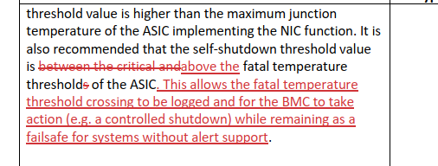
NIC3.0 spec update (draft)
1v2 spec draft is under contributor review. Opening for public review shortly
Changes on Self-shutdown Temperature definition (optional feature)
Include self-shutdown temperature in FRU table

Slide 7
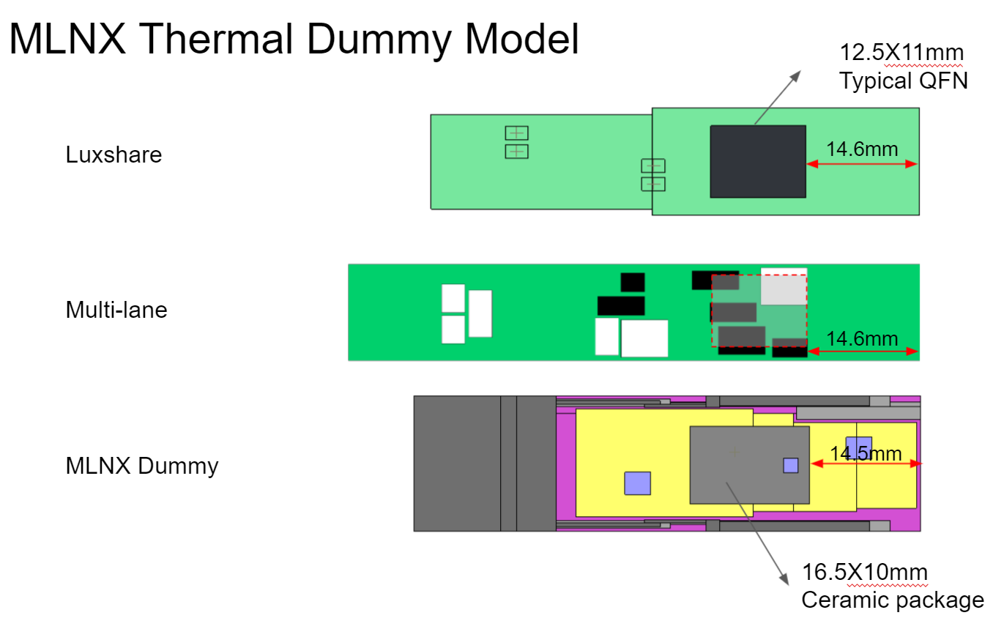
Thermal workgroup update
Large thermal gradient at top of module
Aligned to use Tcase near hot-stop instead of average surface temperature

Slide 8
Thermal workgroup update
Good process on thermal alignment from workgroup
Alignment achieved:
aligned the models are comparable among MLNX dummy heater, Luxshare, and multilane model
aligned that the case temperature difference goes down when heatsink applies, wait the final simulation results from MLNX and Molex
aligned in the future that we can use multi-lane module to perform thermal validation
aligned to use Tcase closer to the hot spot as the monitor point instead of the average surface temp

Slide 9
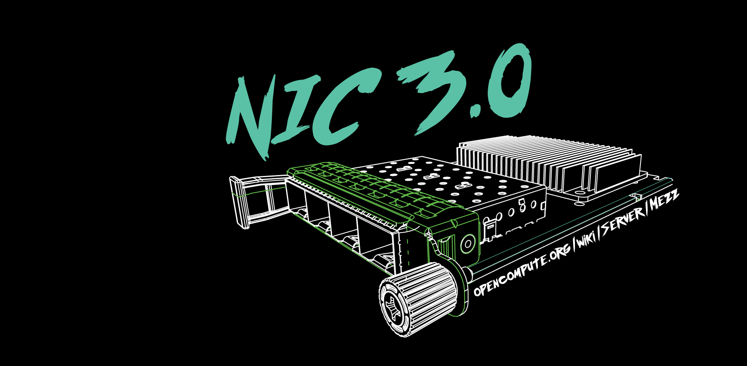

Slide 10
2021 OCP Global Summit - Demo
-2020-
OCP NIC Experience Lab demo coordination
2019: Facebook
2020: Intel & Nvidia
2021: Broadcom

