Slide 2
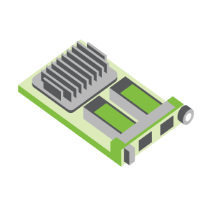
SERVER
OCP NIC Community Update September 2021 for Server Workgroup
Sub-group Project wiki: https://www.opencompute.org/wiki/Server/Mezz
Mailing List: https://ocp-all.groups.io/g/OCP-NIC
NIC3.0

Slide 3
Agenda
OCP Global Summit
NIC3.0 rev1.2 spec published
Feedback form

Slide 4
OCP Global Summit Experience Lab demo
Broadcom/Hemal leading the preparation.
1. OCP NIC 3.0 Multi-Host Connectivity and Manageability (Broadcom: Rahul Vaddelli and Adrian Alvarado)
2. OCP NIC 3.0 Device Attestation Using SPDM (Broadcom: Roman Bacik, Facebook: Chenxi)
3. Zion: Host with up to 12 OCP NIC 3.0 slots (Facebook)
4. Mechanical Fit-test fixture (Facebook, OCP NIC sub-group)
5. Server with OCP3.0 Fiberchannel HBA (Marvell, OCP NIC sub-group)
6. OCP NIC3.0 in Tall Small Form Factor (TSFF) (Nvidia, OCP NIC sub-group)
7. Interface Sandbox with SFF Slots (TE Connectivity)

Slide 5
NIC3.0 spec rev1.2 released
Changes is mainly Tall Small Form Factor (TSFF) related
There are also minor changes and clarifications as noted in change list snippet
NIC self-shutdown changes were not included in rev1.2 from feedbacks about alignment with DMTF recommendation
- Section 1.2 – Added Molex to the acknowledgements section. Changed NVIDIA to NVIDIA Corporation. - Section 1.7.2.x – Updated text "Up to PCIe Gen 5 (32 GT/s) support" - Section 3.4.2, 3.5.4 – Clarified that the BIF[2:0]# pins shall not change states after AUX_PWR_EN is asserted. - Section 3.4.4 – Clarified that the RBT_ISOLATE# signal shall not change state even when the NIC_PWR_GOOD signal is in the don't care state. - Section 3.7.3 – Added note regarding the use of light pipes above I/O cage assemblies for TSFF and cage implementations. - Section 3.11 – Clarified power down sequencing diagram - +12V_EDGE may optionally be disabled in ID Mode. This mirrors the same behavior for the power up sequencing diagram. - Section 7.1.3 – Updated Safety requirements. 60950-1 was withdrawn as of 12/20/2020. 62368-1 replaced 60950-1.

Slide 6
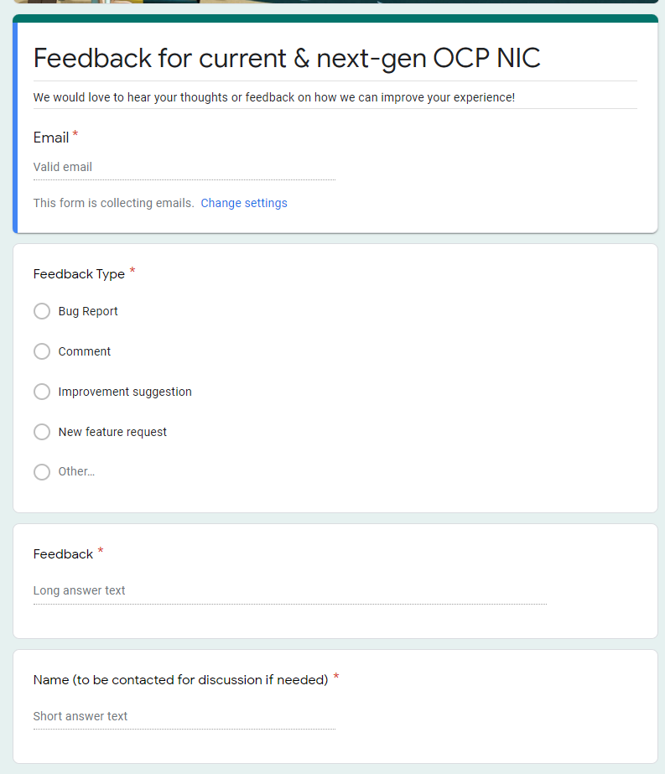
Gather feedback throughout the year
Provide your feedback at: https://tinyurl.com/feedback2ocpnic

Slide 8
2021 OCP Global Summit - Demo
-2020-
OCP NIC Experience Lab demo coordination
2019: Facebook
2020: Intel & Nvidia
2021: Broadcom

