Slide 1
OCP Networking OOM Driver Workshop
OCP Networking Workshop
Sunnyvale, August 2017
Don Bollinger

Slide 2
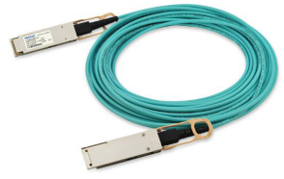
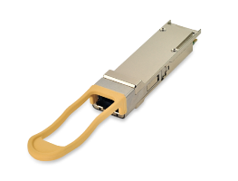
What is Open Optical Monitoring (OOM)?
OOM is a Python package, providing a standard API to read/write optical transceiver modules.
EEPROM data encoded/decoded in key/value pairs.
Same API: Any Linux-based NOS, any switch, any module vendor, any module type.
Open Source, easy to maintain, easy to extend.
Key Messages
Message 1
Message 2
Message 3
Message 1
Message 2
Message 3
from oom import *
for port in oom_get_portlist(): # enumerate the ports on the switch
status = oom_get_memory(port, 'DOM') # DOM = voltage, temp, {TX, Rx}Power, bias
print port.port_name + str(status)
port0{'VCC': 3.30, 'TEMP': 23.55, 'TX_POWER': 0.57, 'RX_POWER': 0.56, 'TX_BIAS': 7.4}
port1{'VCC': 3.31, 'TEMP': 24.02, 'TX_POWER': 0.57, 'RX_POWER': 0.53, 'TX_BIAS': 7.3}

Slide 3
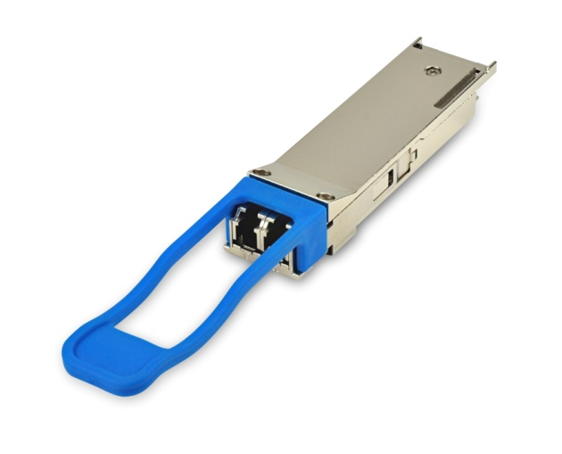
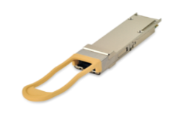
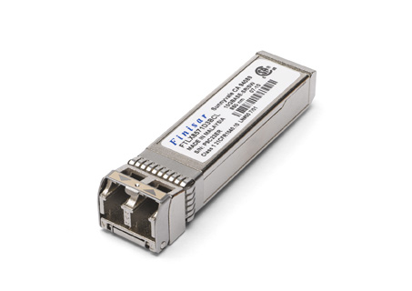
Simplified OOM Architecture
Switch
Network OS (including apps)
Switch Mgmt Interface
Real time Optical Control
Network Agent
Open Mgmt Interface
OOM Decode Library
Network OS
(Kernel)
Drivers, etc.
i2c (HW)
Open Source
Vendor Specific

Slide 4
Requirements for an Optical EEPROM Driver
MUST
Read & Write
Multiple I2C addresses (for SFP)
Multiple Pages, up to the architected limit (128 pages, >16KB)
High Priority
No internal read/write buffer (128+ pages: >16K of EEPROM data)
One driver for all flavors of both SFP and QSFP
Note, we have a driver that meets these requirements
https://github.com/opencomputeproject/oom

Slide 5
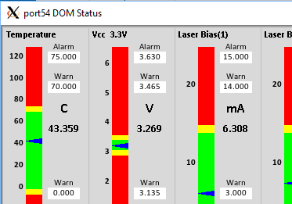
Why those requirements?
Current capabilities are only accessible from paged areas
QSFP alarm/warning thresholds - page 3
Some capabilities require write
Software TX_Disable
New features use both
Connectivity Diagnostics (flashing lights)
Future features need more pages
T2DOC – fetch data from far end transceiver
Upcoming QSFP-DD (8 channels) will require more pages just to represent the MSA standard info per channel

Slide 6
Other potential requirements
sysfs
Which attributes to expose via sysfs?
What names to use for sysfs attributes?
What directory names to use (/sys/bus/i2c…? /sys/class/eeprom? …)
sysfs buffer limit of 4KB? Do we need to check/limit?
Configuration
Port to name mapping (keeping the driver platform independent)
Specifying which ports use which driver?
Specifying dev_id values to the driver (size? SFP/QSFP? …)
How big is the EEPROM?
Check pageable bit? QSFP beyond page 3?
Configurable? Writable sysfs attribute? The architected limit?

Slide 7
Other potential requirements
Interrupt handling, on device add/remove (including user space?)
Do we have to check presence on every device access?
Do we have to read the ‘pageable’ register on every device access?
I2C modes – do we really need smbus{byte, word, block} and i2c?
How to handle i2c_smbus_read_xxx failures? Error or retry?
CFP/MDIO – probably a different driver?

Slide 8
Collaboration, Distribution, Adoption
Who is interested in collaborating?
Development
Code Review
Test
Where should the reference copy reside?
Who is interested in adopting this driver?
Does ONL (and others) automatically adopt the accton driver?

Slide 9
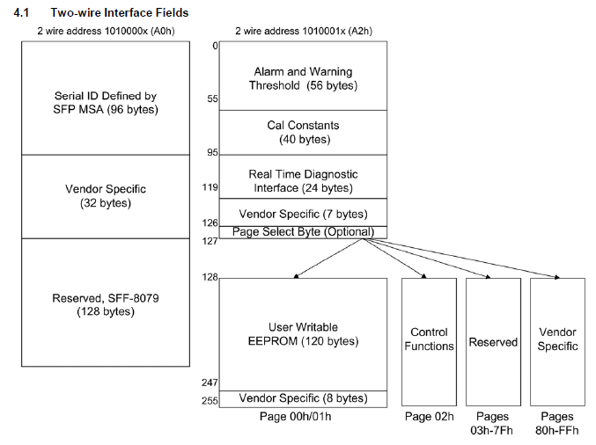
SFP Memory Layout mapped to /sys/…/eeprom
A
B
C
D
E
F
G
/sys/…/eeprom:
Linear address space from 0 to (3 + 128) * 128
A
C
B
D
E
F
G

Slide 10
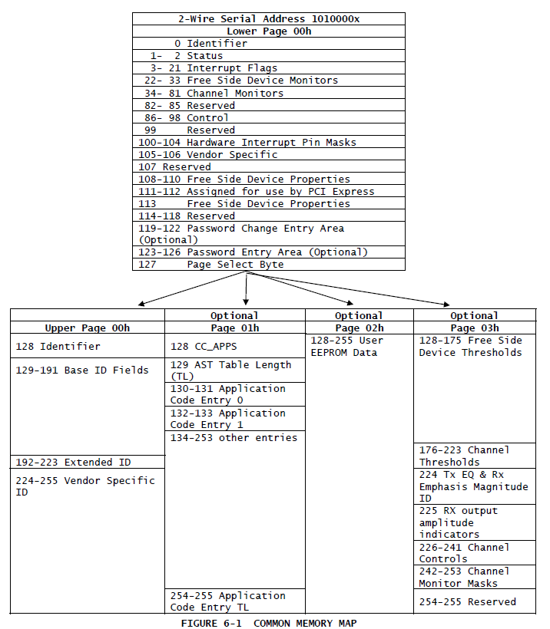
QSFP Memory Layout mapped to /sys/…/eeprom
A
B
C
D
E
F
/sys/…/eeprom:
Linear address space from 0 to (1 + 128) * 128
A
B
C
D
E
F
‘F’ here is architected, but not part of the standard

Slide 11
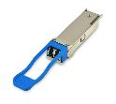
Open Optics Monitoring and Control (OOM)
APPLICATIONS
API to
Network
Applications
OOM was kicked off by the OCP Networking group in October 2015… To address problems with consistent access to EEPROM information on optical transceivers during OCP Interop testing.
Sponsors:
Accton/Edgecore
Big Switch Networks
Broadcom
Cumulus Networks
Finisar
Monitoring
Config &
Automate
QoS
Security
Other
Forwarding SW
(Traditional, Distributed, eg OSPF, BGP, STP etc)
Forwarding SW
(Centralized, eg OpenFlow)
Switch Abstraction Interface (SAI)
Installer
(eg ONIE)
Network OS
Decode
Switch Silicon
Interface to
Transceiver Module

Slide 12
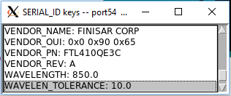
Inventory with OOM
Record identifying info from all modules on the switch
Confirm intended vs actual parts
Key Messages
from oom import *
for port in oom_get_portlist(): # enumerate the ports on the switch
inventory = oom_get_memory(port, ‘SERIAL_ID’) # SERIAL_ID: 23 identifying keys
add_record(port, inventory) # add this module to the database
audit_record(port, inventory) # check for compliance

Slide 13
Health Monitoring with OOM
Monitor and display key health metrics
Key Messages
from oom import *
list = oom_get_portlist(): # enumerate the ports on the switch
health = oom_get_memory(list[53], ‘DOM’) # DOM: Digital Optical Monitoring
show_port(list[53], health) # Display temp, voltage, laser, Rx/Tx power

Slide 14
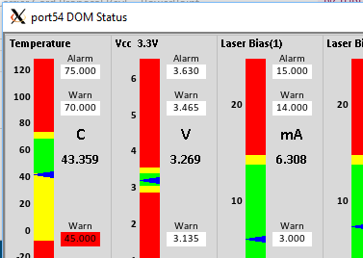
Diagnostics and Support with OOM
Vendor rep adjusts low_temp warning threshold to test alert handling
from oom import *
list = oom_get_portlist(): # enumerate the ports on the switch
oom_set_keyvalue(list[53], ‘PASSWORD_ENTRY’, secret) # Vendor support password
oom_set_keyvalue(list[53], ‘TEMP_HIGH_ALARM’, 45.0) # Change threshold
New Values
Old Values

Slide 15
Custom Uses - Vendor Value Added Content with OOM
Trigger flashing pull tab lights with OOM
Easy documented process to add additional keys to OOM
In the switch, live, running normal production workloads
from oom import *
list = oom_get_portlist(): # enumerate the ports on the switch
oom_set_keyvalue(list[53], ‘TAB_LIGHTS’, flash) # Make the lights flash

Slide 16
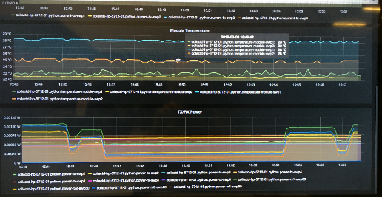
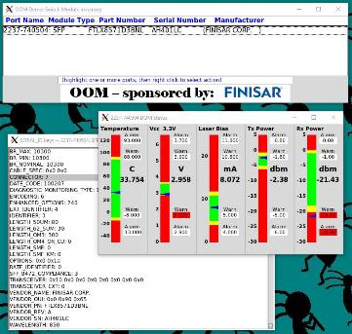
OCP SUMMIT: Interoperability and Open APIs
Key Messages
Message 1
Message 2
Message 3
OOM demonstrated at OCP Summit 2016 and 2017

Slide 17
How can you Access & Participate in OOM?
Key Messages
OOM is now an OCP Accepted™ Project
Download, use and improve!
https://github.com/opencomputeproject/oom
https://youtu.be/kkL2dk7zMOc
Share your use-cases with us.
Used in Interoperability testing at UNH IOL Plugfests.
Demonstrated in numerous Linux-based NOSs, white box switches, evaluation boards and a module simulator.
200+ keys decoded for QSFP+, QSFP28, SFP+… CFPx coming next.
Key Messages
Message 1
Message 2
Message 3
Message 1
Message 2
Message 3

Slide 18
Latest OOM News
May 2016 – OOM installs as a standard Python Package
August 2016 – OOM Web Service using JSON available
September 2016 – ‘Universal Shim’ developed (Cumulus + ONL)
February 2017 – ‘Universal Python Shim’
No longer need to compile C code to install OOM
Extensible to support any (every) Linux-based NOS
August 2017 – Reference Linux Kernel Driver available on github

