Slide 2
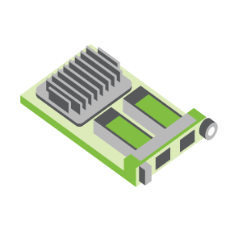
SERVER
OCP NIC Community Update February 2022
For Server Workgroup Sub-group Project wiki: https://www.opencompute.org/wiki/Server/Mezz
Mailing List: https://ocp-all.groups.io/g/OCP-NIC
NIC3.0

Slide 3
Agenda
PCIe Gen5 SI test fixture update
Thermal Workgroup 2022 focus area
NIC sub-group discussion bin list

Slide 4
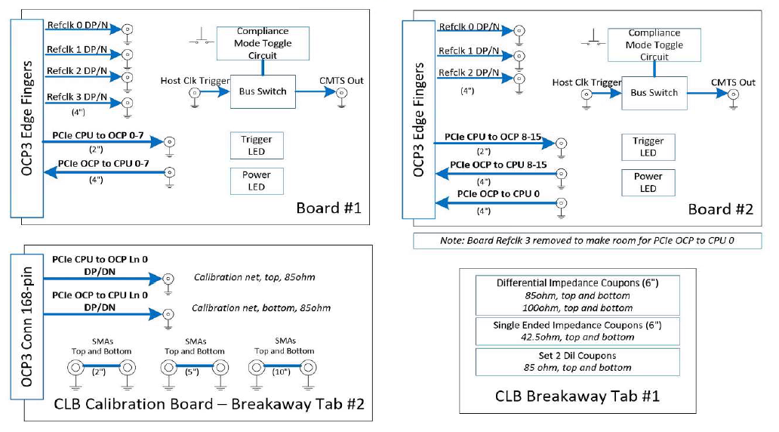
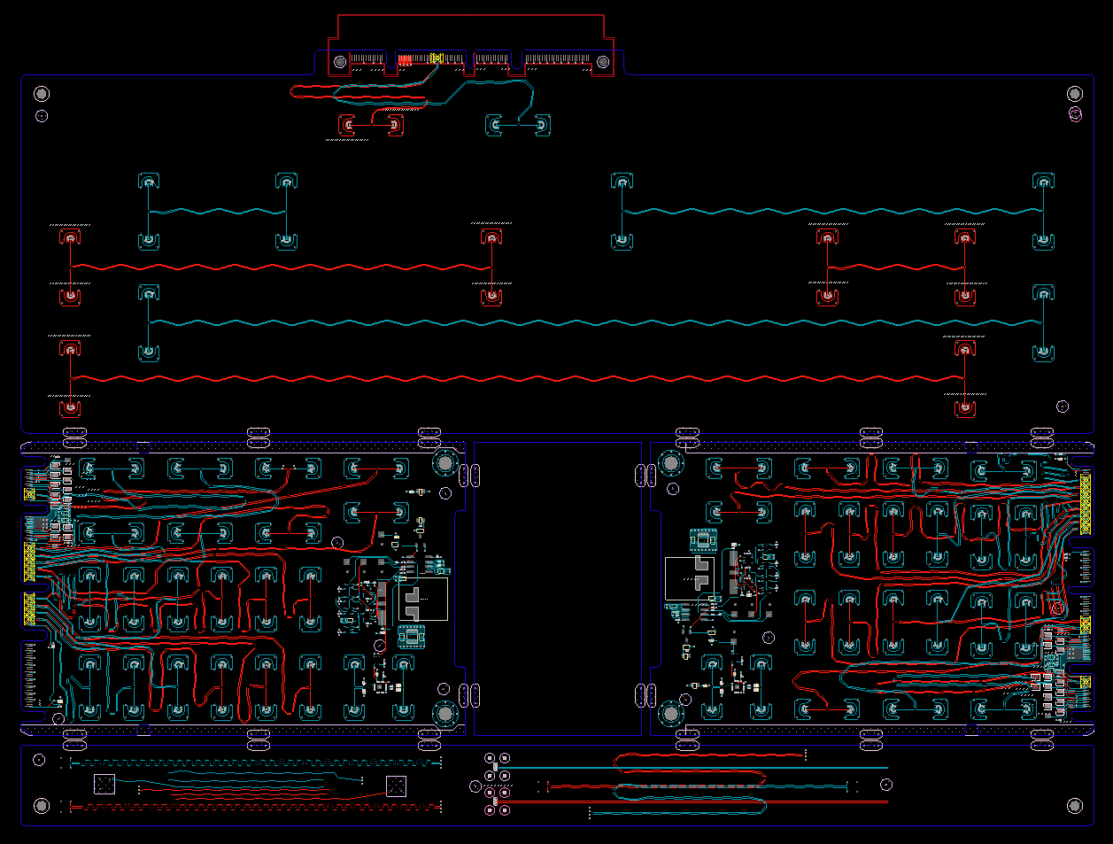
SI PCIe Gen5 test fixture update
CLB Gen5 status:
Gerbered in January
PCB material to arrive after CNY
CBB Gen 5 Status:
Based on Gen4 design
Updates to align with PCI CEM
To be staffed
Netlist block diagram
OCP3 SFF CLB Gen5 ECAD
Calibration
CLB board 1
CLB board 2
Impedance Coupon

Slide 5
Thermal WG: 2022 focus area
Standardize Generic Pluggable thermal model
Development & Validation
Covering below form factors
SFP
QSFP up to 400G
QSFP-DD
OSFP-RHS (only limit to TSFF)

Slide 6
General 2022 Discussion bin list
SFF/TSFF Thermal test fixture with PCIe Gen5
DMTF NIC self-shutdown recommendation
1G NCSI/RGMII side-band support
Next-gen speeds
PCIe Gen6 support
PCI-SIG spec at rev0.7
800G Ethernet port
Elegant cable-up solution
Zion uses 4C+ vertical connector to 4C+ saddle mount connector cable

Slide 7
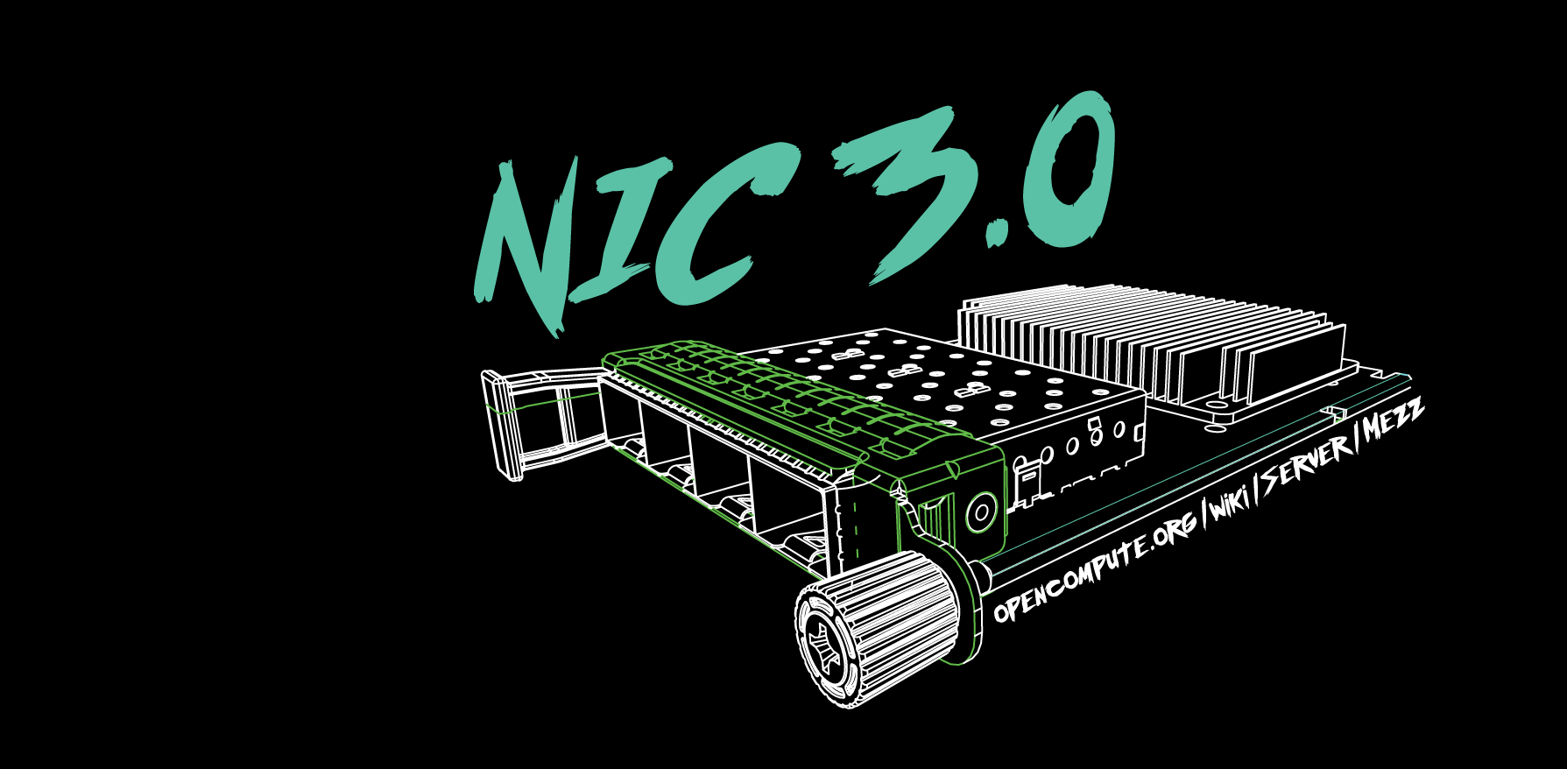

Slide 8
Thermal WG: Recap of 2021
Mainly focus on the QSFP-DD thermal model
Thermal model standardization
Monitoring point
Heat map
Model with stand-alone NIC or testing chamber
TSFF thermal analysis to quantify the gain from SFF

Slide 9
Thermal WG: 2022 Focus Area
Standardize
What model to use for the simulation - active cable (QDD, OSFP)
SFP
QSFP > 400G
QSFP-DD
OSFP-RHS (only limit to TSFF)
Simplified model
Validate
Run the test with different cables, how big the difference will be
Same test fixture
Same card
Design a test fixture to help standardize the test environment (HPE)
AEC
Get the AEC model and quantify in the NIC environment

Slide 10
Thermal WG: 2022 Focus Area
Cable available:
MLNX: OSFP, no QDD (check which vendor use for the QDD test)
Molex: QSFP-DD AEC, check with an updated list
Amphenol: QSFP-DD, OSFP, check with the cable group
Meta: check with cable vendors
Testing fixture:
OCP3 test fixture - no NIC card - MLNX can help run the test
HPE - check the existing OCP3 test fixture (Pranay HPE)

Slide 11
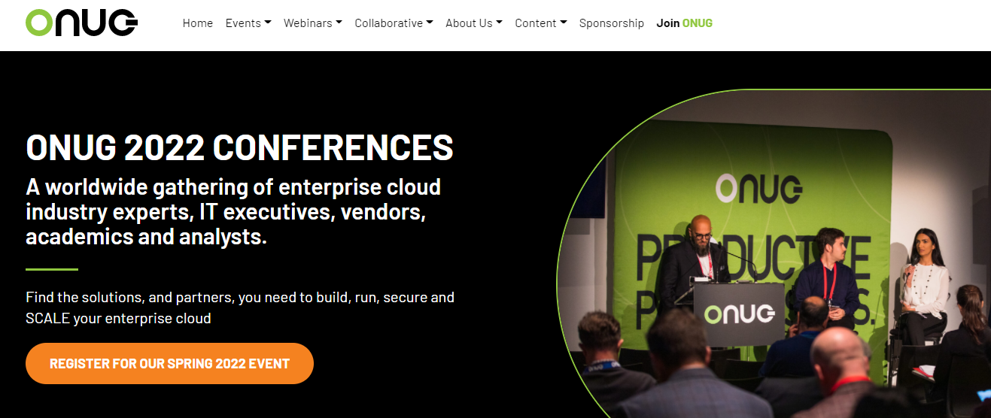
Interest for events & workshops
ONUG
New Jersey, April 27-28
OCP Foundation asking OCP NIC sub-group interest to participate in demo of NIC solutions
Was In-person event, May change to virtual
Lack of interest from group

Slide 12
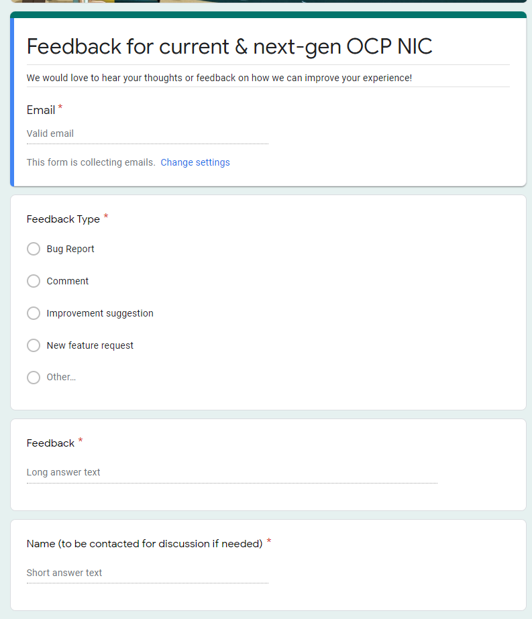
Gather feedback throughout the year
Provide your feedback at: https://tinyurl.com/feedback2ocpnic

