Slide 2
OCP NIC 3.0
Dell EMC Update
Jon Lewis
Distinguished Engineer

Slide 3
Agenda
Form Factor Update
Pinout:
Proposed changes to some pins/features
Pinout proposal for Connector A and B
Closing thoughts

Slide 4
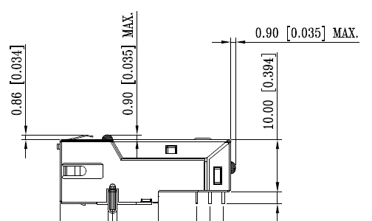
Form Factor
Enumeration 14: 76 mm x 115 mm
Top-side keepout: 11.0 mm
Bottom-side keepout: 2.25 mm < x < 2.67 mm
Really need the NIC vendors to finalize this number.
Motherboard Thickness: Agree with 0.062”, 0.076” and 0.093” +/- 10% tolerances.
Allows a wide range of layer counts and materials to be supported.
Connector A = SFF-TA-1002 style 168 pin straddle mount connector.
Connector B → Proposing 140 pin to allow a full x16.
RJ-45 connectors should be mid-plane mounted. (3D models available)
1x1 max top side height is 8.8 mm
1x4 max top side height is 10.0 mm

Slide 5
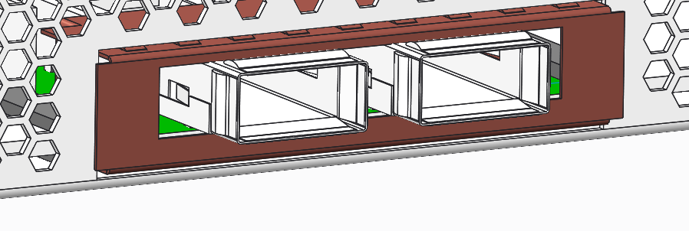
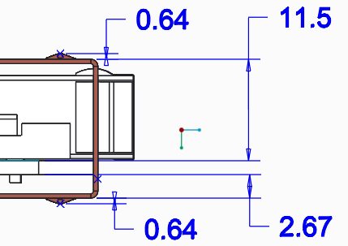
Faceplate Spec Definition
Dell prefers design similar to the design shown:
Enables EMI solution on card.
Enables convenient space for latching.
Minimizes vertical stack.
Design intent and spec details:
Top/Bottom fold over and are inserted into the chassis.
Left/Right side EMI seal flush against rear wall.
EMI fingers need to compress to be flush with top/bottom flanges.
Proposal gives flexibility for different connectors.
Open Items, in order:
Do we need to protect the entire underside of card for installation?
Retention mechanism selection and definition (internal/external/both?)
Options for latching could include ¼ turn retention.
Should EMI fingers be on card or designed into chassis?
Do we need to specify LED locations, definitions, … ?
Gasketing behind these surfaces on card
EMI fingers are beyond keep out but must compress to keep out

Slide 6
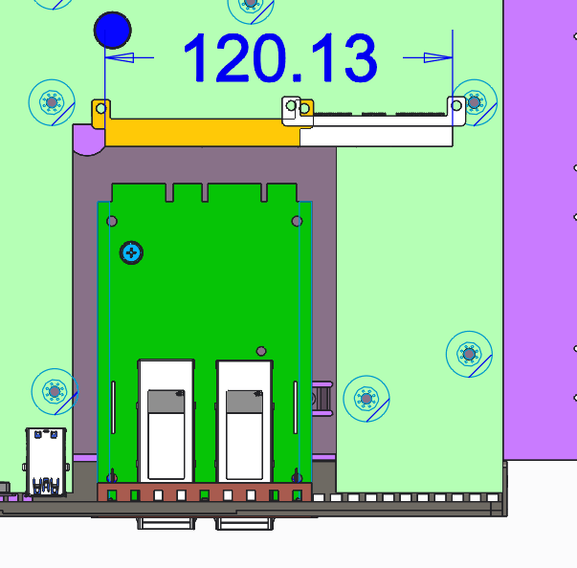
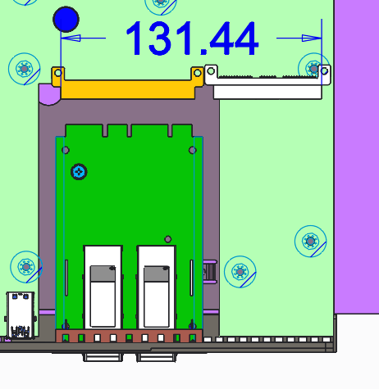
Wider Card Consideration
For the wider board Dell EMC would like to see the board grow to the right instead of the left.
Prefer a x16 on the additional section
Grow width to support additional 140 pin
Top picture: Single connector instead of 2 connectors. Not sure if this is possible but would represent the minimum width for a wider card = ~127mm.
Bottom picture: Connector B = 140 pins from the current concept models for the connector suppliers. The would make the card ~138mm.

Slide 7
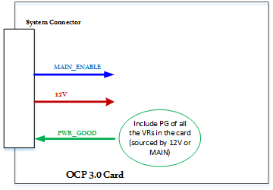
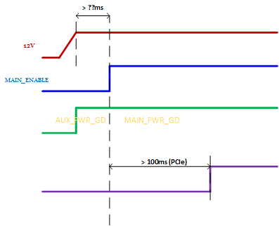
Proposed Pinout Description
Power
Repurpose the 12VAUX pins
6 – 12V pins ~= 79W which should be sufficient (assume 1.1A per pin)
MAIN_EN: Signal from System to NIC indicating main power available.
PWR_GOOD: Signal from NIC to System indicating VRs are operating nominally.
Includes all NIC rails.

Slide 8
Pinout - continued
Deprecate CLK_REQ
Systems Management:
One SMBus
Includes FRU and temp sensor
One NC-SI RBT bus (including arbitration pins)
Add at least one “addressing” pin to enable dual OCP NIC 3.0 on the same management bus: SLOT_ID
I2C address changed
NC-SI package ID changed (This assumes that the maximum number of OCP NIC 3.0 cards on a bus is 2. Additional addressing pins would be necessary if that increased.)
Multi-Host: For Gen4/5 PCIe x4 ports seem to be an optimal choice
4 x {PERST#, WAKE#, REFCLK}
REFCLK likely still required prior to Gen 5 PCIe!
Connector B: (140 pin to include x16)
12V pins – 5 additional pins to increase power to ~145W (nominal assuming 1.1A per pin)
Multi-host support (4 sets of PERST#, WAKE#, REFCLK)

Slide 9
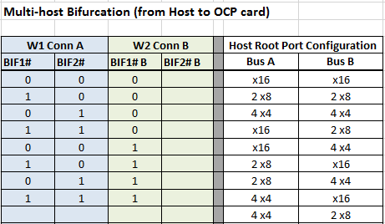
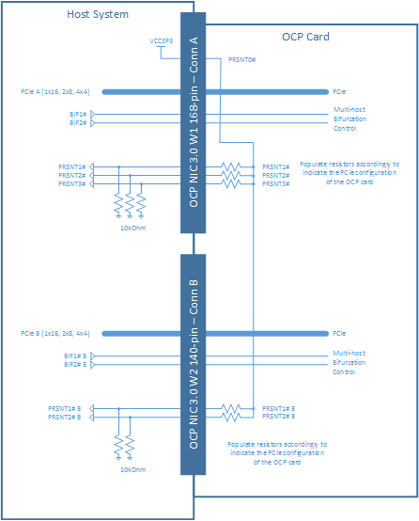
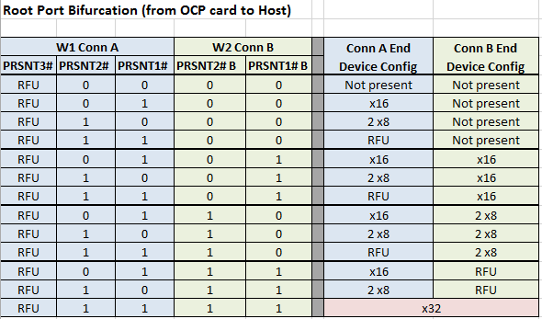
Pinout - continued
Presence/Bifurcation
Dual-purpose the existing 3 presence pins and add 2 pins (BIFn#).
Allows for bidirectional bifurcation

Slide 10
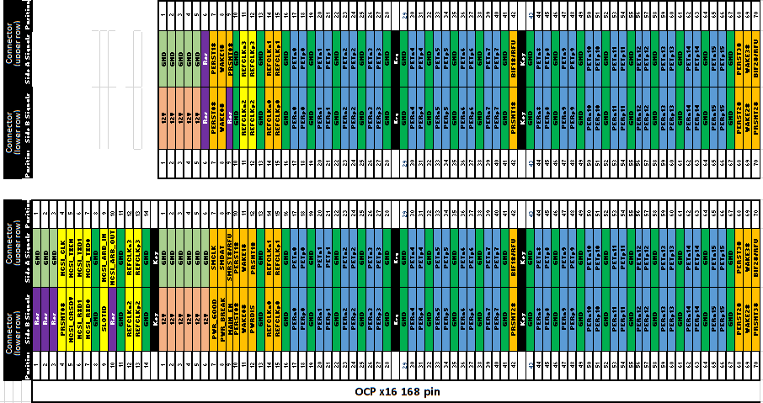
Proposed pinout

Slide 11
Closing Thoughts
Given the current trajectory it would be nice to get together more frequently in targeted groups for discussions to close open items:
Mechanical: Faceplate, latching mechanism, ...
Pinout: definition of pins, new features, …
Contact information:
Jon Lewis | Distinguished Engineer
Dell EMC | Infrastructure Solutions Group
Email: jon.lewis@dell.com | IM/Skype: jon_lewis@dell.com
Office: (512) 723-0767 | Mobile: (214) 505-5924
One Dell Way, MS RR5-31; Round Rock, TX 78682

