Slide 1
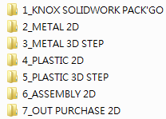
Knox CAD Files Category
7 categories of CAD files as below:

Slide 2
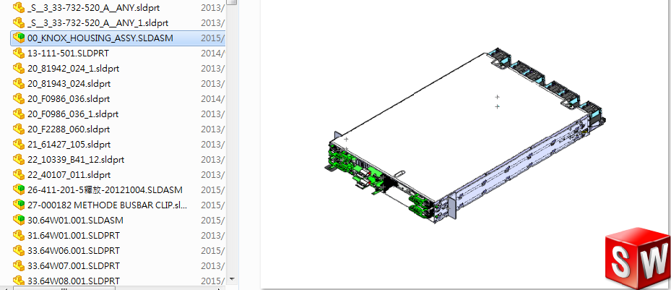
Knox CAD Files Category
7-1 KNOX SOLIDWORK PACK'GO: Solidworks files of Knox
1_KNOX SOLIDWORK PACK'GO
Check “00_KNOX_HOUSING_ASSY.SLDASM” for top assembly.

Slide 3
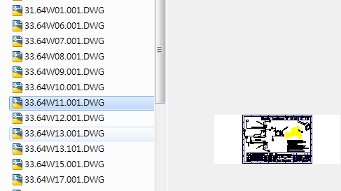
Knox CAD Files Category
7-2 METAL 2D: 2D files of metal parts
2_METAL 2D

Slide 4
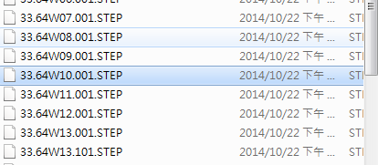
Knox CAD Files Category
7-3 METAL 3D STEP: Step files of metal parts
3_METAL 3D STEP

Slide 5
Knox CAD Files Category
7-4 PLASTIC 2D: 2D files of plastic parts
4_PLASTIC 2D

Slide 6
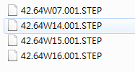
Knox CAD Files Category
7-5 PLASTIC 2D: Step files of plastic parts
5_PLASTIC 3D STEP

Slide 7
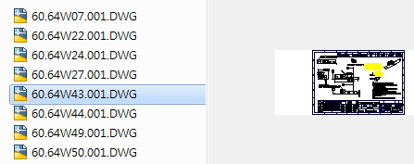
Knox CAD Files Category
7-6 ASSEMBLY 2D : 2D files of assembly parts
6_ASSEMBLY 2D

Slide 8
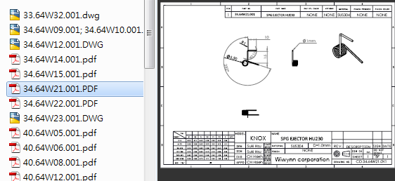
Knox CAD Files Category
7-7 OUT PURCHASE 2D : 2D files of out purchased parts
7_OUT PURCHASE 2D

