Slide 2
Hardware Specification Contribution: -Glacier Point V2 -M.2 Accelerator -Dual M.2 Accelerator Hao Shen Facebook

Slide 3
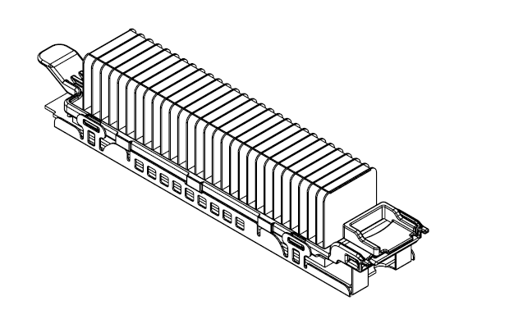
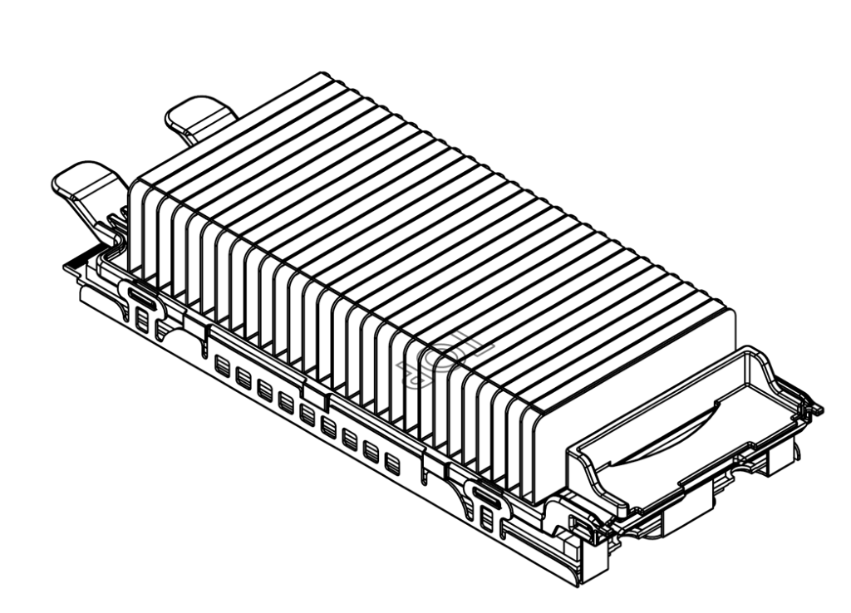
Facebook Accelerator Module – M.2 and Dual M.2 form factor
Standard M.2 Form Factor
ASIC
DRAM
12W TDP
PCIe x4
UART/JTAG
Dual M.2 Form Factor
ASIC
DRAM
20W TDP
PCIe x8
UART/JTAG

Slide 4
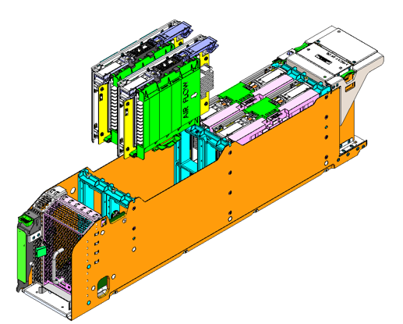
Facebook Accelerator System
Module
Glacier Point v2 Card
Yosemite V2
Single M.2
Dual M.2
Up to 12x single/
6x dual M.2
2x TwinLakes with 2x Glacier Point V2 Cards

Slide 5
Facebook Accelerator Platform Block Diagram
CPU
PCIE GEN3
X24
PCIe Switch
DDR4
PCIE GEN3
X4/X8
PCIE GEN3
X4/X8
PCIE GEN3
X4/X8
PCIE GEN3
X4/X8
System Memory
Accelerator
Accelerator
Accelerator
Accelerator
Networking
SuperNode
Accelerator Memory
Accelerator Memory
Accelerator Memory
Accelerator Memory
CPU
PCIE GEN3
X24
PCIe Switch
DDR4
PCIE GEN3
X4/X8
PCIE GEN3
X4/X8
PCIE GEN3
X4/X8
PCIE GEN3
X4/X8
System Memory
Accelerator
Accelerator
Accelerator
Accelerator
SuperNode
Accelerator Memory
Accelerator Memory
Accelerator Memory
Accelerator Memory

