Slide 1
OCP Design Contribution
Wiwynn Debug Card Introduction
Jackie Lee
Kyan Chen
Date: 2018/02/28
Notes:
Good afternoon and good morning. I’m Bing from Wiwynn.
Before starting to explain our design packages, please let me apologize first.
I feel so sorry that last month I misunderstood the confirmation mail and missed the IC review meeting.
Today I’m very glad that we still have a chance to explain our designs of Leopard, so I invited more Wiwynn’s experts, our PM, EE engineer and ME engineer to answer every questions.
We will tried our best to show the key of design and if you have any questions about every details, please kindly let us know.
Thank you.

Slide 2
Agenda
OCP Debug Card Specification
OCP Debug Card Design Files
OCP debug card is based on the specifications: Facebook OCP debug card with LCD spec_v1p0.pdf
http://files.opencompute.org/oc/public.php?service=files&t=6252e93d73ee2e61a94218b506658be9&download&path=//Facebook%20OCP%20debug%20card%20with%20LCD%20spec_v1p0.pdf

Slide 3
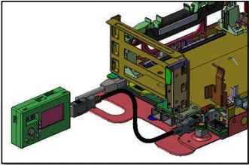
OCP debug card Introduction
The OCP debug card is designed for multiple OCP platforms (Tioga Pass, Bryce Canyon, Lightning)
It provides a friendly user interface so that users can read system information from LCD.
UARTSEL
Reset button
Two 7-segment LEDs for POSTCODE
Power button
USB Connector
5Way button
LCD

Slide 4
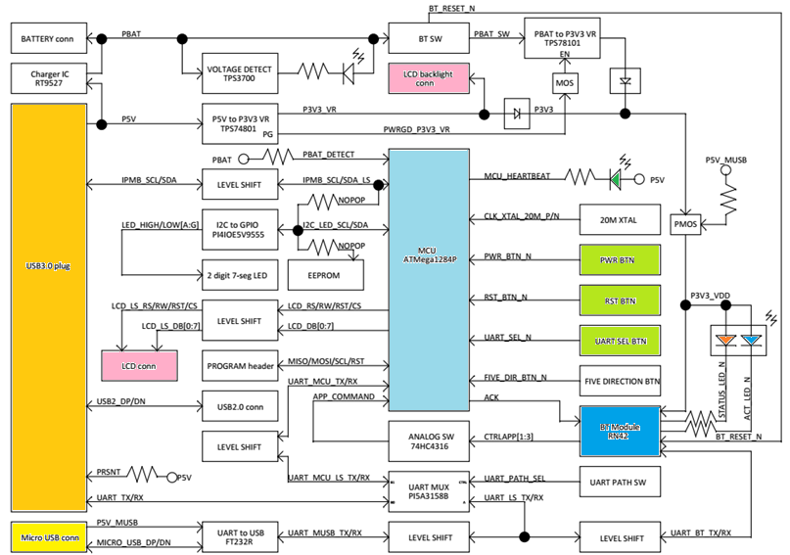
OCP Debug Card Block Diagram

Slide 5
OCP Debug Card Design files
The following folders are included in the zip file
Schematic:
Contain designed DSN file (Cadence OrCAD) package file
Layout file:
Contain designed BRD file (Allegro)
BOM (Bill of material):
An excel file shows full component information.
Mfg file (Gerber):
Excel files show detail stack up information and gerber files for PCB manufacture.
ME CAD (3D Drawing):
Contain 3D CAD file (ProE)
SW:
Contain MCU firmware Hex file

Slide 6
Directory - Schematic
lcd_debug_card_20171226.pdf

Slide 7
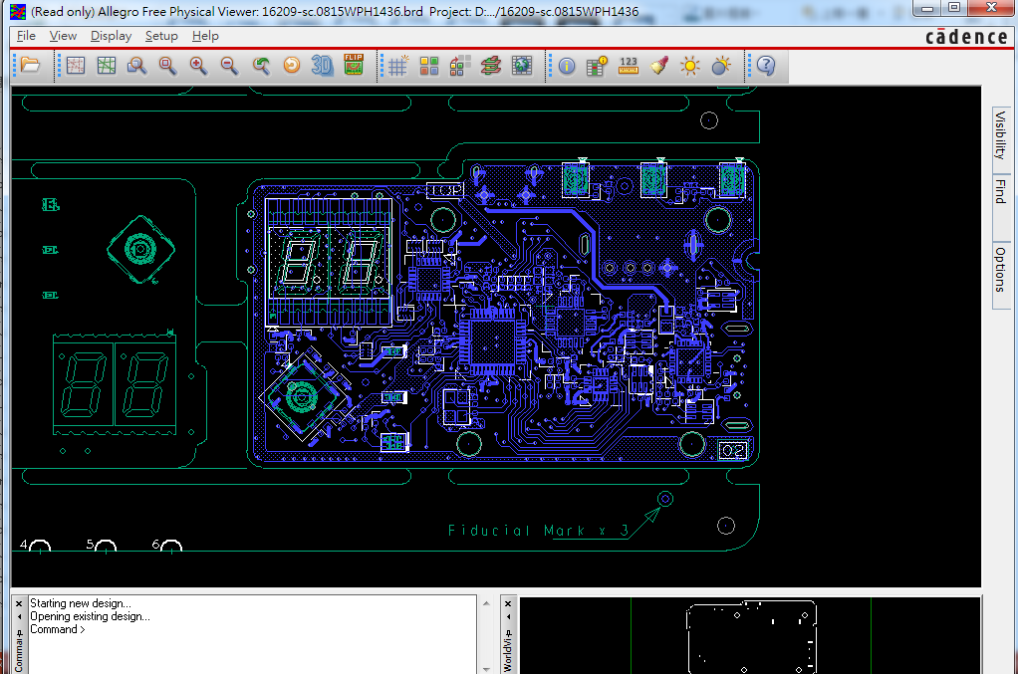
Directory – Board File
placement.pptx
16209-sc.0815WPH1436.brd

Slide 8
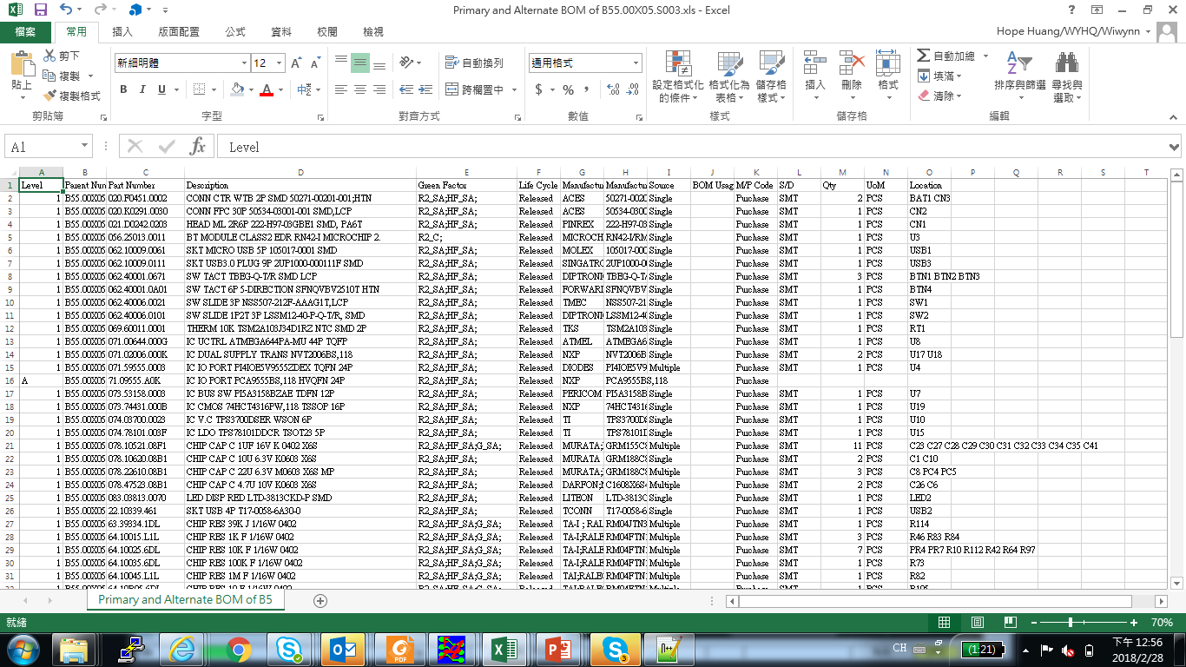
Directory – BOM
Primary and Alternate BOM of B55.00X05.S003.xls

Slide 9
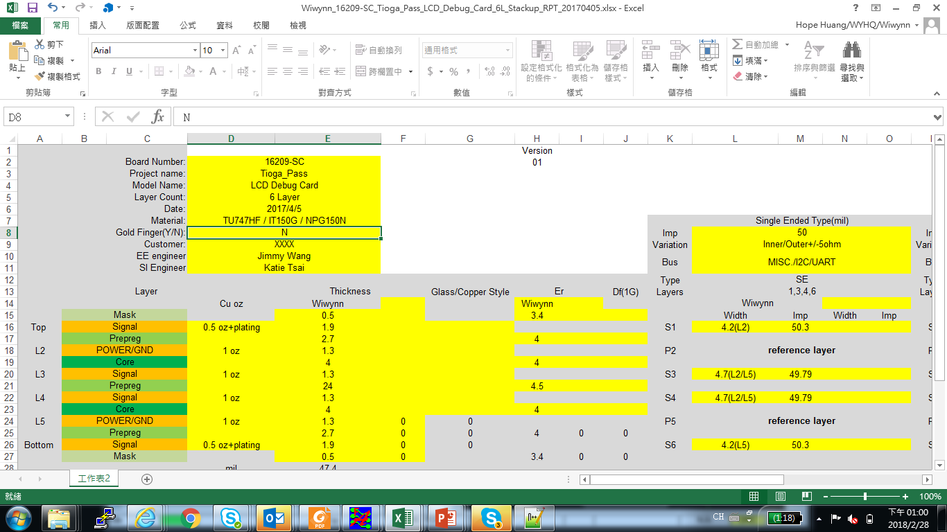
Directory – Gerber Data
Wiwynn_16209-SC_Tioga_Pass_LCD_Debug_Card_6L_Stackup_RPT_20170405.xlsx

Slide 10
Directory – 3D Drawing

Slide 11
Directory – Software/Firmware

Slide 12
Software/Firmware update SOP
LCD debug card FW update SOP

