Slide 2
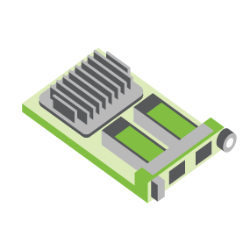
SERVER
OCP NIC Community Update February 2022 Sub-group Project wiki: https://www.opencompute.org/wiki/Server/Mezz
Mailing List: https://ocp-all.groups.io/g/OCP-NIC
NIC3.0

Slide 3
Agenda
PCIe Gen5 SI test fixture update
Thermal Workgroup update
Regional Summits, Events, Workshop
Discussion bin list

Slide 4
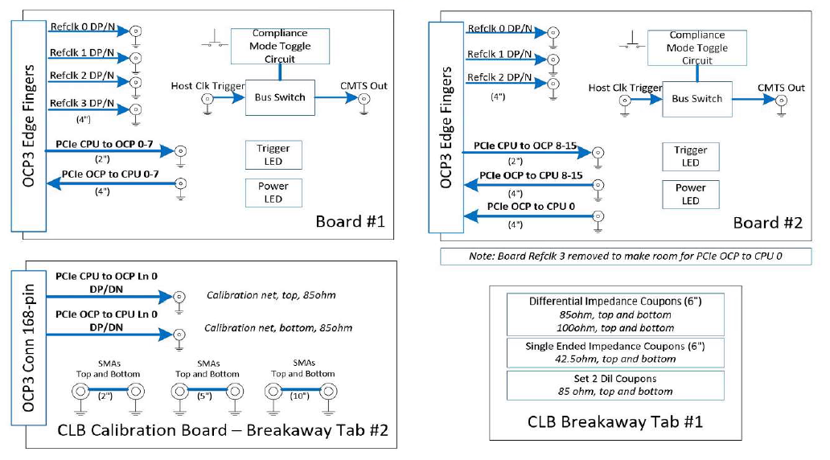
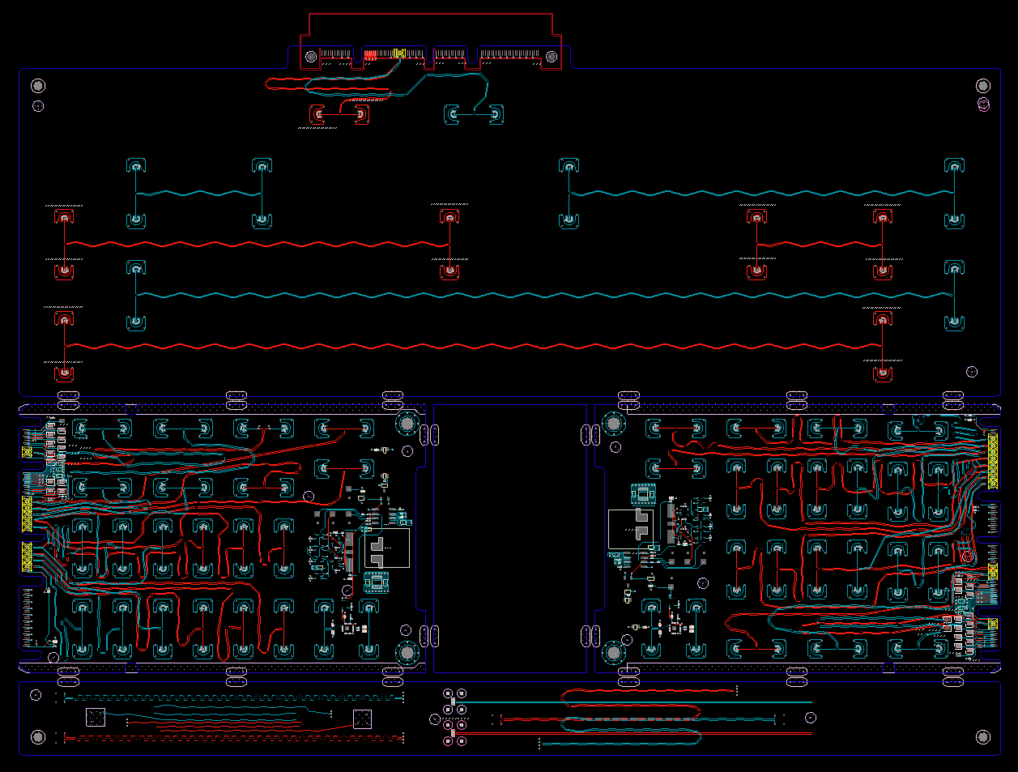
SI PCIe Gen5 test fixture update
CLB Gen5 status:
Gerbered in January
PCB material to arrive after CNY
CBB Gen 5 Status:
Based on Gen4 design
Updates to align with PCI CEM
To be staffed
Netlist block diagram
OCP3 SFF CLB Gen5 ECAD
Calibration
CLB board 1
CLB board 2
Impedance Coupon

Slide 5
Thermal WG: Recap of 2021
Mainly focus on the QSFP-DD thermal model
Thermal model standardization
Monitoring point
Heat map
Model with stand-alone NIC or testing chamber
TSFF thermal analysis to quantify the gain from SFF

Slide 6
Thermal WG: 2022 Focus Area
Standardize:
What model to use for the simulation - active cable (QDD, OSFP)
SFP
QSFP > 400G
QSFP-DD
OSFP-RHS (only limit to TSFF)
Simplified model
Validate
Run the test with different cables, how big the difference will be
Same test fixture
Same card
Design a test fixture to help standardize the test environment (HPE)
AEC
Get the AEC model and quantify in the NIC environment

Slide 7
April Regional OCP Summit
Cancelled for 2022, re-scheduled to 2023

Slide 8
Interest for events & workshops
ONUG
New Jersey, April 27-28
OCP Foundation asking OCP NIC sub-group interest to participate in demo of NIC solutions
Was In-person event, May change to virtual

Slide 9
Interest for events & workshops
Any interest for workshops organized by OCP Foundation?
May combine with other sub-groups or Server workgroup

Slide 10
Discussion bin list
DMTF NIC self-shutdown recommendation
Elegant cable-up solution
Zion uses 4C+ vertical connector to 4C+ saddle mount connector cable
1G NCSI/RGMII side-band support
PCIe Gen6 support
PCI-SIG spec at rev0.7
800G Ethernet port
Additional side-band

Slide 11
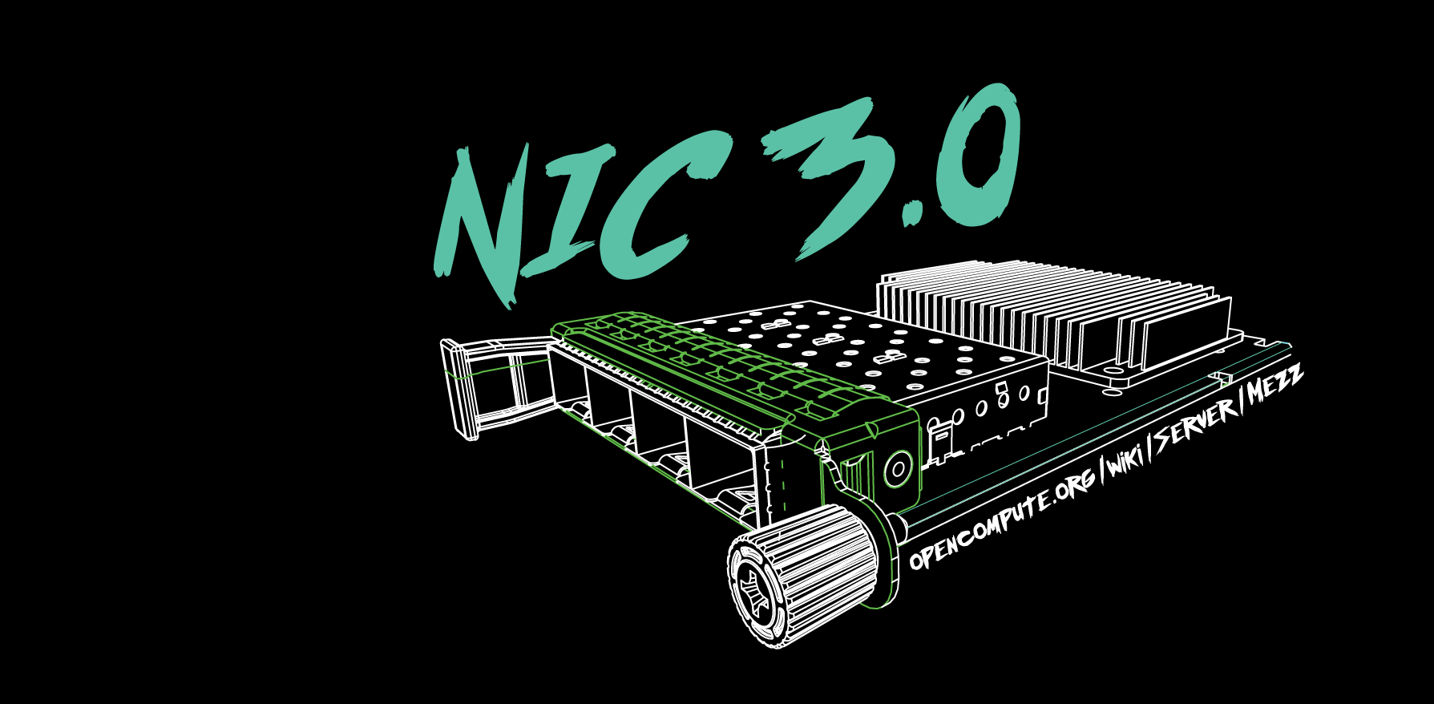

Slide 12
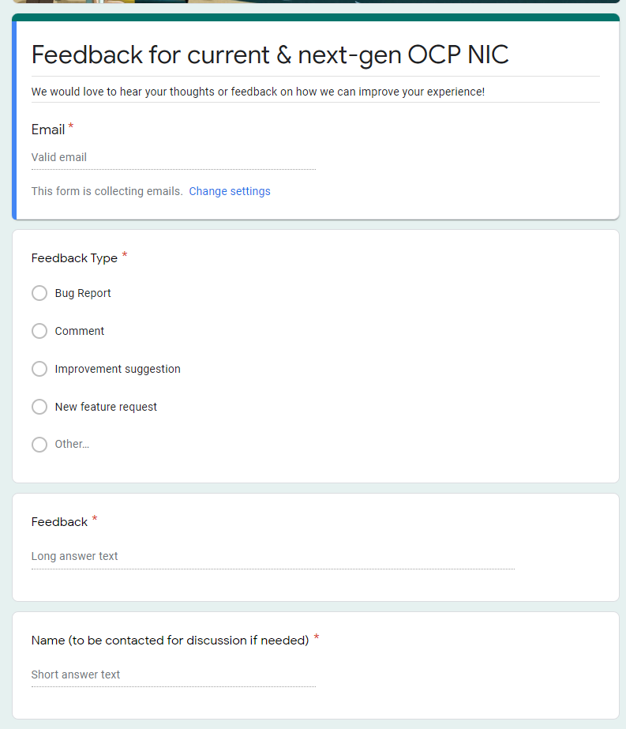
Gather feedback throughout the year
Provide your feedback at: https://tinyurl.com/feedback2ocpnic

Slide 13
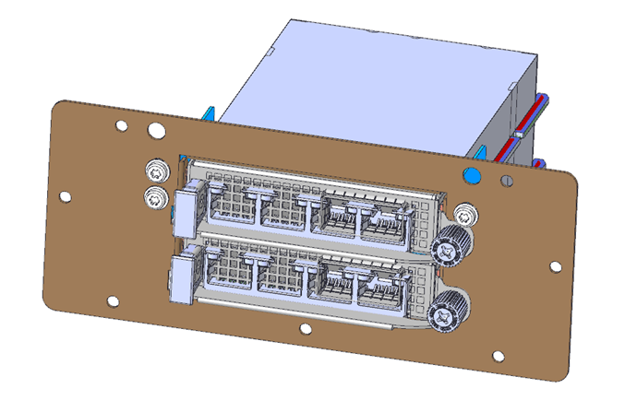
Thermal Test: TSFF TTF Status
Mechanical files received. Pending mechanical engineer peer review
Uses existing TTF with 3 different components to convert to TSFF.

Slide 14
NIC self-shutdown discussion
Get DMTF & HW management feedback
Discussion 1: NIC self shutdown as optional feature?
Discussion 2: NIC self shutdown as threshold?
Discussion 3: If NIC self shutdown implemented, it shall provide mechanism to enable/disable the feature?

Slide 15
NIC self-shutdown discussion
Discussion 1:
NIC self shutdown as optional feature
Keep as optional

Slide 16
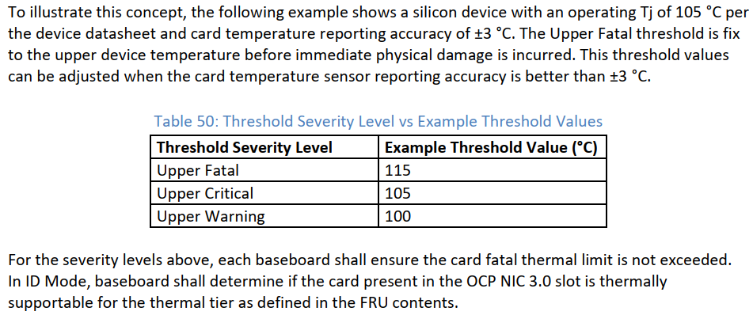
NIC self-shutdown discussion
Discussion 2:
NIC self shutdown as threshold
Change between to “at least”
Or remove this recommendation
Current recommendation

Slide 17
NIC self-shutdown discussion
Discussion 3:
If NIC self shutdown implemented, it shall provide mechanism to enable/disable the feature

