Slide 2
OCP NIC Community Update for Server WG June 2020 OCP NIC Subgroup Sub-group Project wiki: https://www.opencompute.org/wiki/Server/Mezz Mailing List: https://ocp-all.groups.io/g/OCP-NIC
Server Workgroup

Slide 3
Agenda
Virtual Sub-group working session 6/9
Mechanical update
Signal Integrity update – PCIe Gen5

Slide 4
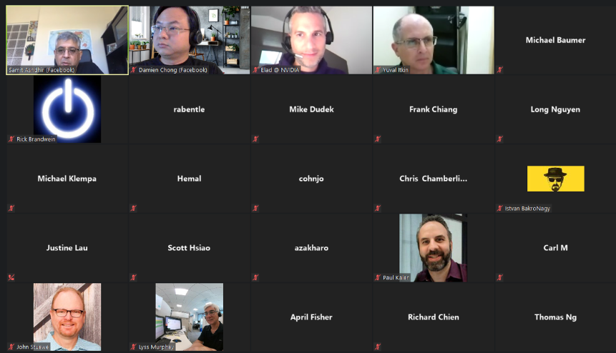
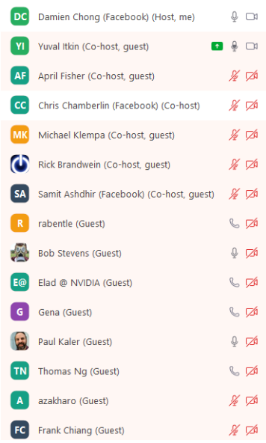
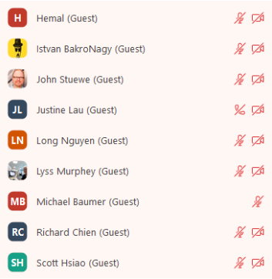
Sub-group virtual working session 6/9/2020

Slide 5
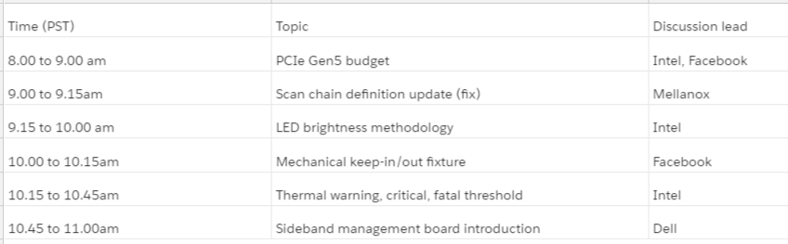
Sub-group virtual working session 6/9/2020
PCIe Gen5 budget & Mechanical Keep-in/Keep-out see later slide
Scan chain definition timing diagram clarified and currently in contributor review.
LED brightness probe proposed. Some members to try out.
Thermal threshold definition clarified. A recommendation based on Tj(max) in spec debated and no closure
SFF sideband management board (Xavier) shared. Soliciting feedbacks regarding LFF version (Xavier2). Due to limited time, this topic will spill over to next session as well.

Slide 6
Mechanical Update
Facebook volunteer to create mechanical keep-in and keep-out test fixture.
Initial proposal is clam shell but it was changed to slot-like to cover critical dimension especially bottom 2mm keep-in zone
The fixture would be machined to ensure tight tolerance

Slide 7
Signal Integrity PCIe Gen5
6/9: Working session discussion
End August (was 6/17): Recommend PCIe Gen5 NIC channel loss candidate and send for mailing list review & feedback
Mid September (was 7/1): Target to finalize and update in spec
SFF NIC-side agreed to -8dB or lower. Final spec likely to be within -5.5dB to -8dB range.
LFF NIC-side agreed to be -9.5dB following PCIe CEM
We would like to optimize further hence the delay

Slide 8
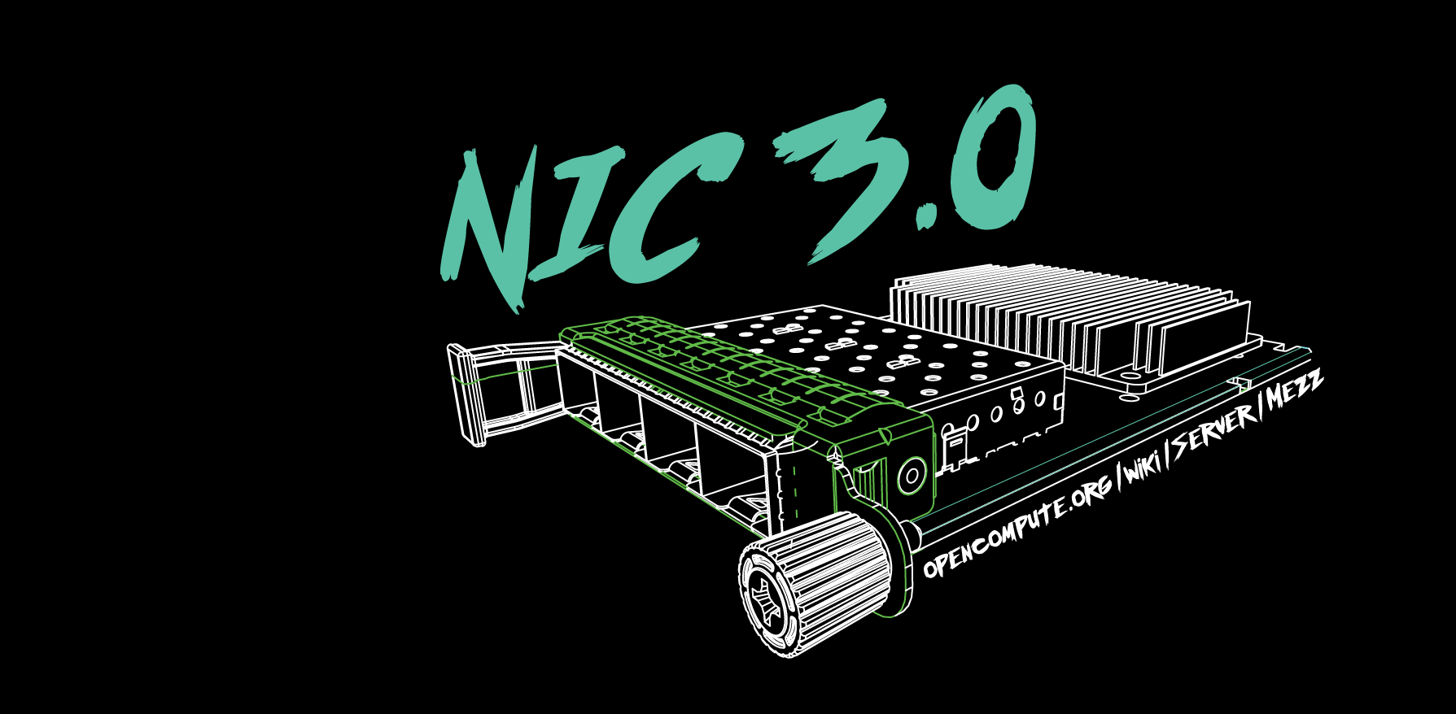
Q&A

Slide 9
March 4-5, 2020

