Slide 2
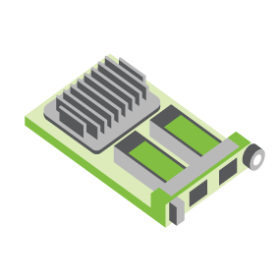
SERVER
OCP NIC Community Update October 2021 Sub-group Project wiki: https://www.opencompute.org/wiki/Server/Mezz
Mailing List: https://ocp-all.groups.io/g/OCP-NIC
NIC3.0

Slide 3
Agenda
NIC self-shutdown discussion
PCIe Gen5 SI test fixture update
Mechanical update
OCP Global Summit
NIC3.0 spec rev1.2 released
Year-round Feedback form

Slide 4
NIC self-shutdown discussion
Get DMTF & HW management feedback
Discussion 1: NIC self shutdown as optional feature?
Discussion 2: NIC self shutdown as threshold?
Discussion 3: If NIC self shutdown implemented, it shall provide mechanism to enable/disable the feature?

Slide 5
NIC self-shutdown discussion
Discussion 1:
NIC self shutdown as optional feature
Keep as optional

Slide 6
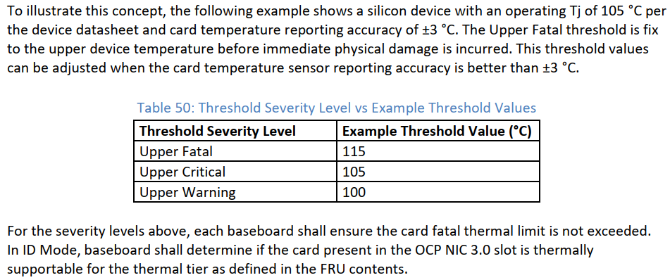
NIC self-shutdown discussion
Discussion 2:
NIC self shutdown as threshold
Change between to “at least”
Or remove this recommendation
Current recommendation

Slide 7
NIC self-shutdown discussion
Discussion 3:
If NIC self shutdown implemented, it shall provide mechanism to enable/disable the feature

Slide 8
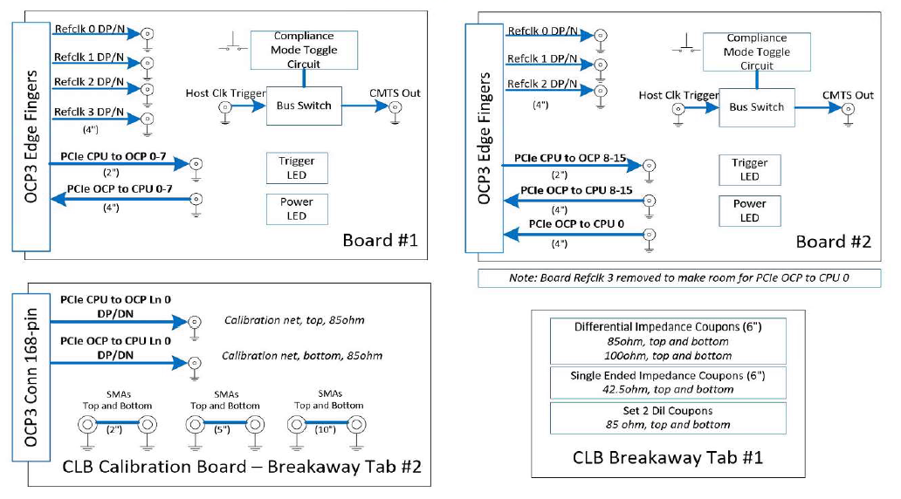
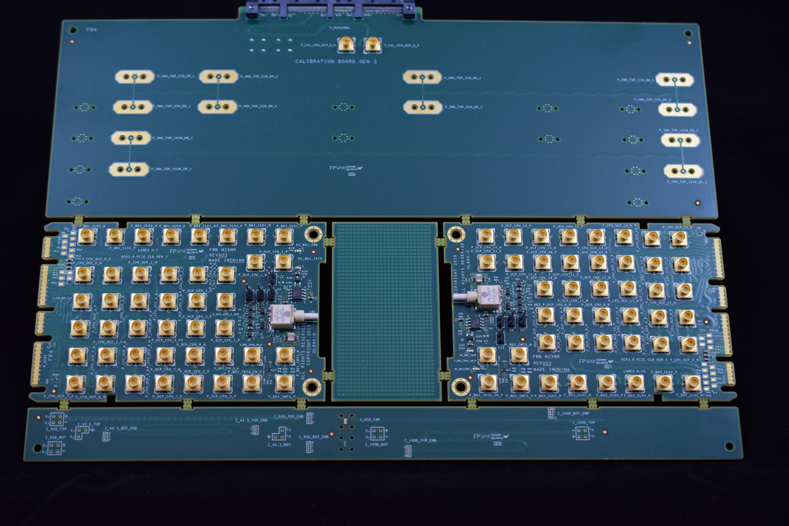
SI PCIe Gen5 test fixture update
Netlist block diagram
OCP3 SFF CLBs include:
Two compliance test boards (lanes 0-7, 8-15)
Calibration board
Impedance coupon
Currently CLB PCI Gen4 is available
https://www.iol.unh.edu/solutions/test-tools/ocp-pcie
Continued ..
OCP3 SFF CLB Gen4 Example
Calibration
CLB board 1
CLB board 2
Impedance Coupon

Slide 9
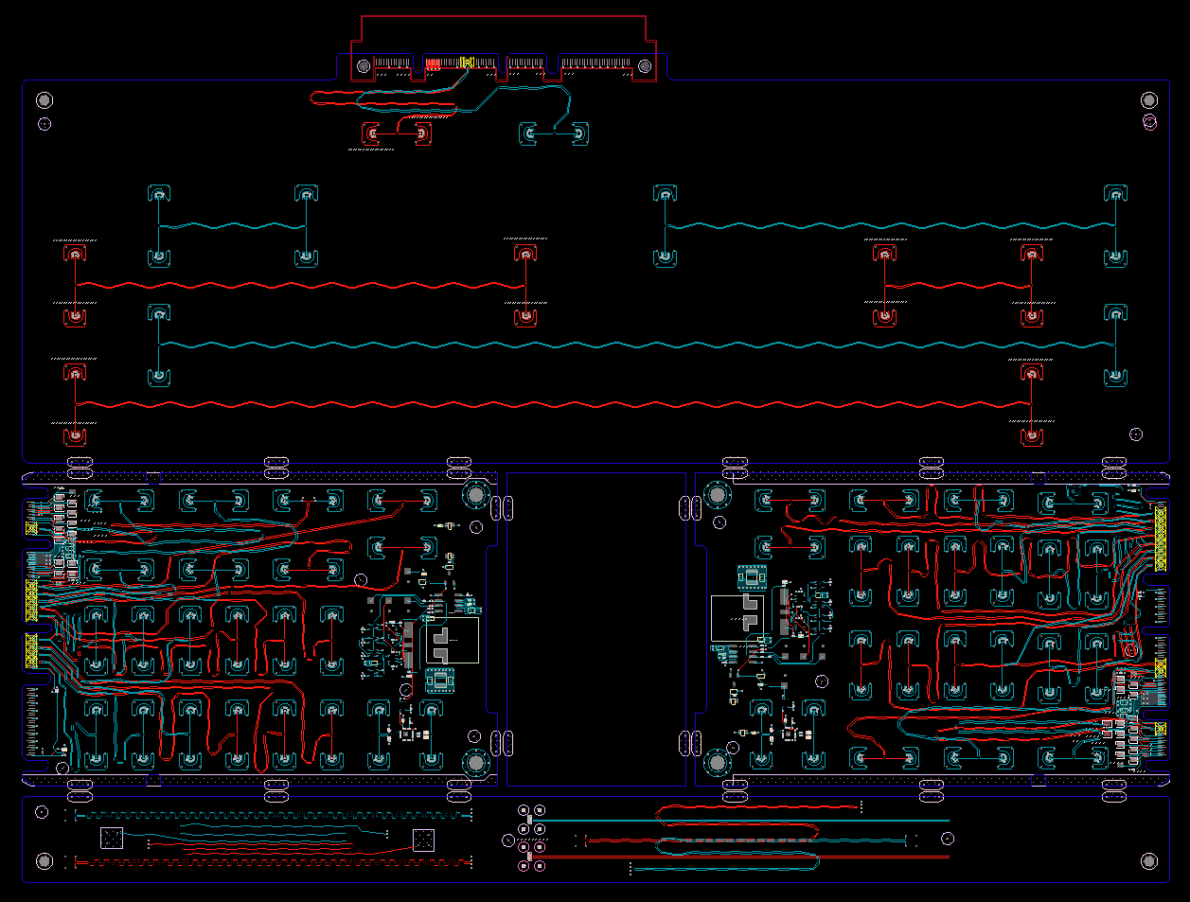
SI PCIe Gen5 test fixture update
Netlist block diagram
Current Gen5 status:
Schematic netlist is done
ECAD nearly complete
Finalizing MMPX connector footprint
Tuning differential pairs
ECAD complete: 15 Oct 2021 (est)
In lab by EOY (pending supply)
OCP3 SFF CLB Gen5 ECAD
Calibration
CLB board 1
CLB board 2
Impedance Coupon

Slide 10
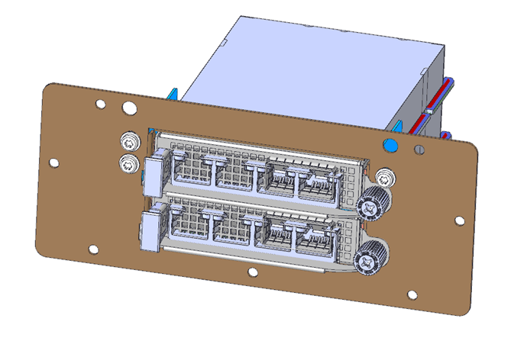
Thermal Test: TSFF TTF Status
Mechanical files completed (plan to send to OCP 10/11/21 for posting)
Uses existing TTF with 3 different components to convert to TSFF.

Slide 11
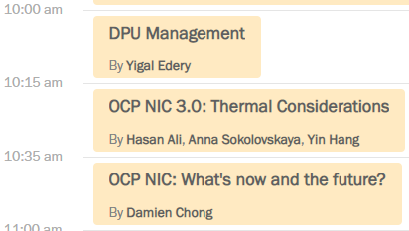
OCP Global Summit: Workshop presentations

Slide 12
OCP Global Summit: Experience Lab demo
Broadcom/Hemal leading the preparation.
1. OCP NIC 3.0 Multi-Host Connectivity and Manageability (Broadcom: Rahul Vaddelli and Adrian Alvarado)
2. OCP NIC 3.0 Device Attestation Using SPDM (Broadcom: Roman Bacik, Facebook: Chenxi)
3. Zion: Host with up to 12 OCP NIC 3.0 slots (Facebook)
4. Mechanical Fit-test fixture (Facebook, OCP NIC sub-group)
5. OCP3.0 Fiberchannel HBA (OCP NIC sub-group)
6. OCP NIC3.0 in Tall Small Form Factor (TSFF) (Nvidia, OCP NIC sub-group)
7. Interface Sandbox with SFF Slots (TE Connectivity)

Slide 13
NIC3.0 spec rev1.2 released
Changes is mainly Tall Small Form Factor (TSFF) related
There are also minor changes and clarifications as noted in change list snippet
NIC self-shutdown changes were not included in rev1.2 from feedbacks about alignment with DMTF recommendation
- Section 1.2 – Added Molex to the acknowledgements section. Changed NVIDIA to NVIDIA Corporation. - Section 1.7.2.x – Updated text "Up to PCIe Gen 5 (32 GT/s) support" - Section 3.4.2, 3.5.4 – Clarified that the BIF[2:0]# pins shall not change states after AUX_PWR_EN is asserted. - Section 3.4.4 – Clarified that the RBT_ISOLATE# signal shall not change state even when the NIC_PWR_GOOD signal is in the don't care state. - Section 3.7.3 – Added note regarding the use of light pipes above I/O cage assemblies for TSFF and cage implementations. - Section 3.11 – Clarified power down sequencing diagram - +12V_EDGE may optionally be disabled in ID Mode. This mirrors the same behavior for the power up sequencing diagram. - Section 7.1.3 – Updated Safety requirements. 60950-1 was withdrawn as of 12/20/2020. 62368-1 replaced 60950-1.

Slide 14
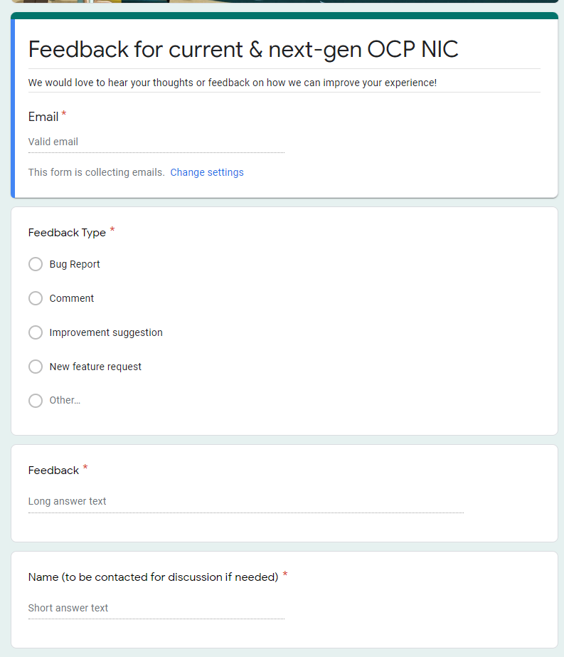
Gather feedback throughout the year
Provide your feedback at: https://tinyurl.com/feedback2ocpnic

Slide 15
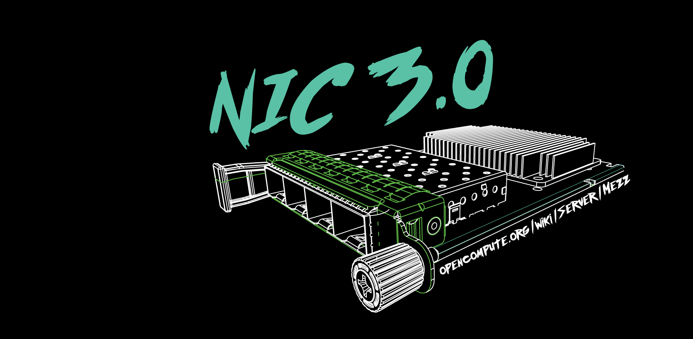

Slide 16
Cable-up OCP NIC solutions
Any interest to study and propose an elegant solutions?

