Slide 1
OCP NIC 3.0
6 September 2017
OCP NIC subgroup teleconference

Slide 2
Enumeration Selection
Enumeration 14 is preferred
Allows hot-swap potential should the server design allow it.
Hot-aisle cooling is optimized allowing more options for I/O
Electrical routing is better on the MB
Only the narrow card would be compatible with most Dell EMC servers.
Adoption likely limited to the narrow card
Special server may be developed for specific use-cases based on the wider card
Work on enumeration 7 should be stopped
Thermals do not allow most high-speed I/O configurations for hot aisle operation.

Slide 3
Connector Selection
Prefer the use of the SFF-TA-1002 connector.
Compatible with other industry standards (or those in progress)
Vertical, RA and Straddle mount (in development)
Supports multiple lengths for different lane widths
Electrical performance based on Gen-Z/PCIe simulations show excellent performance up to Gen 5 PCIe.
A couple discussion points with the HPE pinout proposal:
Prefer bifurcation signal pin option be added
Only supply one 12V rail for power. No VAUX/VMAIN switching on the NIC. Use another method for determination of proper NIC power state.
Motherboard thicknesses are likely to vary depending on vendor/technology. How do we handle the straddle mount connectors?
Different connectors? What is the thickness tolerance that can be supported?

Slide 4
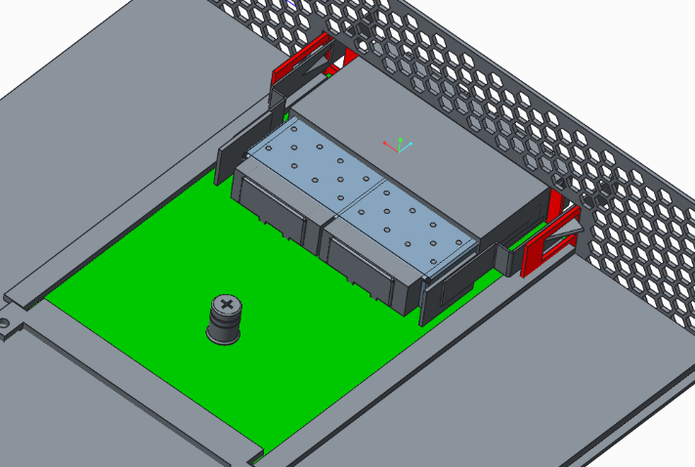
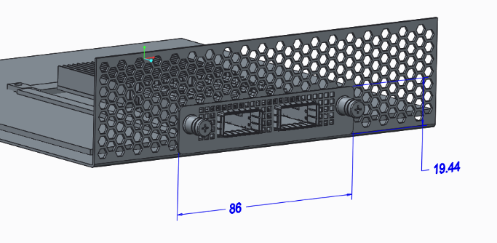
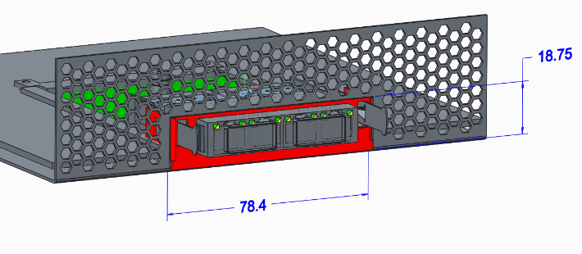
Mechanical Form Factor Recommendations
Mechanical
74 mm x 115 mm (1.6 mm PWB thickness)
5 mm added to allow better PCIe routing on larger ASICs
2.67 mm bottom side keepout
11.5 mm top side keepout
May require the use of offset RJ45’s for some applications
Faceplate ~ 78.4 mm x 18.75 mm
Faceplate/chassis EMI/ESD Gasket attached to the OCP NIC (if required)
Multiple latching options shown at right to help minimize faceplate size.
Use guiderails to align card in the chassis
FB Model

Slide 5
Electrical Recommendations
Gen 4/5 compatible
Bifurcation – supported through signal pin is preferred
Power
Single 12V Power rail.
Separate means for determining NIC power state
Support for up to 4 multi-host via REFCLK
Additional hosts would need to use SRIS
Need additional details on SRIS support for early OCP 3.0 adoption!
Electrical Channel Loss Budget
~2.5 dB @ 8GHz with enumeration 14
~1.0 dB @ 8GHz with enumeration 13
Based on motherboard routing and the existing total loss budgets
Pending further studies!!

Slide 6
Thermal Discussion
Thermal Boundary Conditions
Inlet temperature: 55°C
Inlet Velocity: 200-300 LFM depending on card power and features
Lower speeds may be an option for RJ45 versions
Thermal Wish-List (Should not be system vendor specific)
Common method for sensor data to be passed to the system (closed loop control)
Real-time temperatures and targets
Ability for card to communicate the LFM requirement to the system (open loop control)
Possibility to follow scheme being adopted by PCI-SIG
Latching scheme/method that does not impact face-plate venting.

Slide 7
Specification Details - OCP NIC 3.0
Power requirements including AUX power limitations
Exact Dimensions of faceplate, faceplate cutout, top/bottom keepouts
Latching surfaces/dimensions on chassis
Dimensioned drawings, not just the 3D models
EMI/ESD gasket nominal thickness/working range (if required)
Gathering/guiding options
Is this included in the server specification and just referenced in the NIC specification?
Connector
Wipe/retention tolerances
Pinout and signal definition
Support for multi-host (>= 4 hosts)
Electrical channel loss budget
Thermal boundary conditions
LEDs – Should these be standardized?

Slide 8
Schedule
V4 schedule aligns with expectations.
Expecting first HW in early Q2 2018
SFF-TA-1002 straddle mount connector schedule may also impact the ability to build HW.

Slide 9
Open questions
Move latching mechanism to the chassis?
Hot plug capability is then tied to the specific OEM chassis.
How much power can be cooled in VAUX operation?
Is 1.6mm board thickness sufficient?
For the narrow FF NIC 1.6 mm seems to be sufficient for current/upcoming technologies
For the wider FF NIC 1.6 mm will limit the total layer count and may impact complex designs (smart NIC)
Is 2.67 mm too large a bottom side keepout for the RA connector?
Open questions from the community? Issues?

Slide 10
Thanks ☺

