Slide 2
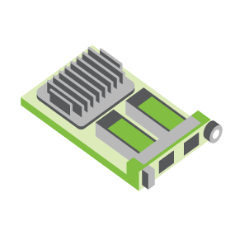
SERVER
OCP NIC Community Update April 2022 Sub-group Project wiki: https://www.opencompute.org/wiki/Server/Mezz
Mailing List: https://ocp-all.groups.io/g/OCP-NIC
NIC3.0

Slide 3
Agenda
OCP Tech Week 2022
SI Test Fixture Update
Thermal Test Fixture Update
PCIe Gen6 connector analysis
NCSI OOB landscape

Slide 4
OCP Tech Week 2022
OCP Foundation Month-long Tech Week workshop
2-days for Server Workgroup and its sub-groups on
4/26 (Day 1): OCP NIC, OAI, HPC & ODSA
4/27 (Day 2): Modularity standardization, DC-MHS, DC-SCM 2.0
8.30am to 11.30am PT
Registration:
https://www.eventbrite.com/e/ocp-tech-talks-server-sessions-1-2-april-26-27-830-1130ampt-registration-277678081617
https://tinyurl.com/ocptechweek2022

Slide 5
OCP Tech Week 2022
OCP NIC presentation:
OCP NIC Next-Gen Trends
Speeds, Form Factor
Thermal Test Fixture PCIe Gen5 support (tentative)
?
?

Slide 6
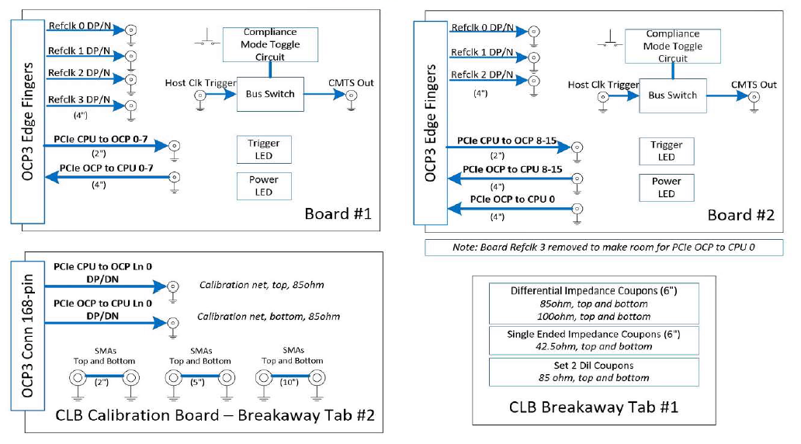
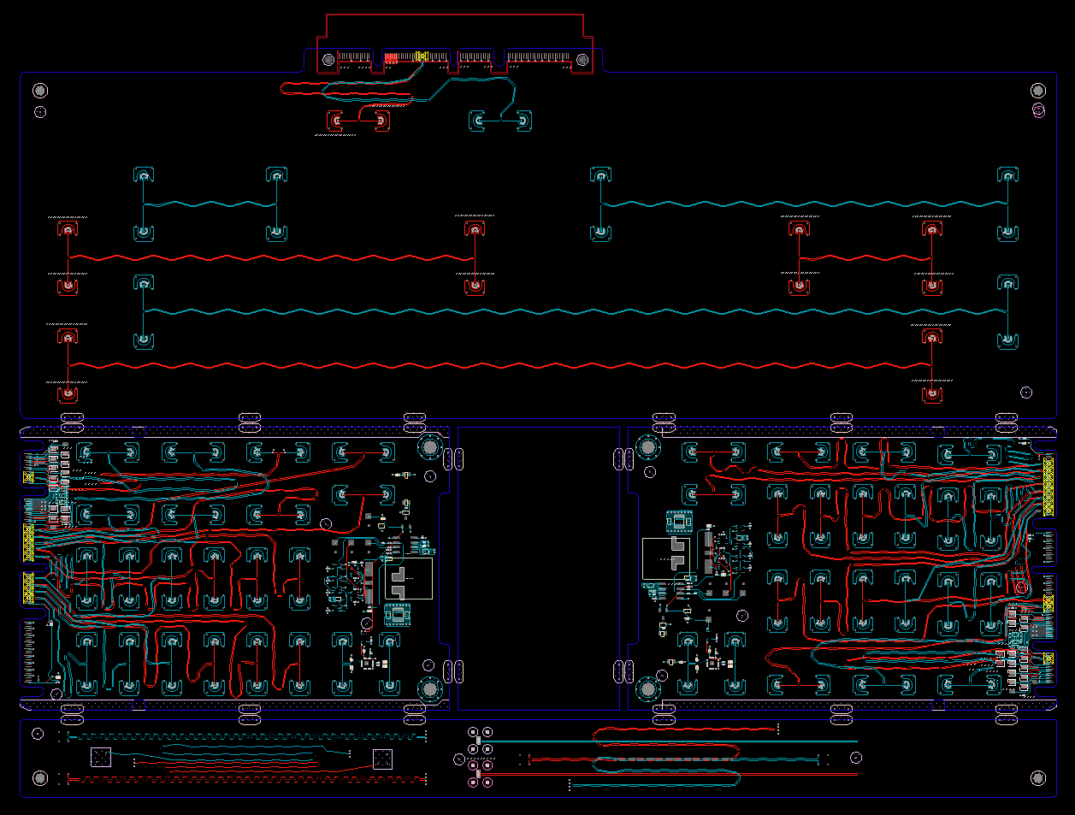
SI PCIe Gen5 test fixture update
Presenter: Jason Rock (Dell)
Netlist block diagram
CLB Gen5 status:
Gerbered in January
PCB arrived at assembler mid-March
Assembled units arrived end-of-March
Preliminary results ~ mid-April
CBB Gen 5 Status:
Based on Gen4 design
Updates to align with PCI CEM
To be staffed within Dell
OCP3 SFF CLB Gen5 ECAD
Calibration
CLB board 1
CLB board 2
Impedance Coupon

Slide 7
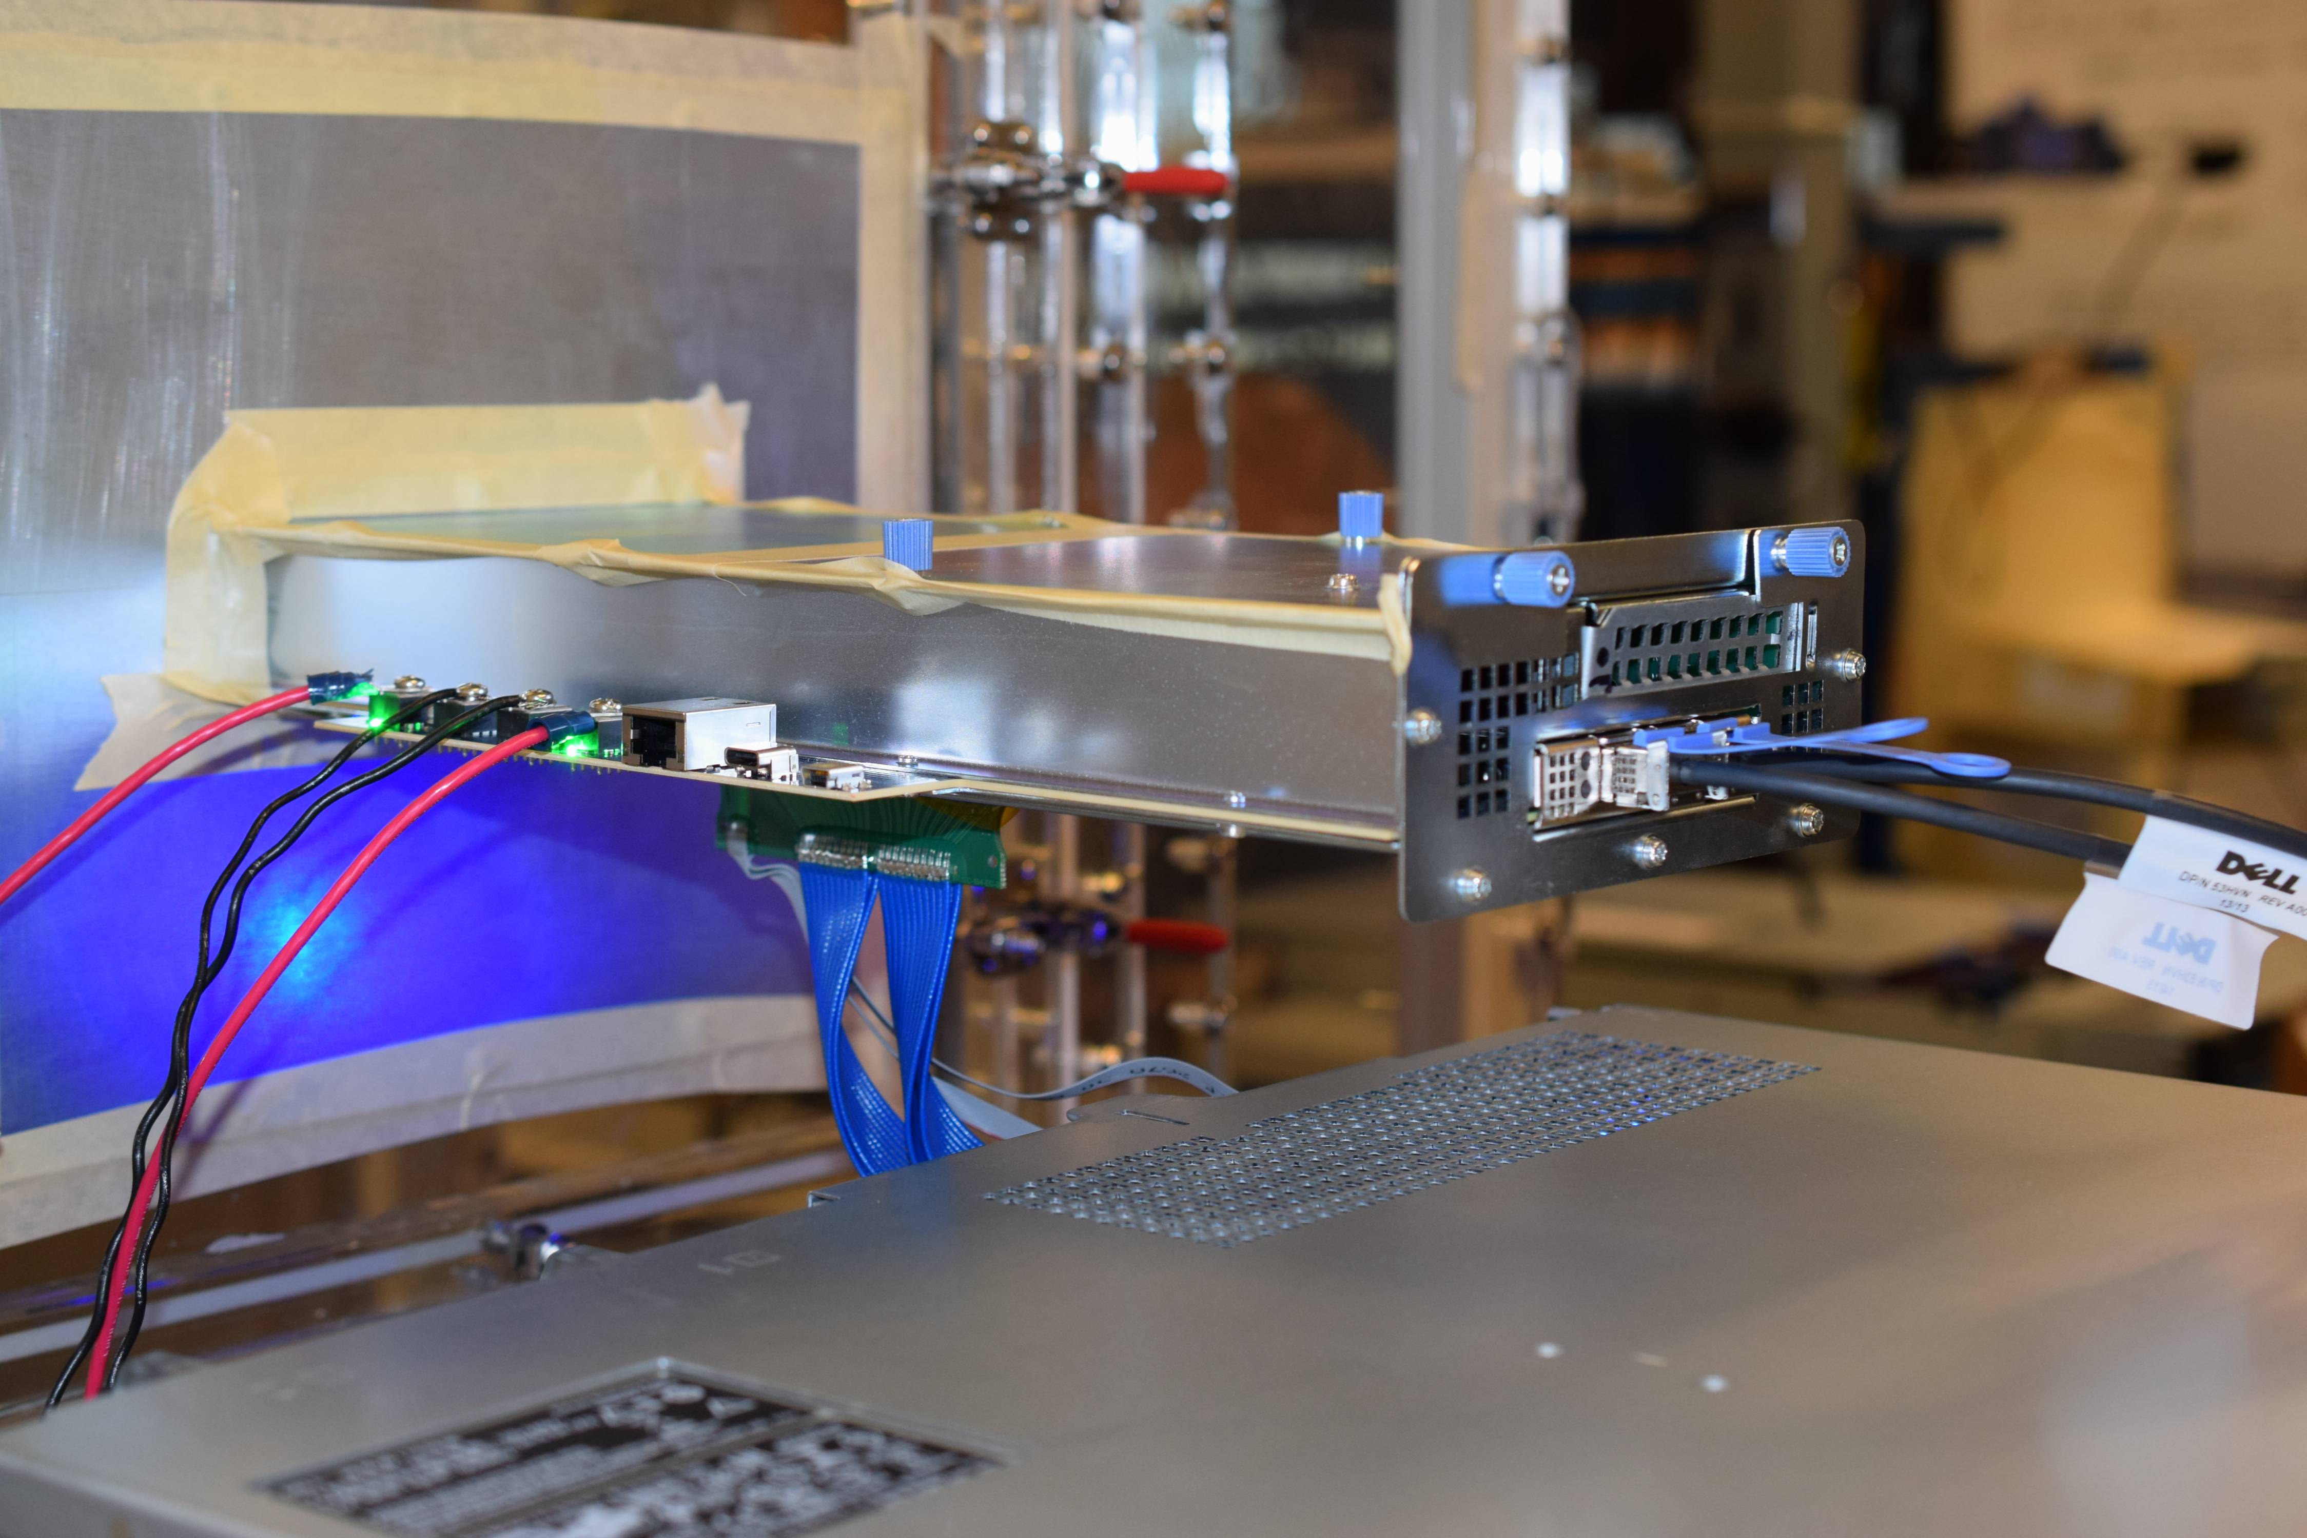
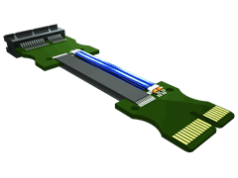
PCIe Gen5 thermal test fixture update
Presenter: Jason Rock (Dell)
OCP NIC 3.0 TTF in use
Much of the existing TTF can be re-used based on simulation *
Mechanicals not impacted
PCB designed to support PCIe Gen5
* PCIE-C (cable assembly) must be rated and sourced for PCIe Gen5 lane speed
Lab experimentation required to confirm simulation
Example cable assembly from Samtec
* Image sourced from Samtec

Slide 8
Presenter: Zhineng Fan (Amphenol)
SERVER
SNIA SFF TA-1002 Connector SI Requirements For OCP NIC 3.0 PCIe6 Speed
NIC3.0
Amphenol

Slide 9
Background
Presenter: Zhineng Fan (Amphenol)
OCP NIC start looking at PCIe6 64G PAM4 speed
NIC interface connector follows SNIA SFF TA-1002 spec
SNIA SFF TA-1002 did not specify 64G PAM4 connector SI requirements
SNIA SFF TA-1002 specified 56G PAM4, 32G NRZ, 56G NRZ and 112G PAM4

Slide 10
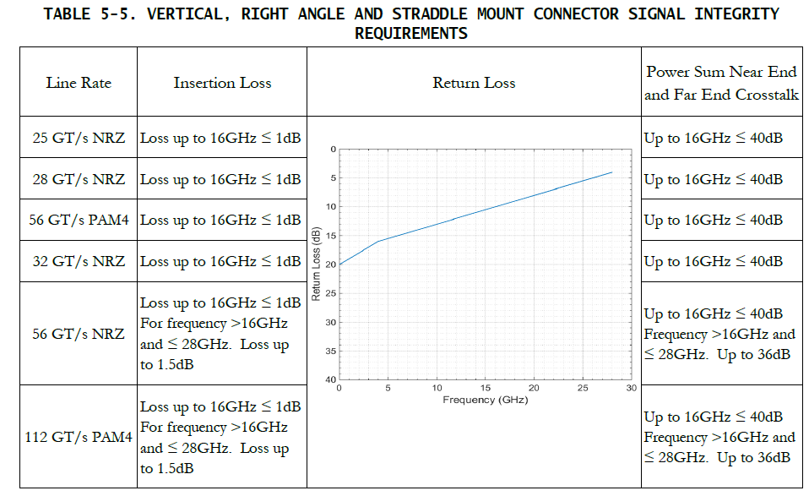
SNIA SFF TA-1002 Connector SI Requirements
Presenter: Zhineng Fan (Amphenol)
Return loss is the same for all speed

Slide 11
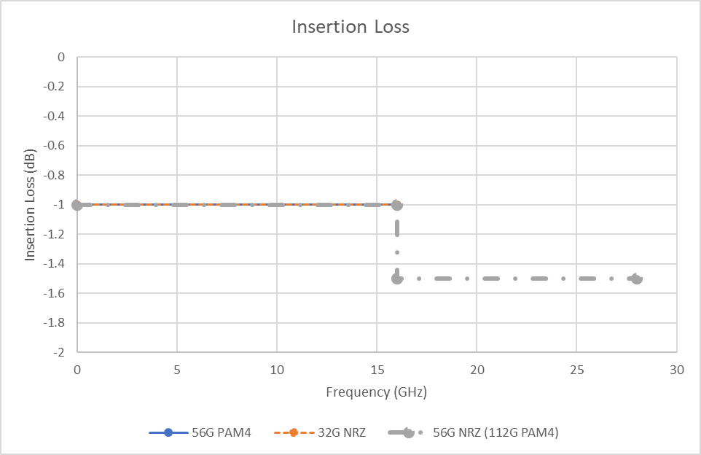
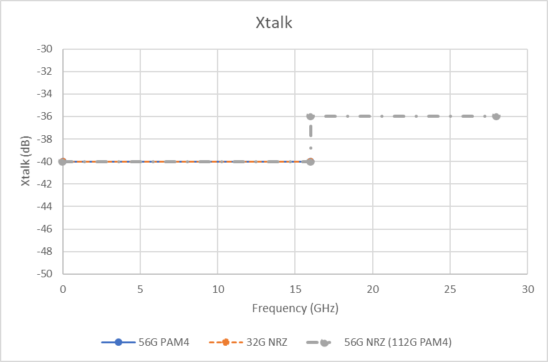
Insertion Loss and Xtalk
Presenter: Zhineng Fan (Amphenol)
56G PAM4 and 32G NRZ share the same limit line
56G NRZ and 112G PAM4 share the same limit line

Slide 12
NCSI sideband landscape
RMII
7 parallel pins
Not backward compatible
RGMII
12 parallel pins
Not backward compatible with RMII
SFF
2 spare RFU pins available
NIC ASIC
Is NIC ASICs capable of RGMII?

Slide 13
Discussion bin list
DMTF NIC self-shutdown recommendation
Elegant cable-up solution
Zion uses 4C+ vertical connector to 4C+ saddle mount connector cable
1G NCSI/RGMII side-band support
PCIe Gen6 support
PCI-SIG spec at rev1.0*
800G Ethernet port
Additional side-band

Slide 14
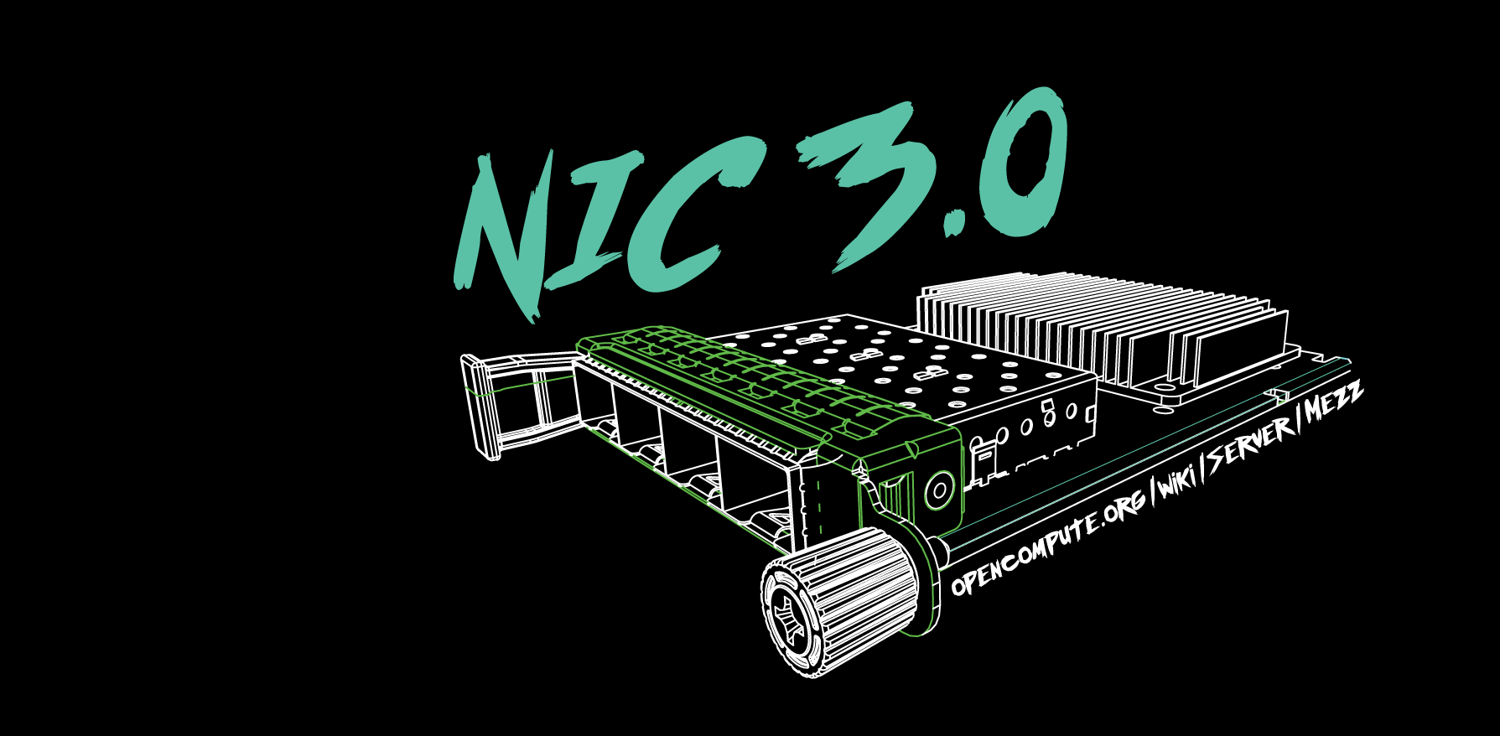

Slide 15
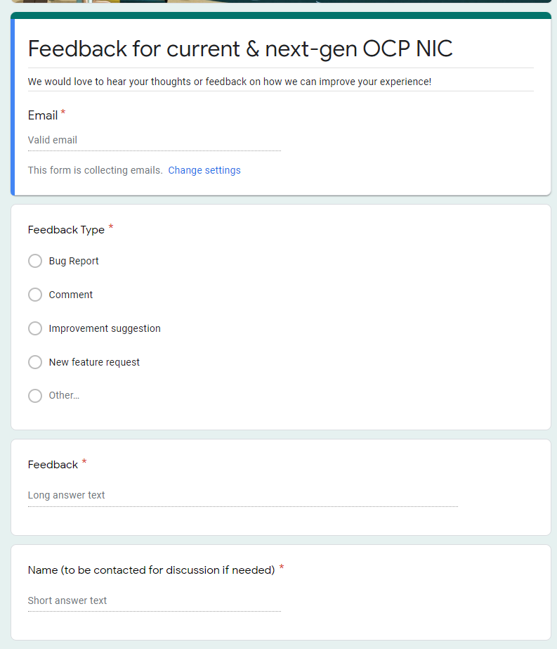
Gather feedback throughout the year
Provide your feedback at: https://tinyurl.com/feedback2ocpnic

Slide 16
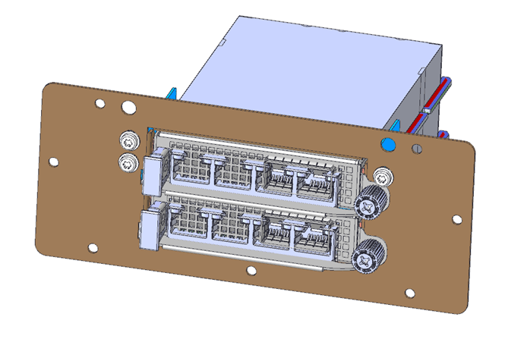
Thermal Test: TSFF TTF Status
Mechanical files received. Pending mechanical engineer peer review
Uses existing TTF with 3 different components to convert to TSFF.

Slide 17
NIC self-shutdown discussion
Get DMTF & HW management feedback
Discussion 1: NIC self shutdown as optional feature?
Discussion 2: NIC self shutdown as threshold?
Discussion 3: If NIC self shutdown implemented, it shall provide mechanism to enable/disable the feature?

Slide 18
NIC self-shutdown discussion
Discussion 1:
NIC self shutdown as optional feature
Keep as optional

Slide 19
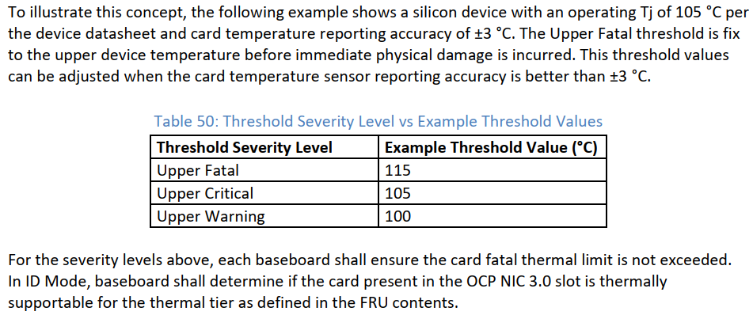
NIC self-shutdown discussion
Discussion 2:
NIC self shutdown as threshold
Change between to “at least”
Or remove this recommendation
Current recommendation

Slide 20
NIC self-shutdown discussion
Discussion 3:
If NIC self shutdown implemented, it shall provide mechanism to enable/disable the feature

